Slide 1
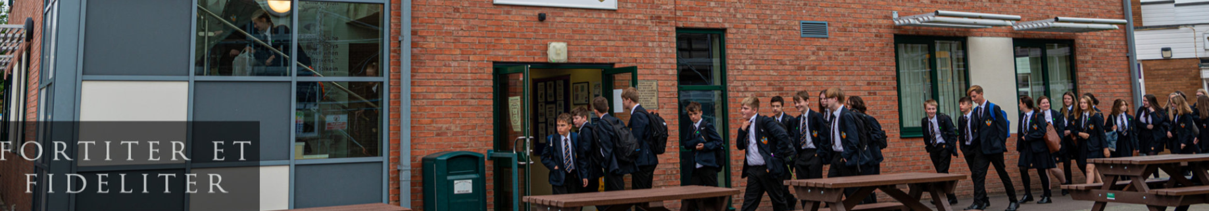


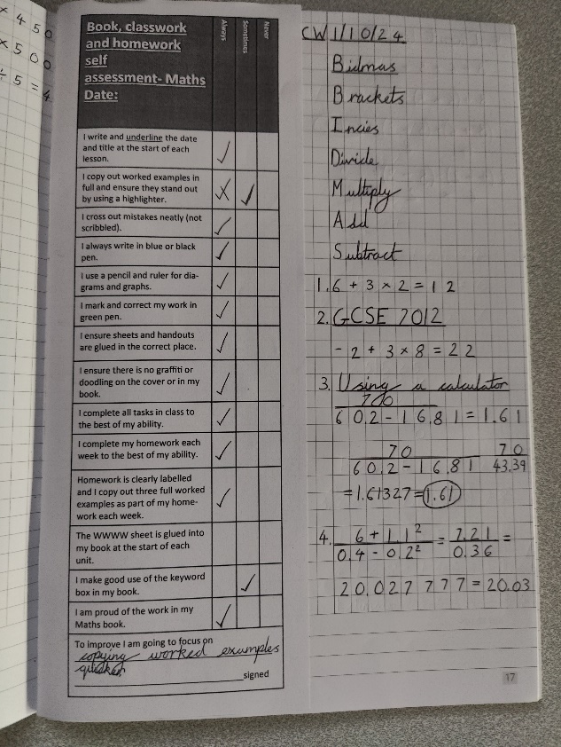

Improving Independent Study Skills
Mr Hosker (Head of Department)
Miss Mann (Second in Department)

Slide 2

Today’s agenda
Independent learning – then and now
Homework
Online learning – Sparx, Mathswatch & Pinpoint
Books
Rewards
Assessments
Student Groupings
Rationale
Best Practice

Slide 3
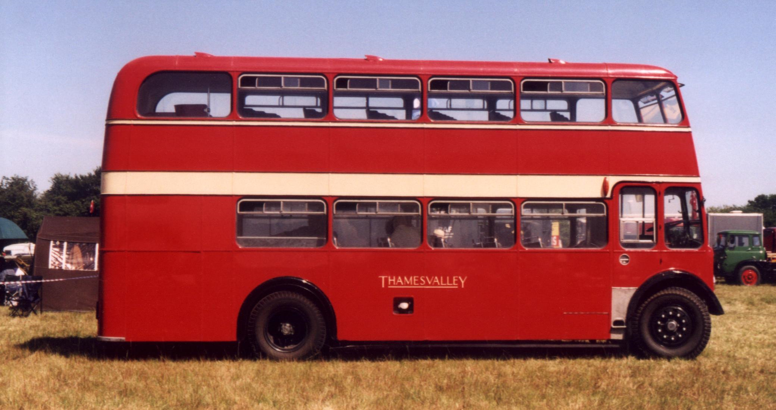

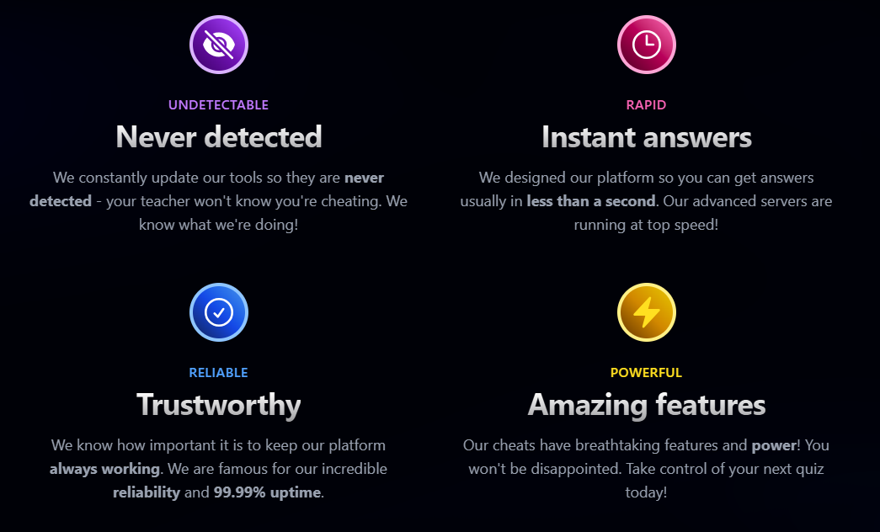

Cutting corners – then and now!
Sparxext

Slide 4
When will homework be set?
FRIDAY*
Year 8 – Thursday for Mr Bushell, Miss Mann, Mrs Whitton & Mrs Brady/Miss Poole (they don't teach Year 8 on Friday)

Slide 5

When will homework need to be completed?
FRIDAY*
Year 8 – Thursday for Mr Bushell, Miss Mann, Mrs Whitton & Mrs Brady/Miss Poole (they don't teach Year 8 on Friday)

Slide 6
What will the homework be?
Sparx Maths tasks (25 weeks)
Mathswatch revision assignments (9 weeks)
Pinpoint re-tests (3 weeks)
Teacher discretion (2 weeks)

Slide 7



What will the content of the homework be?
Sparx - 3 week/6 week review
Mathswatch – revision
Pinpoint – diagnostic following assessment

Slide 8
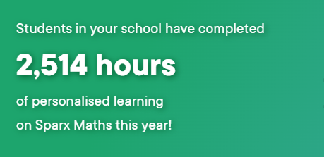
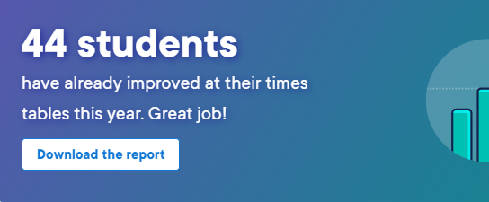
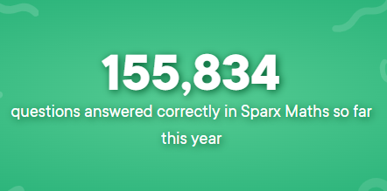

Improving Independent Study Skills

Slide 9
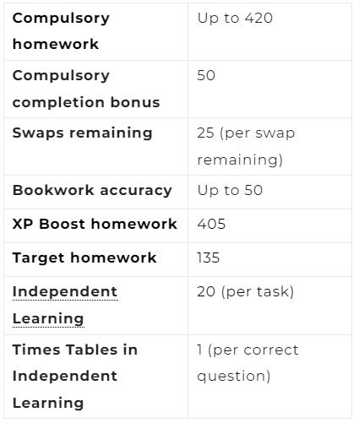
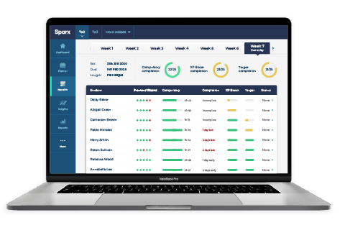
How do you earn XP?

Slide 10
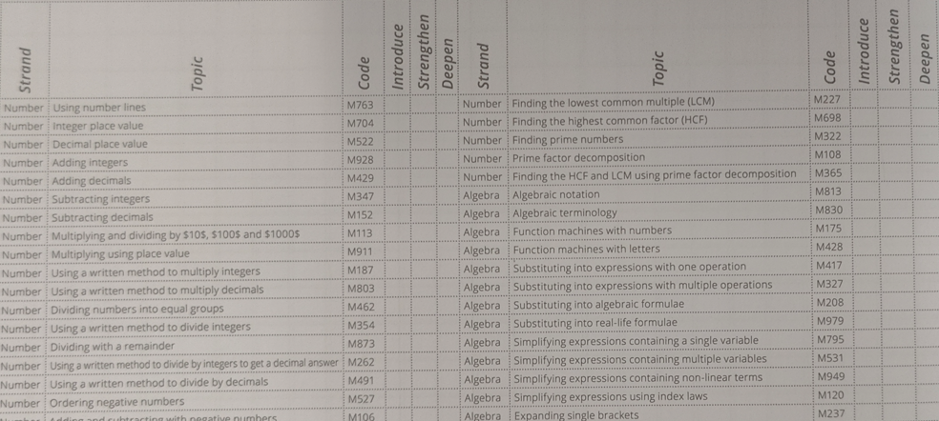
Independent Learning
Grab a book – pages 78 and 79

Slide 11
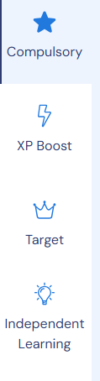
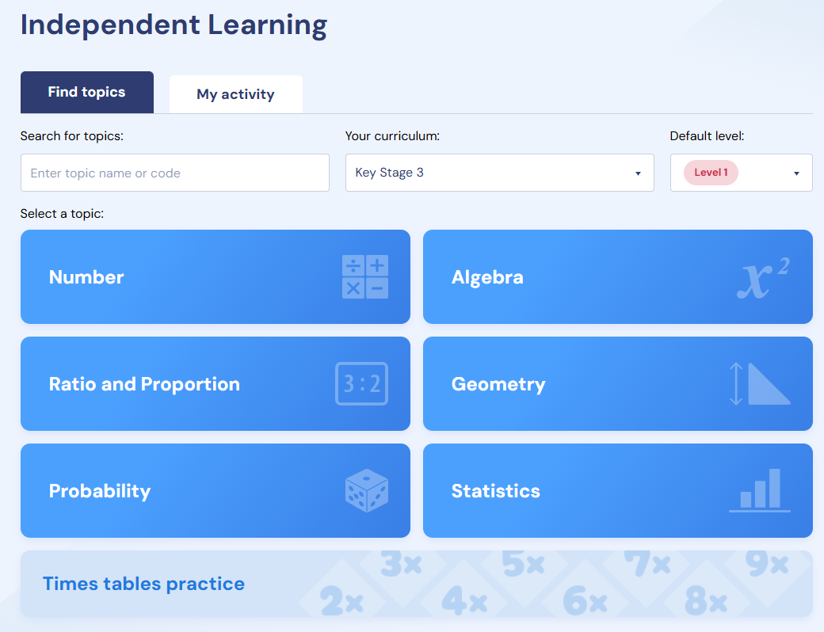
Independent Learning on Sparx

Slide 12
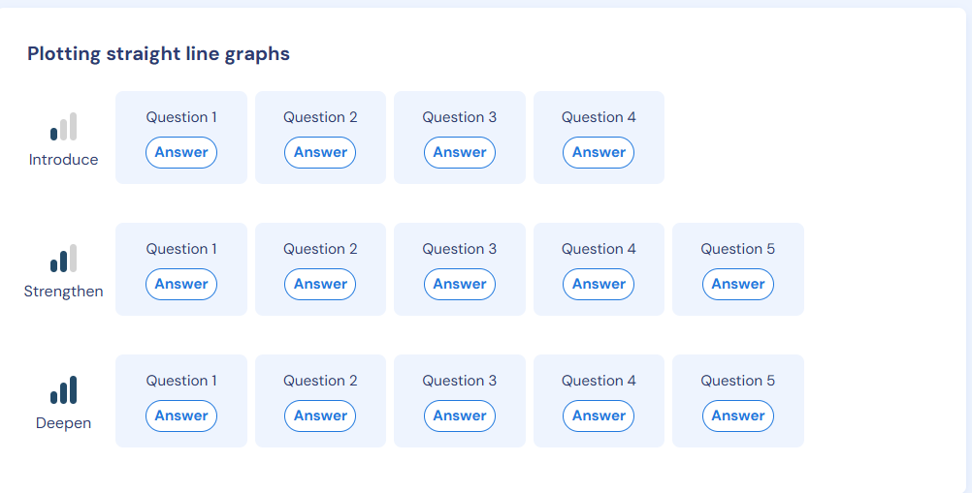
Independent Learning on Sparx

Slide 13

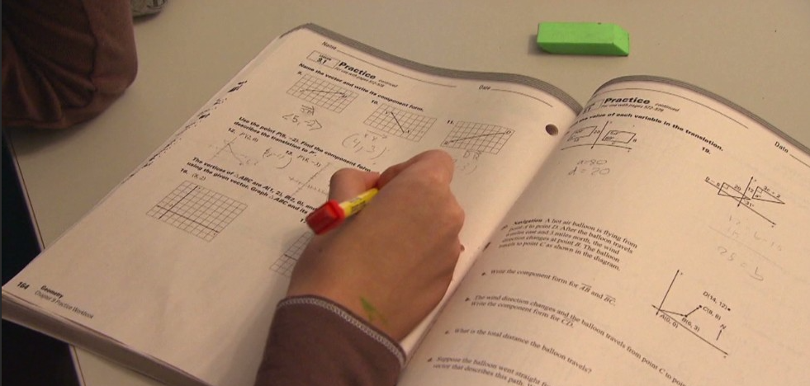
Good Habits
Work area
3 detailed worked examples
Tackling early
Seeking help

Slide 14
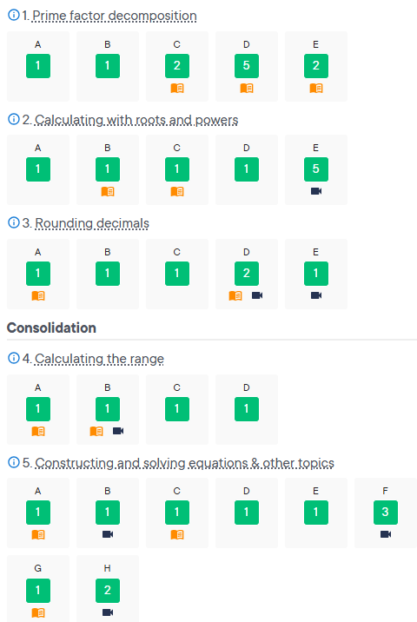
Analysis – good example

Slide 15
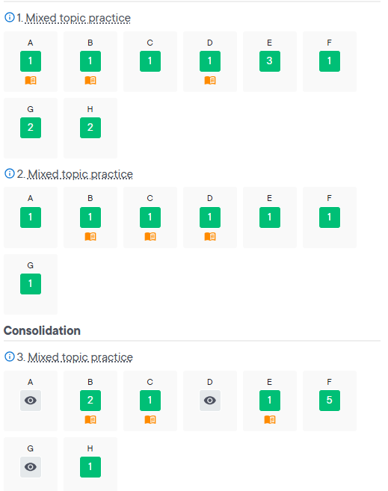
Analysis – NOT so good example

Slide 16
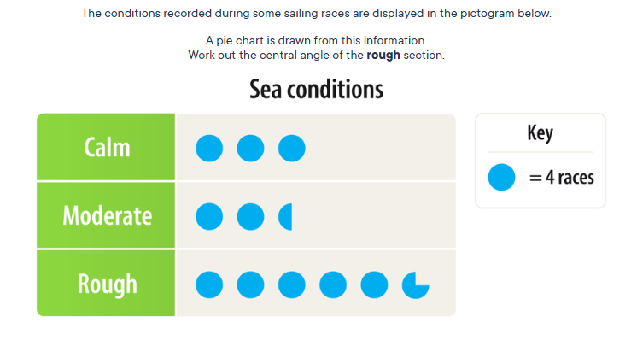

Countdown!

Slide 17
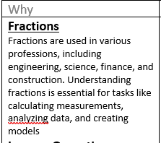
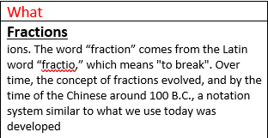
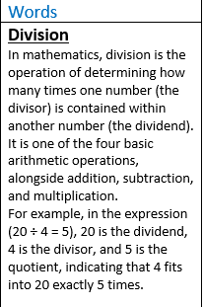
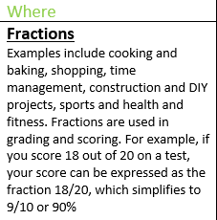

Slide 18

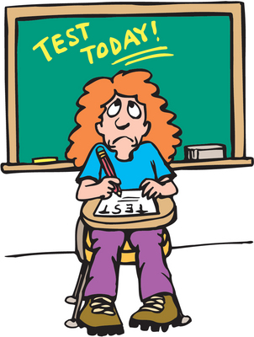

Quizzes

Slide 19
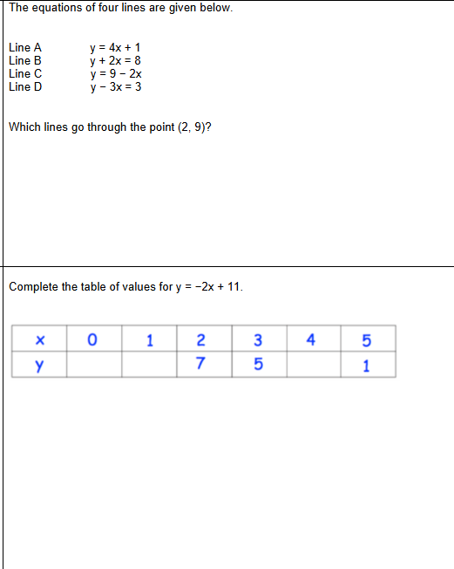
Year 9 quiz example

Slide 20

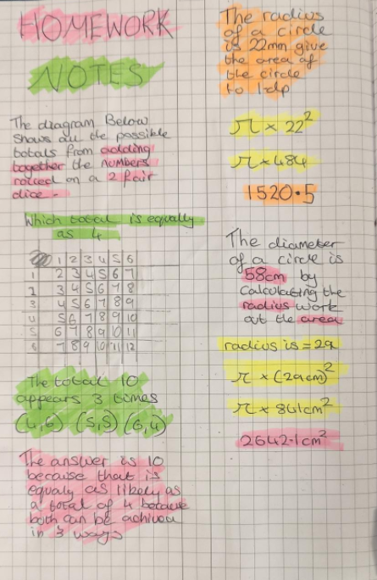
New and Improved Books!

Slide 21
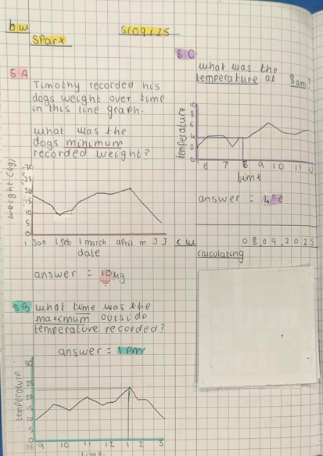
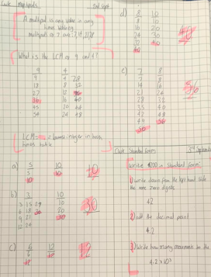
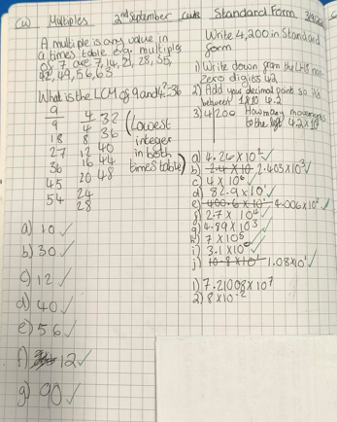
How should should student books be used?
Students should complete a minimum of three useful worked examples in their books
Students to record title and date
Bring into school every Friday – we will reward the best examples.

Slide 22

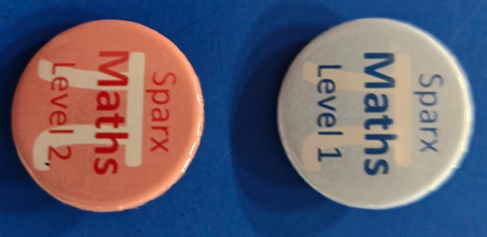
Rewards

Slide 23

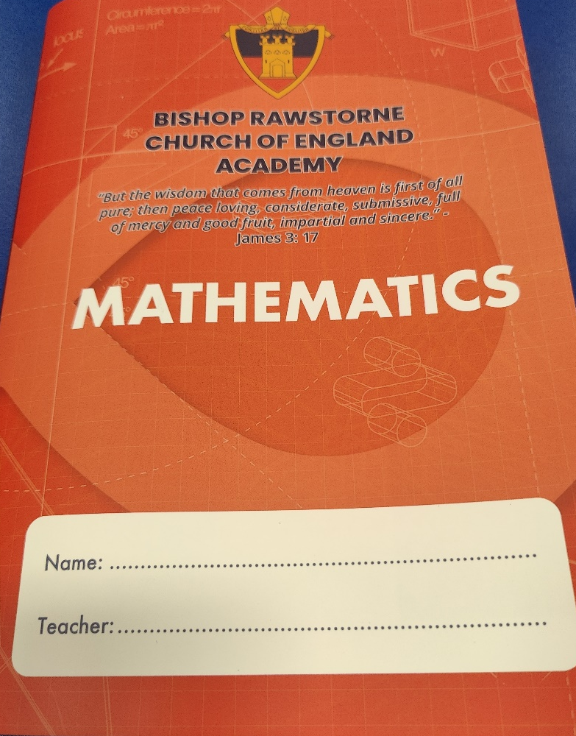


How to prepare for formal assessments?
Homework Club

Slide 24
Assessment Dates Year 8
Autumn Assessment
4th December – 1 paper
Spring Assessment
5th March – 1 paper
Summer Assessment
17/18th June – 2 papers

Slide 25
Assessment Dates Year 9
Autumn Assessment
7th November – 1 paper
Spring Assessment
26th/27th February – 2 papers
Summer Assessment
12th June – 1 paper

Slide 26
Student Groupings – Year 8
Mrs Clare, Mr Bushell, Mr Anglim & Miss Mann
Higher Advanced
Aiming to achieve grades 7-9
Mr Hosker & Mrs Whitton
Higher Basic /Foundation Advanced
Aiming to achieve grades 4-6
Mrs Poole/Mrs Brady
Foundation Basic
Aiming to achieve grade 4

Slide 27
Student Groupings – Year 9
Mrs Poole/Mrs Brady, Miss Mann, Mrs Whitton, Mr Anglim
Higher Advanced
Aiming to achieve grades 7-9
Mr Hosker/Mrs Brady
Higher Basic
Aiming to achieve grades 5-6
Mrs Clare
Foundation Advanced
Aiming to achieve grades 4-5
Mr Bushell
Foundation Basic
Aiming to achieve grade 4

Slide 28
Year 9 - Key Stage 4
Formal GCSE Studies
Begins 16th March 2026
New setting based on Autumn and Spring assessments.
Based on results – either 4 Higher and 3 Foundation sets or 5 Higher and 2 Foundation sets

Slide 29
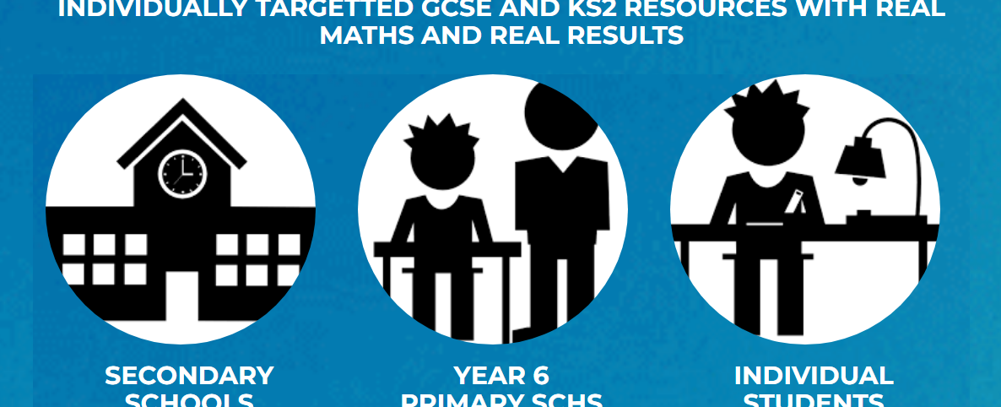
Pinpoint Learning
Personalised post-assessment booklet
Linked to Mathswatch videos
Virtual exam folder
Notes:
After all assessments from year 7 through to year 11 we will input the data into pinpoint. Pinpoint creates a personalized booklets for each pupil focusing on the five topics which they need to work on next. Easy, medium and hard questions are given to guide them through with the support of Sparx Maths videos. This is designed to support every individual pupil to progress and learning from each assessment. Pupils over their time here will grow a virtual exam folder and this will support them in selecting topics for revision ensuring revision is focused to have the maximum impact.

Slide 30
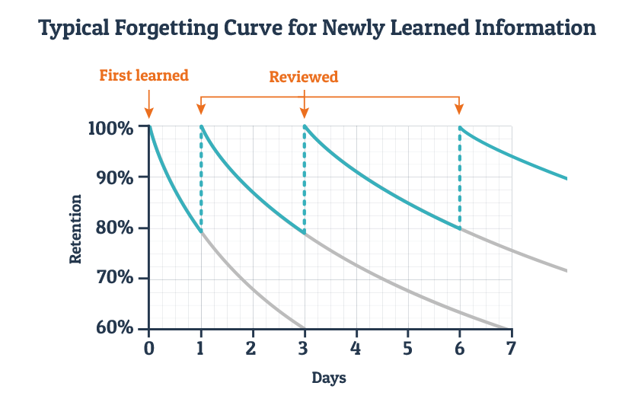
Why are we using this approach?

Slide 31
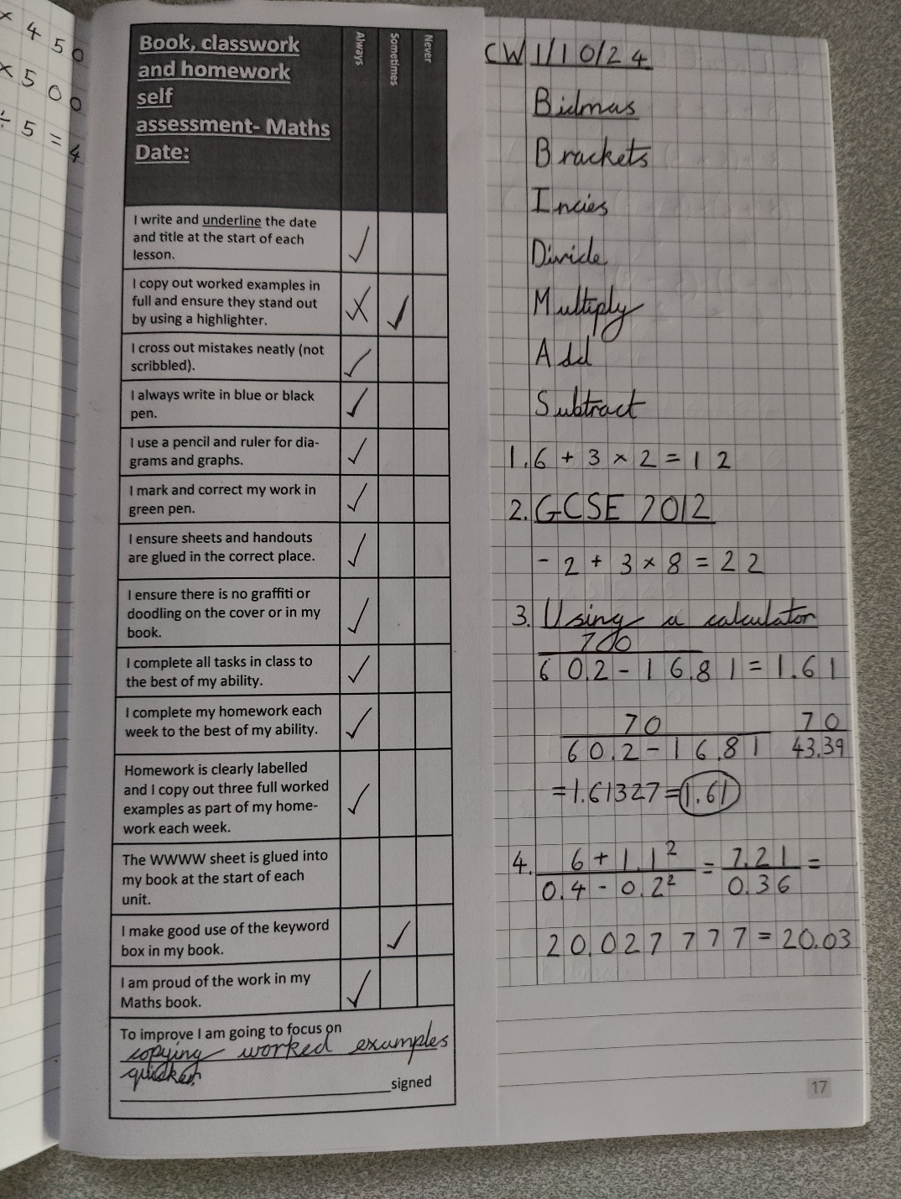
What does excellence look like?

Slide 32
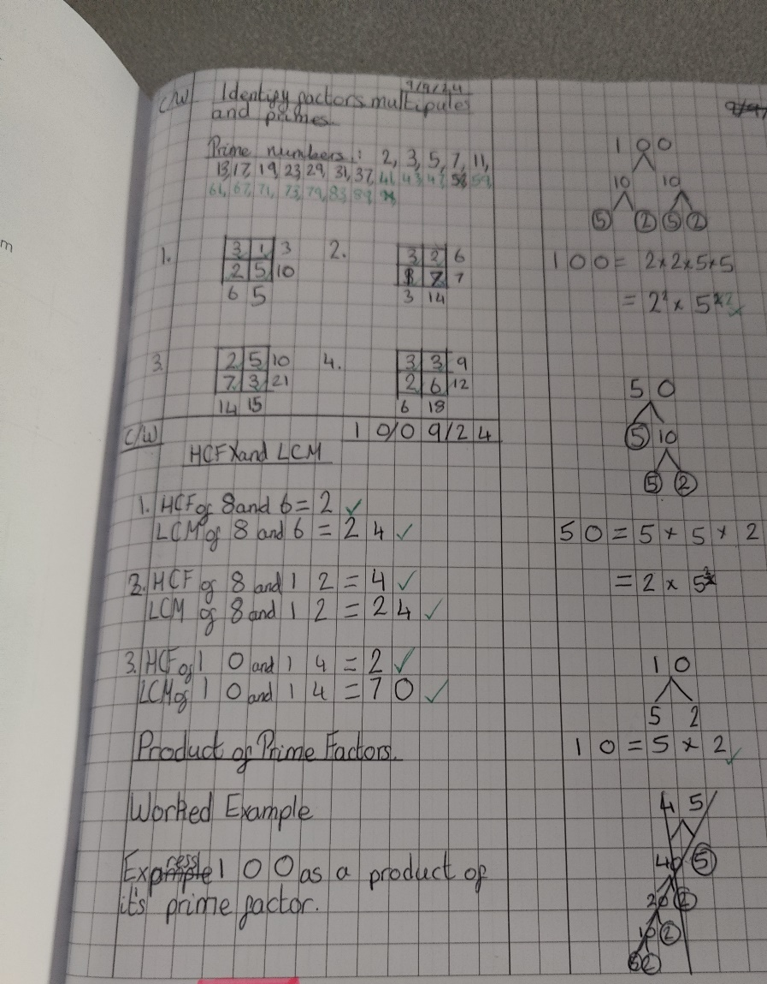
What does excellence look like?

Slide 33
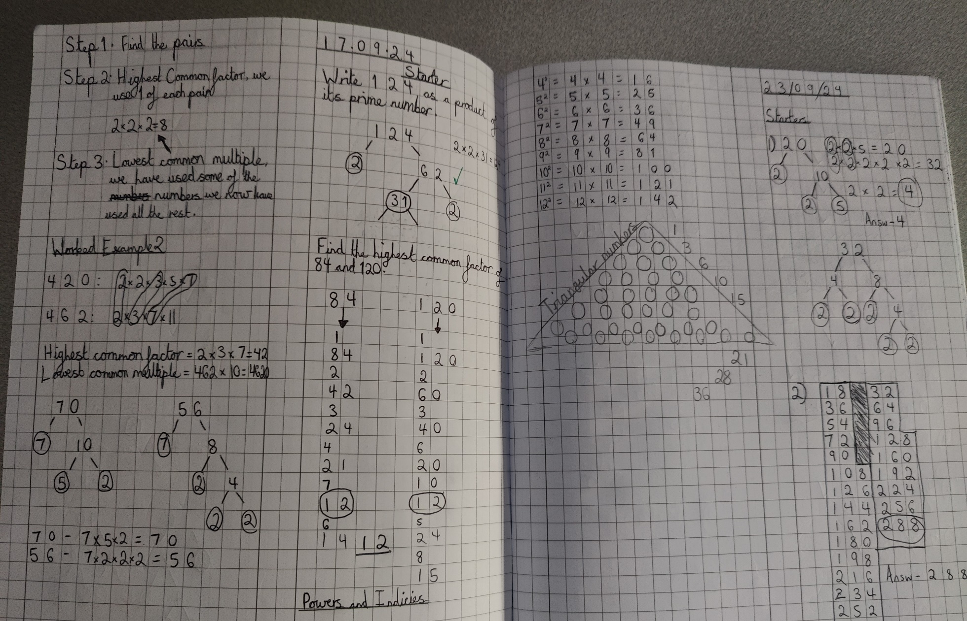
What does excellence look like?

Slide 34
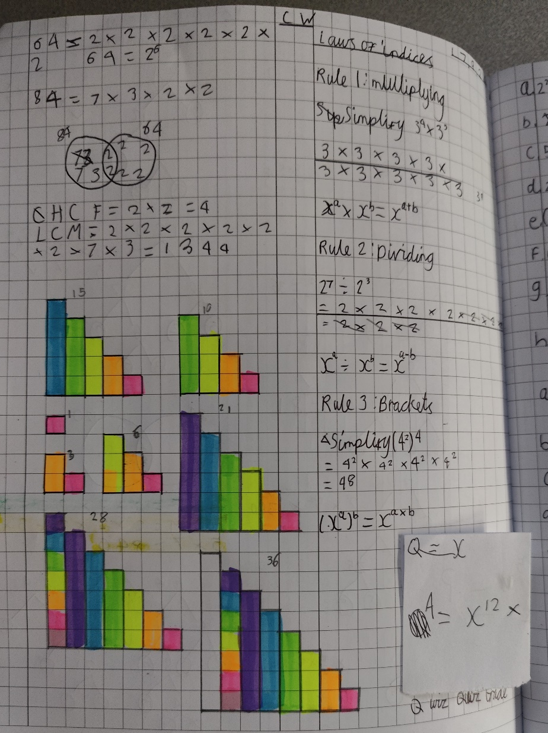
What does excellence look like?

Slide 35
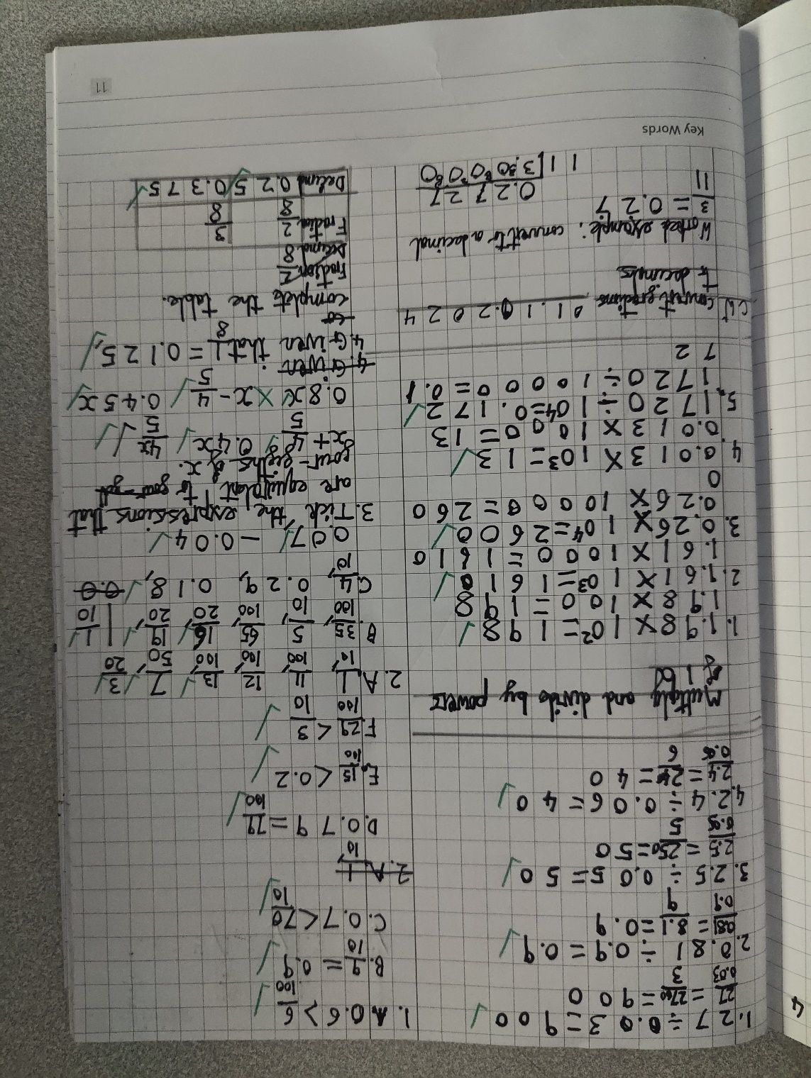
What does excellence look like?

Slide 36

Thank you! Any questions?

