Slide 1
Bishop Rawstorne Christmas Service

Slide 2
Welcome
Leader: The Lord be with you
All: And also with you

Slide 3
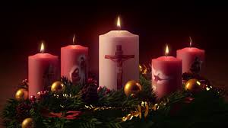
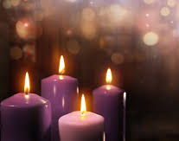
Advent in 2 minutes
https://www.youtube.com/watch?v=eC0FGQLBp7w
How prepared for Jesus
(the celebration of the incarnation) are you?

Slide 4
“The Gospel According to Mark
(1:1-4)
This is the Good News about Jesus Christ, the son of God. It began as the prophet Isaiah had written:

Slide 5
God said, “I will send my messenger ahead of you to clear the way for you.” Someone is shouting in the desert, Get the road ready for the Lord, make a straight path for him to travel.”

Slide 6
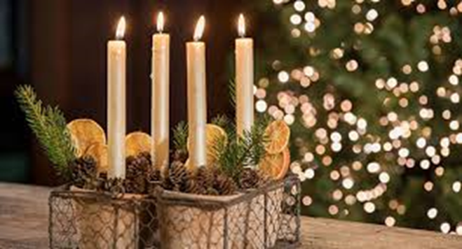
What does Advent Mean?
Adventus is Latin meaning ‘coming’. Advent is all about…
Remembering those who waited for the Coming of Christ
Prepare ourselves to celebrate Christmas
Anticipate the second coming of Christ

Slide 7
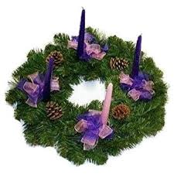
The Advent Wreath
The circle of the wreath reminds Christians of God, His eternity and endless mercy, which has no beginning or end.
The green of the wreath speaks of the hope that Christian's have in God, the hope of newness, of renewal, of eternal life.

Slide 8
The Advent Wreath
Any pine cones, nuts, or seedpods used to decorate the wreath also symbolize life and resurrection.
The four candles represent the four Sundays up to Christmas.

Slide 9
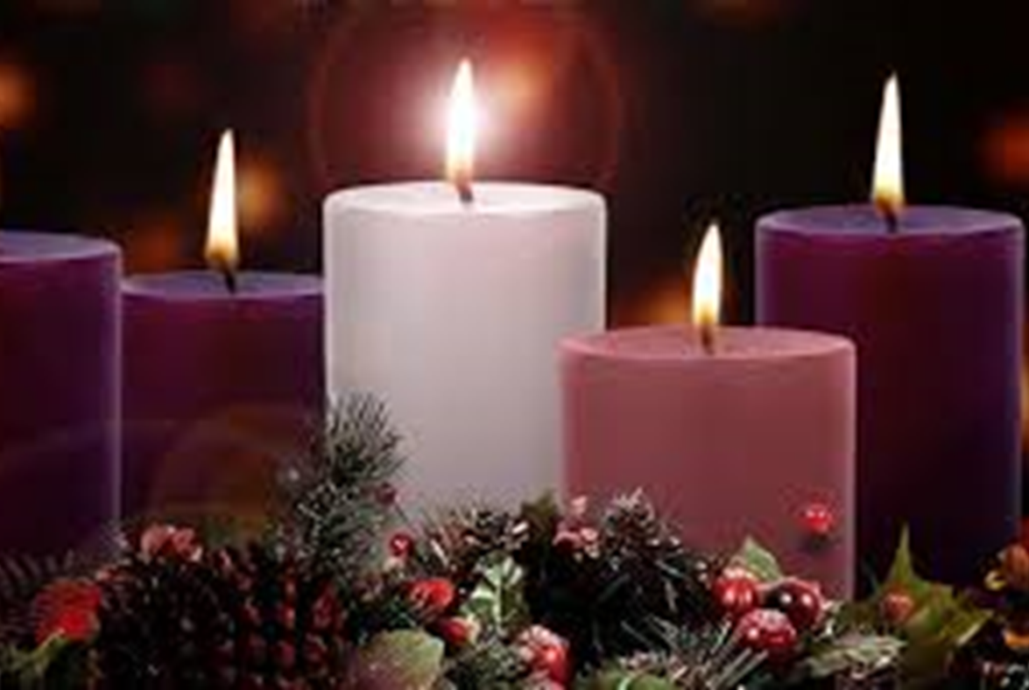
But what does each candle represent?

Slide 10
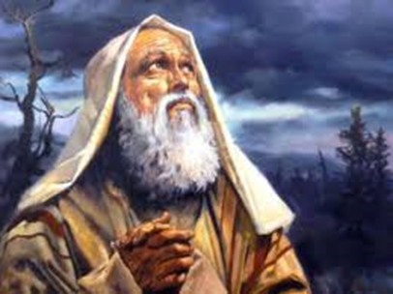
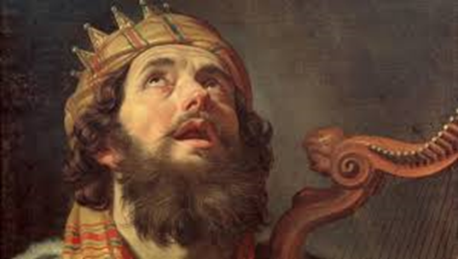
The First Candle
The first candle is the candle of 'Hope', so prayers on this day focus on hope.
This candle represents the 'Patriarchs' such as Abraham and David.

Slide 11
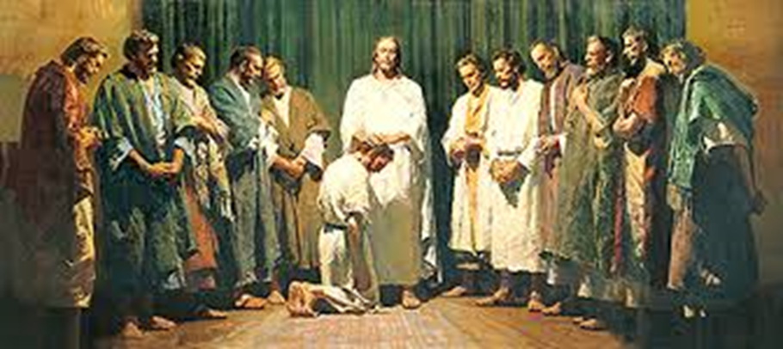
The Second Candle
The second candle is a symbol of God's 'Peace’.
This candle reminds Christians of the Prophets who foretold that the Messiah would be born.

Slide 12
The Third Candle
The second candle is a symbol of God's 'Peace’.
This candle reminds Christians of the Prophets who foretold that the Messiah would be born.

Slide 13
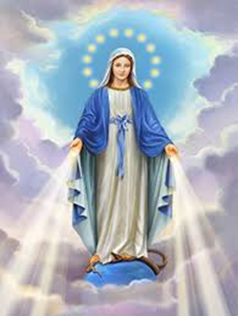
The Fourth Candle
The fourth candle symbolises 'Joy’.
When this candle is lit Christians remember Mary the mother of Jesus who was joyful when the angel Gabriel told her she was to have a baby.

Slide 14
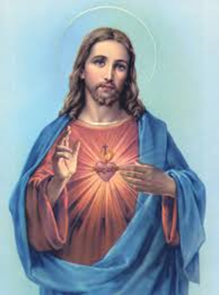
The Fifth Candle
The fifth candle reminds Christians of the birth of Jesus on Christmas Day.

Slide 15
Prayer:
Christ, come into our world of darkness - Light up our lives with your coming.
Fulfil all our longings with the joy of your birth - Strengthen our resolve to work for change in our world - And to share the hope of your birth that each Advent brings. Amen.

Slide 16
Merry Christmas

