Slide 1
5 Top Tips for Starting Secondary School

Slide 2
1. Get involved!
Extra-curricular activities are a great opportunity to build confidence, learn new skills outside of the classroom and make friends.
These experiences are often the special things you remember about secondary school and they also look great on your C.V. and college applications!
Join in and have fun!

Slide 3
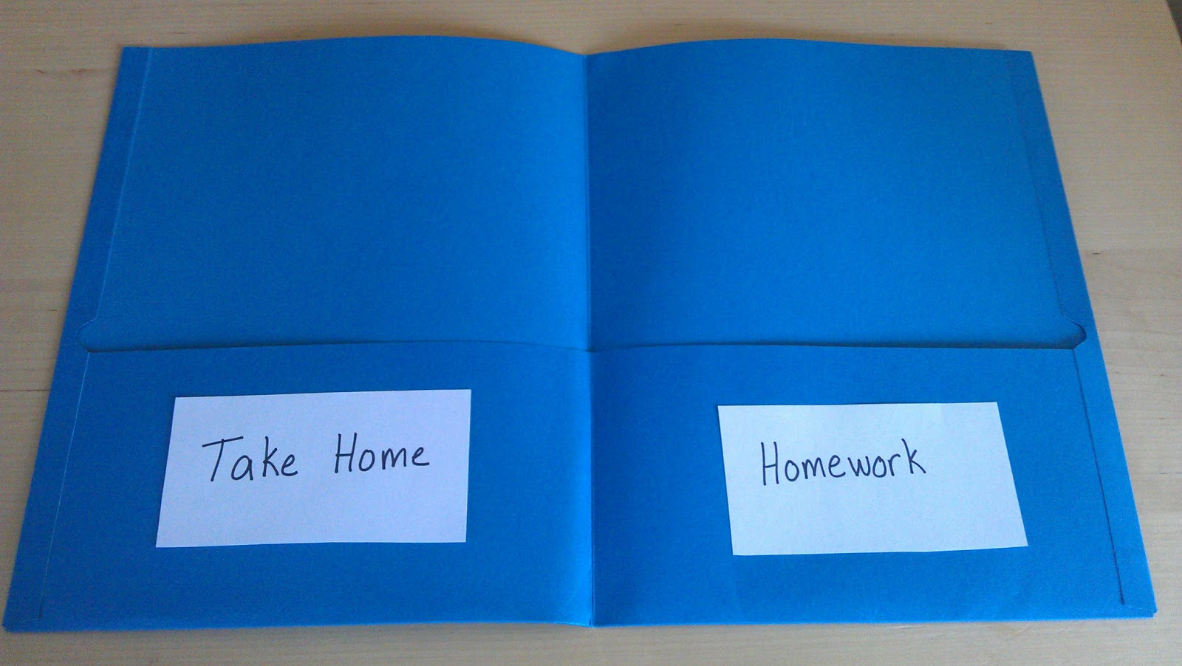
2. Get Organised!
Organise your school bag the night before - ensure all homework and school equipment are packed.
Back your exercise books and use folders to keep your work neat and presentable.

Slide 4
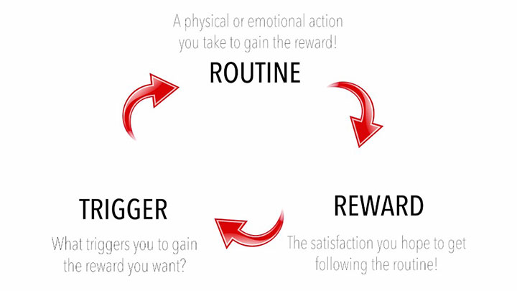
3. Don’t leave things until the last minute!
Establish the best routine for you to make sure that homework and revision is done on time and to the best standard.
Don't wait for things to come to you!
If you think you’d benefit from a Learning or Peer Mentor, speak to Dr Saunders.
Want homework or revision planners? Ask your tutor, HOY, Miss Palmer/Mrs Wade or Dr Saunders.

Slide 5
4. Make good use of SIMS and a planner!
Check SIMS every night. Write down homework/key tasks and tick them off when completed.
If you don't understand something, speak to your teacher ahead of the deadline.
Start good study habits early!

Slide 6
5. Know who can help you
Your tutor, Head of Year and subject teachers are here to help you.
Know where to go to get help if you need it.
Teachers are a brilliant resource. If you don’t understand something in class, put up your hand and wait patiently. Speak to them at the end of the lesson if you are struggling.

Slide 7
Starting Secondary School is an exciting, but also nerve-wracking experience.
We all have different feelings about moving to secondary school.
Be the best version of yourself and talk to someone if you feel overwhelmed or worried.
Remember, you are not alone.

