Slide 1
Choose a number on the advent calendar, which will ask you a question the higher up you go the harder the questions.

Slide 2
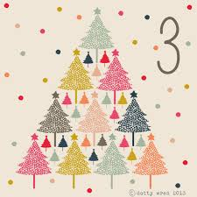
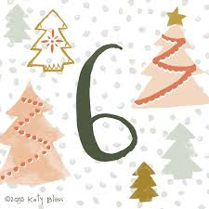
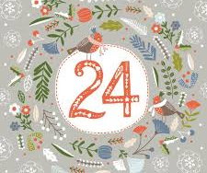
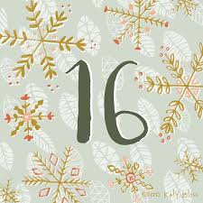
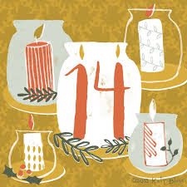
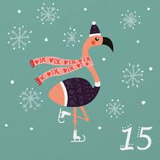
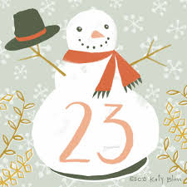
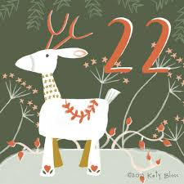

Slide 3
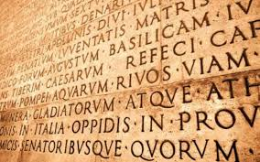
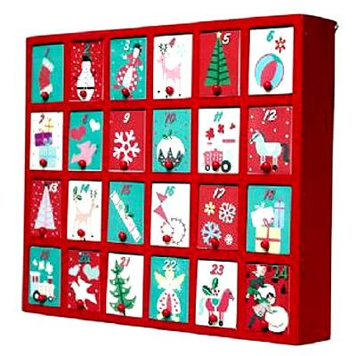
Question 1
Which language does the word advent come from?
Latin

Slide 4
Question 2
What does Advent mean?
Coming

Slide 5
Question 3
When does Advent Start?
30th November
Clue

Slide 6
Question 4
What value does the fourth candle represent?
Joy

Slide 7
Question 5
What is the purpose of Advent?
To prepare for the coming of Christ

Slide 8
Question 6
Name 2 examples of how to prepare for Christ incorrectly?
Shopping
New year

Slide 9
Question 7
What do the pine cones represent on the advent wreath?
They symbolize life and resurrection

Slide 10
Question 8
Which book was the bible verse from ?
Mark
Clue
Its one of the following…

Slide 11
Question 9
How many Sundays does advent last for?
4

Slide 12
Question 10
Who does Candle 5 represent?
Jesus

Slide 13
Question 11
How many boxes do most advent calendars have?
24

Slide 14
Question 12
Fill in the gap: John the _________
Baptist

Slide 15
Question 13
Fill in the gaps!
Advent means ___________. During Advent, Christians are thinking about ______ coming into the ______. They are preparing themselves for ______ when they celebrate the ______ of ______. Advent is the start of the Christian ______ and begins on the fourth ________ before Christmas.
Jesus Christmas birth ‘the coming’
world year Jesus Sunday
Clue

Slide 16
Question 13
Fill in the gaps!
Advent means ‘the coming’. During Advent, Christians are thinking about Jesus coming into the world. They are preparing themselves for Christmas when they celebrate the Birth of Jesus. Advent is the start of the Christian year and begins on the fourth Sunday before Christmas.
Jesus Christmas birth ‘the coming’
world year Jesus Sunday

Slide 17
Question 14
On the 5th day of Christmas what did ‘my true love give to me’?
5 Gold Rings

Slide 18
Question 15
Name 2 reasons how you and your family could be ready for the birth of Jesus?
Prayer
Thought and Silence

Slide 19
Question 16
What does Advent mean?
Coming

Slide 20
Question 17
What colour is the majority of the candles on the wreath?
Purple

Slide 21
Question 18
What is the second candles value?
Peace

Slide 22
Question 19
What colours are the advent colours?
Purple and Pink

