Slide 1
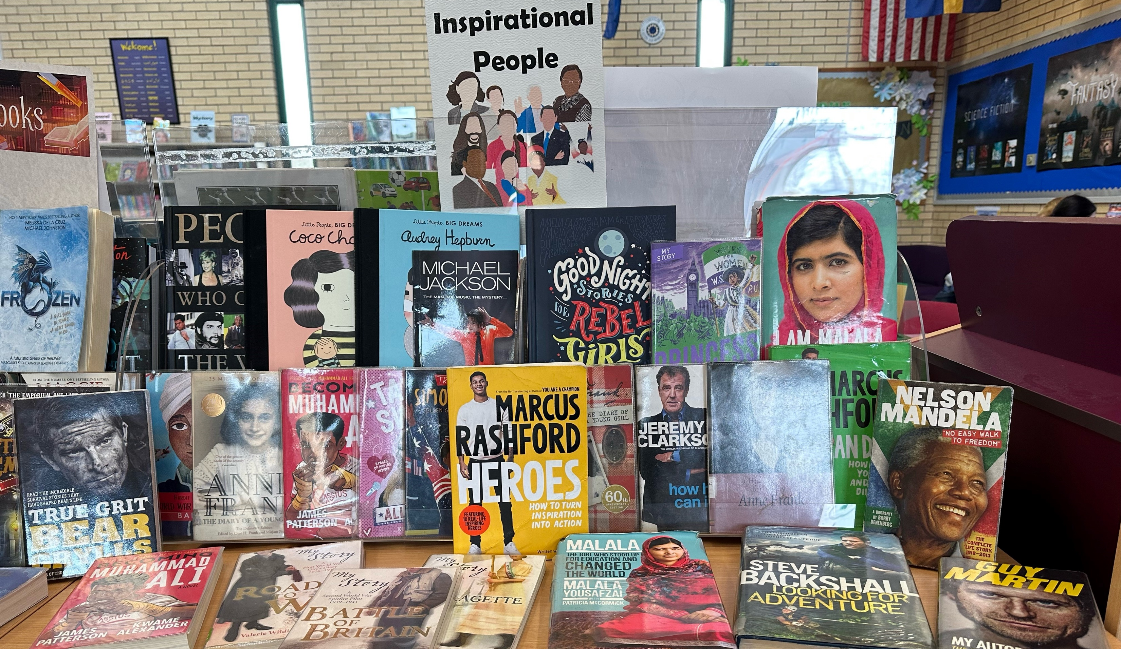
April’s - No Fools - Library Book Selection
This month the Student Librarians have picked out a collection of books featuring people who they believe are influential.
Pop into the Library and find out more about them and why they became celebrities.

