Slide 1
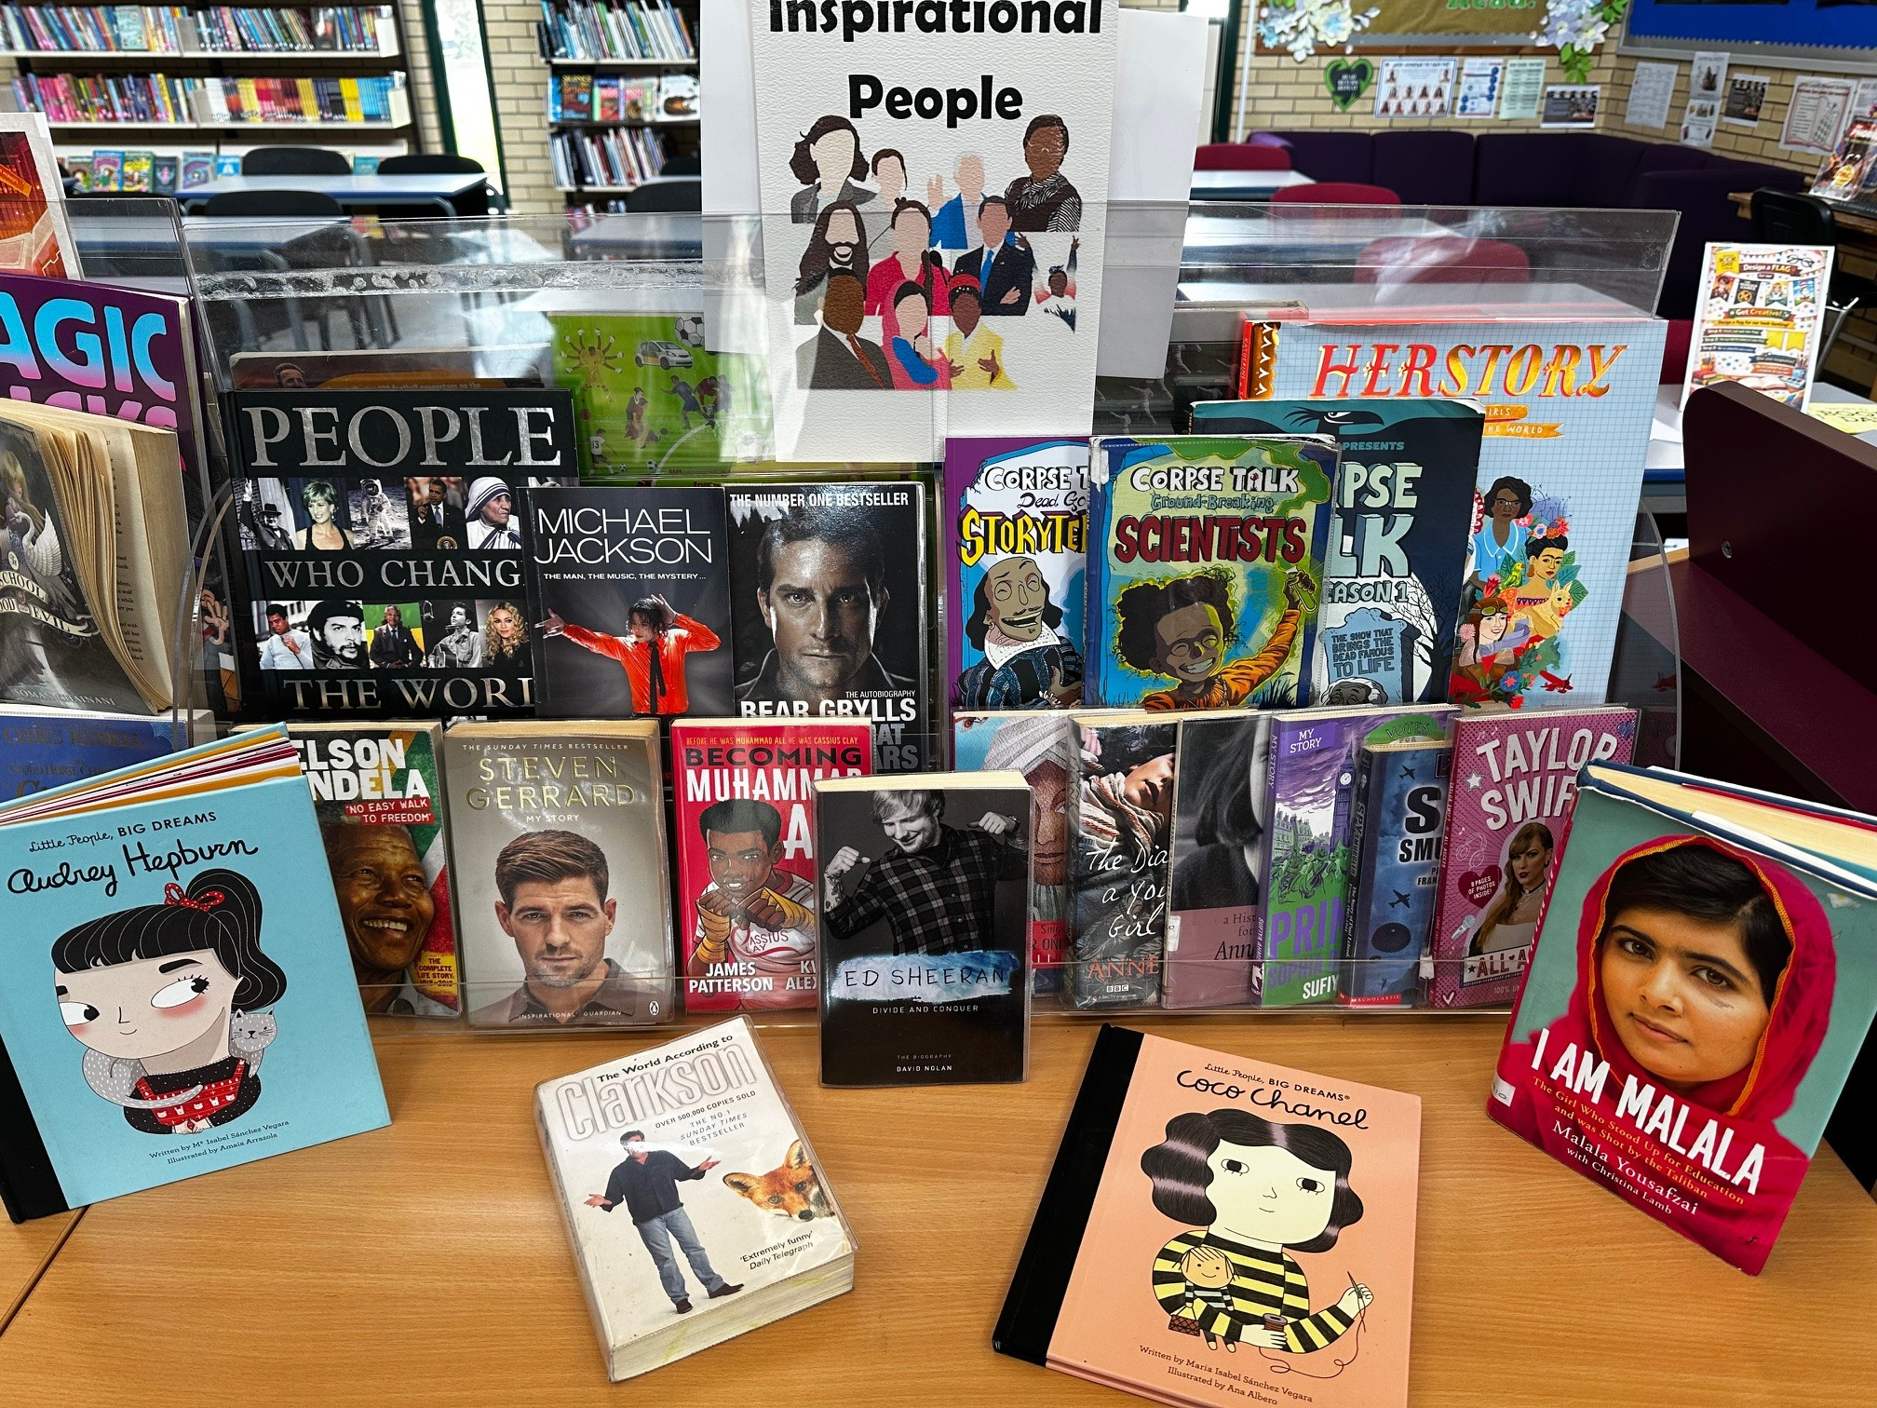

April’s “No Fool” Book Picks
This month, our Student Librarians have chosen a lineup of books all about influential people who’ve made their mark on the world.
Curious about how they rose to fame? Want to know what makes them stand out?
Swing by the Library to explore their stories and discover what turned them into icons!

