Slide 1
Worship context:
Make sure you ‘Enable Content’ when you open so that embedded materials work.
This resources follows the Welcome, Word and Prayer format. With reflection in between.
The welcome section slide 3 is a simple video clip of a ‘kids view’ of Easter. Then I have written a short summary for you to have a look at.
The word of from Philippians – it’s just a short passage that gives an overview of Jesus’ life and the meaning of his death and resurrection, I’ve used a couple of slides to after that with quotes and explanations to try and help illustrate how to understand the meaning and importance of Easter. The themes of humility and New life are key to understanding Easter.
We then finish with a couple of reflective questions and a prayer, take time to discuss these with your form.

Slide 2
Easter
Verse
“But the wisdom that comes from heaven is first of all pure; then peace loving, considerate, submissive, full of mercy and good fruit, impartial and sincere.”
James 3:17

Slide 3
Easter is arguably the most important festival in the Christian calendar. It celebrates the resurrection from the dead of Jesus, three days after he was executed. The Easter story is at the heart of Christianity.
Welcome: What is Easter ?
Notes:
https://www.youtube.com/watch?v=wdn1R90kX9A this clip just gives a kids version of what the Easter story is about.

Slide 4
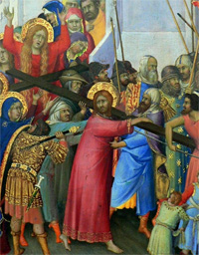
A short summary of the festival:
Palm Sunday, this is the Sunday before Easter Day. It is the first day of Holy Week and celebrates Jesus' arrival in Jerusalem riding on a donkey. Crowds of people came out of the city to greet him, throwing down palm branches on the road.
Maundy Thursday. This is the Thursday before Easter Day. Last Supper: On Maundy Thursday Christians remember when Jesus ate the Passover meal with his disciples, breaking bread and drinking wine, which is now known as the Last Supper.
Good Friday is the Friday before Easter Sunday. It commemorates the execution of Jesus by crucifixion.
Easter Sunday marks Jesus' resurrection. After Jesus was crucified on the Friday (now known as Good Friday), his body was taken
down from the cross, and buried in a cave tomb. The tomb
was guarded by Roman Soldiers and an enormous stone was put over the entrance, so that no-one could steal the body.

Slide 5
Philippians 2:5-11
Word:
Think of yourselves the way Christ Jesus thought of himself. He had equal status with God but didn’t think so much of himself that he had to cling to the advantages of that status no matter what. Not at all. When the time came, he set aside the privileges of deity and took on the status of a slave, became human! Having become human, he stayed human. It was an incredibly humbling process. He didn’t claim special privileges. Instead, he lived a selfless, obedient life and then died a selfless, obedient death—and the worst kind of death at that—a crucifixion.
Because of that obedience, God lifted him high and honored him far beyond anyone or anything, ever, so that all created beings in heaven and on earth—even those long ago dead and buried—will bow in worship before this Jesus Christ, and call out in praise that he is the Master of all, to the glorious honor of God the Father.
Notes:
The word of from Philippians – it’s just a short passage that gives an overview of Jesus’ life and the meaning of his death and resurrection, I’ve used a couple of slides to after that with quotes and explanations to try and help illustrate how to understand the meaning and importance of Easter. The themes of humility and New life are key to understanding Easter.

Slide 6
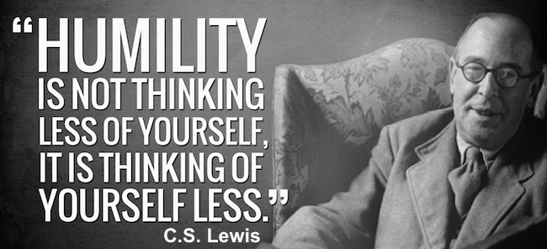
The Easter story is a story of humility and new life
Humility - the quality of having a modest or low view of one's importance

Slide 7
The Easter story is a story of humility and new life
New life is the fresh start and new way of living that is offered through Jesus’ teachings.

Slide 8
Questions for you?
Are there areas of your life in which you’ve lost humility?
Are there issues or parts of your life that require new life – being brought back to life (resurrection)?
Write a prayer asking God for help or guidance.

Slide 9
Prayer for this week:
Almighty God, through the time of Lent let us move now to Easter where we enter into the mystery of Christ’s sufferings, help us to come to know his ways, that we may know life in all its fullness.
Amen

