Slide 1
Worship context: Worship = Epiphany
This resource follows the Welcome, Word and Prayer format.
Slide 2 outlines the school motto and what it means, please take a minute to go over this with your tutor.
Slide 3 explains what Epiphany is
Slide 4 is the Word for today
Slides 5-8 are info and discussion prompts.
Slide 9 close in prayer

Slide 2

Faithfully
Fortiter Et Fideliter
Bravely and Faithfully

Slide 3
What is Epiphany?
The Epiphany is an ancient Christian feast day and is significant in a number of ways. In the East, where it originated, the Epiphany celebrates the baptism of Jesus by John the Baptist in the River Jordan. It also celebrates Jesus' birth.
The Western Church began celebrating the Epiphany in the 4th century where it was, and still is, associated with the visit of the magi (wise men) to the infant Jesus when God revealed himself to the world through the incarnation of Jesus. According to Matthew 2:11 they offered him gifts of gold, frankincense and myrrh.
For many Protestant church traditions, the season of Epiphany extends from 6 January until Ash Wednesday, which begins the season of Lent leading to Easter.
Other traditions, including the Roman Catholic tradition, observe Epiphany as a single day, with the Sundays following Epiphany counted as Ordinary Time.
In the Spanish speaking world Epiphany is also known as Dia de los Reyes (Three Kings Day).

Slide 4

Epiphany
Word:
Matthew 2:11-12
On coming to the house, they saw the child with his mother Mary, and they bowed down and worshiped him. Then they opened their treasures and presented him with gifts of gold, frankincense and myrrh. ¹² And having been warned in a dream not to go back to Herod, they returned to their country by another route.

Slide 5
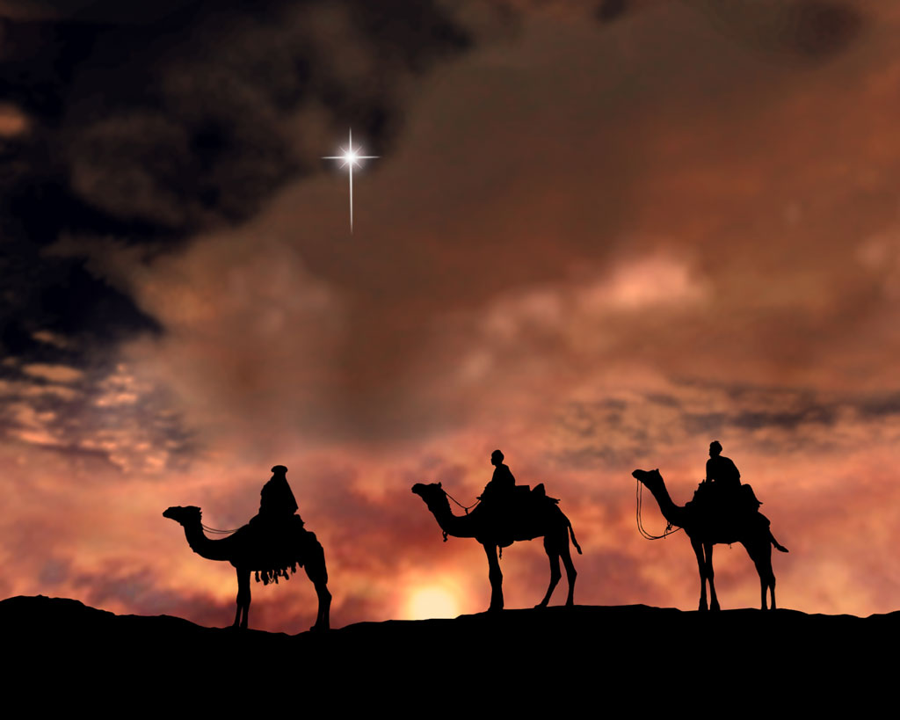
The Magi bring three gifts
Word

Slide 6

As we’ve read - The Western Church began celebrating the Epiphany and associating it with the visit of the magi (wise men) to see Jesus.
According to Matthew 2:11 they offered him gifts of gold, frankincense and myrrh.
Word

Slide 7
Reflection…
Personal Response

Slide 8
The Magi’s gifts revealed who Jesus was.
Do our personal attributes, skills and interests gifts reveal who we are?
Take a moment to ponder you character and personality. What gifts/passions/ characteristics do you have?
Personal Response

Slide 9
Epiphany
Prayer:
Heavenly Father, in Your love - You have called us to know You; Led us to trust You; And bound our lives with Yours. Surround us with Your love And Protect us from evil That we may bravely and faithfully follow You, Through Jesus Christ our Lord. Amen.

