Slide 1
Instructions to support tutor Worship this week: Rugby & Friendship
- On the back of the Rugby league world cup, I’ve followed Mrs Duckworth in looking at friendship.
Slide 3 – Question to set the scene
Slides 4-5 the story of Rob Burrow and Kevin Sinfield
Slide 6 word/Bible verses for the week.
Slide 7 talk about Kevin Sinfield’s work raising money for charity/MND.
Slide 8 is the closing prayer

Slide 2
Fortiter Et Fideliter
Bravely and Faithfully
Hope, Service, Compassion, Fellowship, Wisdom and Peace

Slide 3
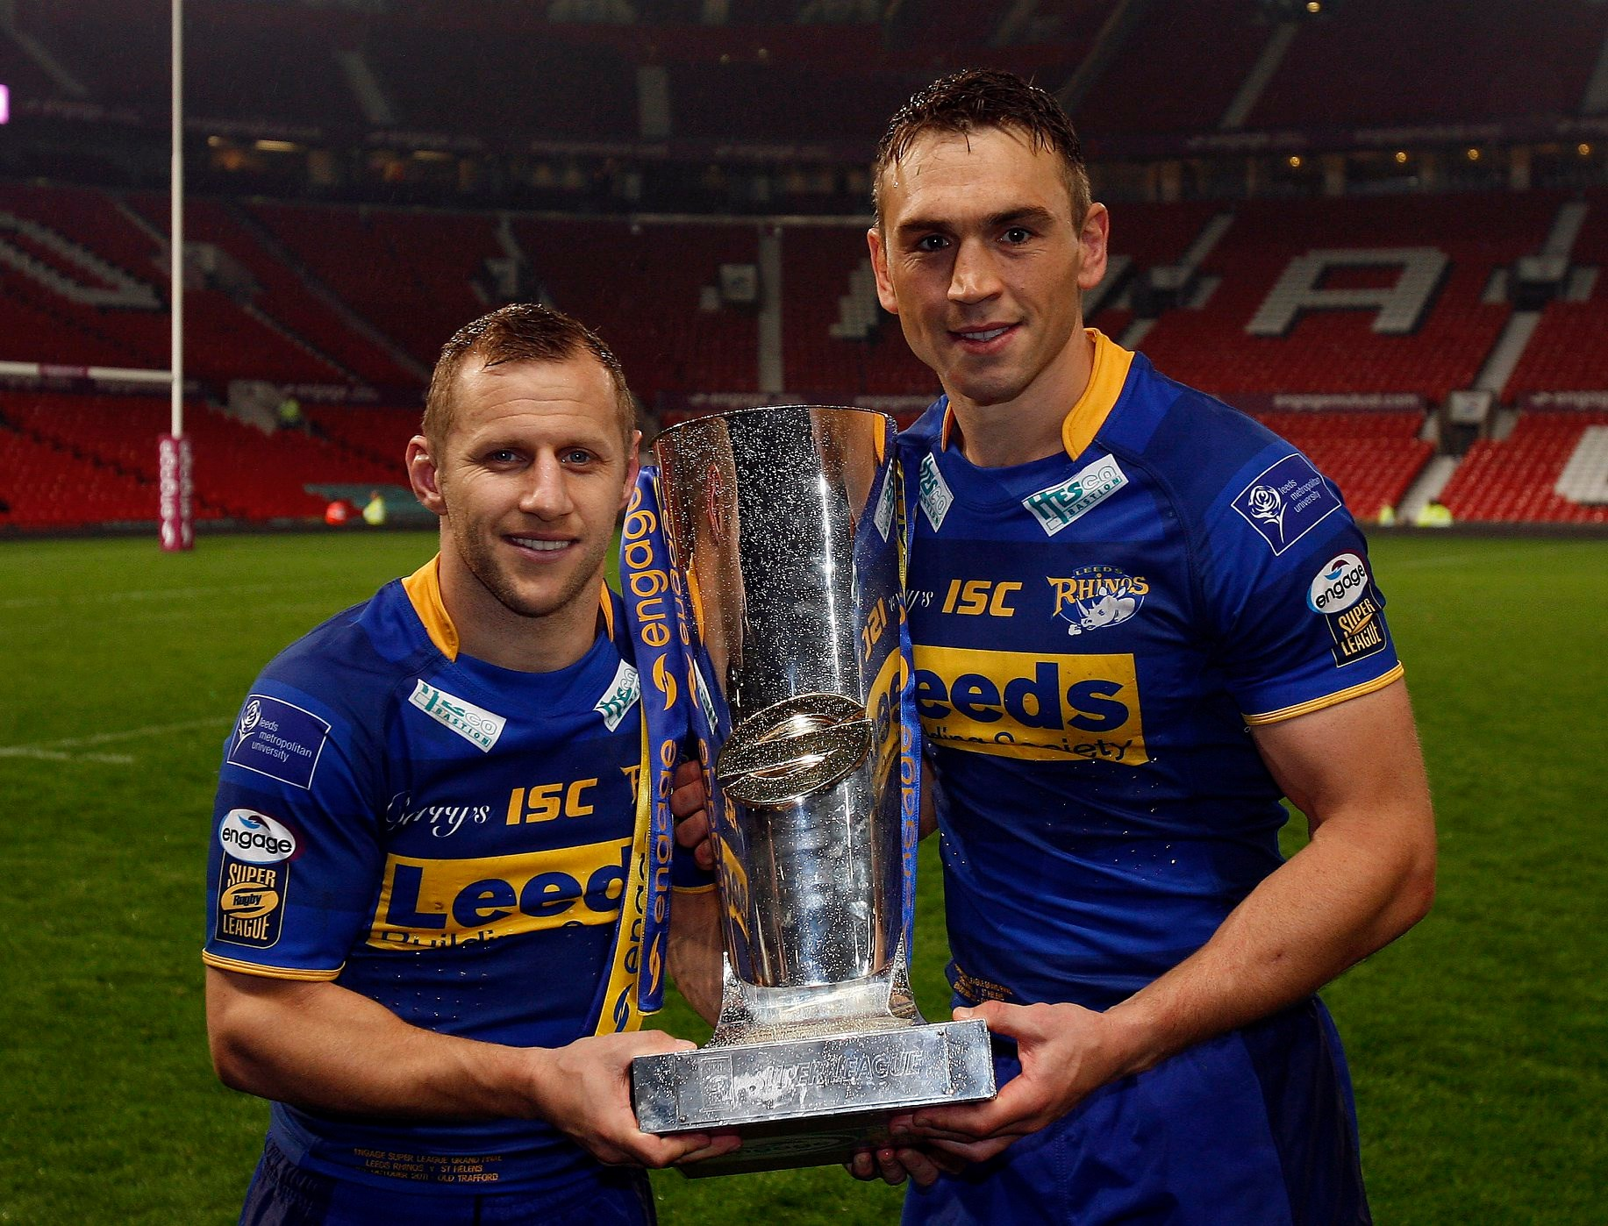
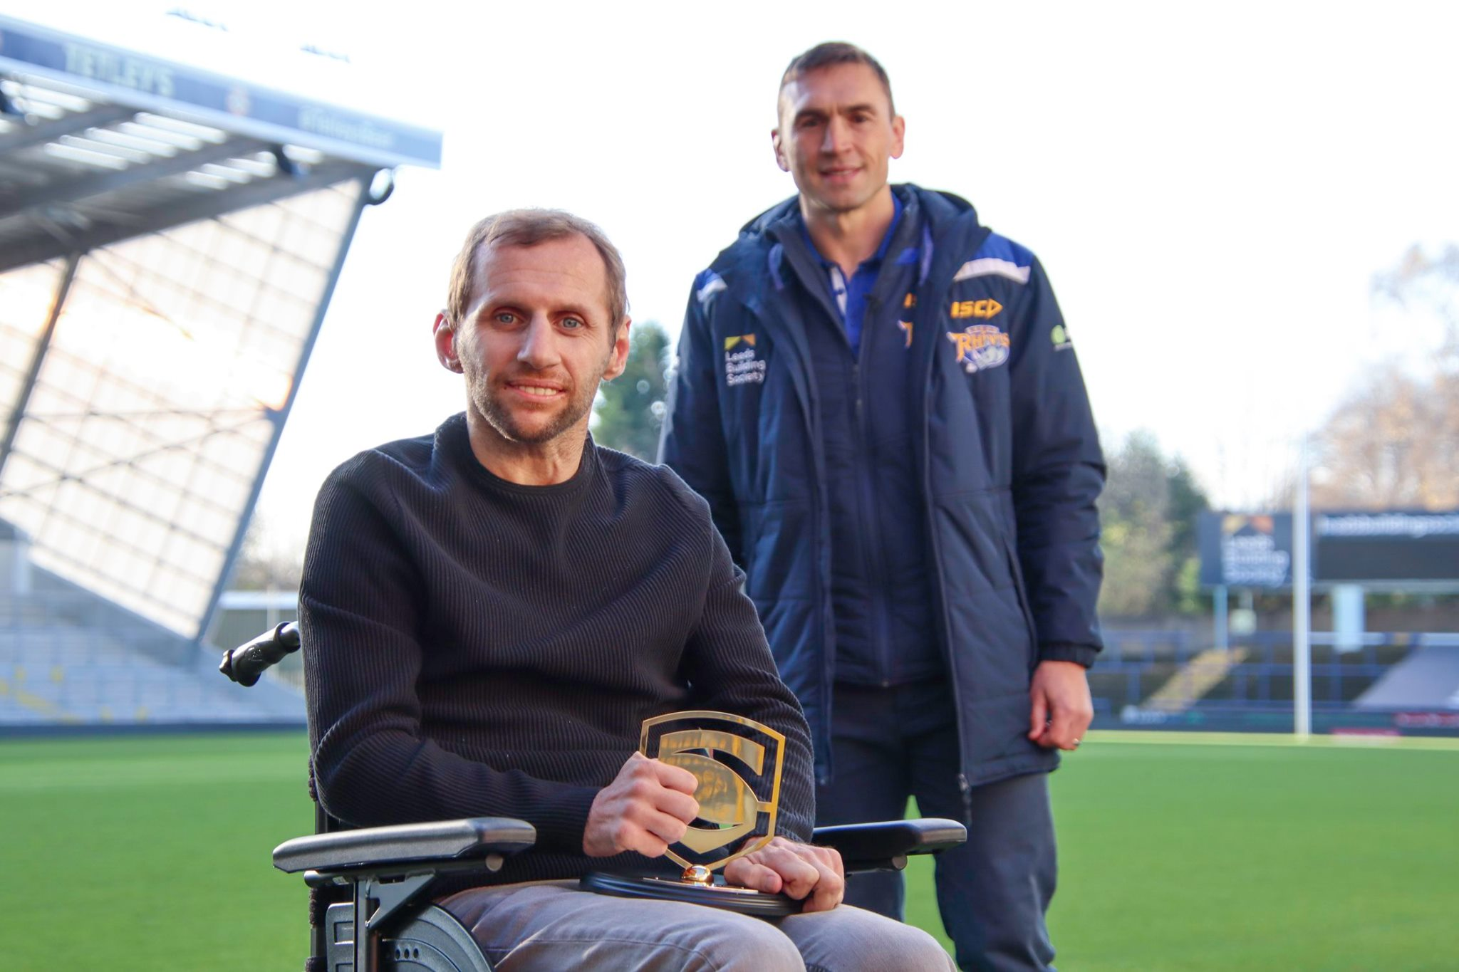
Rob Burrow and Kevin Sinfield

Slide 4
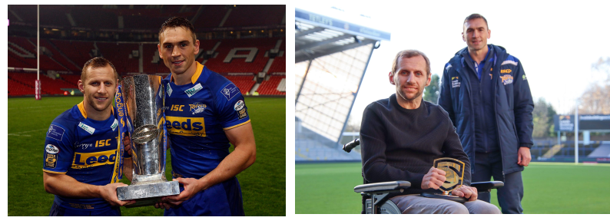
Burrow, was struck down with Motor Neurone Disease in December 2019. His resolve in the face of adversity has been nothing short of miraculous, keeping a smile on his face for his wife and three young children.
Now bound to a wheelchair and unable to communicate without the help of a computer, his condition has regressed rapidly over the last 12 months.
Motor Neurone Disease will ultimately take Rob Burrow's life. But his prime focus since being diagnosed has been for others, not himself, doing all he can to try and help find a cure so future sufferers have a chance of beating it.

Slide 5
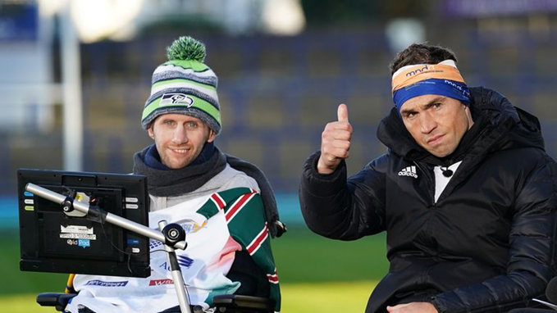
Sinfield’s and Burrow’s friendship is an example of how to support and care for others. Just like the Bible instructs Christians:
Proverbs 27:10
¹⁰ Do not forsake your friend or a friend of your family, and do not go to your relative’s house when disaster strikes you— better a neighbour nearby than a relative far away.
Galatians 6:2
New International Version
Carry each other’s burdens, and in this way you will fulfil the law of Christ.

Slide 6
Kevin Sinfield
Sinfield has run many marathons since finishing his rugby career to raise almost £3 million for MND charities. Heh as taken on two exceptionally difficult challenges of seven marathons in seven days and 101 miles in 24 hours. Over the last week he has taken his training to a new level for Ultra 7 in 7. 7 ultra marathons over 7 days.
"I want people to understand if you truly want to try and make a difference, you can. You've got to use your head and your heart. It just shows the power of friendship," he said.
If you don’t know about Motor Neurone Disease you can have a look
on the NHS website
Notes:
https://www.nhs.uk/conditions/motor-neurone-disease/

Slide 7
Did he do it?
Click
Notes:
https://www.bbc.co.uk/sport/av/rugby-league/63690523

Slide 8
Closing Prayer:
Dear Lord, teach us to love others the way you first loved us. As we build relationships with others, help us to be generous, authentic and kind. All of those things are only possible through you, the God who abides with us and calls us friend. Amen.

