Slide 1

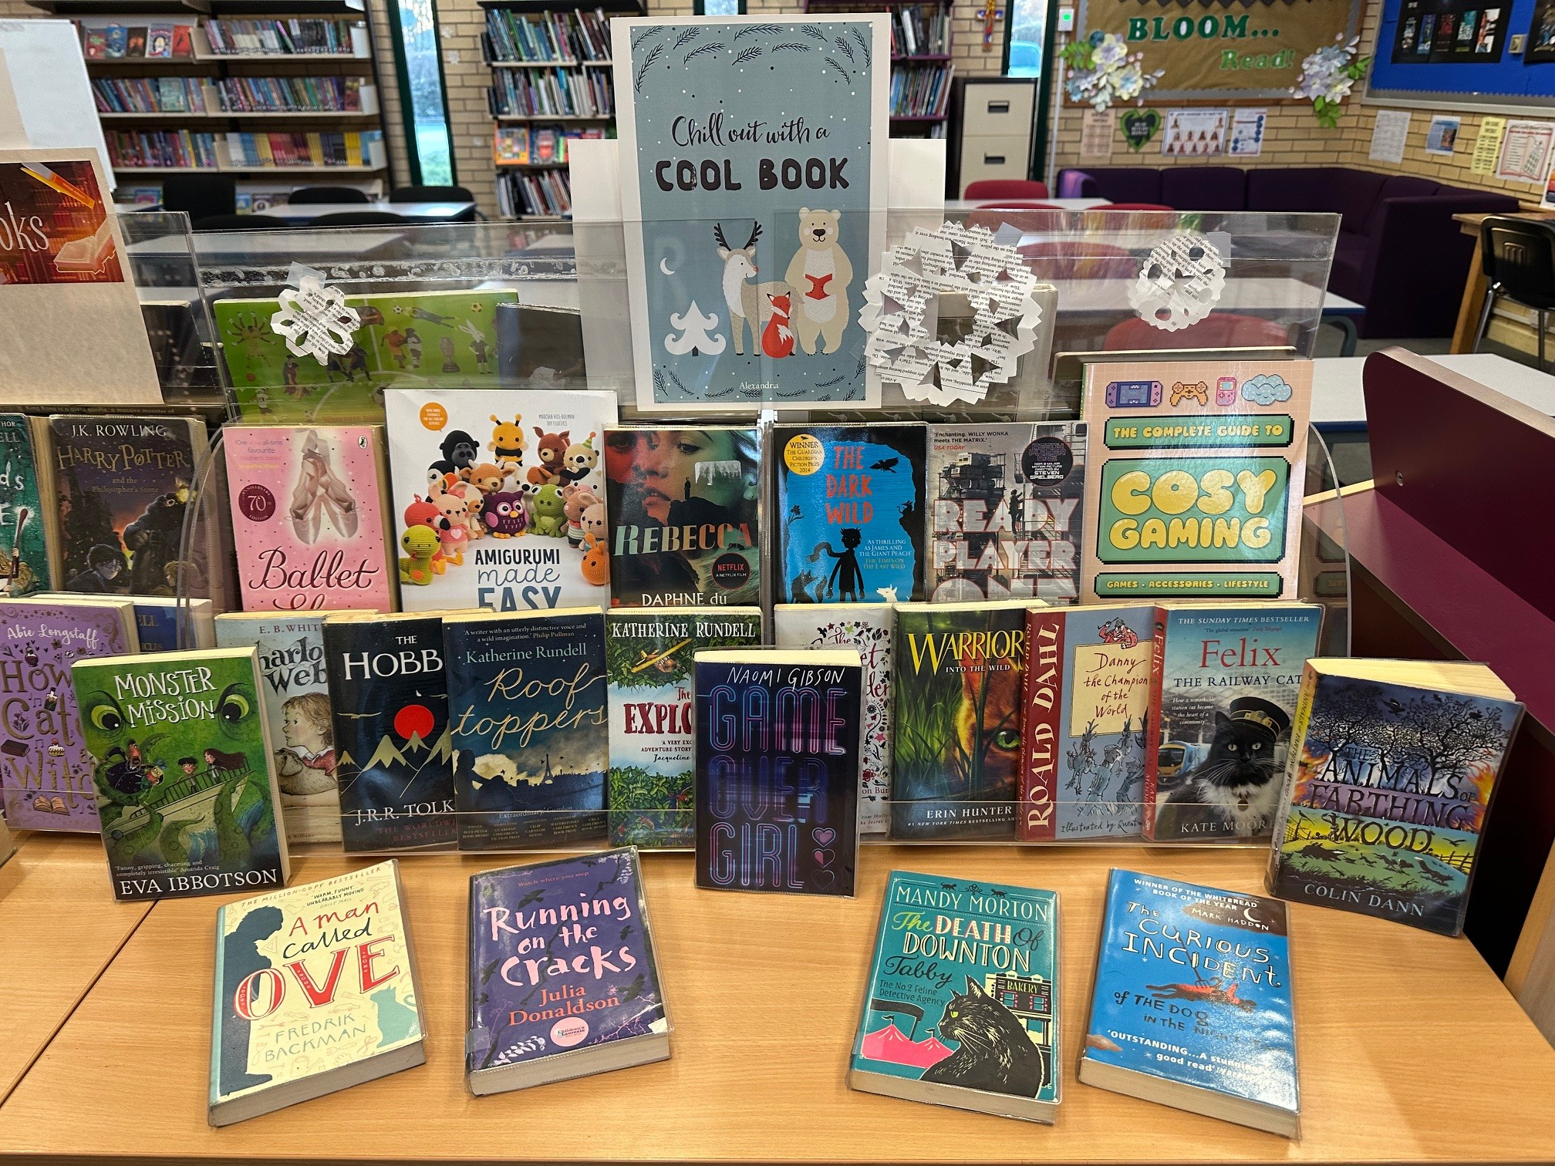
❄️January Book Picks in the Library ❄️
Brrr… it’s chilly out there! Luckily, our Student Librarians have handpicked the perfect collection of books to snuggle up with this January.
This month’s selection features exciting series starters like Warriors: Into the Wild and the timeless adventure The Hobbit. Love a comforting classic? You’ll also find cosy favourites such as The Animals of Farthing Wood and Ballet Shoes.
If you’re in the mood to try something new, why not curl up with Amigurumi Made Easy and get crafty, or level up your downtime with The Complete Guide to Cosy Gaming 🎮🧶
So, pop into the library, and cosy up with a truly good book!

