Slide 1
Worship context: Worship = Lent
This resources follows the Welcome, Word and Prayer format. With reflection in between.
Slides 3-8 give background information about and context to Lent. Take some time to explain the season’s meanings.
Slides 9-12 are a reflective activity
Slide 13 is the ending prayer

Slide 2
Worship at Bishop Rawstorne
Verse
“But the wisdom that comes from heaven is first of all pure; then peace loving, considerate, submissive, full of mercy and good fruit, impartial and sincere.”
James 3:17
Vision
“Bishop Rawstorne Church of England Academy aspires to cultivate wisdom rooted in Christian Values. It is our vision that all members of our community will experience life in all its fullness, flourishing through dignity, knowledge and understanding, bound together in unity, giving hope and worth to all.”

Slide 3
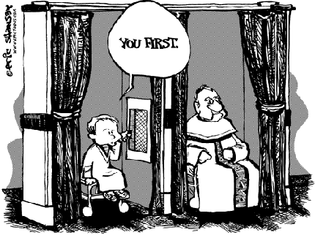
Shrove Tuesday
…what's with the pancakes, why the word "shrove“?
It all relates to the Christian festival of Lent.
"Shrove" is the past tense of "shrive" which the Oxford English Dictionary defines as "presenting oneself to a priest for confession, penance, and absolution".
It's basically the day in which Christians traditionally confess their sins in church ahead of Lent.

Slide 4
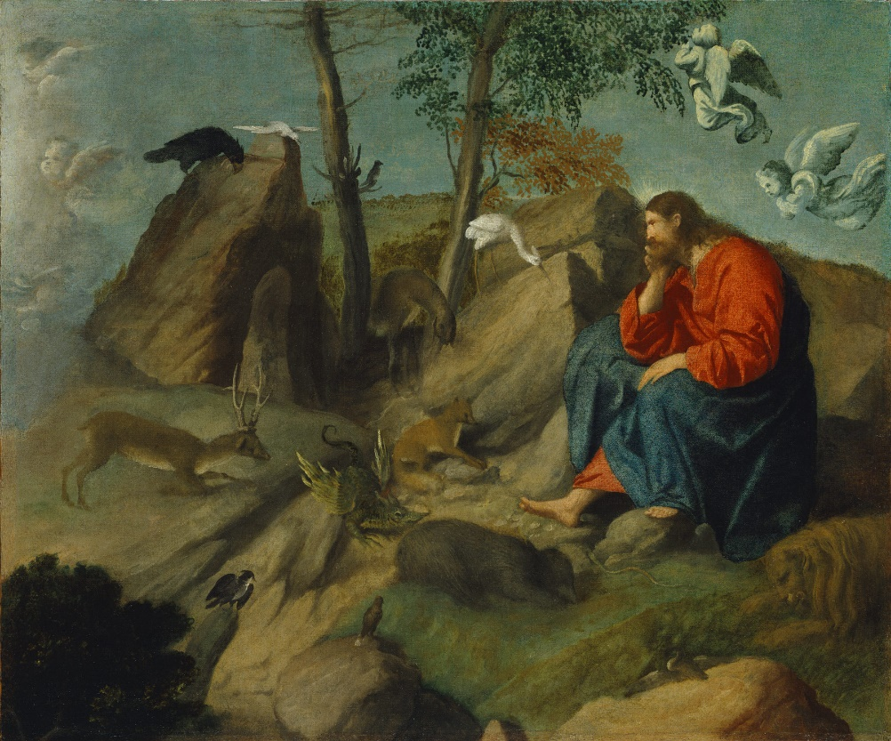
Shrove Tuesday
It's a Christian festival. It’s origins date back to people replicating the suffering of Jesus over the 40-day journey he made through the desert.
A lot of people use Lent as a way of testing their willpower - often giving up things like chocolate or other sweet treats before Easter.
There are 46 days between Ash Wednesday and Easter Sunday.
But many Christians believe there's no obligation to fast on Sundays, which means it is actually only 40 days once you remove them.

Slide 5
Shrove Tuesday
Why pancakes?
Whether you enjoy yours with lemon and sugar, American-style with bacon and maple syrup or French with a bit of chocolate spread and banana - the basis of the recipe is the same.
Eggs, flour and milk. Those three key ingredients were once very common things to give up for Lent, so it made sense to use them all up in one handy dish the day before Lent started.
These days it's probably the toppings that we're more likely to scrap from our diet.

Slide 6
Ash Wednesday
Ash Wednesday marks the first day of Lent and comes straight after Shrove Tuesday.
The ashes that give the day its name are created from burnt palm leaf crosses from the previous year's Palm Sunday.
The ashes are then smeared on the heads of Christians during mass.

Slide 7
Symbolism of the ashes
The marking of their forehead with a cross made of ashes reminds each churchgoer that:
Death comes to everyone
They should be sad for their sins
They must change themselves for the better
The shape of the mark and the words used are symbolic in other ways:
The cross is a reminder of the mark of the cross made at baptism
The phrase often used when the ashes are administered reminds Christians of the doctrine of original sin
The cross of ashes may symbolise the way Christ's sacrifice on the cross as atonement for sin replaces the Old Testament tradition of making burnt offerings to atone for sin

Slide 8
Lent
Lent is the period of 40 days which comes before Easter in the Christian calendar. Beginning on Ash Wednesday, Lent is a season of reflection and preparation before the celebrations of Easter. By observing the 40 days of Lent, Christians replicate Jesus Christ's sacrifice and withdrawal into the desert for 40 days. Lent is marked by fasting, both from food and festivities.
Why is it called Lent?
Lent is an old English word meaning 'lengthen'. Lent is observed in spring, when the days begin to get longer.

Slide 9
Time to Reflect
Reflection Music Click
Notes:
Music for reflection is by Hillsong United the song is Oceans https://www.youtube.com/watch?v=1m_sWJQm2fs

Slide 10
Reflection 1: Prayer
Prayer – do you have something in your life that you would like to pray about?
Personal, local or global issue?
Take time to write a prayer and place it in your tutor prayer box.

Slide 11
Reflection 2: Fasting
2. Fasting – Christians practice ‘giving something up’ for Lent.
Some will go without food at times or will follow a similar pattern to Muslims of abstaining from food during daylight hours.
Is there anything in your life that you need to get rid of?
Often Christians will give up things that are unhealthy or taking wasting time in their lives – unhealthy things like junk food or many will fast from social media.
Is there anything that you think you would be better off without?

Slide 12
Reflection 3: Giving
3. Giving – Christian will seek to be charitable during lent. Focusing on saving money from things they may be fasting in order to give time or money to others.
Individually or as tutor group is there a charity or a need that you see that you could give time or money to during Lent?

Slide 13
Prayer
May we be able to find others who we can communicate and confess with. Lord, help us to listen to the confessions of others so that we may carry their difficulties and support them.
May we focus on our own identity, who it is we should or need to be.
God, help us to find perspective so that we can see and deal with the situations we are in.
Amen.

