Slide 1
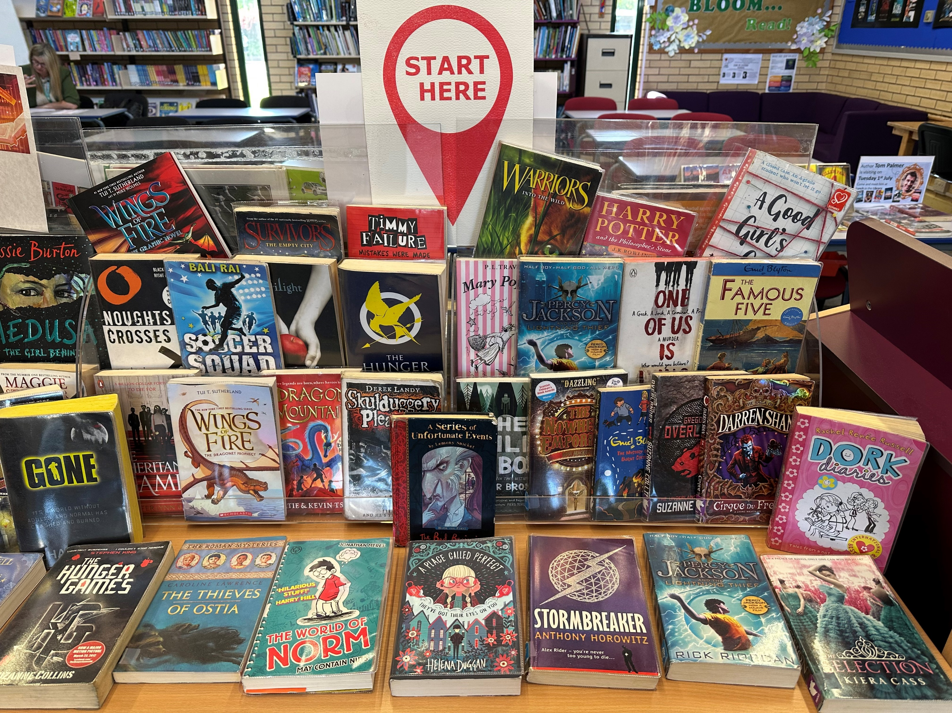
May & June Book Highlights In The Library
There are so many captivating book series to read, but it can be confusing knowing which book to read first!
So, this month we’ve got a huge selection of Book Ones to borrow.
If you fancy getting lost in another world, pop along to the Library and grab a book one – after all, it’s the best place to start!
(Please note: while we’re in the midst of exam season the library will be open intermittently. Please watch the Library door to see when it’s open.)

