Slide 1
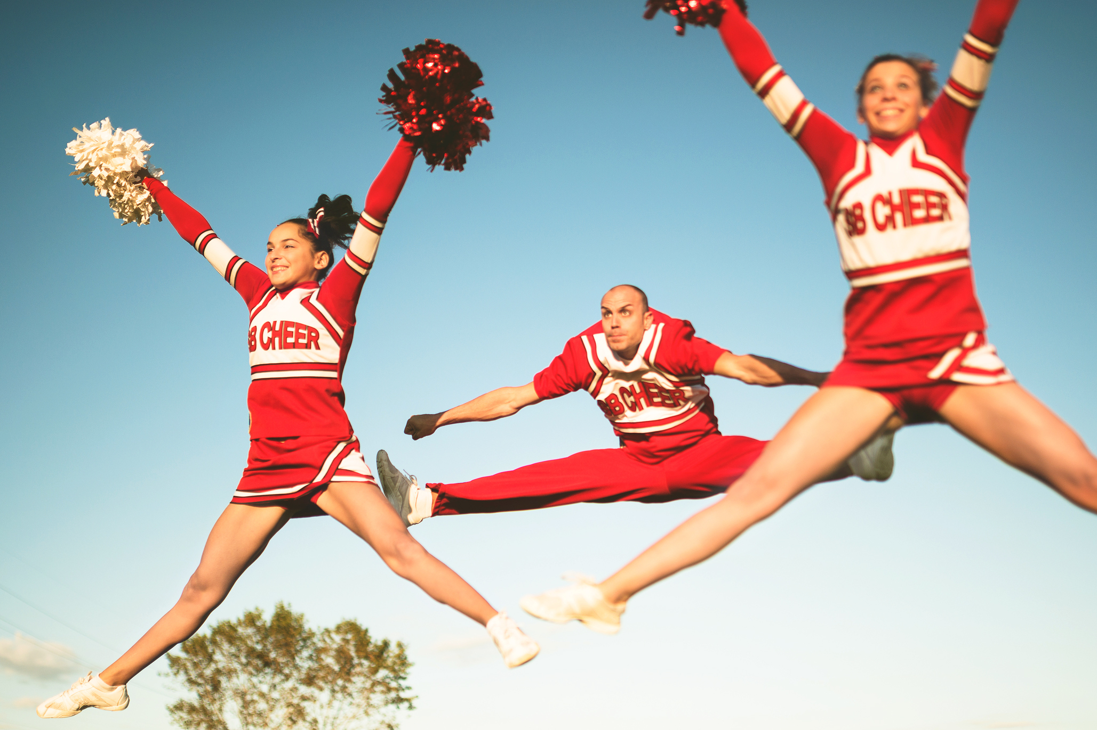
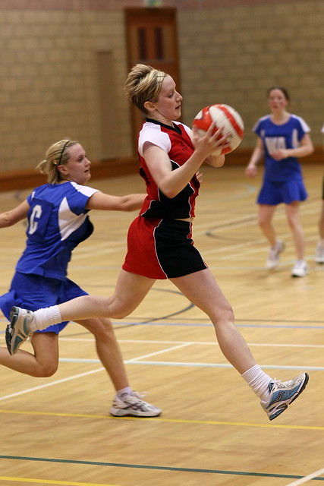
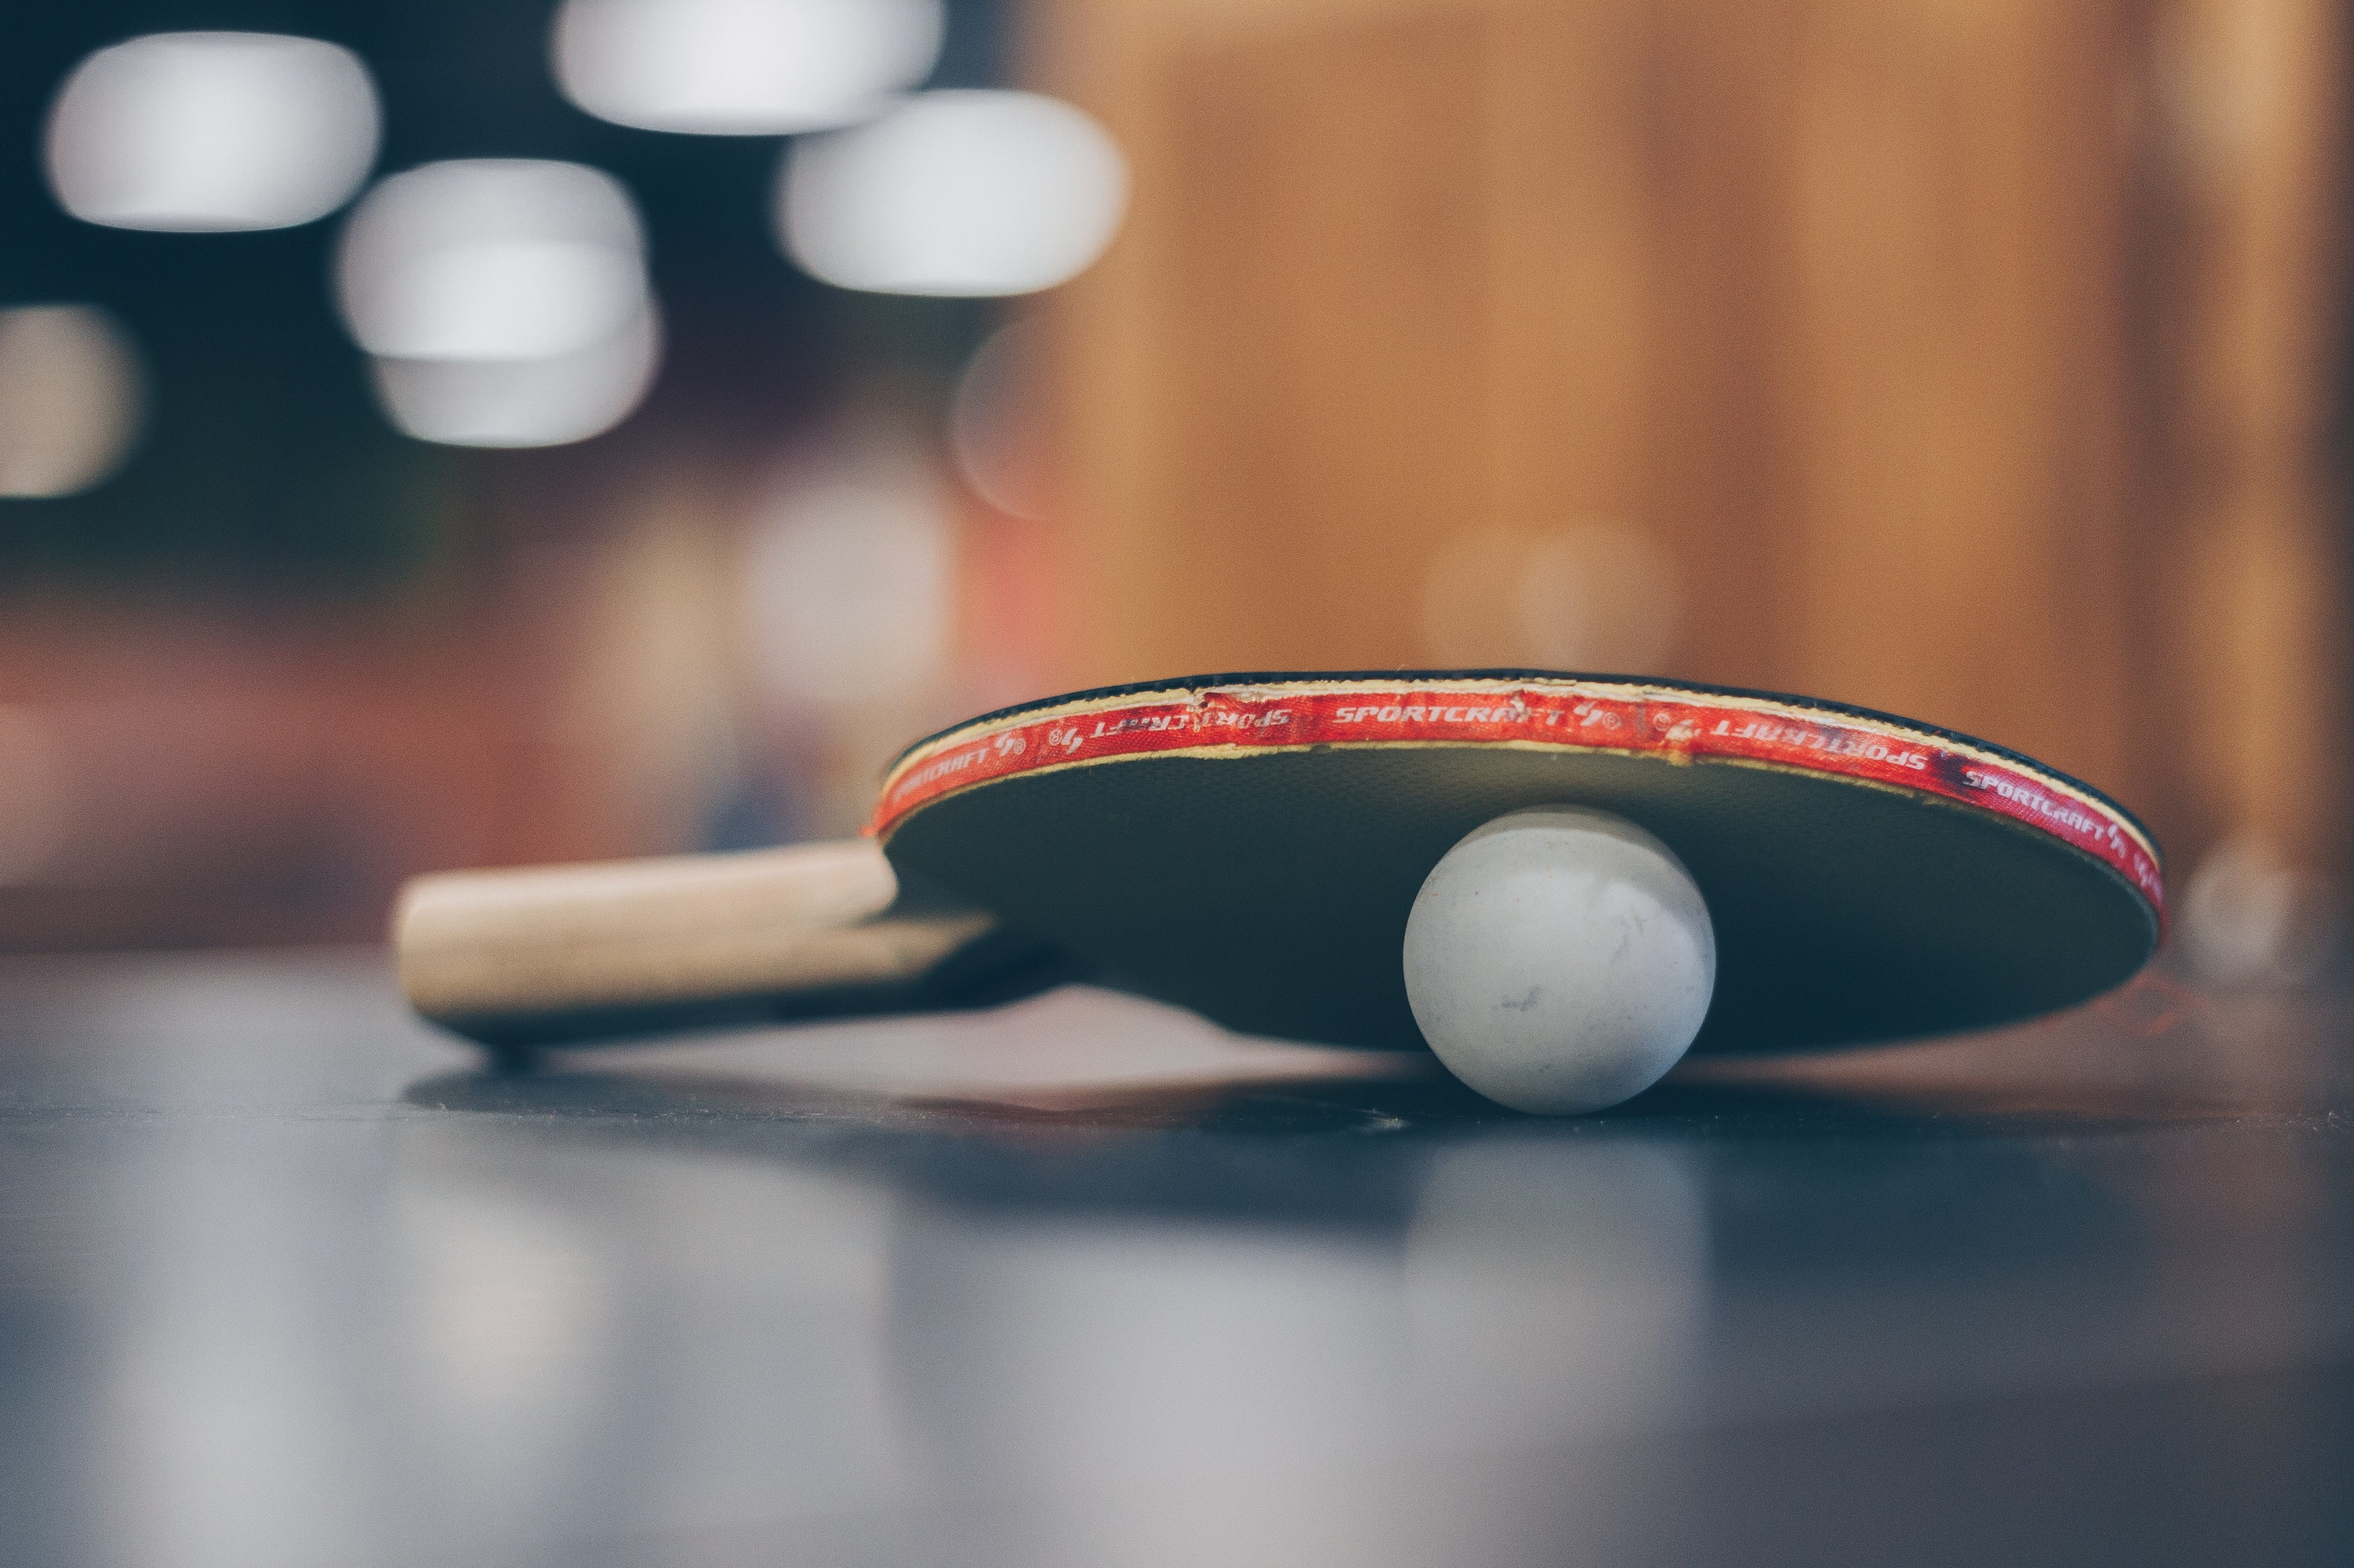
PE Extracurricular Autumn 1
You do not need to sign up.
Please register and then get changed in the SH changing rooms. All clubs are from 3:15-4:15pm
Day | Activity | Location | Year Group | Staff Member
Tuesday | GCSE Catch Up | T8/T9 | 11 | RBR/MWI
 | Football | 3G | 11 | DSM
 | Football | 3G | 10 | TSI
 | Netball | Courts | 7 | KHU
 | Girls Football | Field | 10 & 11 | SED
Wednesday | Girls Football | 3G | 7 | SED
 | Football | 3G | 8 | TCL
 | Football | 3G | 7 | PAS
 | Cheerleading | Sports Hall | 7 & 8 | AHO
Thursday | Netball | Courts | 10 & 11 | RBR
 | GCSE Handball | Sports Hall | 10 | KHU
 | GCSE Table Tennis | Gym | 10 | DSM
 | Football | 3G | 9 | MWI
 | Girls Football | 3G | 8 & 9 | SED
Friday | Netball | Sports Hall | 8 & 9 | RBR

Slide 2
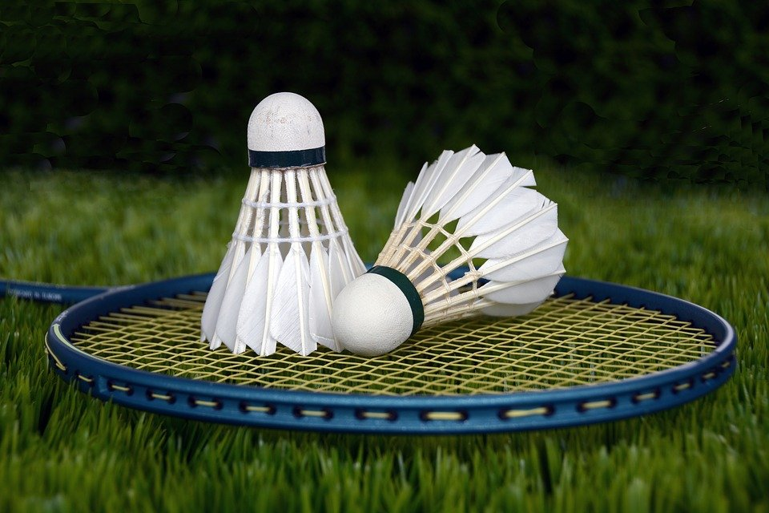
You do not need to sign up or get changed.
Please just put your trainers on.
PE Lunchtimes Autumn 1
Day | Activity | Year Group | Staff Member
Monday | Badminton/Basketball | 10 | DSM
Tuesday | Badminton/Basketball | 7 | RBR
Wednesday | Badminton/Basketball | 9 | SED
Thursday | Badminton/Basketball | 11 | MWI
Friday | Badminton/Basketball | 8 | KHU

