Slide 1
PSHE at Bishop Rawstorne CofE Academy
Aims of this session –
To open a dialogue between parents and carers, governors, and staff about the PSHE curriculum at Bishop Rawstorne.
To consult parents and carers about the effectiveness of PSHE at Bishop Rawstorne.
To address specific issues in regards to sequencing the new statutory content.

Slide 2
Statutory Changes to PSHE
In 2019, the Department for Education released new Statutory Guidance on Relationships Education, Relationships and Sex Education, and Health Education.
The new guidance specified a range of objectives that must be met by the end of both primary and secondary school.
One of the biggest areas of change was the focus on ‘relationships’.

Slide 3
The PSHE ‘revamp’
In part due to the new guidance, but also a series of other factors, we decided to ‘revamp’ our PSHE curriculum. It needed to meet the statutory requirements, but most importantly, work for and serve our students. As part of this process, we consulted:
Government Guidance, statutory and non-statutory (advised)
Blackburn Diocese
Students and Staff
PSHE Association
Local Agencies
Other schools
Parents and Carers

Slide 4
What is our PSHE, RSE and Citizenship Curriculum Intent?
PSHE, RSE and Citizenship aim to encourage all students to grow, develop and flourish into confident and positive citizens of the future, as individuals and as members of families and communities. It encourages and equips students with the knowledge and skills to make decisions that contribute to healthy and balanced lifestyles, positive relationships, economic well-being, the achievement of aspirations and their involvement and impact within wider community.

Slide 5
How does our Christian Distinctiveness impact RSE?
We have to deliver the national curriculum regardless of faith identity and we also have to tailor this to the needs of our students and community.
However, our Christian identity can impact the way we deliver PSHE.
Jesus said “‘You shall love the LORD your God with all your heart, with all your soul, and with all your mind.’ This is the first and great commandment. And the second is like it: ‘You shall love your neighbour as yourself.’ On these two commandments hang all the Law and the Prophets.” Matthew 22: 37-40.
The Diocese advises that this passage should be the basis of all RSE education within a church school/academy.

Slide 6
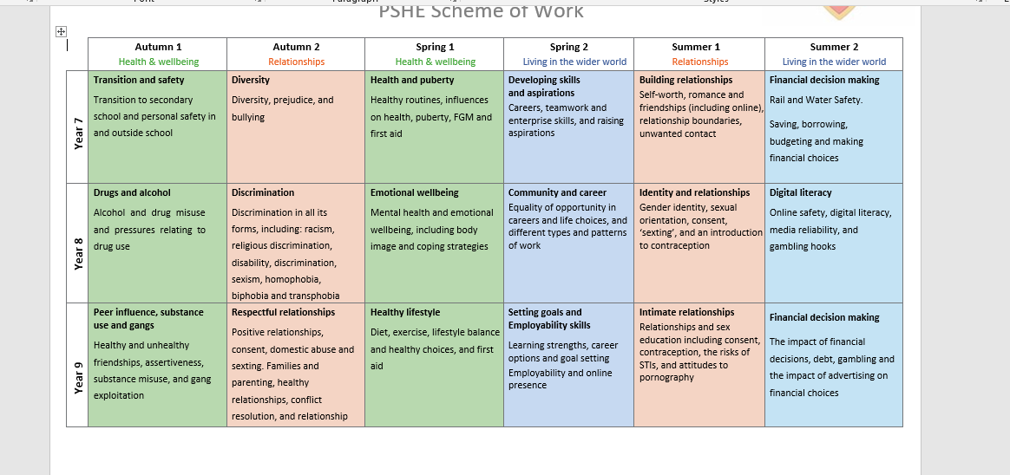
How do we plan and resource our schemes of work?
Government Guidance, statutory and non-statutory (advised)
Blackburn Diocese
PSHE Association
School staff and local agencies
Other schools
EC Resources
External agencies and ‘experts’

Slide 7
How is PSHE timetabled?
PSHE embedded into wider curriculum
Drop down/collapsed time table days
5 hours per academic year
PSHE embedded into wider curriculum
5 Sessions per half term (more for Y11)
30 hours per academic year (more for Y11)

Slide 8
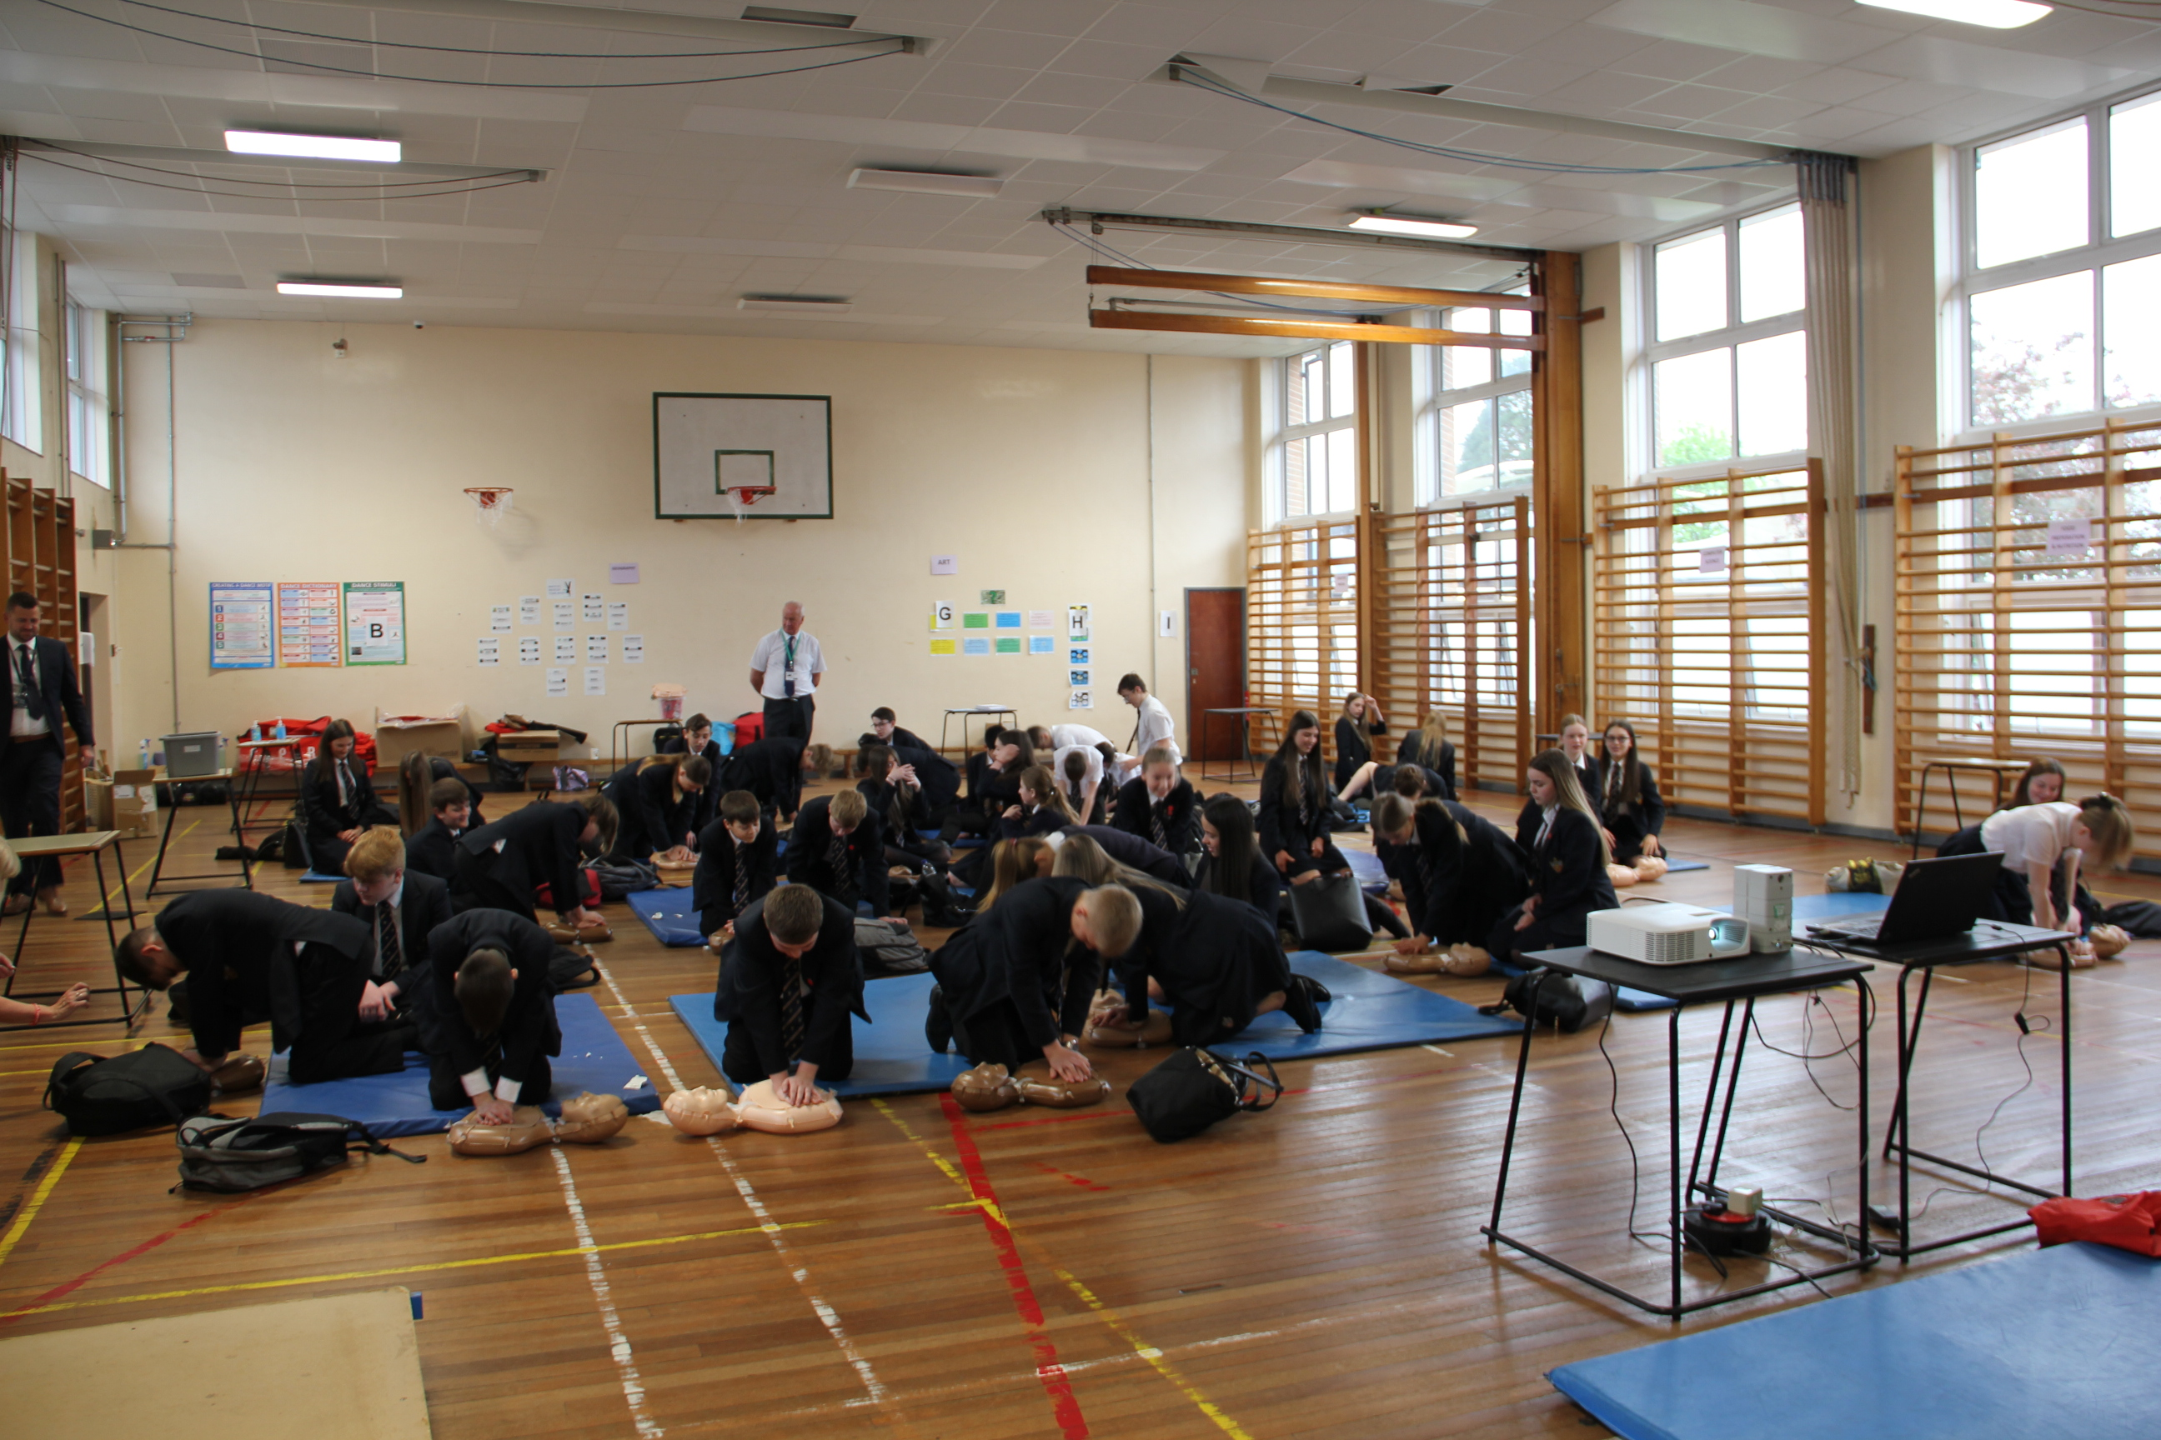
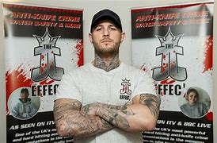
What external agencies are used?
Lancashire Police – Early Intervention Team (Sexting and County Lines)
Lancashire Fire Service (Fire Safety, Road Safety, Anti-Social Behaviour)
Lancashire County Council – Road Safety Team (Road Safety)
Lancashire County Council - Prevent Partnership (Internet Safety, Respect and Tolerance, Extremism)
Lancashire Sexual Health Service (4 C’s Presentation)
JJ Effect (Knife Crime)
Key Charity (Relationships, Domestic Abuse)
Epic Risk Gambling (Risks of Gambling and Addiction)
Amy Winehouse Foundation (Drugs and Alcohol Education)
School Counsellor - Asa Burton (Mental Health)
Just Like Us (Relationships, Respect, Diversity, LGBTQ+)
Stand Against Violence (Anti-Bullying/Anti-Violence)
British Red Cross (First Aid)
British Heart Foundation (CPR)

Slide 9
Questions to Consider
How do you (or your children) find the way in which PSHE is scheduled? Does it work well? Is it manageable?
How do you (or your children) feel about the order that the content is delivered in? Are there any topics you would do earlier on in school, or later on? Are there any topics you feel should be regularly revisited which aren’t already?
How do your children find the delivery of the content? Is it engaging? Is it interesting? Do they discuss topics/lessons at home?
Do you receive the PSHE and Mental Health newsletters? Are they helpful? Is there anything else you would like to see on them?
When should we cover FGM?

Slide 10
Final Comments

