Slide 1
Parental Engagement
Tracking & Reporting
SIMS App and General Communication
Parents Evening and School Cloud

Slide 2
Tracking & Reporting
Frequency of tracking reporting.
What we report and why;
Year 7 and 8
Years 9 to 11
Issues for explanation;
Attitude to Learning measures explained
Academic prediction system explained
Targets for students - the principles
Why no academic picture is shared until the last Yr. 8 Tracking

Slide 3
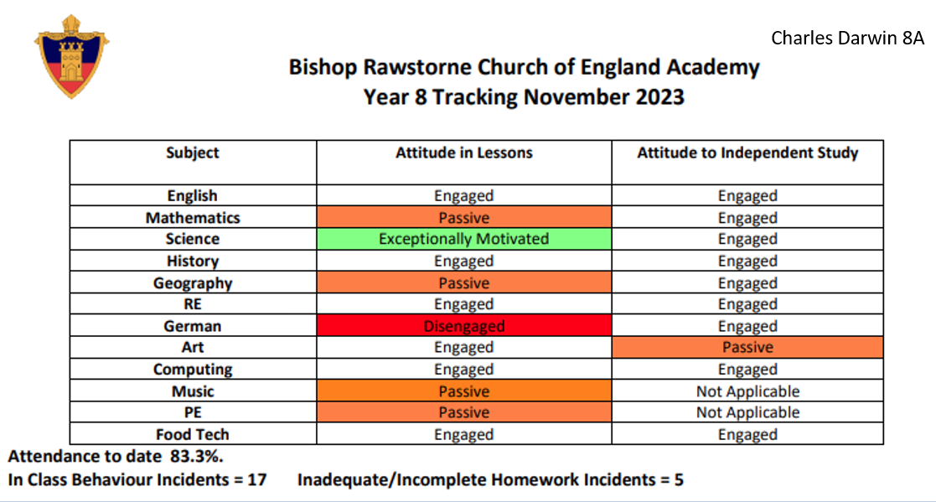
Year 7 and 8

Slide 4
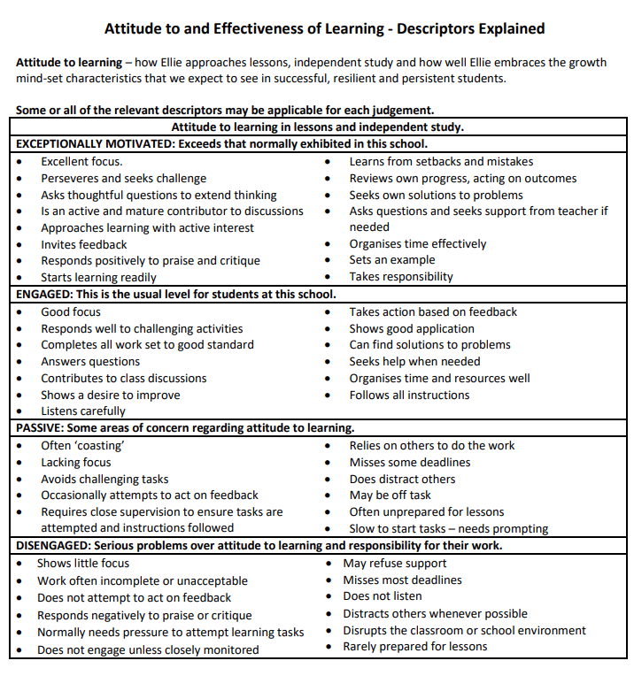

Slide 5
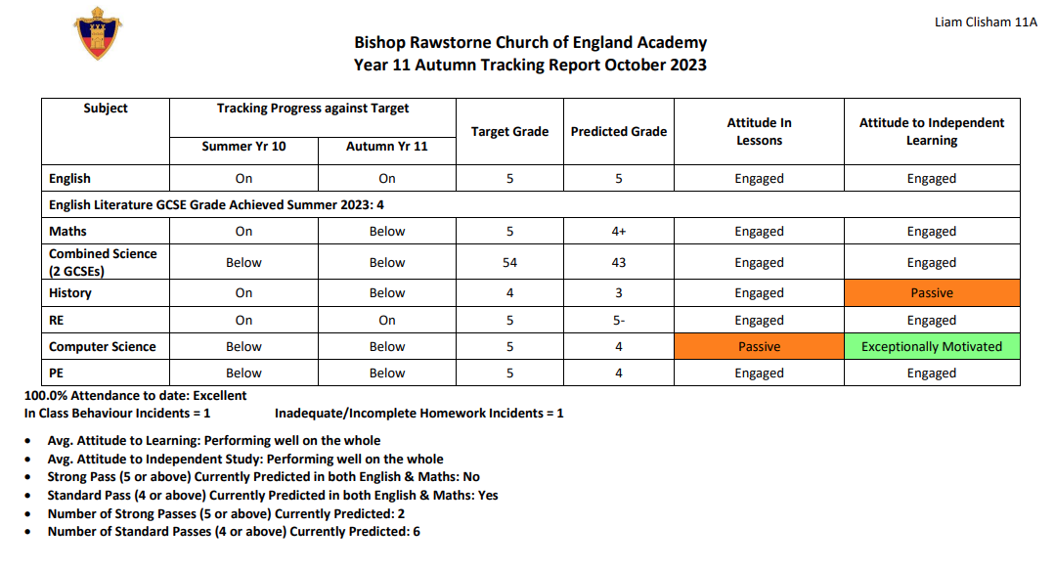
Flo Nightingale 11X

Slide 6
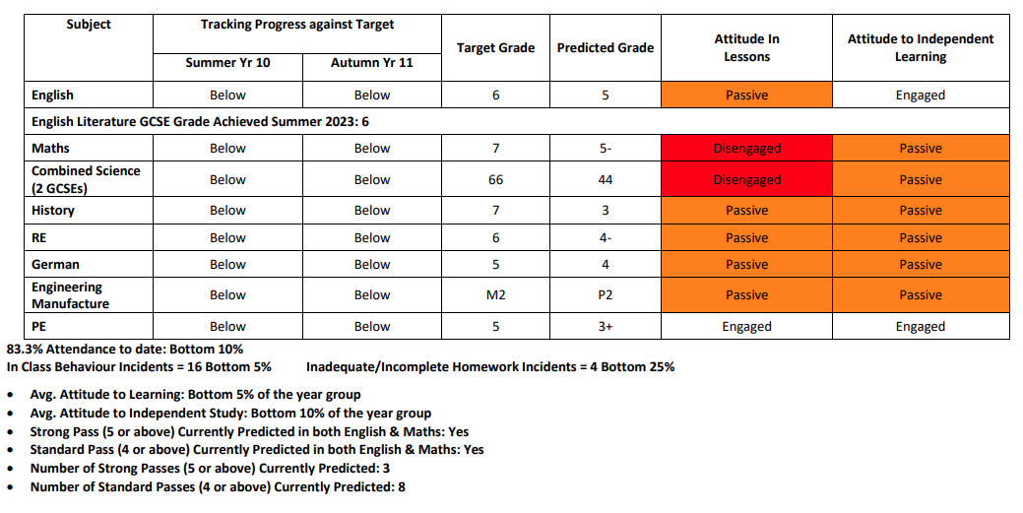

Slide 7
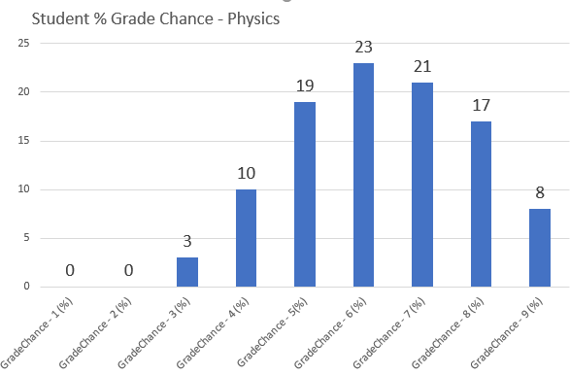
Target Setting (FFT)

Slide 8
Questions you might wish to consider:
Does the tracking report make sense, is it clearly explained, and does it inform you of how your child is progressing?
Does it provide you with everything you feel you need to know?
Does the format work for you; would you add or remove anything?
Does the academic information tell you what you need to know?
How do you feel about the fact we only introduce academic performance information late in Year 8?
Does the Behaviour, Independent Study (Homework) and Attendance information tell you what you need to know; how do you feel about the 'ranking' information we provide in Year 9 onwards.
How important is the academic target information to you?

Slide 9
2. SIMS App and General Communication
What we will discuss:
App gives students and parents access to timetable, calendar, homework (what is set when, by whom, and due date).
In addition, parents (only) get achievement and behaviour notifications as they arise, and termly tracking reports.
We use emails for general notifications to parents, either as specific communication about one student, through group communications based around small specific groups (classes, tutors, teams and clubs, year groups) through to whole school communications.

Slide 10
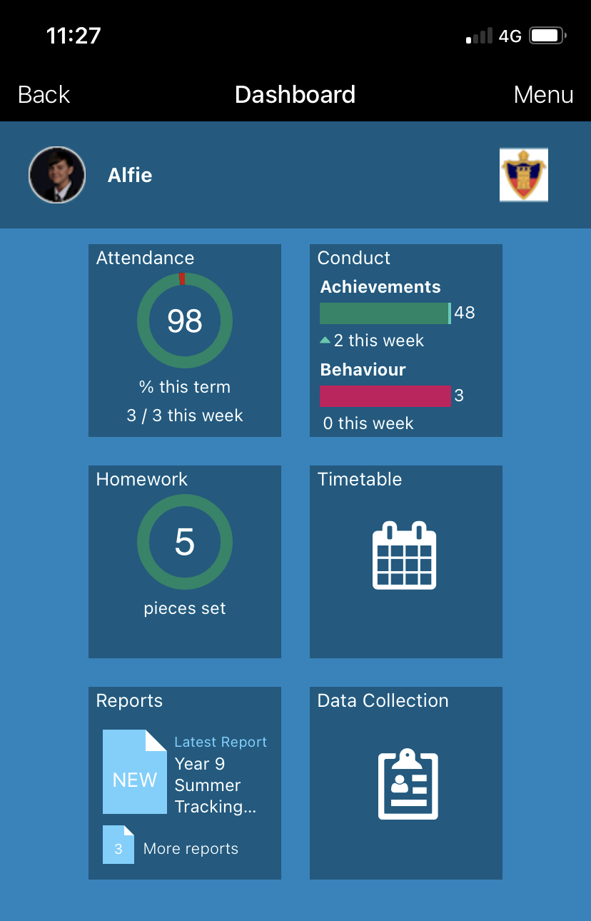

Slide 11
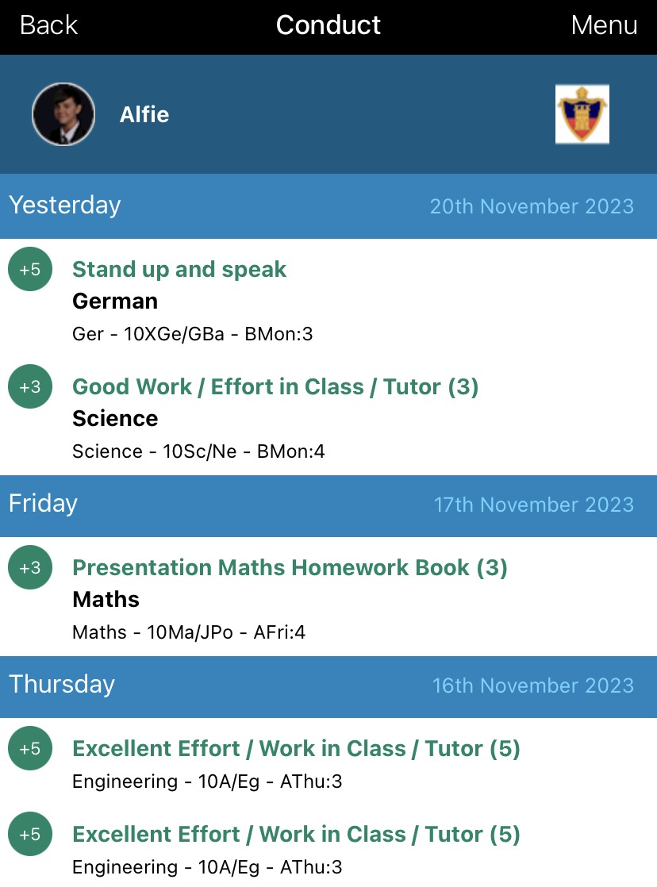

Slide 12
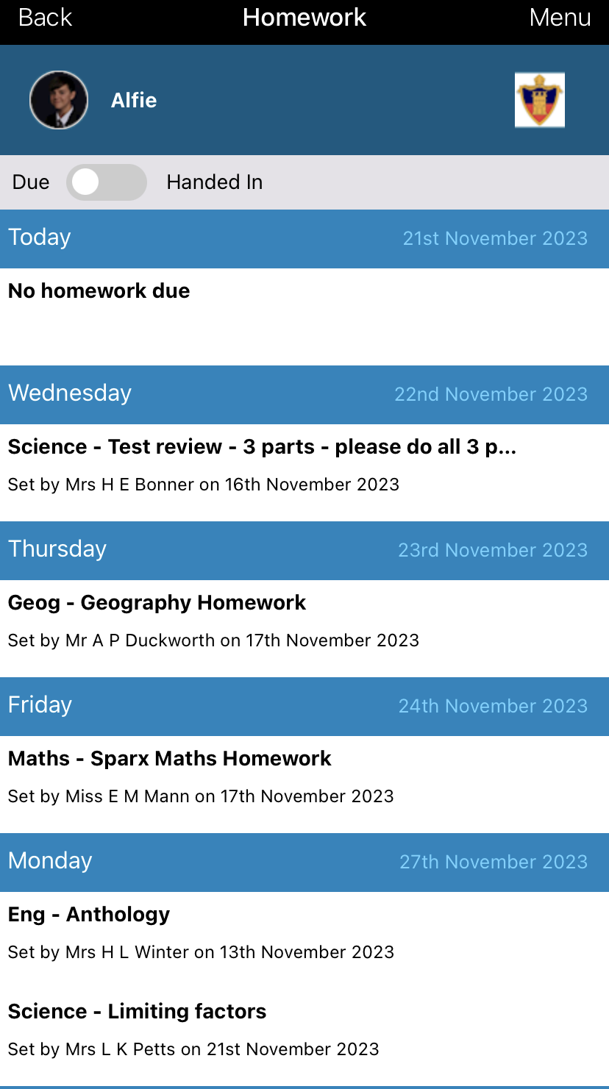

Slide 13
Questions you might wish to consider:
How do you find the SIMS Parent App, and the information it provides? Also, how do you think the students find the Student App?
How are we doing with regards email notifications? Informative, too infrequent or excessive?
Is there anything we do well? Is there anything you think we should consider for improvement?
Is the technology a problem for students and parents?

Slide 14
3. Parents Evening and School Cloud
What we will discuss:
Parents evening format, using video appointments on the School Cloud system.
What is it? How it works? Why the change, and what are the perceived improvements and draw backs?

Slide 16
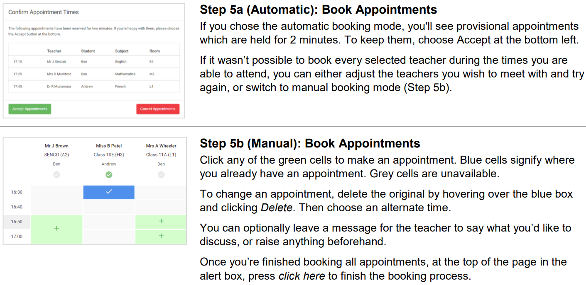

Slide 17
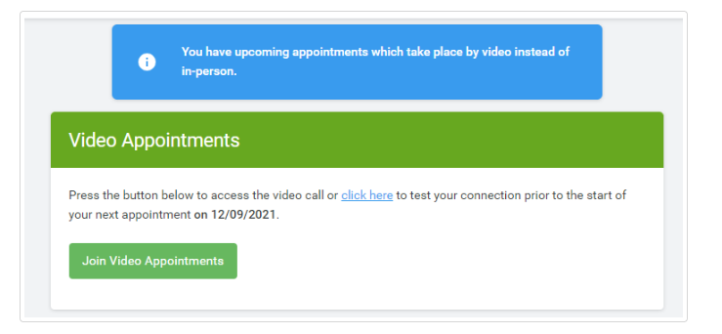
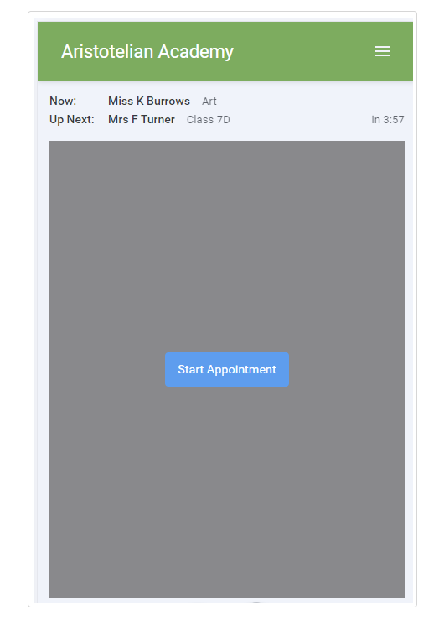
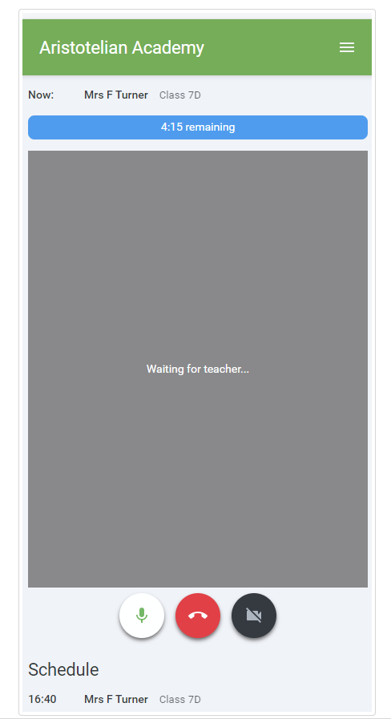

Slide 18
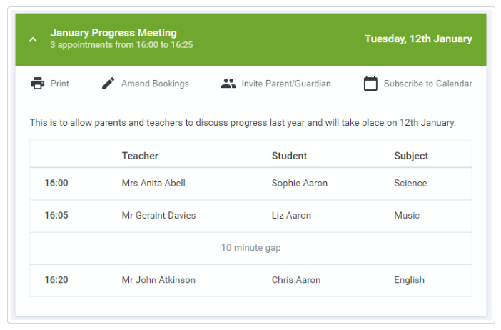
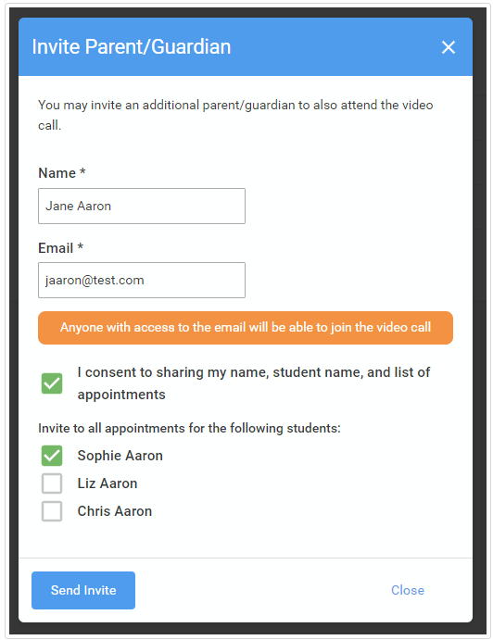
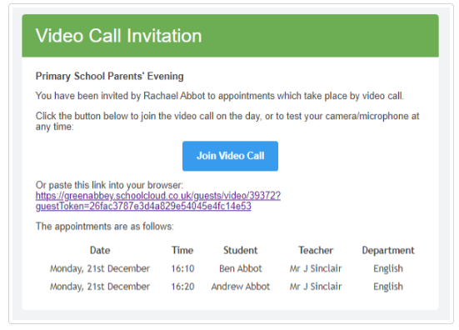

Slide 19
Questions you might wish to consider:
How do parents feel about the overall format?
How easy is it to use from your perspective, initial communication, appointment booking and the appointments themselves?
Is the technology a problem for parents?

