Slide 1
Revision Skills – A refresher guide
Session 1 – Where to begin – consolidating work

Slide 2
WHY IS THIS USEFUL TO ME – IN Y11
Your GCSES are being made from the syllabus or course outline so you want to make sure you are studying notes that also come from it – that way, your notes are 100% complete, and you can be confident that you are going to memorise everything that could potentially come up in a test.
It’s a no brainer – yu cant plan for the summer without complete notes

Slide 3
How can I check this then?
In the course outline or syllabus, there are things called ‘learning outcomes’ that show you what is being taught and what you need to know for your tests.
You want to read these and write them down in the planner under ‘syllabus point’.
If you are not organised enough to look at the syllabus information then you can just look at the page in the revision guide that has all your subjects in it broken down into topics – it’s a starting point.

Slide 4
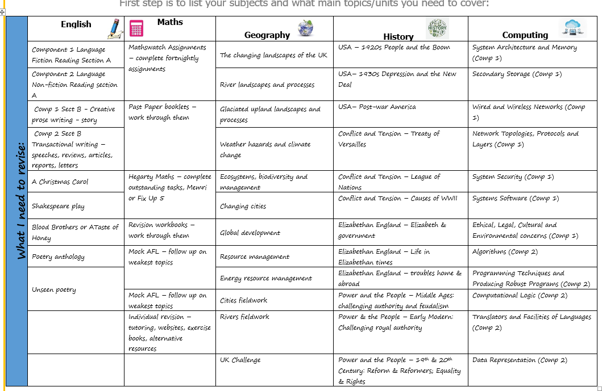

Slide 5
THEN WHAT?
The next step is to add in a deadline for when you are going to write notes for the outcomes you’ve just added into the planner.
This is very much an applicable skill if you’ve had time off school this year or last year or in Year 9. It’s a starting point to make certain that you have everything you need and FEBRUARY is about as late as it should get to be doing this.
Once you know you have all the notes you can then start makingflashcards etc…..

Slide 6
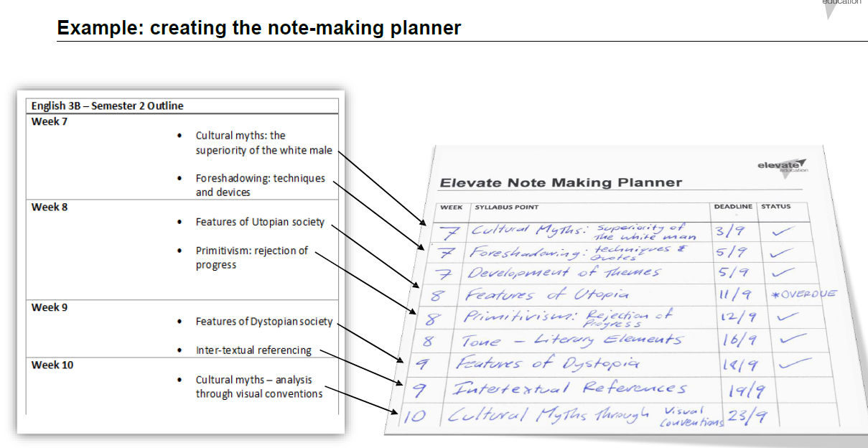

Slide 7
