Slide 1
Revision Skills – A refresher guide
Session 2– Designing and storing notes and flashcards

Slide 2
Designing note pages OR Flash cards
Frequently the most effective way to take notes is to employ the use of triggerwords, or words that bring back a lot of memories. When you write using trigger words, not only do you end up writing a lot less, but you also remember more from the notes as trigger words bring back a lot of memories. Think of the words you write on your hand – you probably only write 1-2 words to remember a lot of information. Here are some tips for writing your notes in a way that not only saves time, but makes them easier to remember when it comes to studying for a test

Slide 3
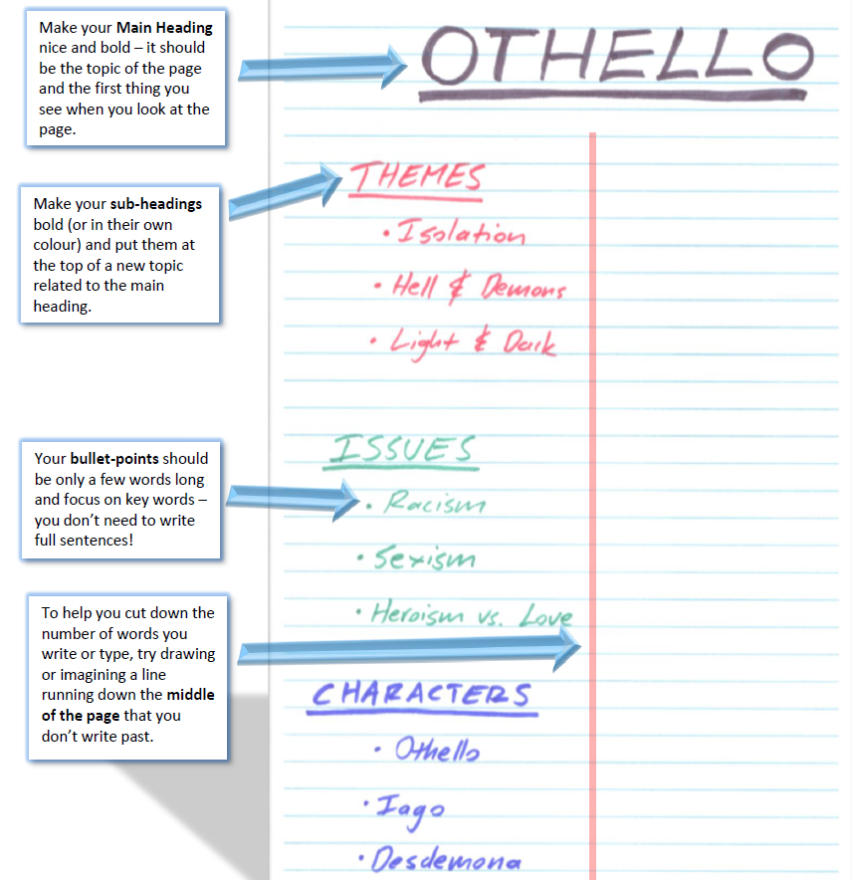

Slide 4
SOME people also prefer mind maps
Step 1 – Main idea in the middle
The main topic of your mind map goes in a circle in the middle of the page. For example, in biology this might be something like “cell division” if that’s the major topic you’re studying at the moment. When you are studying, this should be the very first thing you see when you pick up the page.
Step 2 – Sub-headings branch off the middle
Next, take the sub-headings from your page of notes and have them coming as branches off the centre circle.
Step 3 – Bullet points branch off branches
Once you’ve done that, take the bullet points from your sub-headings and have them branch off the sub-headings in your notes.
Step 4 – Link different branches together
Once you’ve put a few pages of notes into the mind map, have a look for ways you can link them together. For example, you can link different sub-headings together which share a common theme.

Slide 5
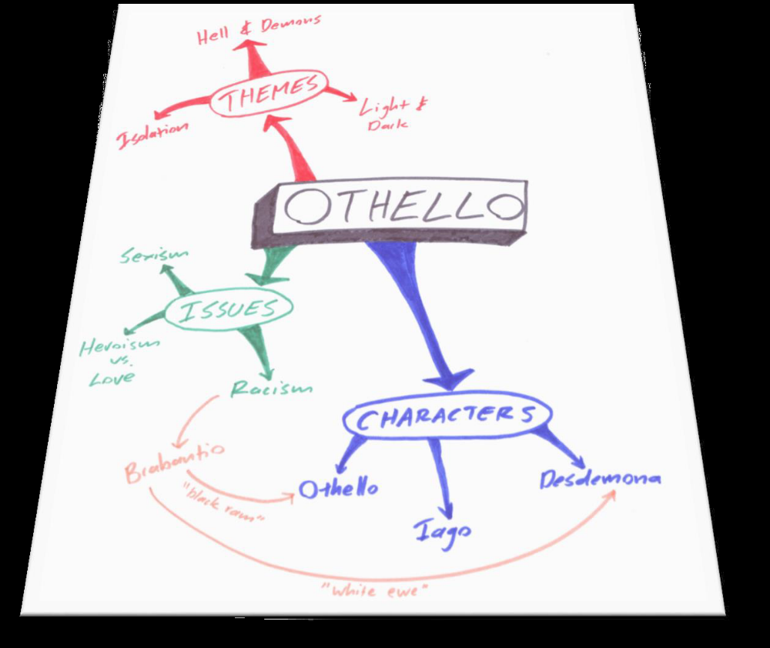
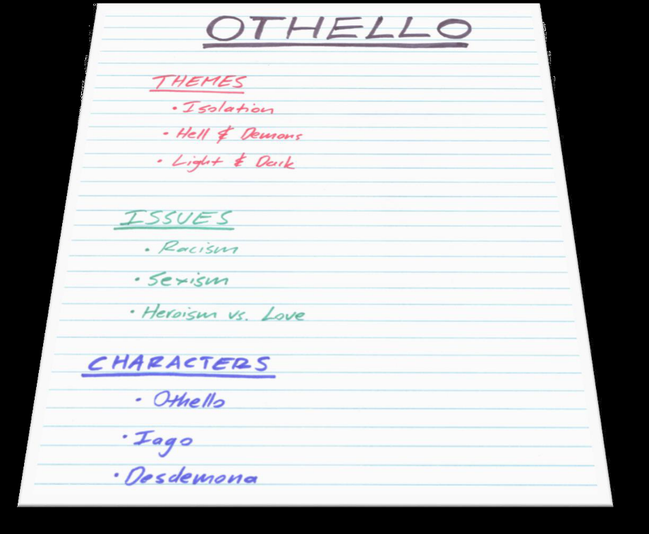

Slide 6
Finally – Organise your things – AND DO EXTRA READING
Get folders or books for each subject – If you have not already get a ring binder and set of flash cards OR pad of paper for each exam you will take – this is a straight forward and common sense way to make certain that all the work you are doing can be easily set out.
Make an extra-reading file
When you think about it, every single student in your class, and every student doing your subjects across the countrty are basically learning the same content. When it comes to year 11 everyone is learning exactly the same content.
This means in an exam or test, 99% of students are just regurgitating the same facts, quotes, ideas and examples. But if you can do just 20 minutes of extra reading each week to bring something new to your test, instantly your answer goes to the top of the pile – it’s something new and different.

Slide 7
