Slide 1
Revision Skills – A refresher guide
Session 3– Am I alone in this – or can I work as a team
And
How can I avoid procrastination

Slide 2
STUDY GROUPS
A common mistake students make is viewing Y11 as a solo journey. However, in surveys with students on their time management skills, a large majority will typically never find themselves working collaboratively. However, our research shows that top-performing students work in teams and share tasks around to free up time. This enables them to lead more relaxed lives during busy periods, and frees up time to focus on other types of work which have a higher yield in test performance. The easiest and most effective way to achieve this is by delegating time-heavy tasks like note-making to friends in a study group. However, for these groups to work students need to ensure they form them with the right people, and have a clear plan as to how they will share the work around.

Slide 3
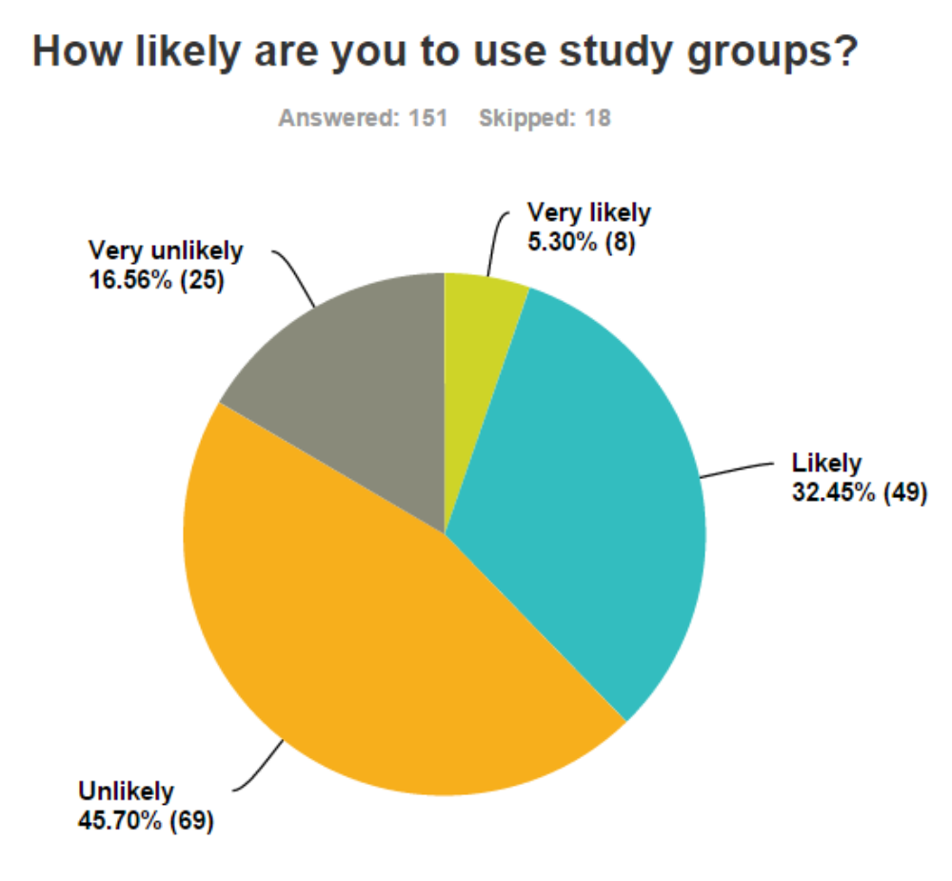

Slide 4
USING A STUDY GROUP FOR REVISION
Form study groups of four.
Research shows that the ideal number of students for a study group is four. Some students will form effective groups of their own volition, while others will form groups which are more aimed at socializing than effective study.
MAKE SURE YOU PUT TOGETHER AN EFFECTIVE GROUP – NOT A DOSS GROUP
Division of labour
Students will be required to divide a sub-topic up into four segments, which each student will write 1-2 pages of notes on
Students should type their notes if possible to ensure other group members can easily read them
Students should allocate each other topics which have a relatively equal work load
Study Groups Meet
One week after the groups were formed and the work delegated, have the groups re-convene and present their notes to one another. Move from group to group and check that students have both brought enough copies of their notes for the other group members, and that they have come prepared to explain their notes. Have each group member spend 5 minutes explaining their notes to the study group, and answering questions from other group members. Ensure that each student shares their notes with the other group members.

Slide 5
PROCRASTINATION
The main tasks students tend to procrastinate are big, heavy-weighted assignments and assessments that require significant investments of time. Students often try to break these tasks down, but end up with, say, four 2-hour tasks. For a student who is tired after a day at school, it is still very easy to find easier tasks to complete first.
Many students simply assume “revision” is a single step. But breaking this down further, there are many smaller tasks incorporated into it. For example, a smaller task within “revision” might be “go to Seneca and complete 2 assessment tasks”.
Another step might be “read 7 pages from each source”. These are highly specific tasks, but ultimately very short and easy to complete.
Your revision planner should be more specifically tailored to avoid becoming overwhelmed by the amount of work that has to be done.

Slide 6
Time: | Monday | Tuesday | Wednesday | Thursday | Friday | Saturday | Sunday
9am-10am | School | School | School | School | School
10am-11am | School | School | School | School | School | Spanish Module 5 – Ciudades – local area
11am-12pm | School | School | School | School | School |  | Revision for English flashcards Living Space
12pm - 1pm | School | School | School | School | School | My Maths | Geog revision Weather hazards and climate change
1pm-2pm | School | School | School | School | School | Physics Energy
2pm-3pm | School | School | School | School
3pm-4pm |  | English after school | Maths Revision after school | Science after school |  | Revision English flashcards London
4pm-5pm | RE revision – 30 mins Geog revision - 30 mins Weather hazards and climate change |  |  |  | Night off! |  | RE revision 30 mins
5pm-6pm |  | My Maths | PE - Health, fitness & well-being | Any homework |  | Any homework | Maths booklet
6pm-7pm |  | Any homework | Computing -Secondary Storage (Comp 1) | Poetry – poetry question 20 mins Prelude |  |  | Any homework
7pm-8pm | Biology B1 Cells
8pm-9pm

