Slide 1
Revision Skills – A refresher guide
Session 4 – Memory skills

Slide 2
Memory and Mnemonics
Realistically, you are not going to use mnemonics to memorise all of your notes – it would be very time consuming. Mnemonics are a great system to use to memorise the information and areas of your notes that you struggle to remember. This will provide you with a safety net so that you are less likely to forget anything in the exam room.
The Rhyming Peg System: You can use number rhymes to memorize a list of items using the "peg system" (also known as the "hook system"). In this system, for each number, you memorize an image of a word that rhymes with it. That image provides a "hook" or "peg" for things you want to remember,

Slide 3
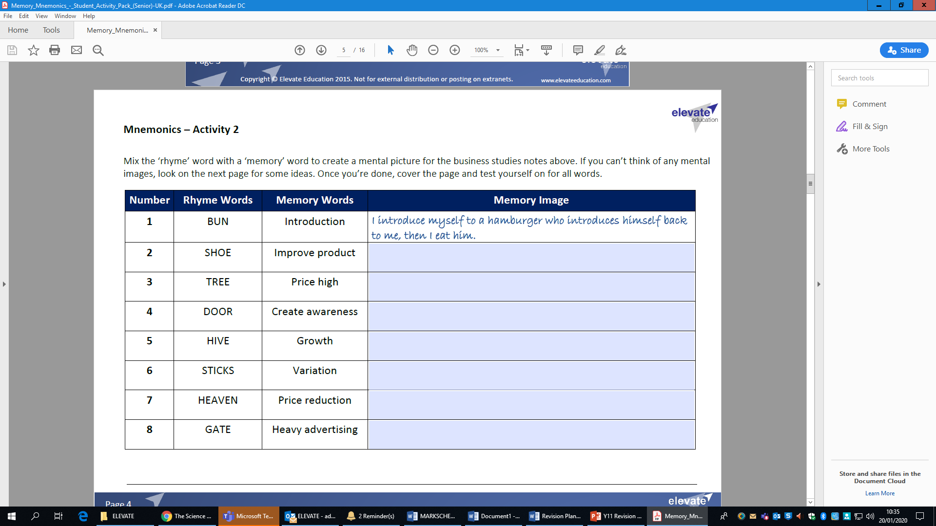
One of the key concepts here is that there are rhyme words. Weve got 1 – 8 below

Slide 4
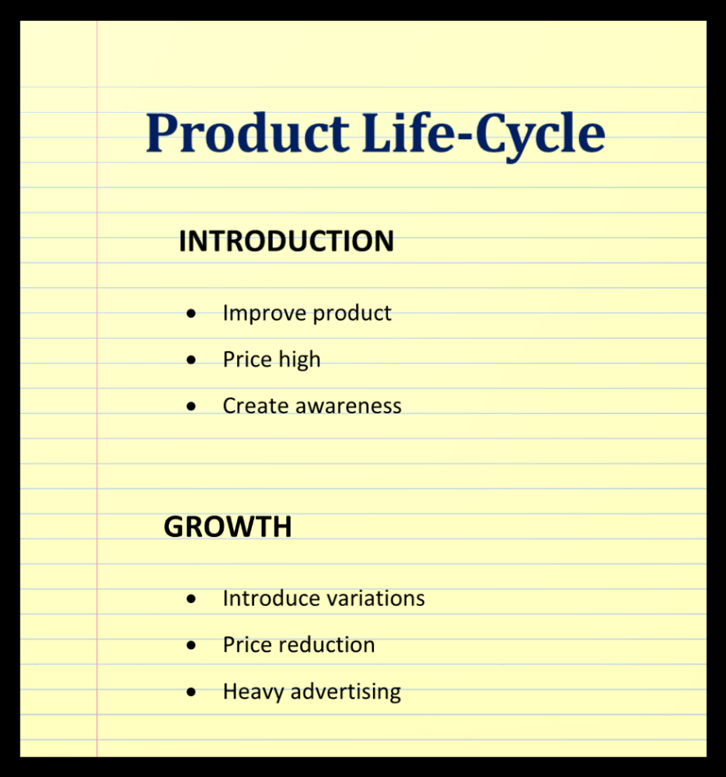
The next step is to link them to the key concept you are trying to recall. This is an example from product design as a sequence

Slide 5
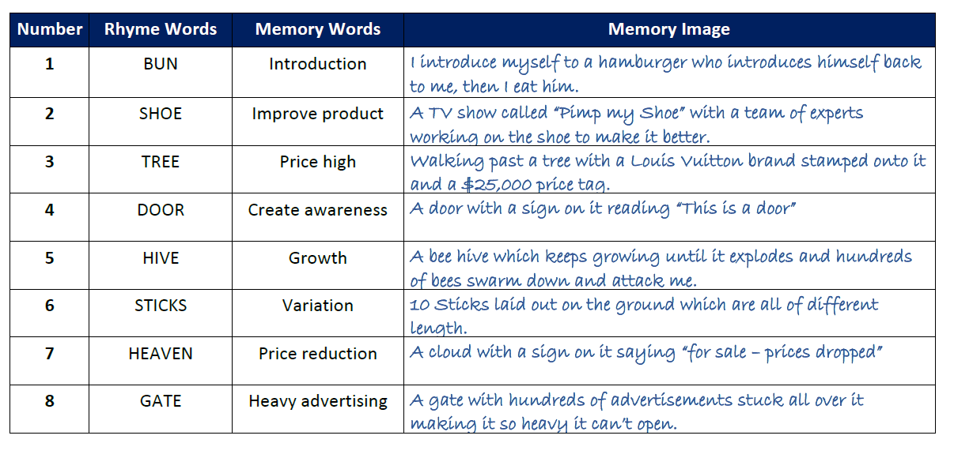

Slide 6
Once you’ve got the rhymes and sequence sorted you can use it over and over again for different subjects
OTHER EXAMPLES
Acronyms or Expression Mnemonics: Similar to the planetary example above, thinking "Every Good Boy Does Fine" can help you remember the lines of the treble clef in music (EGBDF).

