Slide 1
Revision Skills – A refresher guide
Session 5 – Creating a learning environment and a learning persona

Slide 2
attention is critical to the memory process.
However, when most of us sit down to study we put ourselves in environments where we are surrounded by a range of distractions. Beyond limiting how much we actually remember, these distractions also increase how long it takes to get the work done. Start by surveying your study space and identifying how many distractions you have around you.

Slide 3
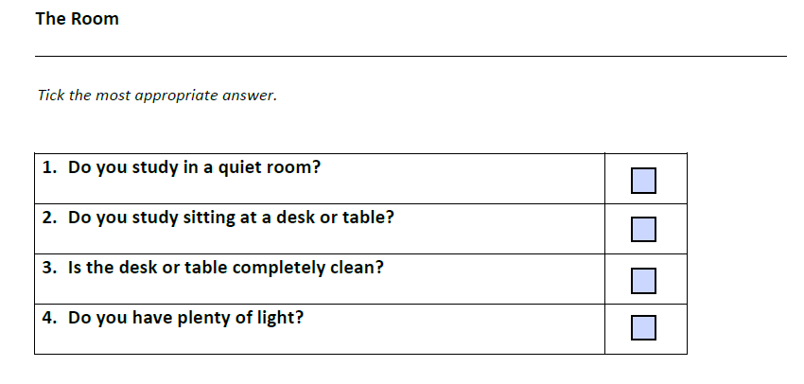

Slide 4
1.Find a quiet room: When it comes to study, anything that can divert your attention will. TV, Facebook, music, parents, brothers and sisters will all act as distractions. It is essential that you find a quiet place to study.
2.Sit up: Lying down tells your brain to go to sleep. Find a desk or table to work at.
3.Clean the desk: Anything that is within reach or visible will distract you, so get a clean space.
4.Light: Straining your eyes is both draining and secondly, distracting. Make sure the study space is well lit, preferably with a desk or table lamp as well.

Slide 5
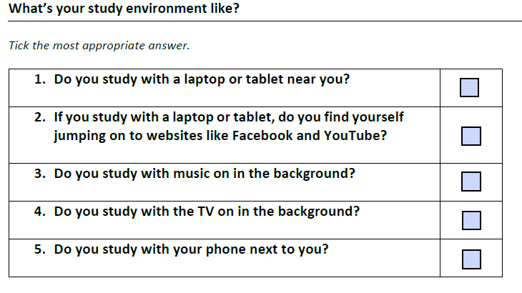

Slide 6
Laptops and Technology:
Traditionally, the old advice when it came to study was don’t use a laptop or don’t work in front of a computer as it will only distract you. However, this is much harder to do today, as a lot of your study might be done on a laptop. However even though laptops and tablets have become necessary, they are still distractions that we need to master. One great way to do this is to use apps like cold turkey or selfcontrol which allow you to block distracting websites for an amount of time that you choose.
2.Music & TV: Don’t have music on in the background. The lyrics and the changing tempo can be massive distractions. Radio is even worse. Finally, TV is worst of all. Your study environment should be as quiet as possible. But if you absolutely have to have some background noise, try downloading an app like study – it’s proven to help students boost their concentration when studying in noisy environments.

Slide 7
3.Phone: Turn your phone-off. It may be hard to believe, but the world is not going to turn upside down in the next 60 minutes. We all know that study isn’t that hard once you get going. Unfortunately, the hardest part is just picking up a pen and starting. If it takes you 10 minutes to get into the swing of study, each text message that you read takes you back to the start, and it takes another 10 minutes to settle back in and get into a rhythm.

Slide 8
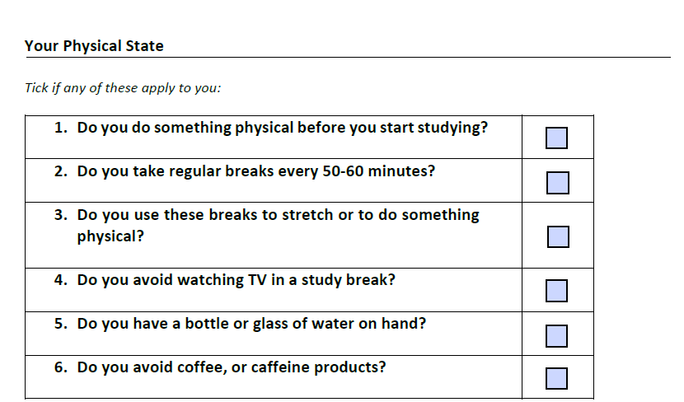

Slide 9
Get pumped up! Yes – weird advice we know, but our energy levels dictate the amount of mental focus we have and the amount of information we retain. Put on some music, dance around, do press-ups, run on the spot, shadow box, skip. Try and do something intensely for 60 seconds before you study. As soon as you hit 60 seconds, sit down at a desk or a table, sit up straight and start studying. Give it a try and see if it makes the study easier. When you find your attention beginning to wander, take a 60-second timeout and do the same activity again and then sit back down and get straight back into the study. If you do this every 15-25 minutes, you would be amazed at how long you can study without needing a long break.
2.Study breaks: Even if you are keeping your energy levels high, you will need to take regular study breaks across the day or evening. The research is very divided as to how long you can go without your attention lapsing, but generally people tend to suggest that 50-60 minutes is about the maximum. Use this as a guide, but if you find yourself flagging, take more regular breaks. But be careful how you use these breaks. Ideally use them to do something physical such as going for a walk around the block. Try not to use the time as a TV break. Plonking yourself in front of the TV is normally a great way to ensure that you don’t get off the couch for the rest of the night.

Slide 10
3.Avoid Caffeine: As we all know, caffeine is a stimulant, which means it is harder to get to sleep having just had a coffee. Lost sleep may not immediately distract you, but it catches up with you. Research shows that it only takes 8 hours of lost sleep to negatively impact memory and attention, while people who haven’t slept for 19 hours tend to have lower mental and motor skills than a child! As such, avoid relying on coffee to get you through an evening’s work. Instead, keep a bottle of water nearby and make sure you regularly hydrate. Even slight dehydration can lead to sluggishness, lack of focus and impairment of thought and memory.

