Slide 1
School apps and Online Learning

Slide 2
Online Learning via Apps
Online learning has continued at Bishop Rawstorne after remote learning during the Covid-19 lockdowns.
It is an effective, enhanced and modern means of monitoring and assessing student progress.
The following slides will show you and your child how to access school apps via the Student Link area on the Bishop Rawstorne main website.

Slide 3
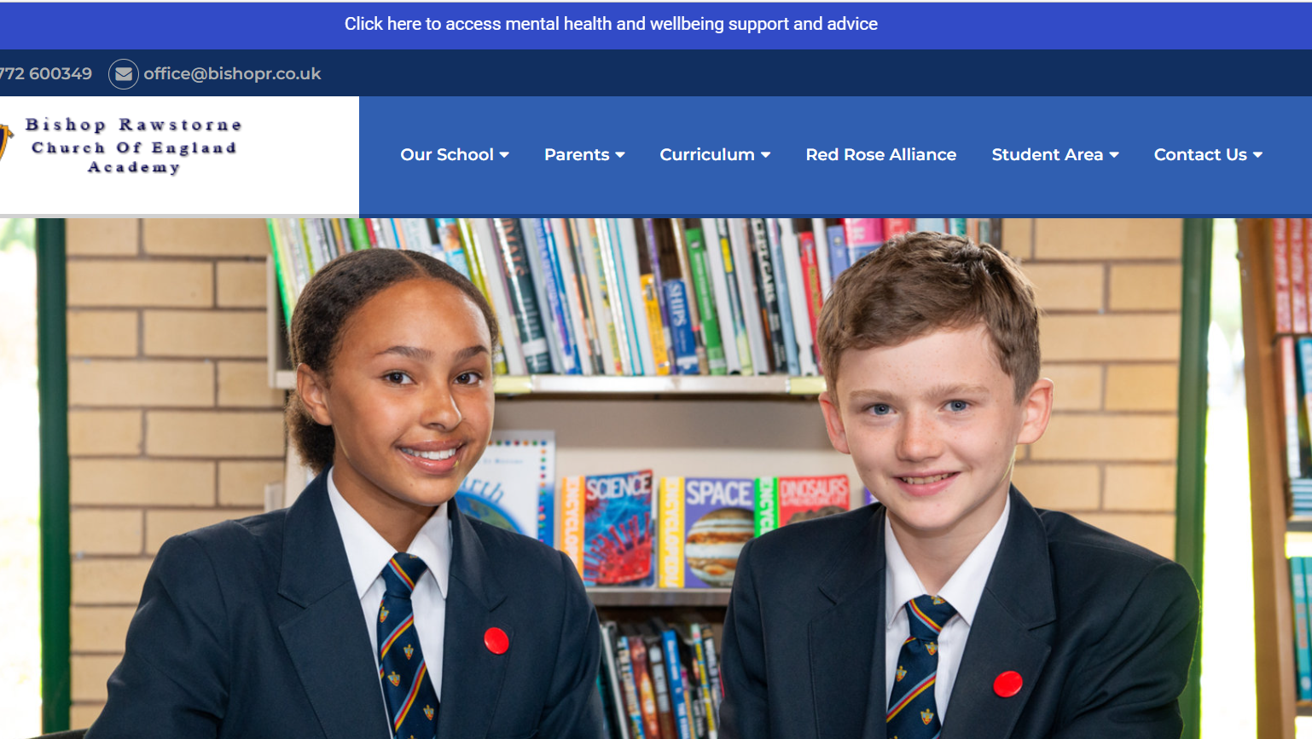

Slide 4
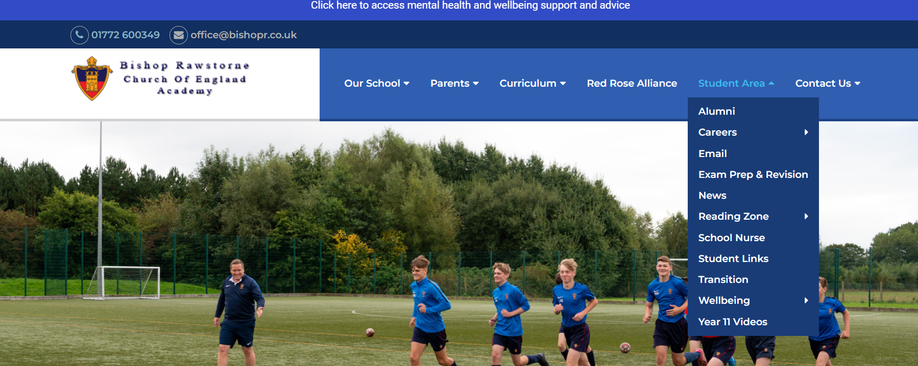

Slide 5
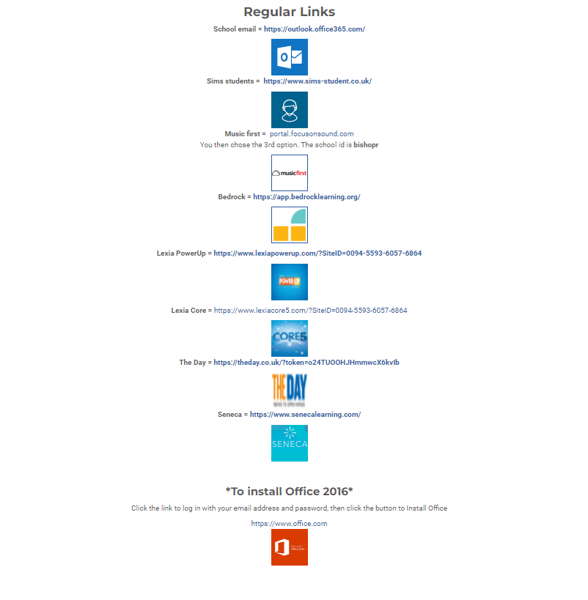

Slide 6
SIMS Student and Parent App
At the start of the year, all new-intake Year 7 students will register and have access to SIMS.
Teachers will set homework on SIMS and students are strongly advised to check SIMS regularly.
Parents and guardians will be sent a link inviting them to download the Parent’s App. The app will allow you to support and monitor your child’s academic achievement.

Slide 7
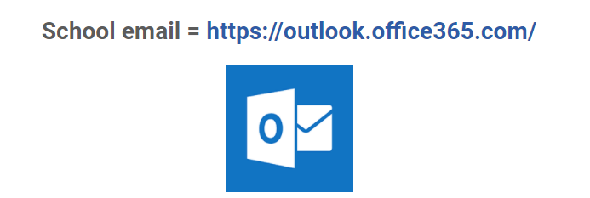
School Email and TEAMS
Email may be used by the school or a subject teacher to communicate information.
Teams may be used to communicate information, set homework assignments or distribute revision resources.
Your child is encouraged to get into a habit of checking their email and Teams regularly.

Slide 8
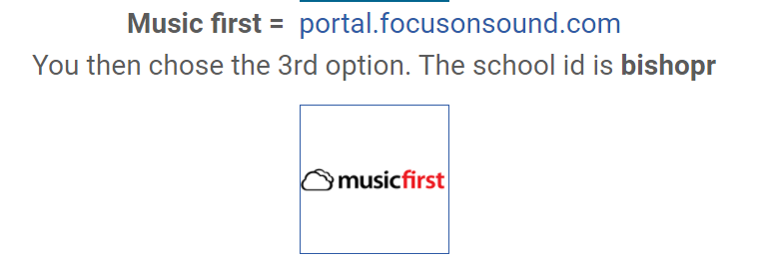
Music First
When your child is timetabled for Music lessons, they will use this app to complete weekly homework set by their teacher.

Slide 9
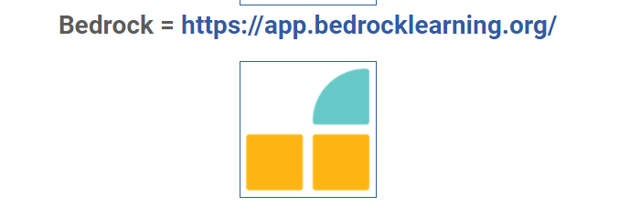
Bedrock
Your child may be selected to participate in Bedrock which enhances literacy skills, such as reading, vocabulary and spelling.
You will be contacted by Miss Palmer/Mrs Wade (SENCO) or Mrs Dawson (Literacy Coordinator) if your child is chosen for Bedrock.

Slide 10
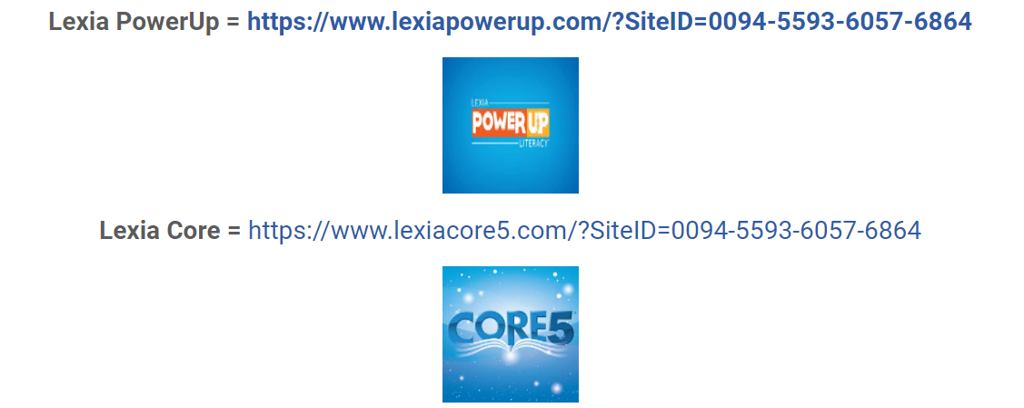
Lexia
Your child may be selected for Lexia which enhances literacy skills such as reading, vocabulary and spelling.
You will be contacted by Miss Palmer/Mrs Wade (SENCO) or Mrs Dawson (Literacy Coordinator) if your child is chosen for Lexia.

Slide 11
Maths Hegarty
The maths department subscribes to Hegarty Maths, which provides an online platform that teaches, assesses and tracks everything your child needs to learn.
In addition, Hegarty Maths is used to set homework.
The Maths department will support your child in registering and accessing their account.

