Slide 1

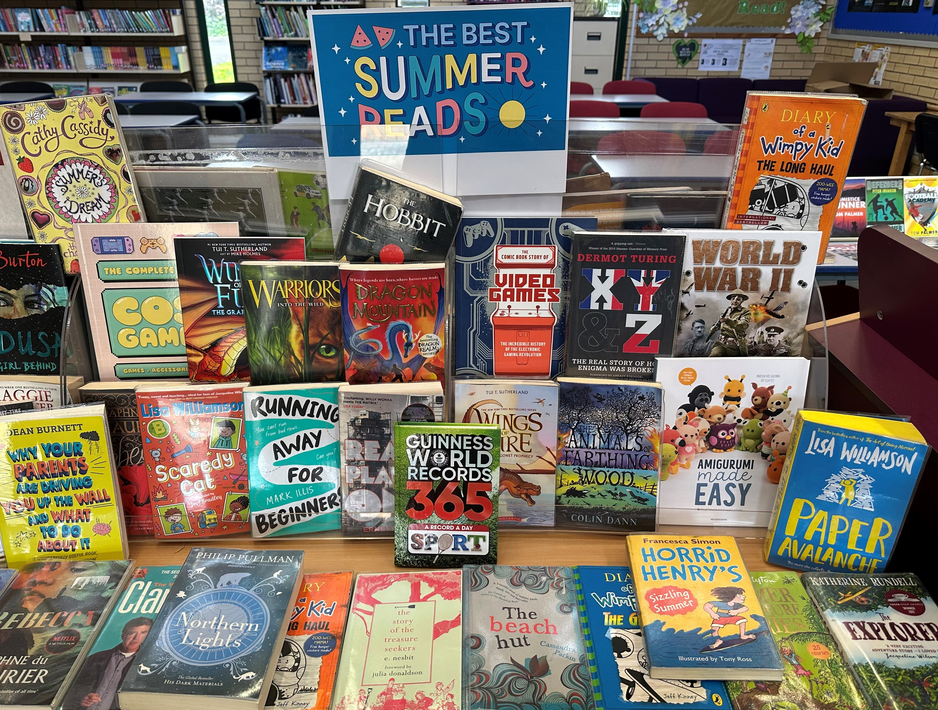
Summer wouldn’t be summer without a good book, so the Student Librarians have been busy finding a suitable selection of books to enjoy over the summer holidays.
This selection includes crafty books, gaming books, novels, comics and factual books.
If you’d like to borrow one, pop into the library, be warned, these books are proving popular, so don’t delay!

