Slide 1
Map Skills
knowledge checkers
It is your responsibility to make sure that you are able to answer each of the questions set in the tasks below. This will be based on what you are taught in lessons and the information included the knowledge organisers.
Task 1 What are the three types of Geography? Can you name the 5 scales of geography locations? Can you give an example for each scale? | Task 2 How many continents are there? Can you name them? How many oceans are there? Can you name them? Can you locate all of the oceans and continents on a map? | Task 3 Can you remember a rhyme to remember the compass directions? Can you label a 4 and 8 point compass? Can you use compass directions when describing where places are in relation to other places e.g. France is south east of the UK.
Task 4 What countries make up Great Britain? What countries make up the UK? What countries make up the British Isles? Can you name the capital cities for each country in the British Isles? Why do we use symbols on maps? Can you identify some OS map symbols and what they represent? | Task 5 How can we would you distance on a map? How would you measure a wiggly road on a map? What do contour lines show us? What can they tell us about the shape of the land? | Task 6 What do we use grid references for? What rhyme can you use to remember how to give grid references? Can you give 4FGRs? Can you give 6FGRs?
Knowledge Expert

Slide 2
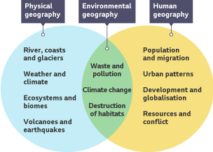
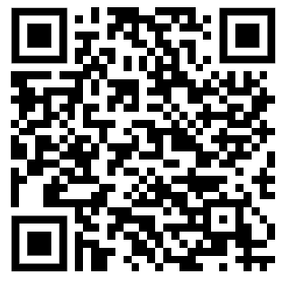
Map Skills
knowledge checkers
What is Geography?
Core knowledge
Key words
Physical geography - Natural features and events on earth
Human geography- where and how people live
Environmental geography - How people affect the surrounding world
Scale - the size of settlements
We refer to three types of geography. These are physical (natural), human and environmental.
local
international
global
national
regional
Knowledge Organiser
As geographers we need to be able to use a variety of scales to describe locations.
Misconceptions
Take it further...
As settlements become bigger there will be fewer of them, although they will contain more people.
BBC

Slide 3
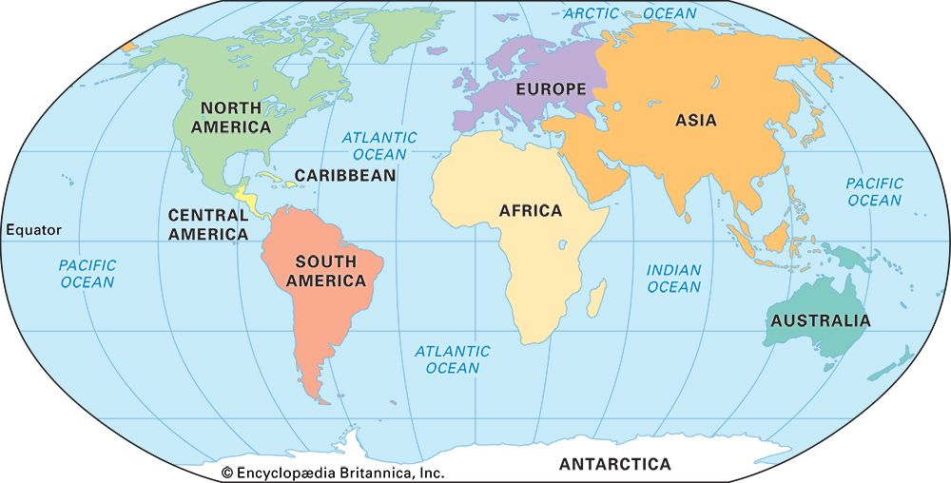
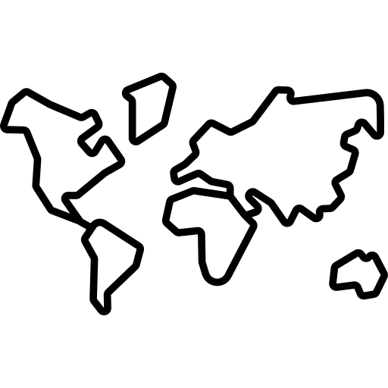
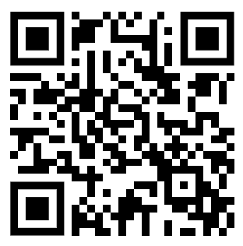
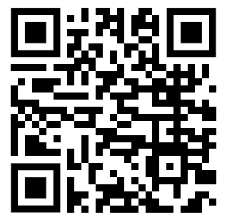
Map Skills
knowledge checkers
Continents and Oceans
Core knowledge
Key words
Continents - a very large area of land, such as Africa or Asia, that consists of several countries
Ocean - a huge body of salt water.
Knowledge Organiser
Continent's are large solid areas of land. Earth has seven continents. They are Asia, Africa, North America, South America, Antarctica, Europe, and Australia. Sometimes people think of Europe and Asia as a single continent called Eurasia. Australia is part of a larger area called Oceania or Australasia. It includes many islands in the Pacific Ocean.
Misconceptions
Take it further...
There is no real border between oceans, water flows freely between them.
Video
Game

Slide 4
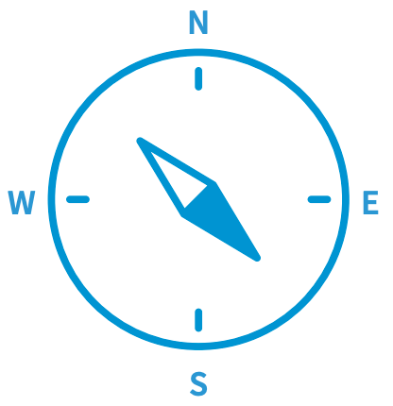
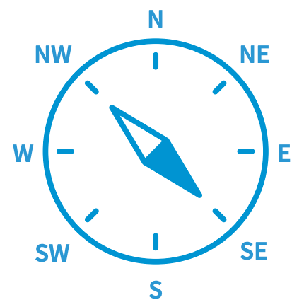
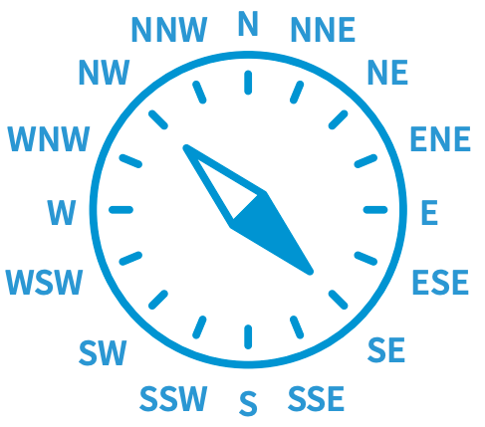
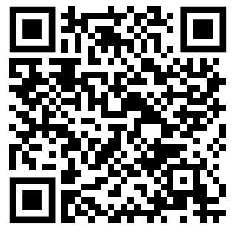
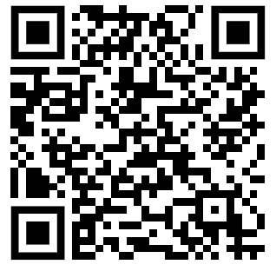
Map Skills
knowledge checkers
Compass Directions
Core knowledge
A compass is an important tool for map readers. It tells us which way is north and where to find east, south, and west. Together, these are known as the four cardinal points of the compass.
Helpful phrases
To help you remember where the points of the compass are, you could try learning a phrase like:
Naughty Elephants Squirt Water
The eight-point compass
You can make your compass more accurate by adding more points to it. By drawing a line in between each of the cardinal points, you can create an eight-point compass that shows the directions for north-east (NE), south-east (SE), south-west (SW) and north-west (NW).
The 16-point compass
For even more accurate readings, some compasses add eight more points to make a total of 16. Each of these points also has a direction. West-south-west (WSW) points to a direction west of south-west. Similarly, north-north-east (NNE) points north of north-east.
Knowledge Organiser
Misconceptions
Take it further...
For 8 point compass directions north or south should always be the first part of the direction.
BBC
Ordnance Survey

Slide 5
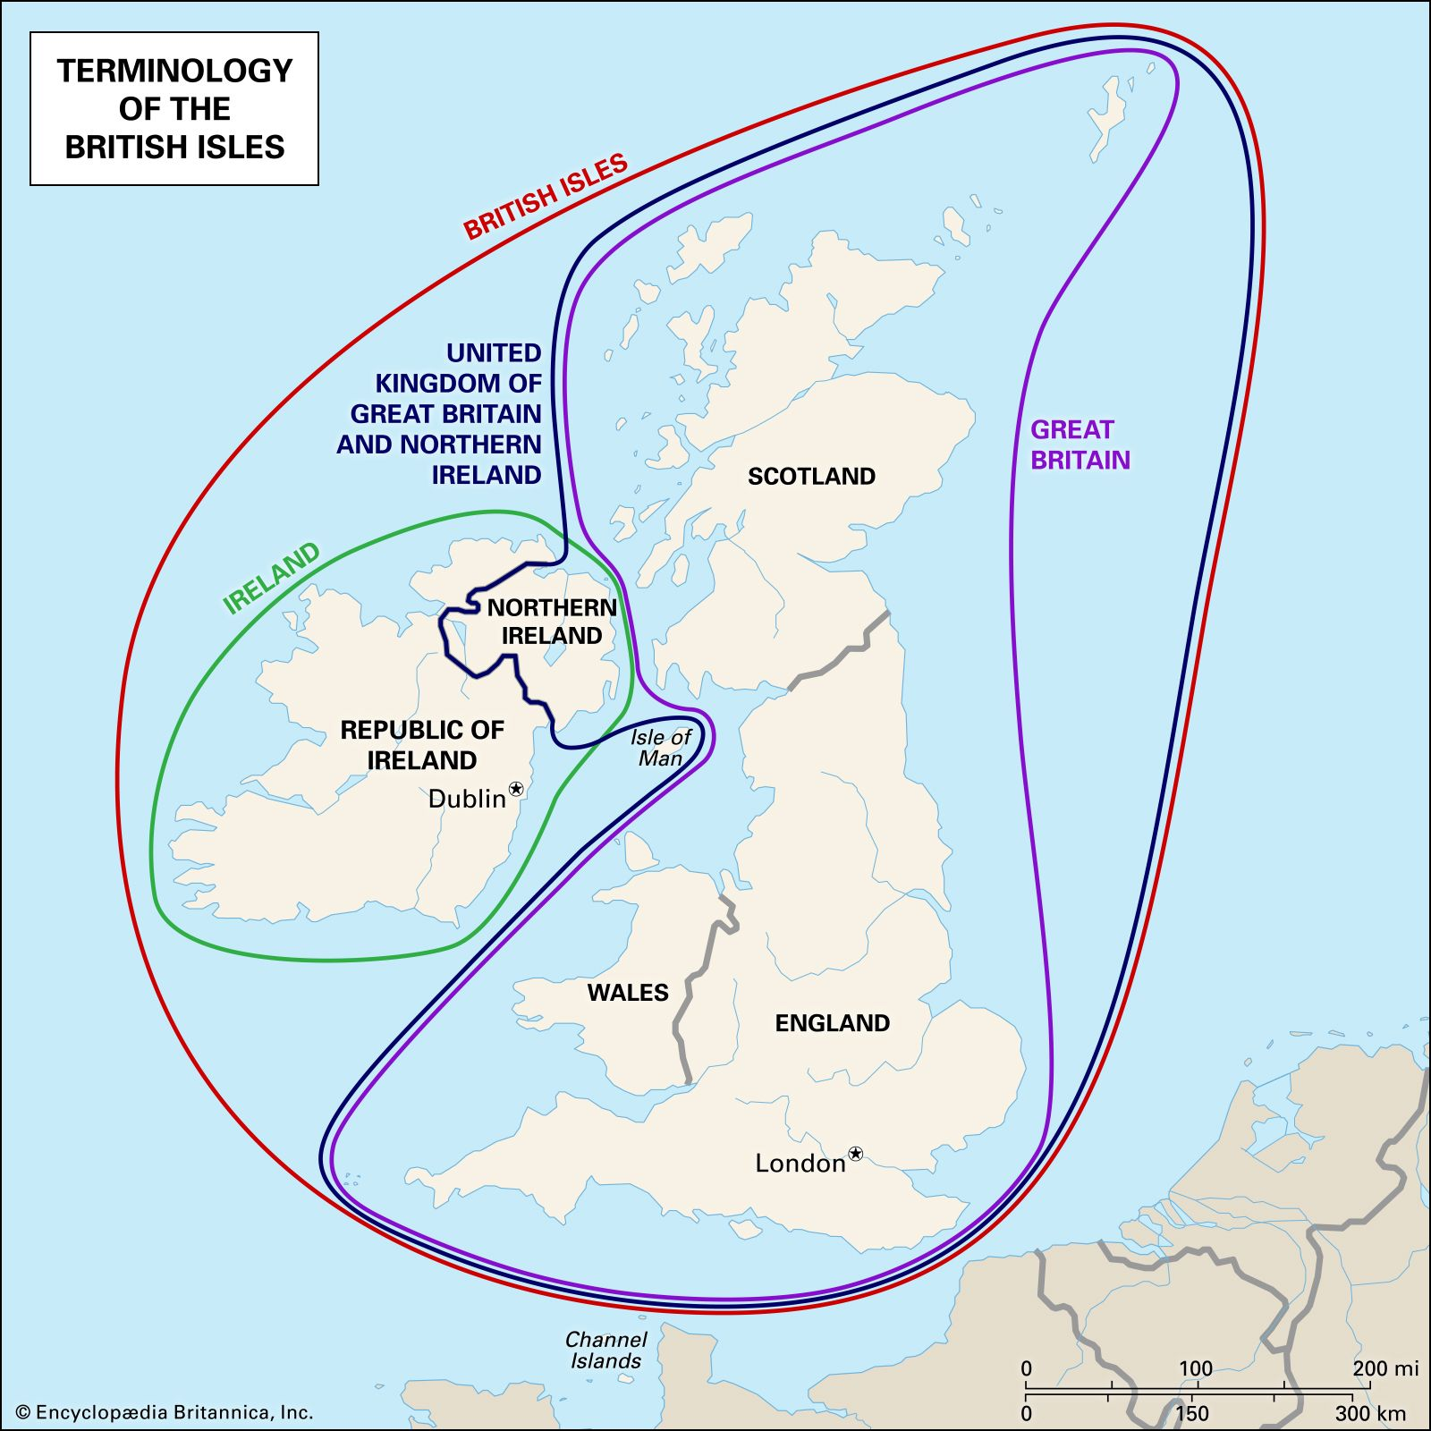
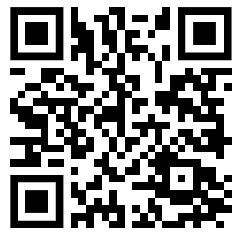
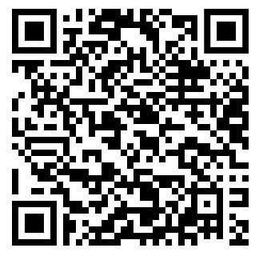
Map Skills
knowledge checkers
UK? Great Britain?
Core knowledge
Misconceptions
The United Kingdom of Great Britain and Northern Ireland is the official title of the state. Wales, Scotland, Northern Ireland and England are often called the Home Nations. All of them can be described as countries, or nations, as can the UK in its entirety.
Knowledge Organiser
Take it further...
Video
Britannica

Slide 6
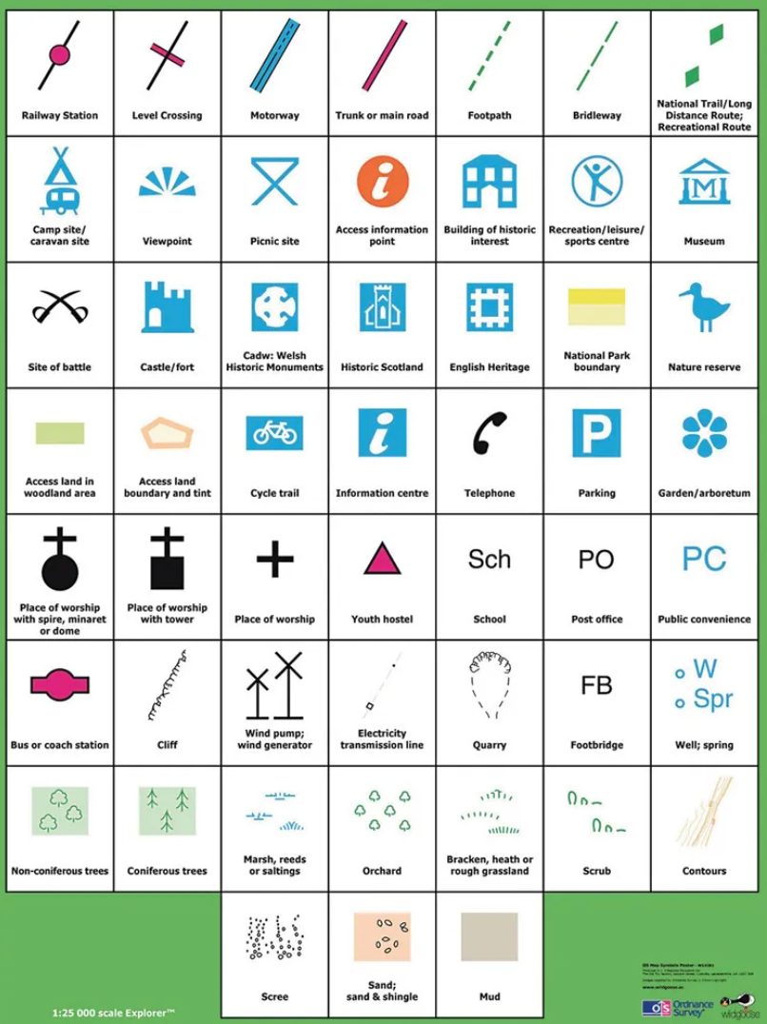
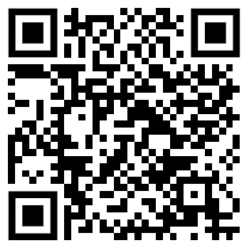
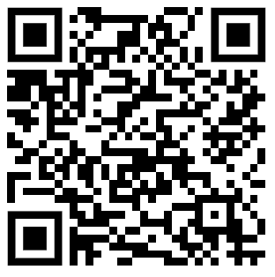
Map Skills
knowledge checkers
OS Maps
Core knowledge
The Ordnance Survey (OS) is the United Kingdom's mapping agency. It conducts official surveys in the United Kingdom, giving the most precise and up-to-date geographic data on which the government, businesses, and individuals rely.
They've created a variety of maps over the years, catering to the military, walkers, the government, cyclists, and road users and the building industry.
Maps contain a lot of information about the areas of land that they show. There are too many features to label everything using text, so we use map symbols.
Map symbols can include letters, coloured areas, pictures or lines. These symbols can be used to show the location of different features such as roads, viewpoints, bus stations, train stations, schools and post offices.
The maps are covered with a grid of faint blue lines that are accompanied by numbers that allow you to properly pinpoint your location on a map.
Knowledge Organiser
Misconceptions
Take it further...
In geography your 4 and 6 numbers do not need to be in brackets or separated by commas. (see the final page for more info on grid references)
BBC
Ordnance Survey

Slide 7
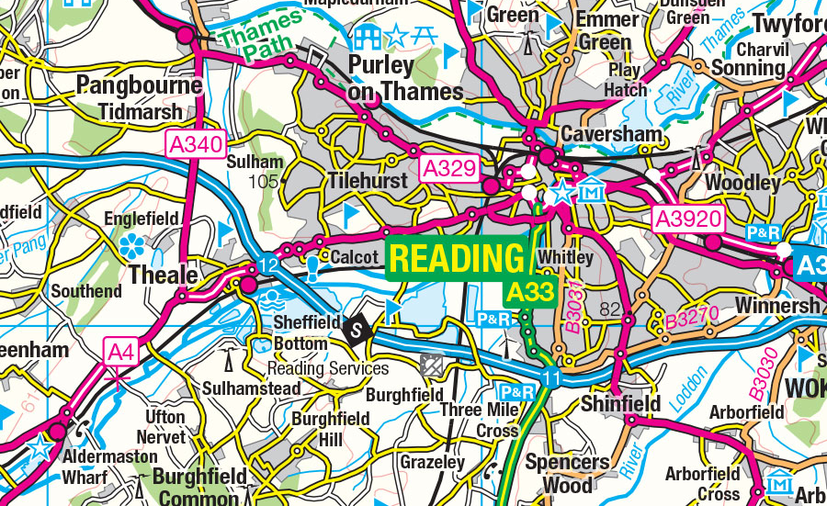
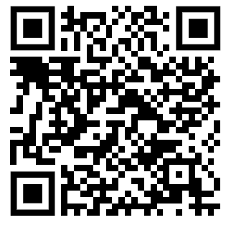
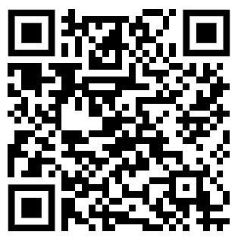
Map Skills
knowledge checkers
Scale and Distance
Core knowledge
Key words
It wouldn't be possible for maps to show things the size they are in real life, so maps make things smaller using scale. Drawing something to scale means showing it at a different size to what it is in real life.
When maps are drawn to scale things are made many times smaller than they really are. Because maps are important to a lot of people, this process has to be very accurate.
The scale of a map allows a reader to calculate the size, height and dimensions of the features shown on the map, as well as distances between different points. The scale on a map is the ratio between real life sizes and how many times it has been shrunk to fit it on the map.
Scale: the scale tells you how much you would have to enlarge your map by to get the actual size in real life. For example, on a 1:100000 scale map, 1cm on the map equals 1km on the ground.
On a 1:50,000 scale map, 1 cm on the map represents 50,000 cm on the ground (= 500 m or 0.5 km).
Knowledge Organiser
A map scale is the size ratio of a feature on the map to the one in the real world.
Measuring roads that are not straight
To measure a road that is not straight, lay a piece of string along the route or use a piece of paper to work out the distance.
Step 1 - mark on the map the route you wish to measure. Step 2 - place the paper on the map and make a mark at the start of the route. Step 3- every time the route curves, pivot (turn) the paper to continue to follow the route and make another mark. Step 4- pivot the paper until you get to the end point. Step 5- either hold the paper against the scale bar at the bottom of the map or measure it to work out the distance.
Take it further...
BBC
Ordnance Survey

Slide 8
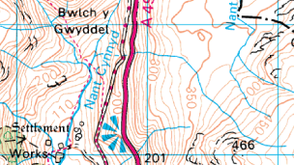
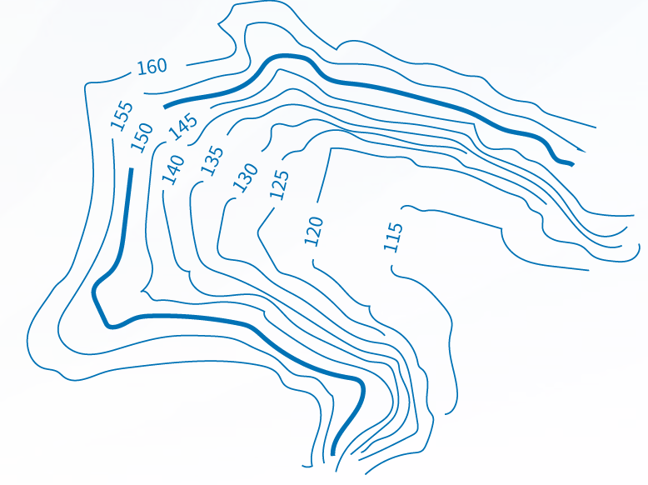
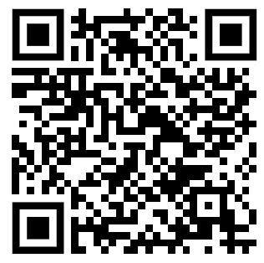
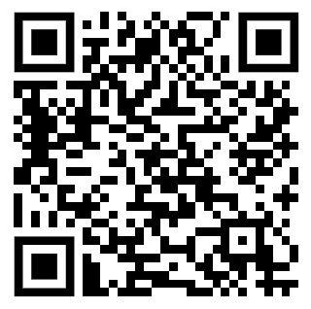
Map Skills
knowledge checkers
Height on a map
Core knowledge
Like any piece of paper, maps are flat, but the land they cover is often quite hilly. Contour lines are a map's way of showing how high the land is. They join together points of equal height and never cross.
When contour lines appear close together, this means the land slopes sharply and would be steep to climb. The further apart the contour lines are, the flatter the land will be.
If you take some time to look at the contour lines on a map, you will soon get an idea in your mind of what the land actually looks like in real life.
What are contour lines?
Contour lines join areas of equal height and are shown in orange on an Ordnance Survey (OS) map.
The number written on the contour line shows the height above sea level in metres.
The interval between contours is usually five metres, although in regions it may be ten metres.
What do contour lines show?
The distance between contour lines shows how steep or flat the land is.
If the contour lines are very far apart, it means the land is flat.
If the contour lines are close together, it means the land is steep.
Knowledge Organiser
Key words
Take it further...
Contour line - A line joining places of equal height above sea level on a map. On Ordnance Survey (OS) maps, contour lines are usually orange.
Mountainous - A region having many mountains.
BBC
Ordnance Survey

Slide 9
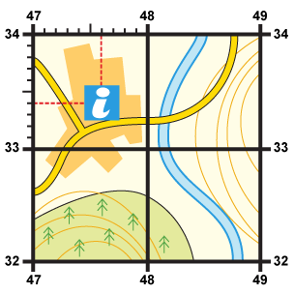
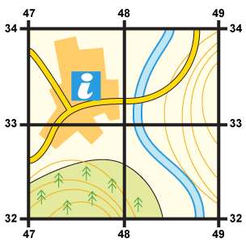
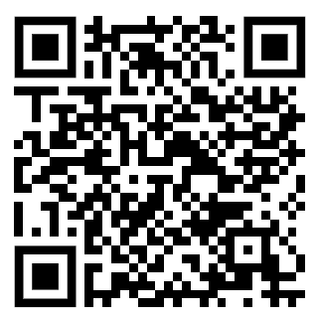
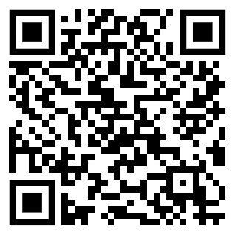
Map Skills
knowledge checkers
Grid References
Core knowledge
Sometimes it is necessary to be even more accurate. In this case you can imagine that each grid is divided into 100 tiny squares. The distance between one grid line and the next is divided into tenths.
First, find the four-figure grid reference but leave a space after the first two digits.
Estimate or measure how many tenths across the grid square your symbol lies. Write this number after the first two digits.
A grid of squares helps the map-reader to locate a place. The vertical lines are called eastings. They are numbered - the numbers increase to the east. The horizontal lines are called northings as the numbers increase in an northerly direction.
When you give a grid reference, always give the easting first: "Along the corridor and up the stairs".
Four-figure grid references can be used to pinpoint a location to within a square. To find the number of the square:
Next, estimate how many tenths up the grid square your symbol lies. Write this number after the last two digits.​
You now have a six figure grid reference. In this instance, the tourist information office is located at 476334.
Knowledge Organiser
Start at the left-hand side of the map and go east until you get to the bottom-left-hand corner of the square you want. Write this number down.
Move north until you get to the bottom-left corner of the square you want. Look at the number of this grid line and add it to the two-digit number you already have. This is your four-figure grid reference.
In this case, the tourist information office is in grid square 4733.
Take it further...
BBC
Ordnance Survey

Slide 10
Notes

Slide 11
Notes
________________________________________________________________________________________________________________________________________________________________________________________________________________________________________________________________________________________________________________________________________________________________________________________________________________________________________________________________________________________________________________________________________________________________________________________________________________________________________________________________________________________________________________________________________________________________________________________________________________________________________________________________________________________________________________________________________________________________________________________________________________________________________________________________________________________________________________________________________________________________________________________________________________________________________________________________________________________________________________________________________________________________________________________________________________________________________________________________________________________________________________________________________________________________________________________________________________________________________________________________________________________________________________________________________________________________________________________________________________________________________________________________________________________________________________________

