Slide 1
Rainforests
knowledge checkers
It is your responsibility to make sure that you are able to answer each of the questions set in the tasks below. This will be based on what you are taught in lessons and the information included the knowledge organisers.
Task 1 Where are rainforests found? Why are they found here? What are the four layers of the rainforest? What can be found in each layer? What are the conditions like? | Task 2 What conditions do plants and animals need to deal with? Explain two plant adaptations. Explain two animal adaptations.
Task 3 What is deforestation? Explain three reasons for deforestation. | Task 4 What does it mean to sustainably manage a rainforest? Explain two ways, in detail, that deforestation can be managed. Pros and cons to each.
Knowledge Expert

Slide 2
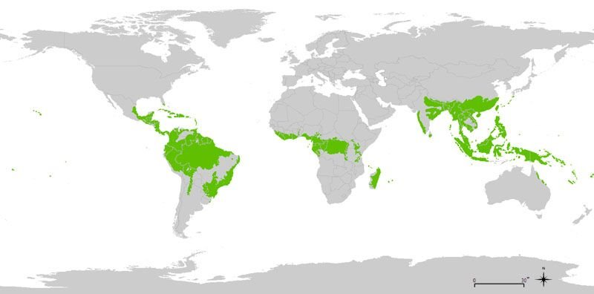
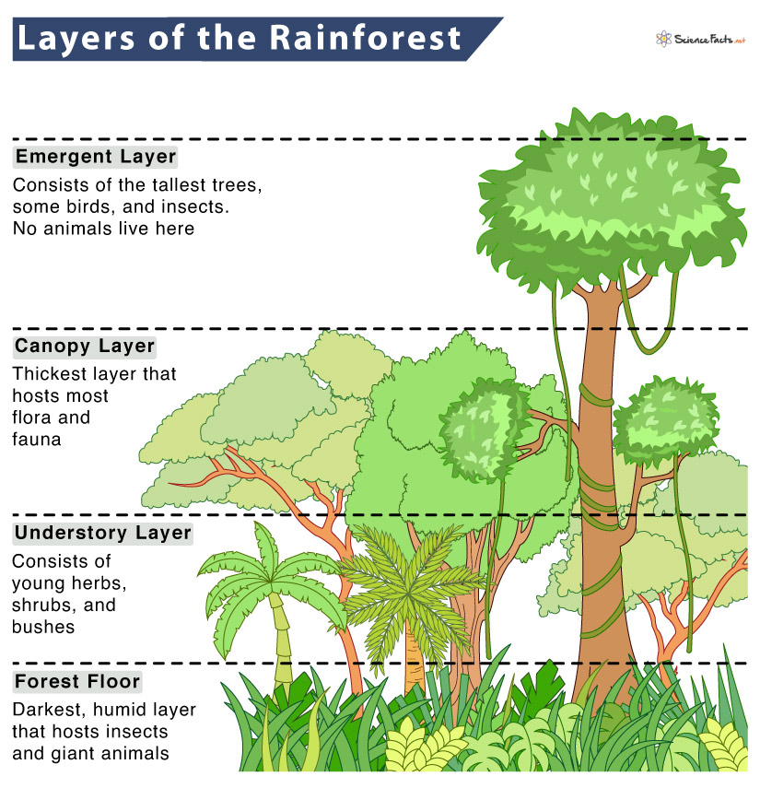
Rainforest
knowledge checkers
Location and Structure
Core knowledge
Key words
Equator - An imaginary line that runs around the Earth. The equator marks the dividing line between the Northern and Southern hemispheres.
Tropic of Cancer- An imaginary line that runs parallel to the Equator at 23.5° north.
Tropic of Capricorn - An imaginary line that runs parallel to the Equator at 23.5° south.
Tropical rainforests lie along the equator, mainly between the Tropics of Cancer and Capricorn.
Rainforests have four main layers: the emergent, the canopy, the under canopy and the forest floor.
Knowledge Organiser
Misconceptions
Take it further...
Tropical rainforests are not just found in South America, they are found across the world around the Equator.
BBC
Climate Graph

Slide 3
Rainforest
knowledge checkers
Adaptation
Core knowledge
Key words
Plants
Animals
Lianas - these are woody vines that have roots in the ground but climb up the trees to reach the sunlight. Their leaves and flowers grow in the canopy.
Sloth - uses camouflage and moves very slowly to make it difficult for predators to spot.
Adaptation - the process of change by which an organism or species becomes better suited to its environment
Ecosystem - The living organisms in a particular area, together with the non-living components of the environment.
Tree trunks - these are tall and thin to allow trees to reach the sunlight. The bark on these trees is smooth to allow water to flow down to the roots easily.
Spider monkey - long, strong limbs to help it to climb through the rainforest trees.
Knowledge Organiser
Drip tips - plants have leaves with pointy tips. This allows water to run off the leaves quickly without damaging or breaking the leaves.
Flying frog - fully webbed hands and feet, and a flap of loose skin that stretches between its limbs, which allows it to glide from plant to plant.
Misconceptions
Take it further...
Animals cannot instantly change to fit into their environment. Climate change is changing the condition in which plants and animals live, many will not be able to adapt in time as so may need to migrate or become extinct.
BBC
Video

Slide 4
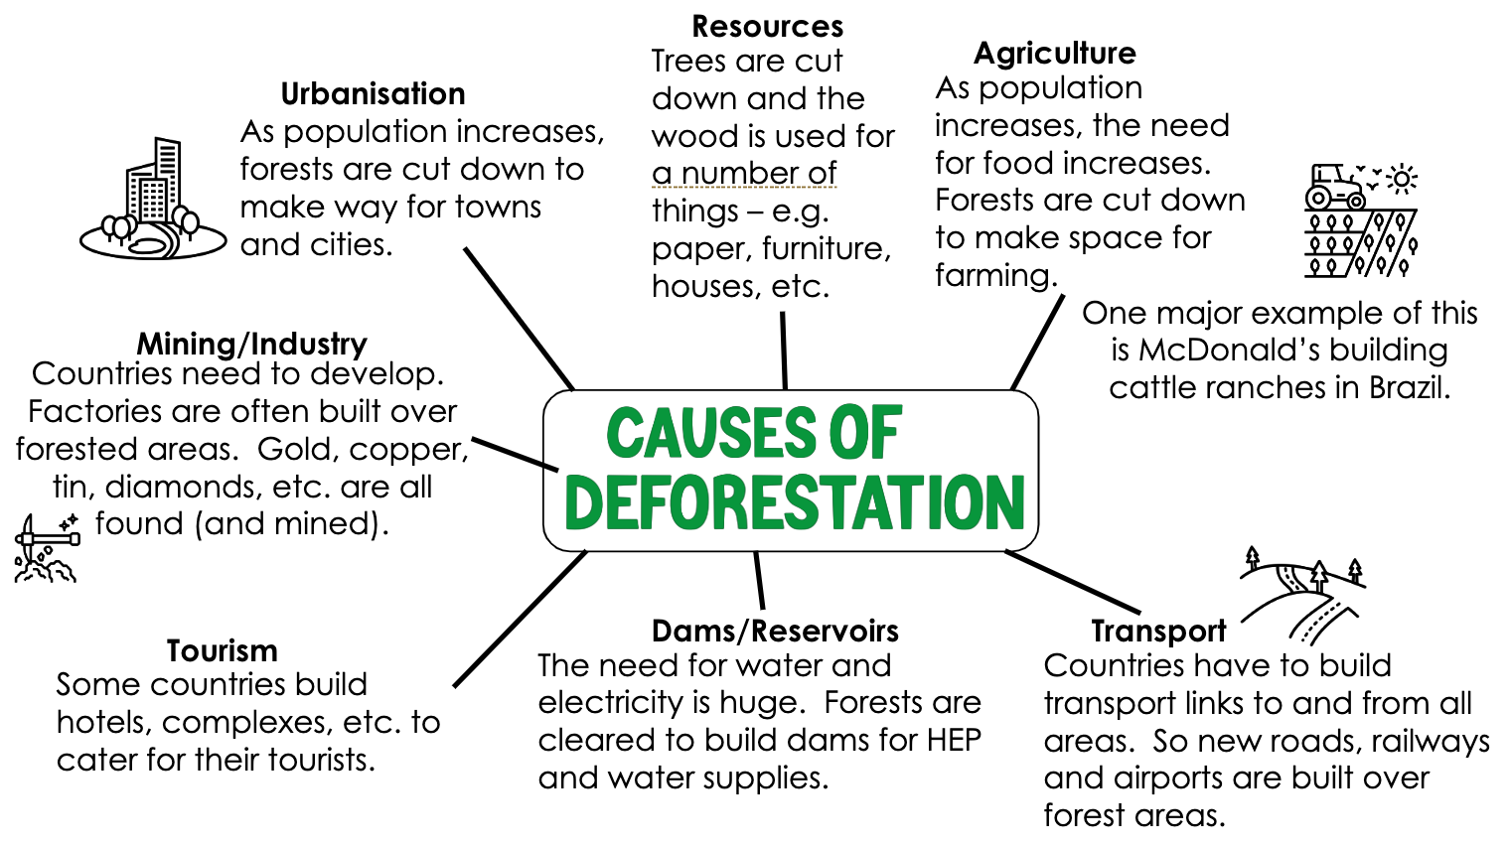
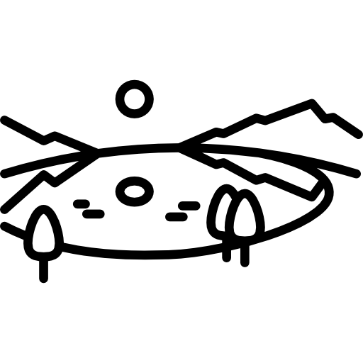
Rainforest
knowledge checkers
Deforestation
Core knowledge
Key words
Deforestation is the removal of a forest from land which is then converted to a non-forest use.
Hydroelectric power - Energy generated from fast-flowing water.
Reservoir - a large natural or artificial lake used as a source of water supply
Urbanisation - the growth in the number of people living in towns and cities
Agriculture - farming
Knowledge Organiser
Misconceptions
Take it further...
The majority of trees are not cut down for wood or paper, they are removed so the land can be used for agriculture.
BBC
Video

Slide 5
Rainforest
knowledge checkers
Sustainable Management
Core knowledge
Key words
Sustainable management means ensuring that it is a sustained in a way for future generations. You can use it, but not over use it so that it runs out or is damaged.
Sustainable- An activity which does not consume or destroy resources or the environment
Ecotourism - Tourism which aims to be environmentally friendly
Debt - Money owed to someone else
Conservation - the careful maintenance and upkeep of a natural resource to prevent it from disappearing
Method | Description- What is it? | What is good about it? | What is bad about it?
Selective Logging | The cutting out of trees that are mature or defective, or of inferior kinds to encourage the growth of the remaining trees in a forest or wood | Only chops down a small amount of trees. The Rainforest can regrow. | Can increase forest fires due to small branches being left behind.
Conservation and Education | The process of influencing people's attitudes, emotions, knowledge, and behaviours about wildlife and wild places | If we become more passionate about the rainforest we are more likely to protect it. | Some people will not care.
International Agreements/ Debt Relief: | Countries are relieved of some of their debt in return for protecting their rainforests. | Allows countries to spend more money on rainforest protection | Some countries might be corrupt and spend the money on other things.
Ecotourism | tourism directed towards exotic, often threatened, natural environments, intended to support conservation efforts and observe wildlife | Gives local people a job which means they will protect the rainforest | Increase people going to the rainforest which might cause damage.
Knowledge Organiser
Take it further...
Ecotourism
Video

Slide 6
Notes

Slide 7
Notes
________________________________________________________________________________________________________________________________________________________________________________________________________________________________________________________________________________________________________________________________________________________________________________________________________________________________________________________________________________________________________________________________________________________________________________________________________________________________________________________________________________________________________________________________________________________________________________________________________________________________________________________________________________________________________________________________________________________________________________________________________________________________________________________________________________________________________________________________________________________________________________________________________________________________________________________________________________________________________________________________________________________________________________________________________________________________________________________________________________________________________________________________________________________________________________________________________________________________________________________________________________________________________________________________________________________________________________________________________________________________________________________________________________________________________________________

