Slide 1
Antarctica
knowledge checkers
It is your responsibility to make sure that you are able to answer each of the questions set in the tasks below. This will be based on what you are taught in lessons and the information included the knowledge organisers.
Task 1 Where is Antartica? Why is it so cold there? Can you describe a climate graph for Antarctica? | Task 2 What conditions to animals have to deal with in Antarctica? Can you explain how at least two different animals have adapted to the Antarctic climate? | Task 3 How is a glacier formed? Where is the accumulation zone and what happens there? Where is the ablation zone and what happens there?
Task 4 What is a global common? What is the Antarctic Treaty? What are the rules of the treaty? | Task 5 Why do people want to visit Antarctica? What problems can tourist cause in Antarctica? What rules should tourist follow? | Task 6 What kind of jobs are available in Antarctica? What types of things do people take with them when they go to work in Antarctica?
Knowledge Expert

Slide 2
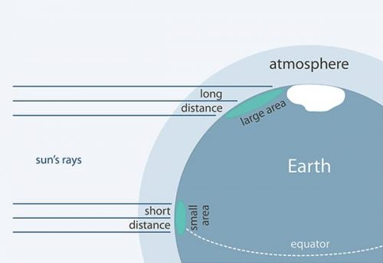
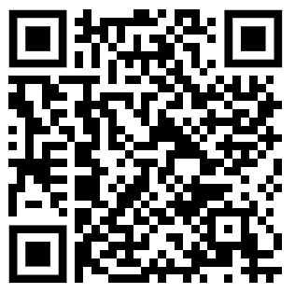
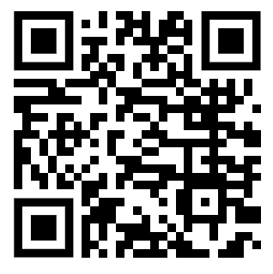
Antarctica
knowledge checkers
Why so cold?
Core knowledge
Key words
Antarctica is the highest continent on the planet, due to thick layers of ice that raise its average elevation to around 3,000m. Temperatures drop by about 1°C for every 100 metres of altitude you gain, so Antarctica’s high altitude has a big impact on its temperature.
Latitude- how far north or south you are
Albedo – how reflective a surface is, white surfaces will reflect more light away from the surface of the earth
Altitude- the height of the land above sea level
Precipitation - rain, hail , sleet or snow
Climate Graph - a way of showing both temperature and precipitation in one graph.
Angle of sunlight - Antarctica receives less sunlight than other places on earth due to its position at the south extreme of the globe. In the polar regions the sun has to push through more atmosphere, and is spread over a bigger area than at the equator.
Knowledge Organiser
Lots of ice - Larger amounts of ice have a cooling effect on the air temperature above the ice. Antarctica has large ice sheets and seasonal sea ice, both of which help keep it cold.
Large reflective surfaces - The white surfaces of ice and snow are highly reflective. They radiate most of the heat that reaches them back out to space, keeping the air above them relatively cool.
Misconceptions
Take it further...
The Arctic and Antarctica are quite different. Although both found at the poles, Antarctica is a continent with land beneath it, whereas the Arctic does not.
BBC
Game

Slide 3
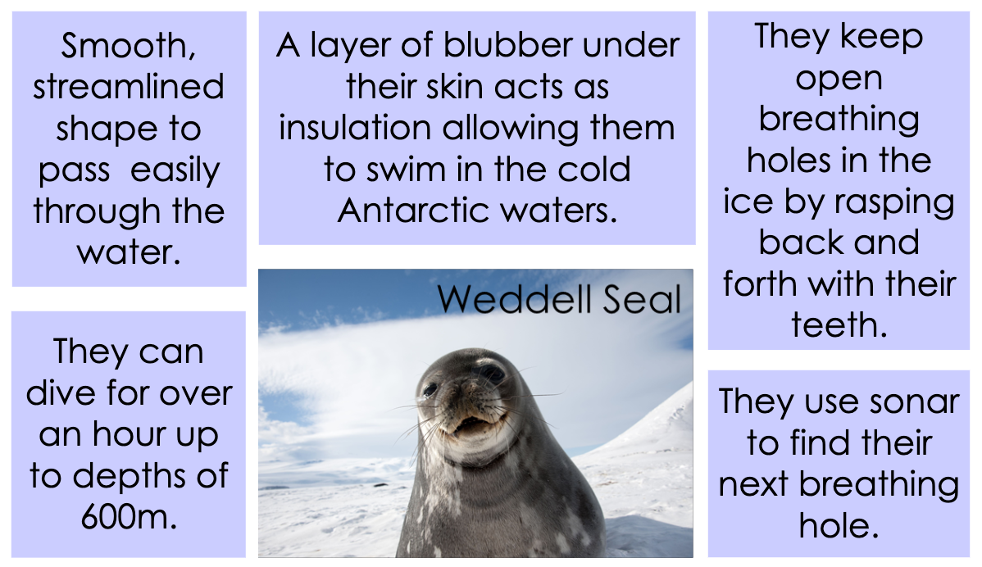
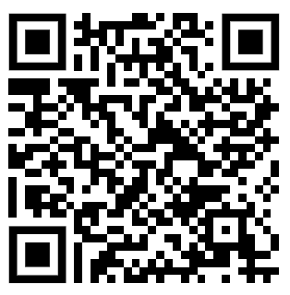
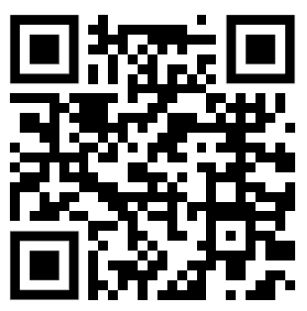
Antarctica
knowledge checkers
Adaptations
Core knowledge
Key words
Some animal species have adapted to survive the hostile conditions in Antarctica.
For example, penguins have flippers to help them to swim and feathers to trap warm air close to their bodies.
Plant species such as lichen and mosses grow, particularly around coastal regions.
Biome- areas of the planet with a similar climate and landscape, where similar animals and plants live.
Ecosystem - a community of living organisms (plants, animals and microbes) in a particular area
Marine – relating to the sea
Organism - a living thing
Adaptation- changing to suit your environment
The ocean contains a range of life, including phytoplankton, krill and whales.​
​
Knowledge Organiser
Misconceptions
Take it further...
Polar bears are not found in Antarctica
BBC
Biomes

Slide 4
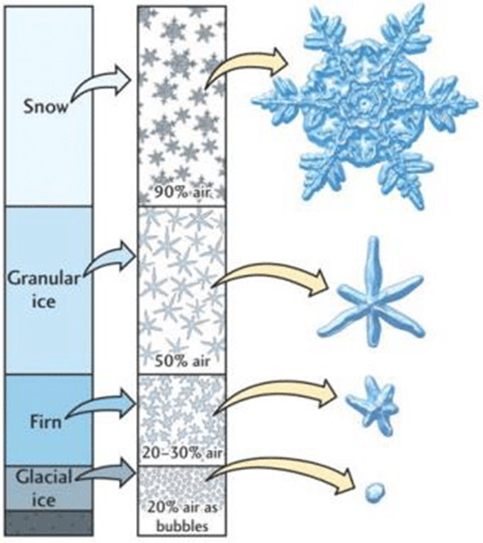
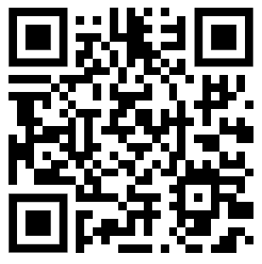
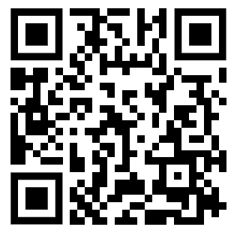
Antarctica
knowledge checkers
Glaciers
Core knowledge
Key words
Glaciers are large bodies of ice that cover about 10% of the Earth’s surface in cold regions such as Antarctica and the Arctic as well as in high mountain ranges such as The Alps, Andes and Himalayas.
Glaciers are made up of snow that has built up over many years. The weight of the layers of snow become compressed into ice. This process, for most glaciers, takes over a hundred years.
Accumulation- Adding to the glacier, more snow
Ablation – losing ice, melting
Calving – when pieces if ice break off the glacier forming icebergs
Equilibrium line - the area between the accumulation and ablation zone
advancing - when the glacier moves forward because more ice is added
retreating – when the glacier gets smaller and appears to move backwards as it melts.
Crevasses – cracks that appear on the surface of the glacier.
All glaciers have an upper area where more snow piles up during the year than can be lost (the ‘accumulation zone’) and a lower area where there is more ablation than snow accumulation. So, the glacier ice moves from the accumulation zone to replace the ice lost in the ‘ablation zone’. The dividing line between these two zones is called the ‘equilibrium line’.
Over a year a glacier will tend to expand a little in the winter (with more snowfall and less melting) and then shrink back a little in the summer as the area of the glacier experiencing melting increases. If on average the glacier remains the same size over many years, then the glacier is neither ‘advancing’ nor ‘retreating’ – it is in balance.
Knowledge Organiser
Misconceptions
Take it further...
The ice is created by snow being compressed into ice rather than water freezing like when you make ice cubes.
Glaciers
Glacial Budget

Slide 5
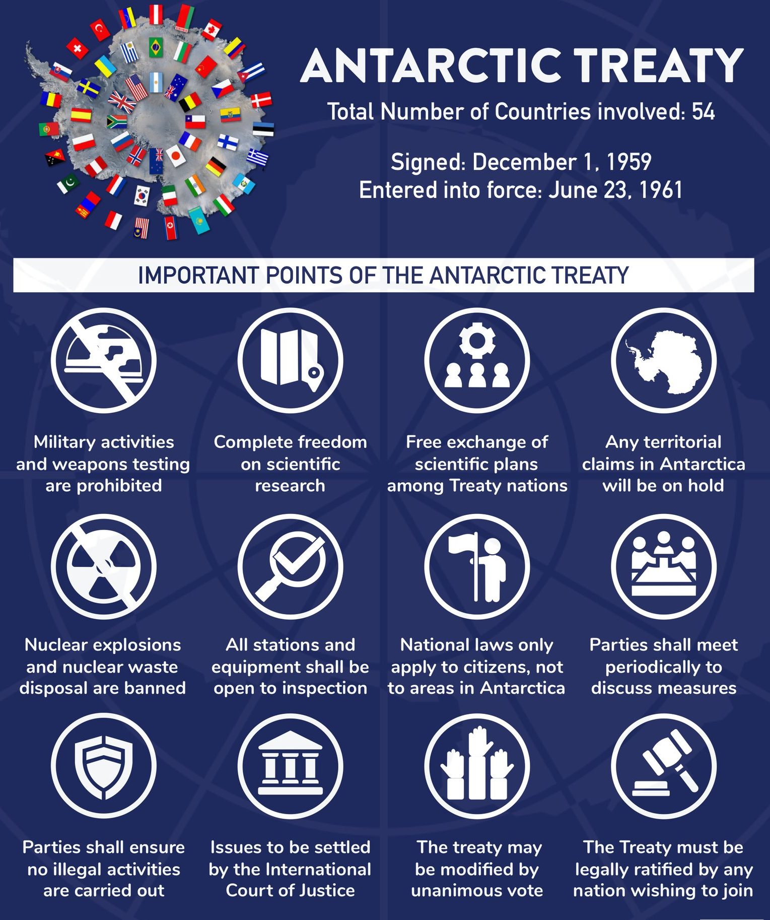
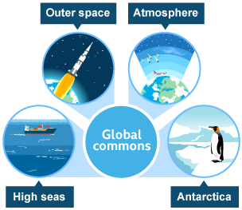
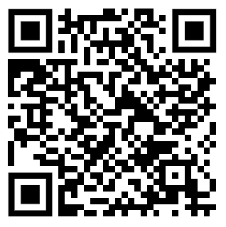
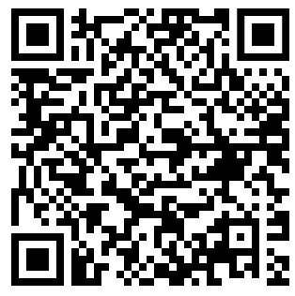
Antarctica
knowledge checkers
Antarctic Treaty
Core knowledge
Key words
Nobody owns Antarctica. It has no government or permanent population. During the 20th century, North American and European explorers raced to become the first to explore Antarctica. In 1911, Norwegian explorer Roald Amundsen became the first to reach the South Pole. His team were closely followed by Robert Falcon Scott of the United Kingdom. The expeditions were dangerous but deemed important as a show of strength and power over other nations.
Global Commons- An area that lies outside the control of any nation, for example outer space and Antarctica.
Treaty - a formal agreement between countries.
Nation - an area where its the people are led by the same government
Antarctica is a global common, which means it is outside of the control of any one country. Many countries work together in Antarctica and so the continent needs careful management to ensure that it is not destroyed.​
​
Knowledge Organiser
Take it further...
BBC
Treaty

Slide 6
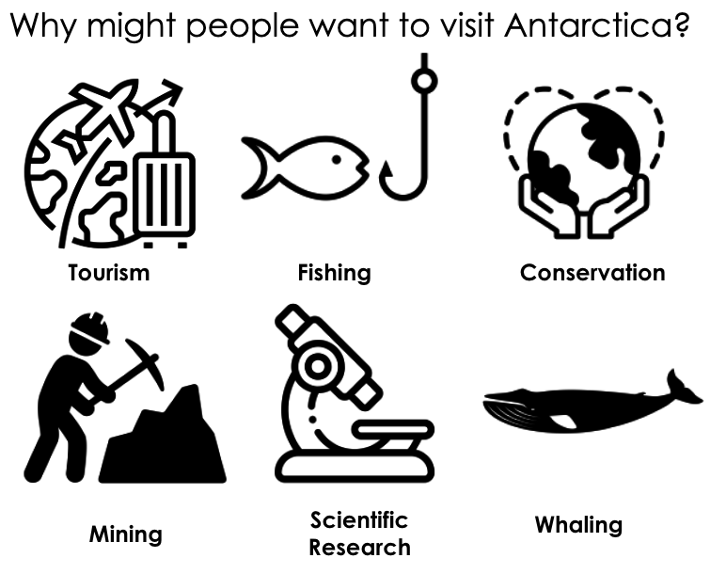
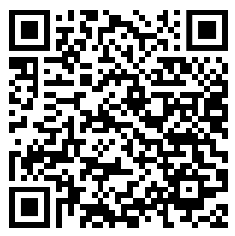
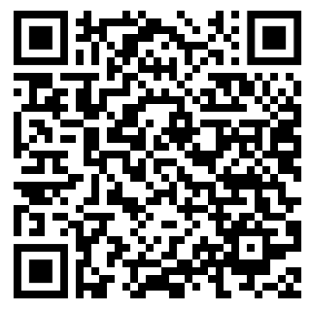
Antarctica
knowledge checkers
Tourism
Core knowledge
Key words
Antarctica's clean air, water and ice of are of importance to science for understanding how the Earth's environment is changing both naturally and as a result of human activity.
The concern for the environmental management of Antarctica is how to make good past damage and how to reduce the current and future impacts.
Extinction- when the last of a species dies and it no longer exists anywhere in the world.
Tourism – people visiting an area on holiday
Environmental Management- How the natural environment is looked after to reduce damage
Knowledge Organiser
Rules for tourists​
​
Protect Antarctic wildlife​
Respect protected areas​
Respect scientific research​
Be safe​
Keep Antarctica pristine
Impacts of tourism
Sewage and rubbish left behind by tourists can cause damage. | Tourists can help to protect the wildlife.
Tourists need toilets, equipment hire shops etc. This changes the use of the land. | Too many vehicles on the ice will cause damage.
Animals will become stressed due to the crowds of people. | Helps scientists to find information about wildlife.
Increase the love of nature in Antarctica. | Cruise ships have struck icebergs causing oil spills which damage the environment and wildlife.
Take it further...
Discover Antarctica
Impacts

Slide 7
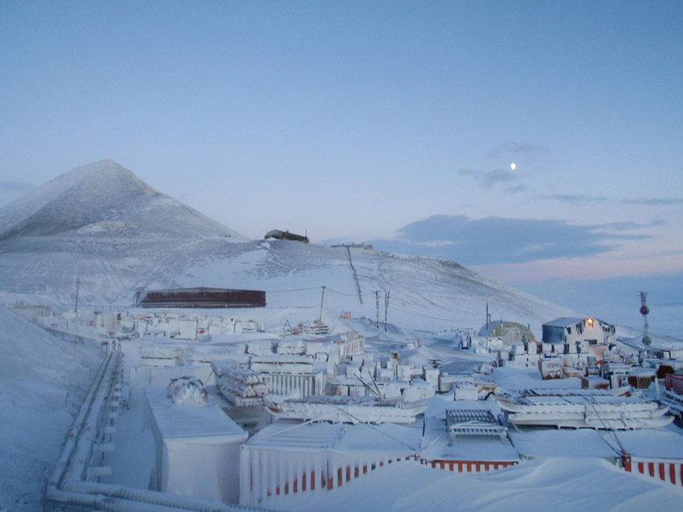
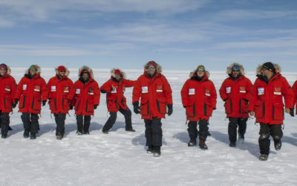
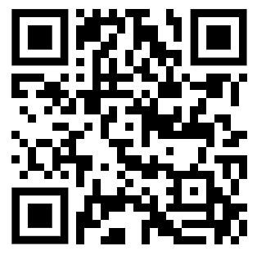
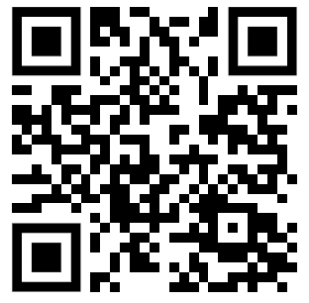
Antarctica
knowledge checkers
Working in Antarctica
Core knowledge
Ellie Honan, working with Durham University and the British Antarctic Survey, here's what she took with her.
Jobs in Antarctica are almost exclusively on National Research Stations. These stations vary in size quite considerably, typically having 40 - 50 people in the summer months, from around November - March, and a much smaller winter crew of maybe 10 - 20 from March to November (ish).
Books (for the bad weather days when you can’t leave the base)​
Moisturiser (because it’s a desert, the air is dry and you can get very dry skin and nosebleeds when you stay for a few months)​
A camera
A notebook
Teabags ​
Photos for your room of your loved ones and fairy lights to make it homey (they're very basic wooden bunk beds normally!)​
An eye mask to block out the light at night (24-hour daylight makes it hard to sleep!)​
Things that smell nice like lavender sachets - there’s nothing that smells strong in Antarctica because it’s just ice and rock, so it can be nice to have something sweet smelling for your room​
A multiplayer non- battery dependant game like cards or Yahtzee​
A teddy of some sort, because it's nice to have something from home.
The British Antarctic Survey are one of the world’s leading environmental research centres.​
They are responsible for the UK’s scientific activities in Antarctica.​
They conduct polar science both on Antarctica and in
Knowledge Organiser
the Southern Ocean.​​
They employ over 500 people in a variety of different roles.
Misconceptions
Take it further...
It is not just scientific jobs available in Antarctica, people are also employed to help people move around the sites, main the area and ensure everyone gets fed!
Jobs
Frozen Worlds

