Slide 1
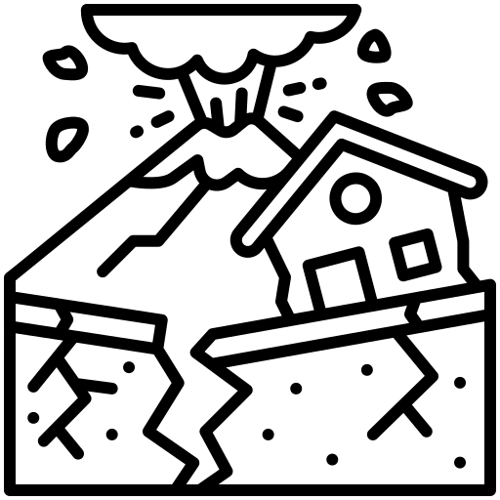
What on Earth is going on?
knowledge checkers
It is your responsibility to make sure that you are able to answer each of the questions set in the tasks below. This will be based on what you are taught in lessons and the information included the knowledge organisers.
Task 1 How many layers of the Earth are there? What are they like? What is the difference between oceanic and continental crusts? How might convection currents affect the crust? | Task 2 How do plates move at a constructive plate boundary? What hazards are created? How do plates move at a conservative plate boundary? What hazards are created? How do plates move at a destructive plate boundary? What hazards are created? | Task 3 How do we measure earthquakes? What is the difference between the two?
Task 4 What is a tsunami? How are tsunamis formed? | Task 5 What are the characteristics of a shield volcano? What are the characteristics of a composite volcano? Where are each usually found? | Task 6 What natural hazards affect the Philippines? Why would people choose to remain living in areas like the Philippines?
Knowledge Expert

Slide 2
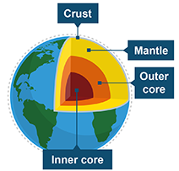
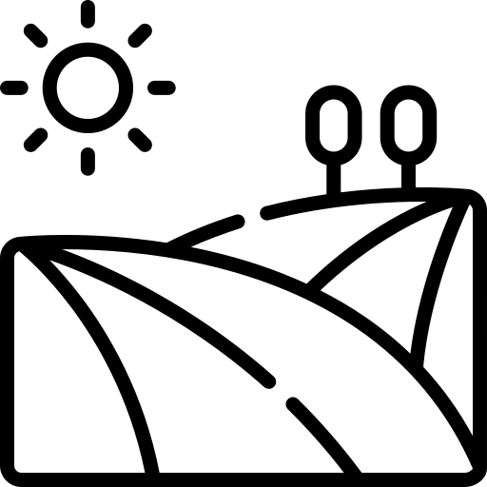
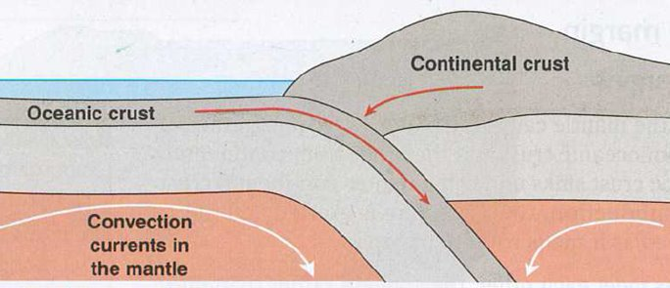
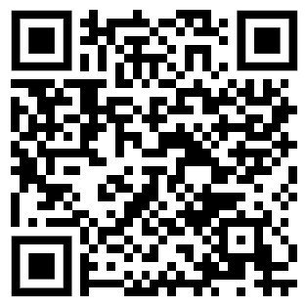
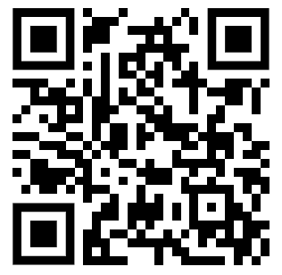
What on Earth is going on?
knowledge checkers
Structure of the Earth
Core knowledge
Key words
Earth is divided into four layers: the inner core, the outer core, the mantle and the crust.
Layer | Description
Inner core | The inner core is 2900 km below the Earth’s surface, in the centre of the Earth, and is the hottest layer. It is spherical and solid and made up of iron and nickel. Its temperatures can reach 5500°C.
Outer core | The outer core is the layer surrounding the inner core. It is made of liquid iron.
Mantle | The mantle is the layer of the Earth which makes up 84% of its volume. It is also the thickest section at approximately 2900 km thick. The mantle is made up of different layers. The upper mantle is hard but below that is semi-molten rock called magma.
Crust | The crust is the outer layer of the Earth on which we live. It is the thinnest layer and is between 5 and 90 km thick.
Oceanic Crust - found mainly under the ocean
Continental Crust - mainly found under land
Knowledge Organiser
Oceanic Crust
Newer – most less than 200 million years old​
Denser​
Can sink​
Can be renewed and destroyed
Continental Crust
Older – most over 1500 million years old​
Less dense​
Cannot sink​
Cannot be renewed and destroyed
Take it further...
BBC
Video

Slide 3
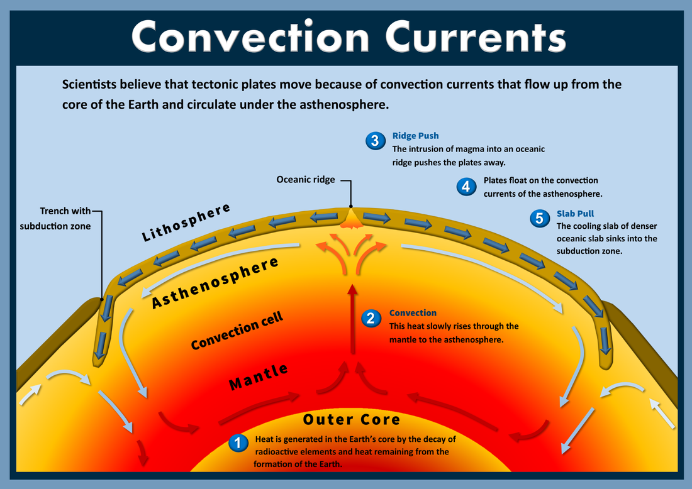
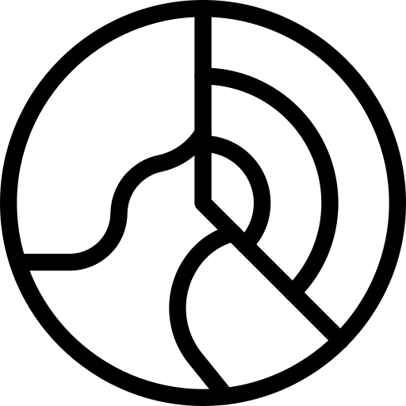
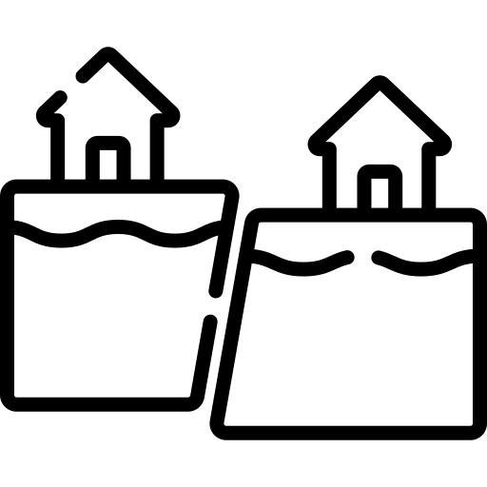
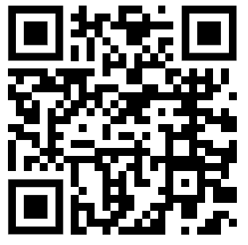
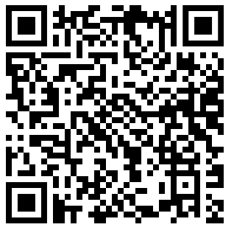
What on Earth is going on?
knowledge checkers
Convection Currents
Core knowledge
Key words
Asthenosphere - a portion of the Earth's mantle that flows like molten plastic despite being solid
Magma - Molten rock underneath the surface
Semi molten - Metal or rock that is in a state between a solid and a liquid
Continental Drift - the movement of continents resulting from the motion of tectonic plates.
Knowledge Organiser
Misconceptions
Take it further...
The heat at the core that moves the mantle is as a result of radioactive decay.
Convection Currents
TED Ed

Slide 4
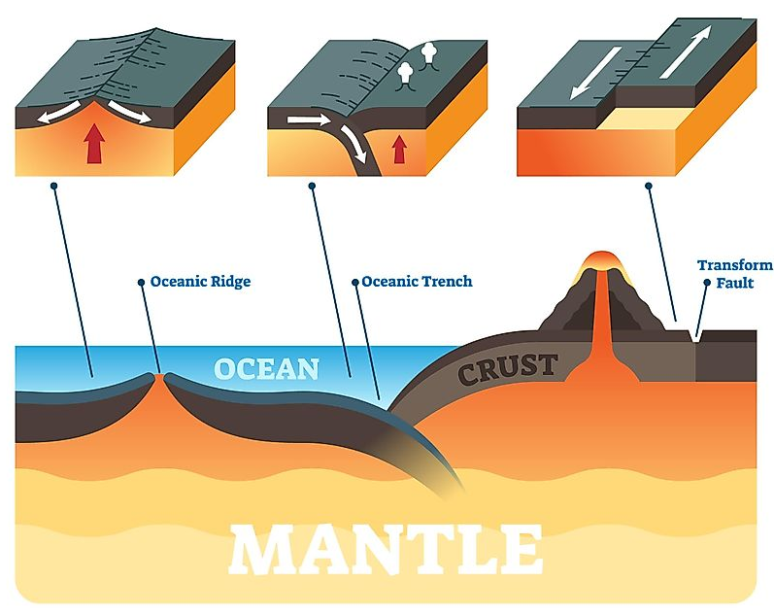
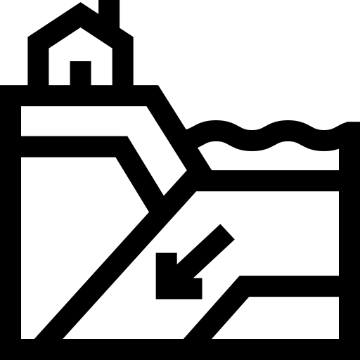
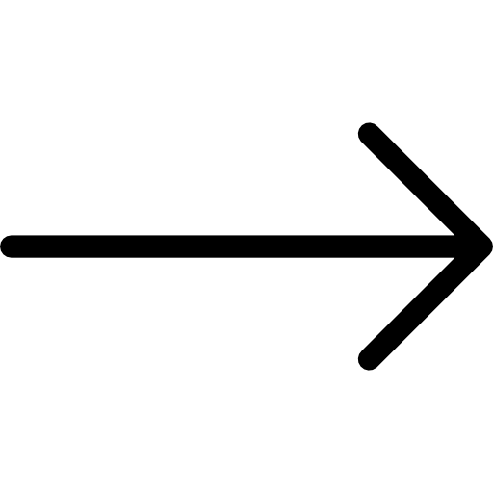
What on Earth is going on?
knowledge checkers
Plate Boundaries
Core knowledge
Key words
Constructive Plate Boundary
Destructive Plate Boundary
Conservative Plate Boundary
Plate boundary - The region where two or more tectonic plates meet. It is a zone of intense seismic activity.
Subduction - When one crustal plate is forced beneath the other.
Constructive plate boundary - An area where two tectonic plates are moving away from one another.
Destructive plate boundary - When two tectonic plates move towards each other and collide.
Conservative plate boundary - Areas between two crustal plates that are moving past each other in opposite directions or at different speeds.
Knowledge Organiser
Misconceptions
Take it further...
Plate boundaries refers to the way that tectonic plates come into contact with each other, it's not the name of the plates itself – the same plate could have different plate boundaries with several plates.
Convection Currents
TED Ed

Slide 5
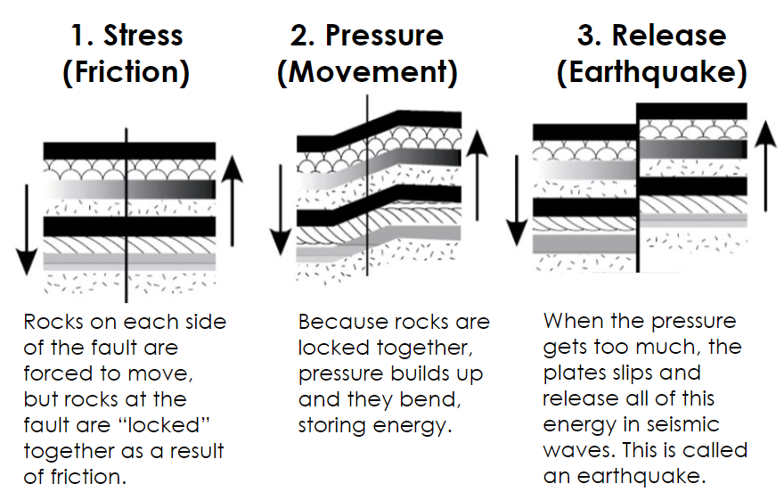
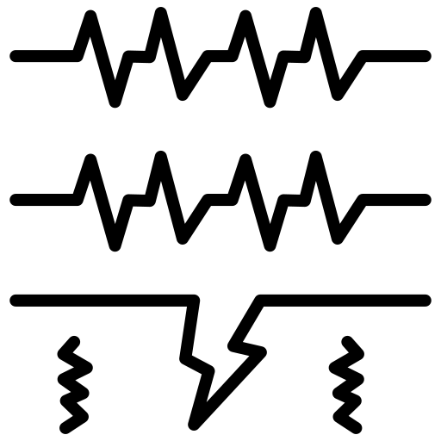
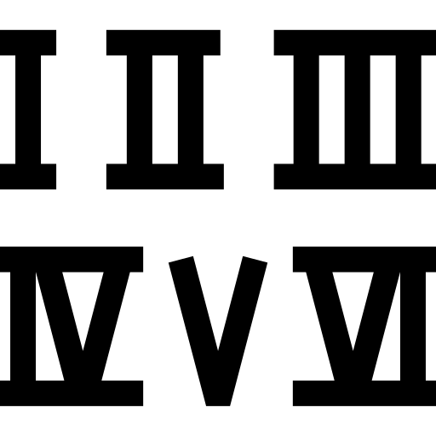
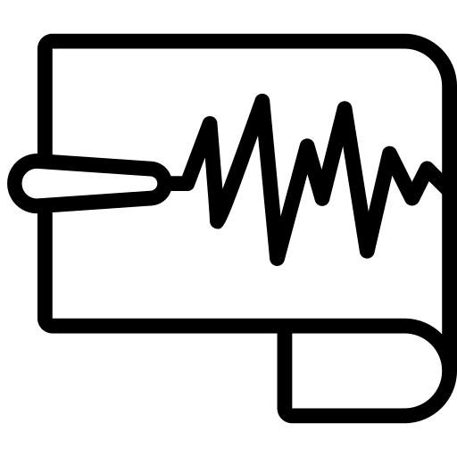
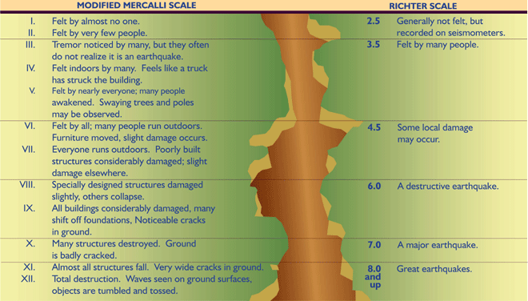
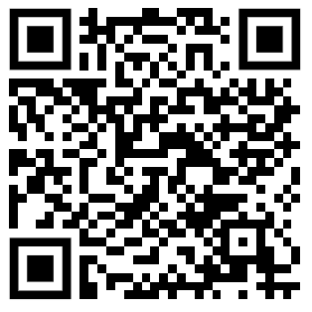
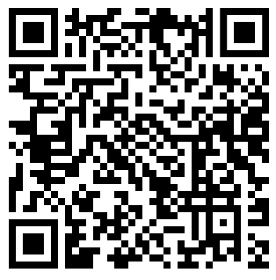
What on Earth is going on?
knowledge checkers
Earthquakes
Core knowledge
Key words
An earthquake is a sudden, violent shaking of the ground.
An earthquake occurs when two tectonic plates push together. The pressure of these colliding plates builds up inside the Earth’s crust. The point in the crust where the pressure is released is called the focus. The point on the Earth's surface above the focus is called the epicentre. When the pressure is too much it is suddenly released and waves of energy, called seismic waves, occur. These seismic waves travel through the earth causing it to shake.
Seismic waves - A wave of energy released by an earthquake.
Mercalli - measures the intensity of an earthquake by observing its effect on people, the environment and the earth's surface
Richter - The measure by which the strength of earthquakes is determined.
Knowledge Organiser
Take it further...
BBC
TED Ed

Slide 6
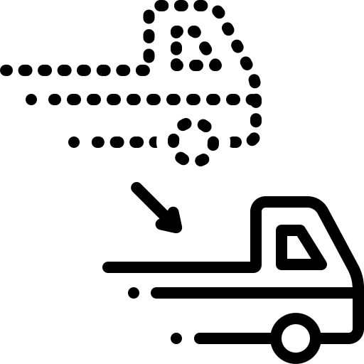
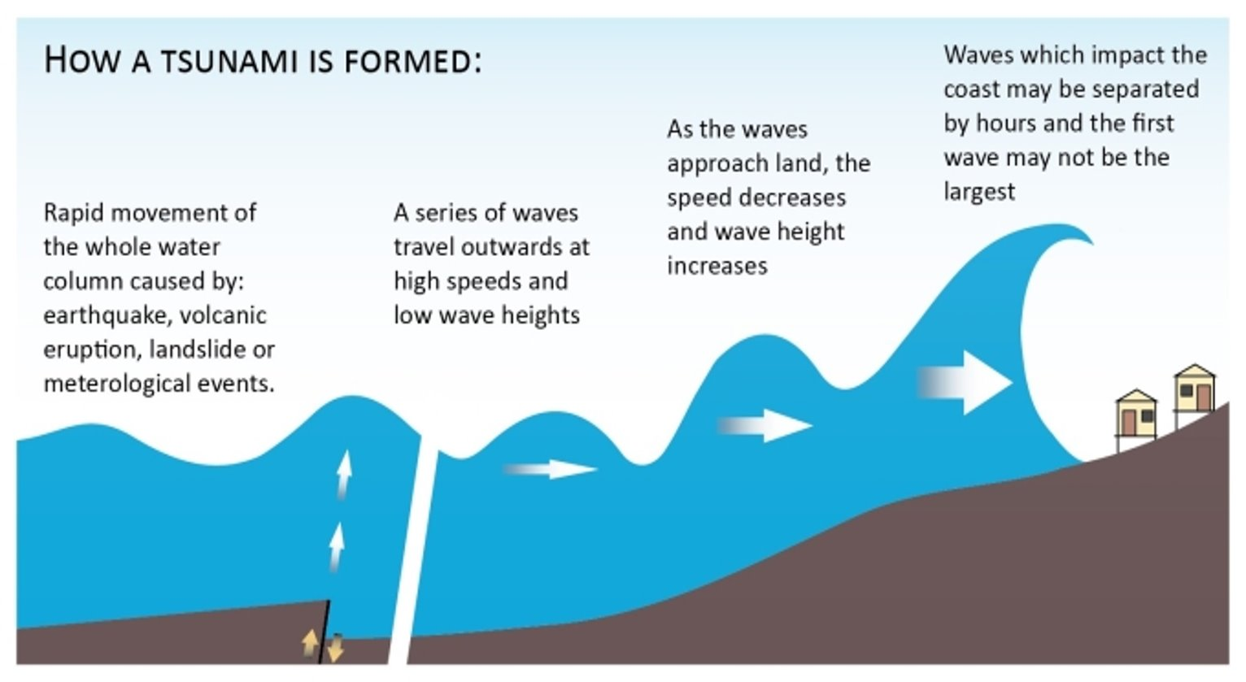
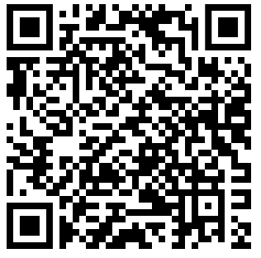
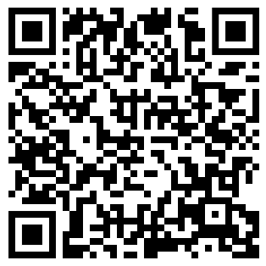
What on Earth is going on?
knowledge checkers
Tsunamis
Core knowledge
Key words
Earthquakes at sea cause water to be displaced, creating a fast-moving wave that spreads out in all directions. In the deep ocean, tsunami waves can reach speeds of up to 800 kilometres per hour. As the wave approaches shallower waters near to the shore, its speed will decrease but the waves will become higher.
Displaced - moved from its original position
Shore - the land along the edge of the sea
Retreats - moving backwards
Trough - the bottom of the wave
It is hard to see that a tsunami is approaching. The most obvious sign is when coastal water retreats just before the waves reach the shore. This is actually the trough of the wave following behind.
Knowledge Organiser
Misconceptions
Take it further...
Tsunamis are not affected by the weather, storms/hurricanes do not cause tsunamis.
BBC
TED Ed

Slide 7
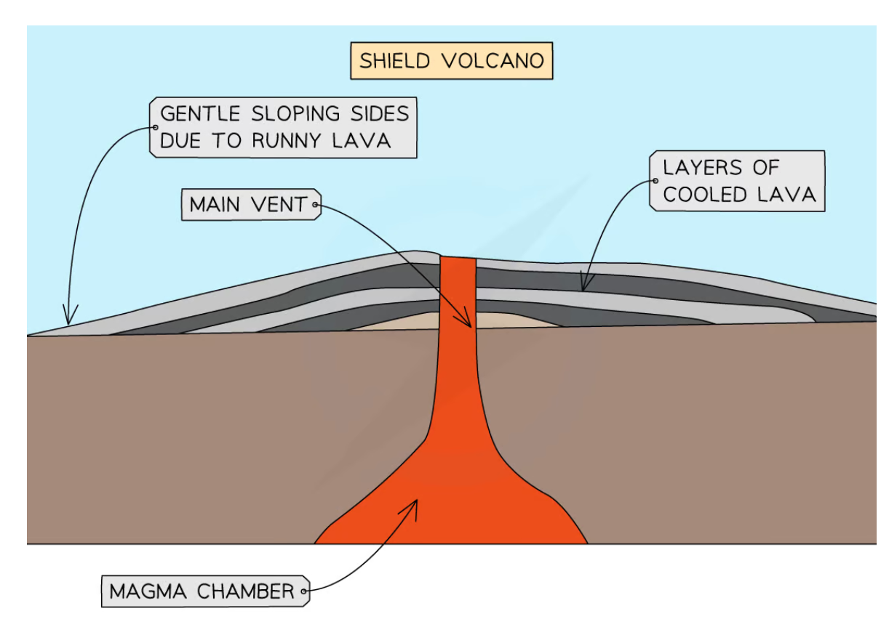
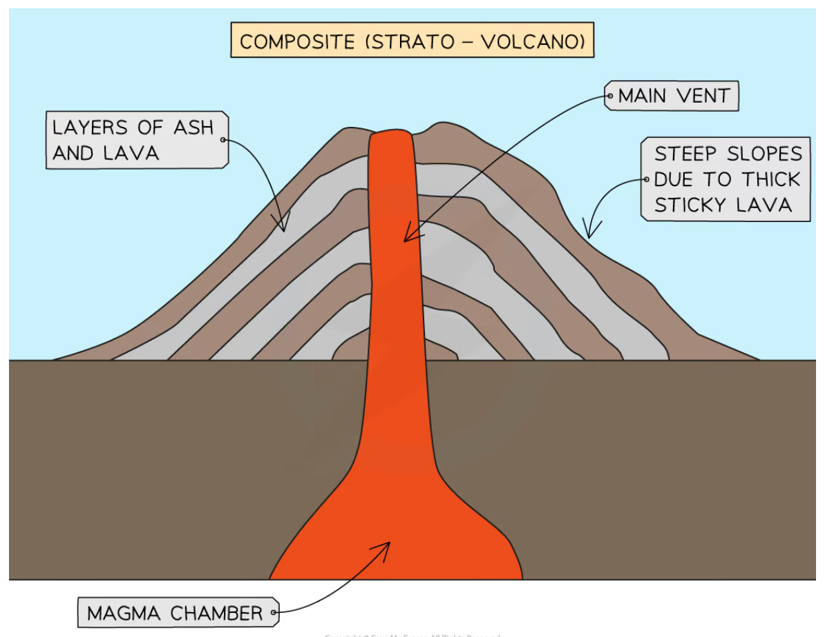
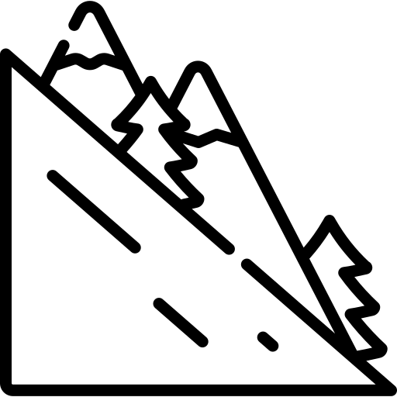
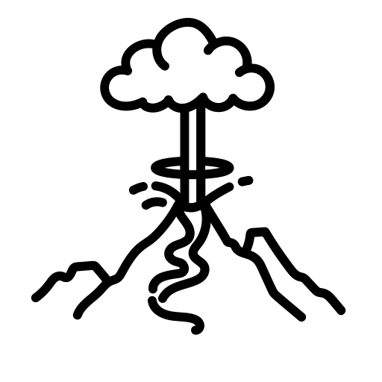
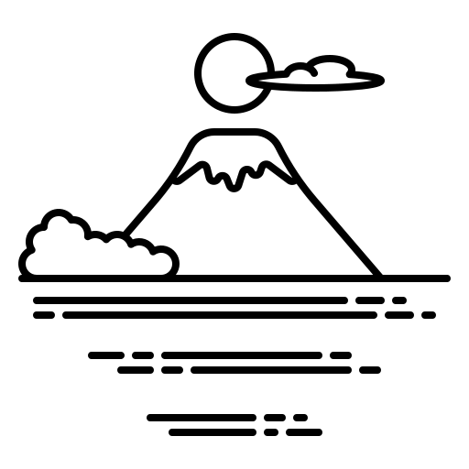
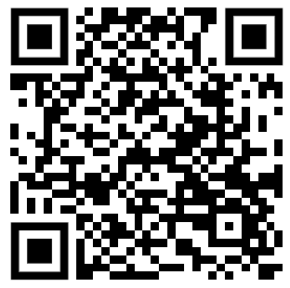
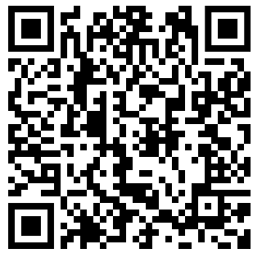
What on Earth is going on?
knowledge checkers
Volcanoes
Core knowledge
Key words
Gradient- the steepness of the land
Pyroclastic flow - superheated ash and gas that rushes down the side of the volcano.
Hot spot - an area in the mantle from which heat rises as a thermal plume from deep in the Earth
Shield Volcano
Composite volcano
Plate boundary | Constructive or Hotspots (thin crust) | Destructive (subduction) (thick crust)
Shape | Flat and symmetrical | Cone shape and symmetrical
Gradient | Gentle slopes | Steep slopes
Lava type | Runny lava, No ash | Viscous lava, Ash & dust
Explosiveness | No explosive | Very explosive
Eruption frequency | Frequent | Long periods in between
Knowledge Organiser
Misconceptions
Take it further...
Volcanoes are found at constructive and destructive plate margins. An exception to this are hot spot volcanoes.
BBC
TED Ed

Slide 8
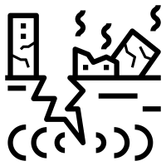
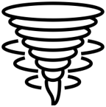
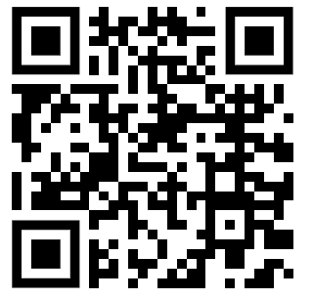
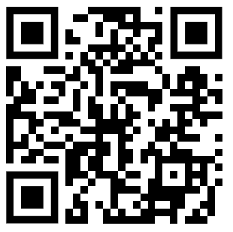
What on Earth is going on?
knowledge checkers
Multi-hazard Zones
Core knowledge
Key words
Philippines
The volcanoes of the Philippines rank as the most deadly and costly in the world.
Developing- A country that is often quite poor, has few services and a low standard of living.
Vulnerable - easily damage
Monitor - watch, keep an eye on something.
Typhoon - another name for a hurricane. A huge storm that forms over the ocean.
Sitting on the tectonically active Pacific Ring of Fire the Philippines suffers from frequent earthquakes. Most are relatively small but some are much larger.
In a total of 21 tsunamis since 1749 a total of 4,868 people died in the Philippines. ​ 1976 - 9m Tsunami contributed 4,300 of total deaths.
Knowledge Organiser
As well as being tectonically active, the Philippines is within the tropics which means they are affected by tropical storms. These can be extremely deadly. Such as Typhoon Haiyan (Yolanda) 11-13th November 2013. 6000 people were killed.
Volcanic ash makes soil very fertile for farming
Many multiple hazard zones are in developing countries so people do not have an option
Some settlements have grown into enormous cities and would be hard to move anywhere else (Rapid urbanisation)
Take it further...
Many larger/deadly volcanic and earthquake events are INFREQUENT – so people don’t think they will get caught up in a disaster.​
A good job and way of life may keep you in a danger zone
Why?
Some places are well prepared for hazards so people feel safe
Pacific Video
TED Ed

