Slide 1
Geography of My Stuff
knowledge checkers
It is your responsibility to make sure that you are able to answer each of the questions set in the tasks below. This will be based on what you are taught in lessons and the information included the knowledge organisers.
Task 1 What is the Brandt Line? Why is the Brandt Line not always a good way to judge a country? What other development indicators can we use? | Task 2 What are food miles? Why are we concerned by them? What changes can we make about the food we choose to eat? What is a carbon footprint? | Task 3 How does plastic end up in the ocean? Why is it a problem? What can be done to reduce the amount of plastic in the ocean?
Task 4 What is palm oil? What is it used for? Why is palm oil a problem? What can we do about it? | Task 5 What is CT? Why are we concerned about it? | Task 6 What are the 3R's? What can you do to meet the 3R's?
Knowledge Expert

Slide 2
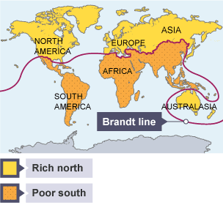
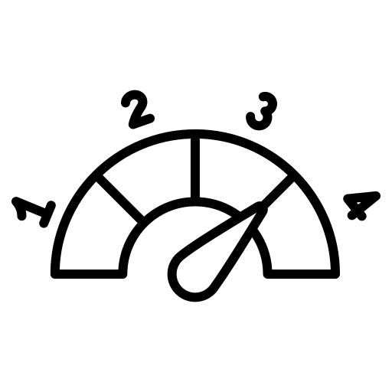
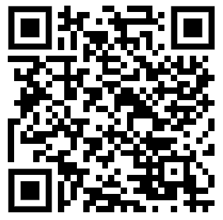
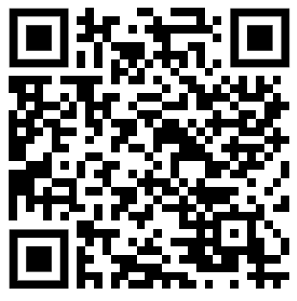
Geography of my Stuff
knowledge checkers
Levels of Development
Core knowledge
Key words
In the past, the Brandt Line (A line that separates countries in the rich north of the world from those in the poorer south.) divided the planet into the rich north and the poor south. However, the world has changed a lot in the last 20 years and the Brandt line is now too simplistic. For example, China and India are no longer seen as poor countries
Development indicator - a method used to measure how developed a country or region is. Development indicators can then be used to compare levels of development between countries or regions.
Wealth - the value of all the resources that are possessed by an individual or society
Developed - one that is considered to have a high standard of living, such as: good housing. good education system. longer life expectancy.
Developing - one that is considered to have a lower standard of living, such a lack of medical care, limited access to education, more people working in agriculture
Per capita - per person
Knowledge Organiser
Measure of development | Description
Birth rate | The number of live births per 1,000 people. Birth rates are often high in a less developed country.
Death rate | The number of deaths per 1,000 people. High death rates can indicate a less developed country.
GNI per capita | Gross national income per person. The value of a country's income, divided by the number of people in that country.
Infant mortality rate | The number of babies who do not survive to the age of 1 per 1,000 live births.
Life expectancy | The average age that a person may live to.
Literacy rate | The percentage of adults who can read and write.
Take it further...
Brandt Line
Development Indicators

Slide 3
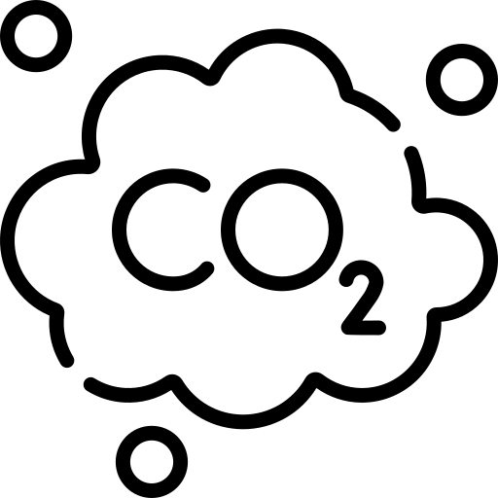
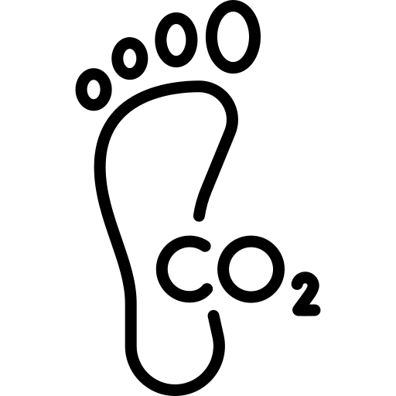
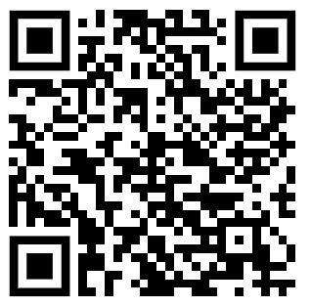
Geography of my Stuff
knowledge checkers
Food Miles
Core knowledge
Key words
The further a piece of food has to travel to be eaten, the worse it is for the environment. This is because it will have to be transported by lorry, boat and/or plane, using fuels that harm the environment.
If we eat food that has been grown locally, it won't have travelled as far to get to us. This means it will have less of an impact on the environment.
Seasonal foods are fruit and vegetables that are ripe and ready in a particular season. If we want to eat fresh strawberries during winter time we need to import them from other countries or grow them in greenhouses that use heating and lighting powered by electricity.
Knowing when food is being grown locally can help us to eat a sustainable, local diet, reducing food miles and helping the environment.
Plant-based foods are fruits, vegetables, beans, nuts, grains, seeds and even seaweed!
Growing plants for food needs land and energy but the plants get most of that energy from the sun.
Keeping animals for meat, eggs or dairy needs more energy. The animals get energy from food but just like us, a lot of that energy is used for movement and bodily functions. Much less of the energy goes towards food for people.
Another problem is that cows produce a lot of methane. This is a greenhouse gas that contributes to global warming.
Eating more plant-based foods can make our diet more sustainable
Around 4.5 million tonnes of food are wasted in the UK each year. Some of the waste is out of date food from shops and supermarkets, or leftover food from restaurants. We waste lots of food at home too.
Food miles- the distance food has travelled to get to your plate. Food must travel from the farm it is grown on or the factory it is made in to a supermarket or shop to be sold.
Carbon emissions: harmful gases such as carbon dioxide are released into the Earth’s atmosphere when we use fossil fuels to provide energy. We need energy to grow, produce and transport food.
Carbon footprint - the amount of carbon dioxide released into the Earth's atmosphere as a result of human activities, rather than any natural emissions
Knowledge Organiser
Take it further...
Food Miles
Food Miles Calculator

Slide 4
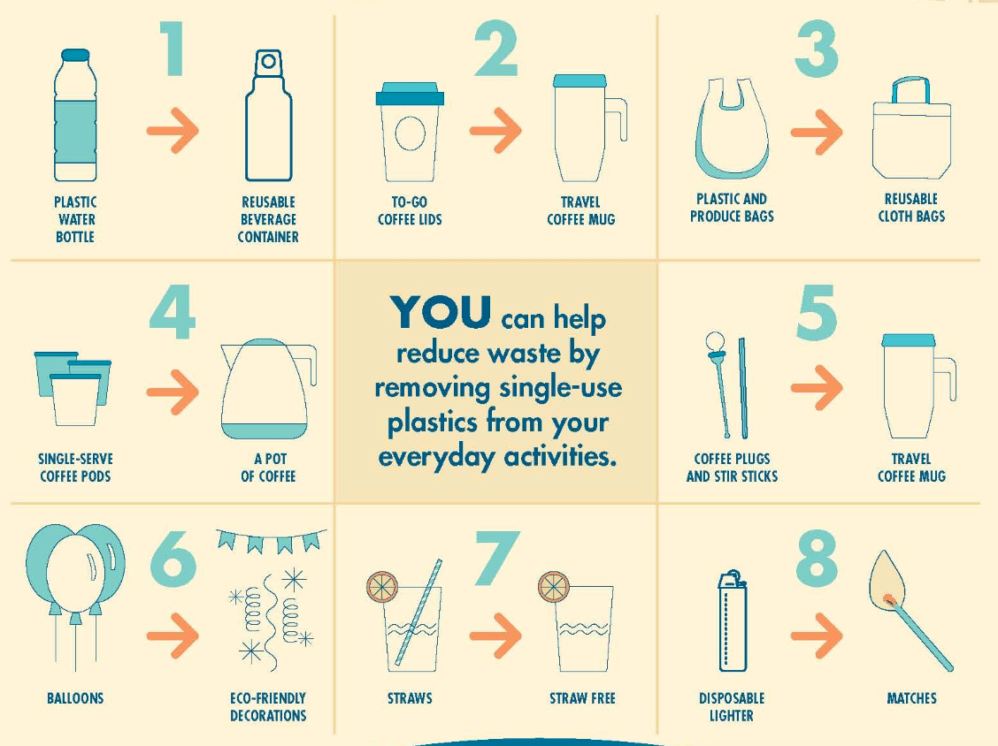
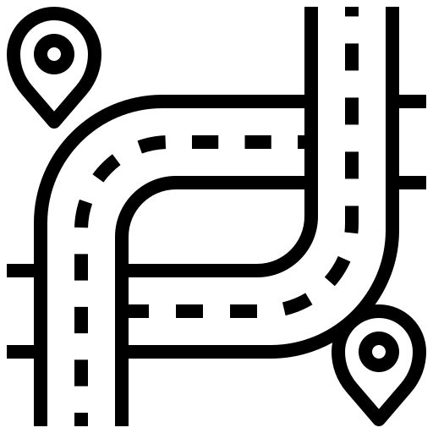
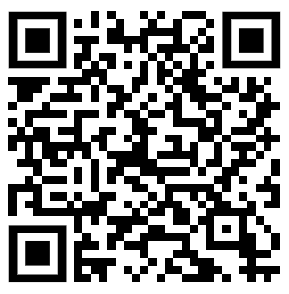
Geography of my Stuff
knowledge checkers
Plastic Pollution
Core knowledge
Key words
Around 80 per cent of the plastic waste found in the oceans today originated inland. Littering, poor waste management and industrial activity can all allow plastic to enter the natural environment.
A significant proportion of this then blows into rivers and streams, which carry it into the ocean. This is particularly common in countries where waste infrastructure is lacking: an estimated two billion people worldwide don’t have access to solid waste collection.
Littering - dropping waste on the ground
Waste management - the various schemes to manage and dispose of waste
Industrial activity – the processes involved in making, or processing goods on a large scale
infrastructure - the basic facilities and systems a country needs. Examples of infrastructure include road and rail network and telecommunications networks.
Knowledge Organiser
Take it further...
Green Peace
That Bad?

Slide 5
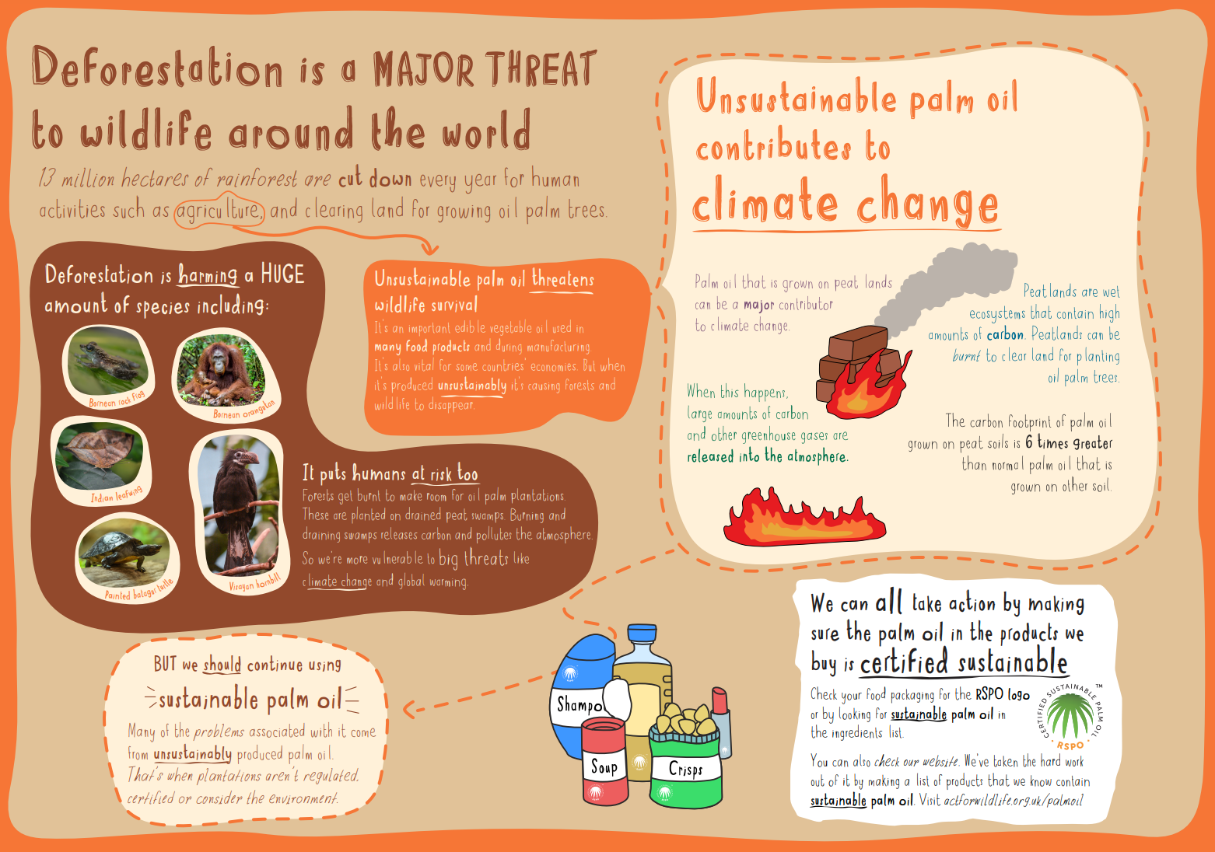
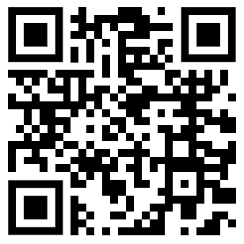
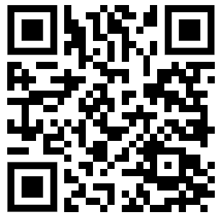
Geography of my Stuff
knowledge checkers
Palm Oil
Core knowledge
Palm oil can be found in many things, from make-up to pizza, soap to chocolate.
Palm oil is a type of oil which can be extracted from the fruit of the oil palm. These trees are originally from Africa, but are now widely grown in Malaysia and Indonesia.
Palm oil is a highly-efficient oil crop because it takes less land to produce the same amount of oil as other varieties.
However, because it’s in such high demand, increased production has led to deforestation and the destruction of habitats, putting species like the orangutan at risk.
Improvements can be made to how palm oil is harvested and produced, minimising the impact on nature while supporting the livelihoods of local communities. We can help by checking what the things we buy are made of and trying to make the most sustainable choices.
Knowledge Organiser
Key words
Take it further...
Deforestation- The removal of trees. This is sometimes done to make land for farming, roads or settlement.
The problem
Chester Zoo

Slide 6
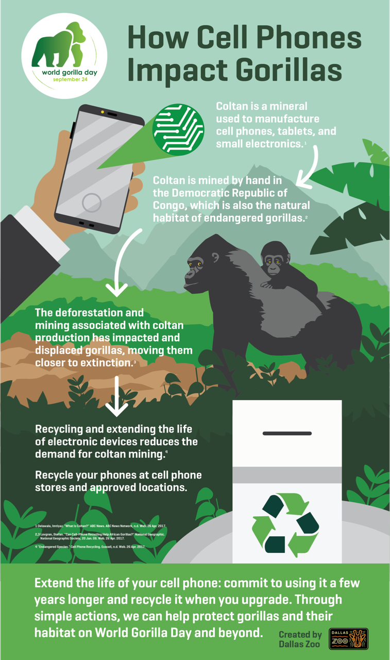
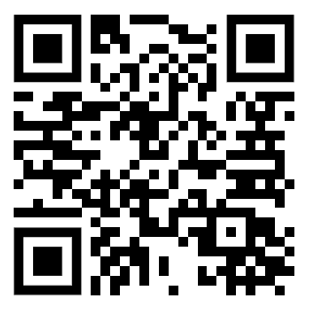
Geography of my Stuff
knowledge checkers
The Three R’s and Mobiles
Core knowledge
Key words
Consumers have a big role in looking after the environment through the products they buy. The Three Rs Rule: Reduce, Reuse and Recycle.
Reduce: it is important to reduce consumption in the first place – stopping the creation of waste, changing our consumption habits and buying products responsibly.
Reuse: products can be used more than once, repaired if they are not working or even used for something entirely different - like using newspapers to make pots for planting seeds in.
Recycle: only when the first two options aren’t available should we recycle, which means reintroducing waste materials into the production cycle as raw materials to produce new goods.
The reason why recycling is the last option is that it takes a lot of resources and energy to turn the waste back into a raw material.
Coltan - Columbite Tantalite is ideal for making capacitors, which are used in many electronic devices, including mobile phones
Product - something we buy
Consumer - a person who buys or uses a product
Knowledge Organiser
Take it further...
Just
3 R’s
Cobalt

