Slide 1
KS3 Coasts
It is your responsibility to make sure that you are able to answer each of the questions set in the tasks below. This will be based on what you are taught in lessons and the information included the knowledge organisers.
Task 1 What is the coastline? Why might people want to live near the coast? | Task 2 What causes waves? How are waves formed? What is the difference between constructive and destructive waves? | Task 3 How do waves break down rocks and cliffs? Can you name and describe the four types of erosion? Can you explain how headlands and bays are created? k
Task 4 How is a headland affected by erosion? Can you describe the correct sequence of erosion of a headland? | Task 5 Can you name and describe the 4 main types of transportation? Explain longshore drift and why material moves in a zig zag pattern. Can you explain how longshore drift is linked to the formation of a spit? | Task 6 What is the difference between hard and soft engineering? How can we protect the coastline from erosion?
Knowledge Expert

Slide 2
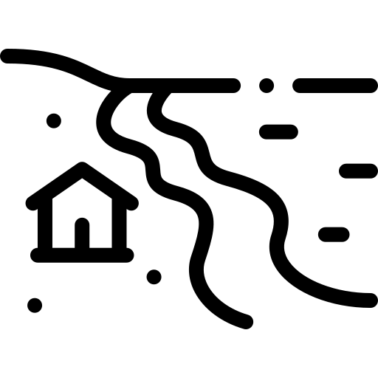
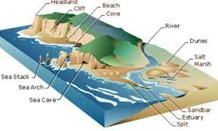
KS3 Coasts
knowledge checkers
Lesson 1
What is the coast
Core knowledge
Key words
Across the planet the coastal areas are generally well populated. Although coastal zones account for less than 15% of the world land area , they are home to more than 40% of the world population.
In Europe alone, around 50% of the population lives within 50 kilometres of the sea!
People live near the coast for many reasons including access to transport facilities such as sea ports, for fishing, for tourism, for a good climate and for flat land.
However, the coastal zone is vulnerable to flooding, wave erosion and damage to the delicate ecosystem. This means that coastal land is well-populated and economically valuable, but also vulnerable, so protecting it is important. The costs of protecting it can be justified because the cost of doing nothing will be greater than that of installing coastal defences.
Many people have an interest in the coast; people who live there, tourists, business owners who rely on tourism, the fishing industry, sea transport networks, railways, roads, power stations needing access to water, and many more.
Coastline – the area where the land meets the sea.
Knowledge Organiser
Misconceptions
Take it further...
Multiple processes can occur at the same time on the coastline.
What is the coast?

Slide 3
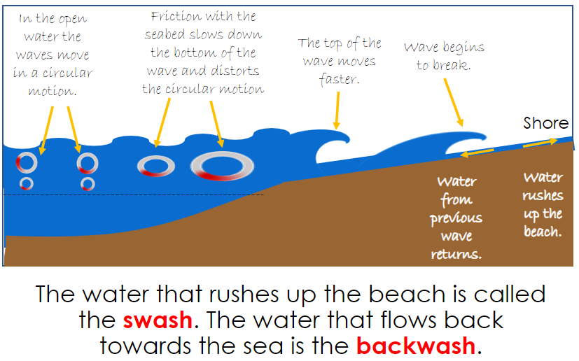
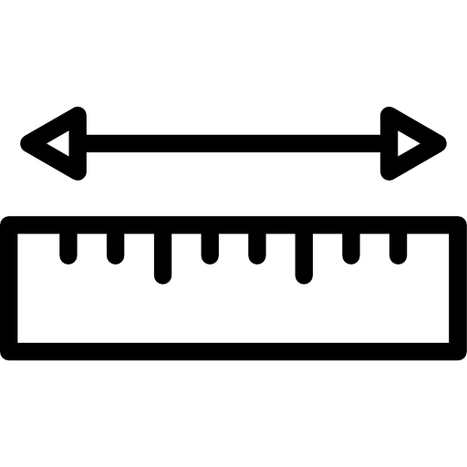
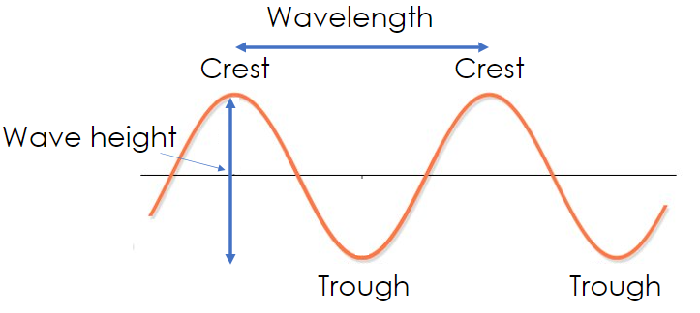
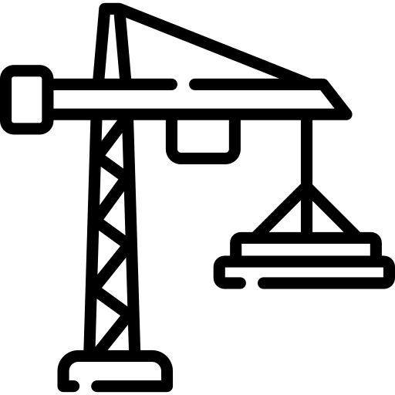
KS3 Coasts
knowledge checkers
Lesson 2
Waves​
Core knowledge
Key words
Waves are caused by energy transfer from the wind to the sea. As the wind blows over the surface of the sea, it creates friction forming waves. The size of the fetch will affect the strength of the waves.
Fetch - is the distance a wave travels
Wave length – distance between the crest (top) of two waves
Constructive waves - Waves which help build up material on the beach.
Destructive waves - Waves which remove material from the beach.
Knowledge Organiser
The characteristics of a constructive wave are:
small waves, with low wave height and long wavelength
occurs in calm conditions, without much wind
strong swash and weak backwash
the strong swash brings sediments to build up the beach
the backwash is not strong enough to remove the sediment
the waves are low and further apart
The characteristics of a destructive wave are:
weak swash and strong backwash
occurs in stormy conditions, with strong winds
the strong backwash removes sediment from the beach
the waves are steep and close together
tall waves with short wavelength
they arrive quickly and have a high frequency – a lot of them come in a short period of time
Take it further...
BBC
Video

Slide 4
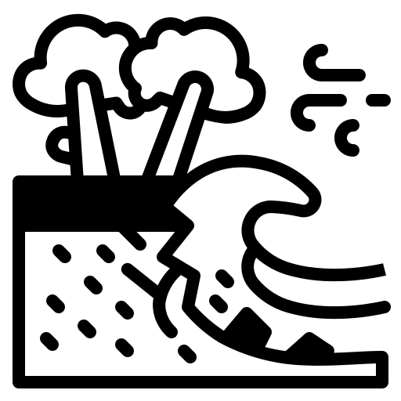
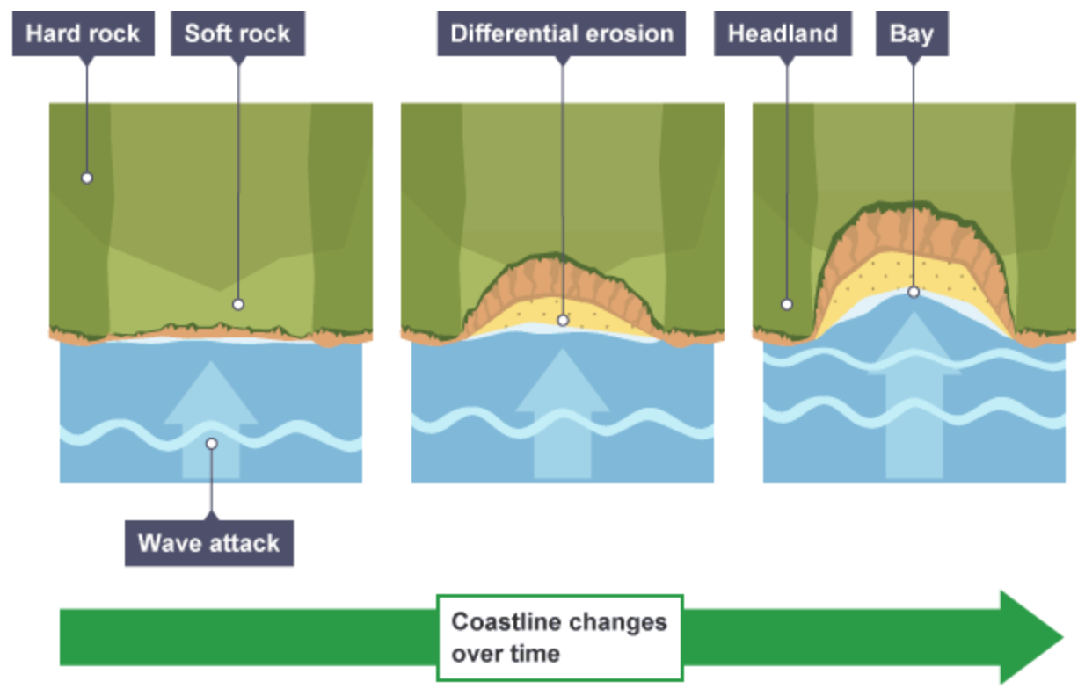
KS3 Coasts
knowledge checkers
Lesson 3
Coastal Erosion​
Core knowledge
Key words
Hydraulic action | Waves force air into cracks in the rock. This pressure helps to break the rock up.
Abrasion | Sand, pebbles and large stones scrape against the rock, wearing it away like sand paper.
Attrition | Chunks of rock get knocked together and worn into smaller and smaller pieces.
Solution | Substances in the water dissolves material from the rock.
Erosion - the wearing away of rocks by the action of the sea​
Coastline – the area where the land meets the sea.
Knowledge Organiser
Take it further...
Headlands and bays. Bands of soft rock such as clay and sand are weaker and therefore they can be eroded quickly. This process forms bays. A bay is an inlet of the sea where the land curves inwards, usually with a beach. Hard rock such as chalk is more resistant to the processes of erosion. When the softer rock is eroded inwards, the hard rock sticks out into the sea, forming a headland.
BBC
Video

Slide 5
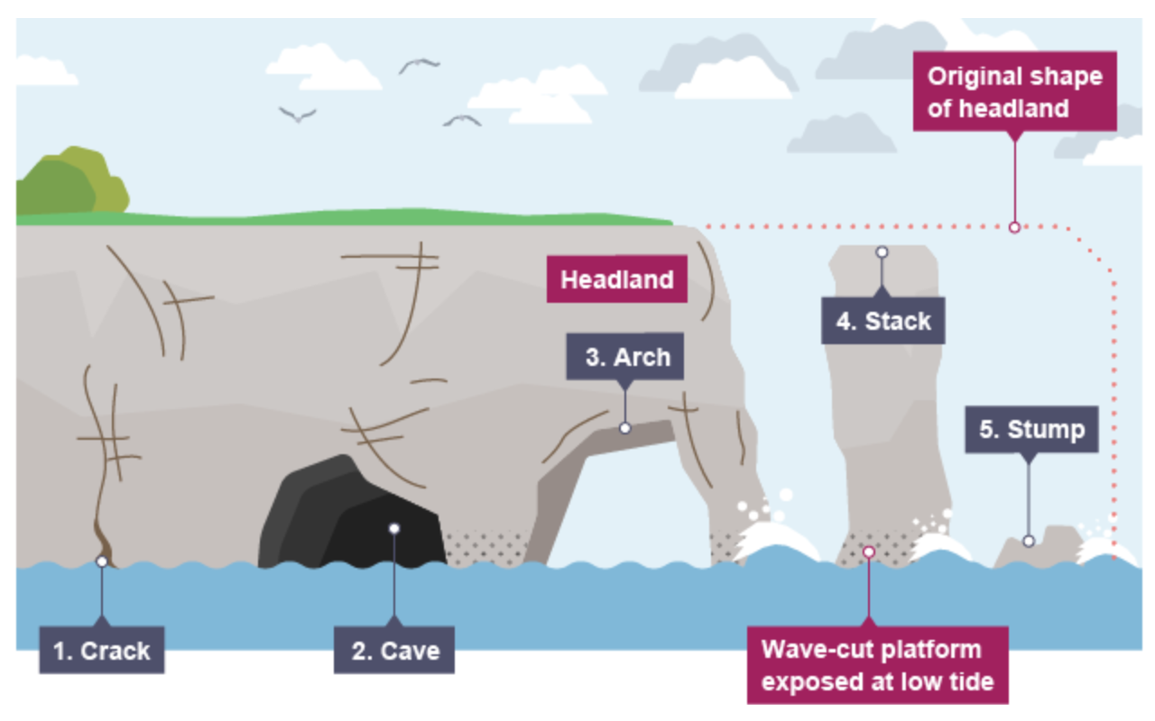
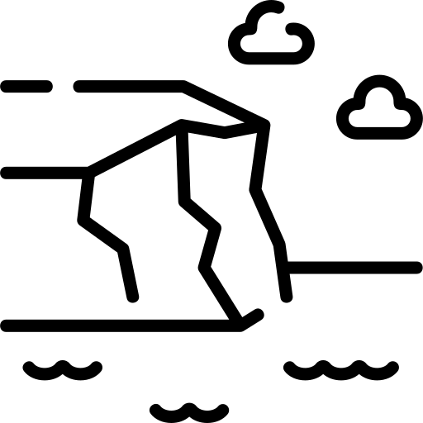
KS3 Coasts
knowledge checkers
Lesson 4
Erosion of a headland
Core knowledge
Key words
Erosion of a headland​
Cracks are formed in the headland through the erosional processes of hydraulic action and abrasion.
As the waves continue to grind away at the crack, it begins to open up to form a cave.
Hydraulic action - Waves force air into cracks in the rock. This pressure helps to break the rock up.
Abrasion - Sand, pebbles and large stones scrape against the rock, wearing it away like sand paper.
Headland – an area of hard rock cutting out into the sea.
Knowledge Organiser
The cave becomes larger and eventually breaks through the headland to form an arch.
The base of the arch continually becomes wider through further erosion, until its roof becomes too heavy and collapses into the sea. This leaves a stack (an isolated column of rock).
The stack is undercut at the base until it collapses to form a stump.
Misconceptions
Take it further...
Many of these features of erosion can be present on any part of the headland at any time.
BBC
Video

Slide 6
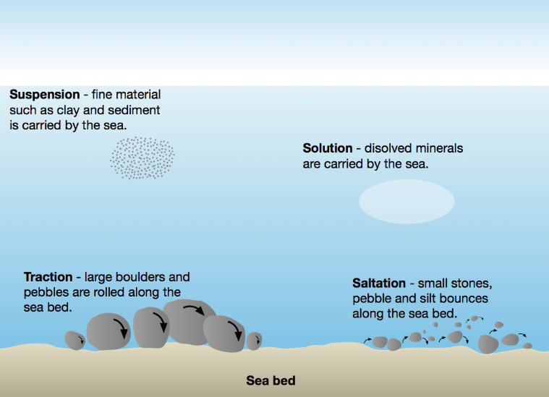
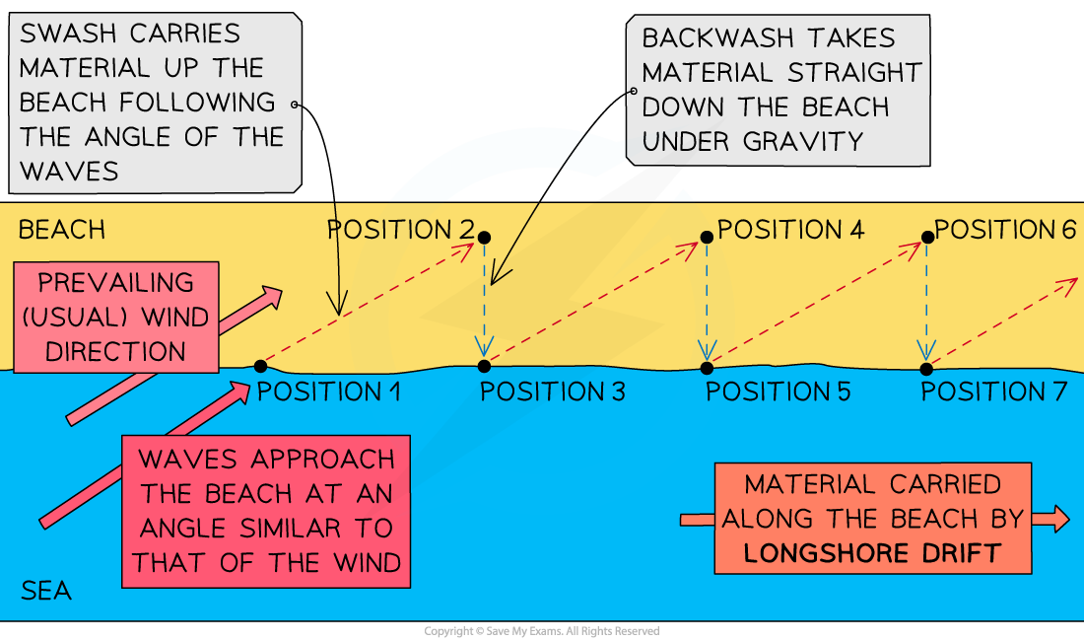
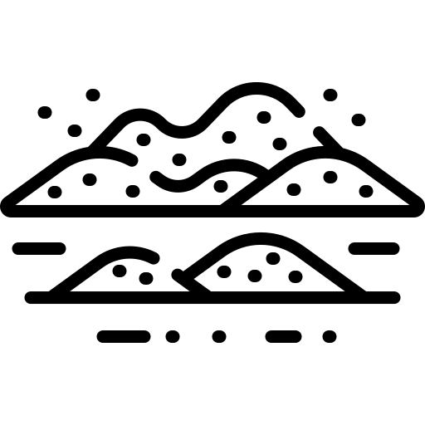
KS3 Coasts
knowledge checkers
Lesson 5
Transportation
Core knowledge
Key words
Coastal transportation - the movement of material in the sea and along the coast by waves.
Swash – The water flowing towards a beach when a wave breaks.
Backwash – The movement of water down the beach.
Sediment - Small fragments of rock and soil that form layers.
Prevailing wind - The most common wind direction
The energy of the waves will allow the water to move sediment. They way that they are moved will depend on the size and weight of the sediment and the power of the waves.
Movement of sediment along the beach is known as longshore drift.
Knowledge Organiser
Take it further...
BBC
Video

Slide 7
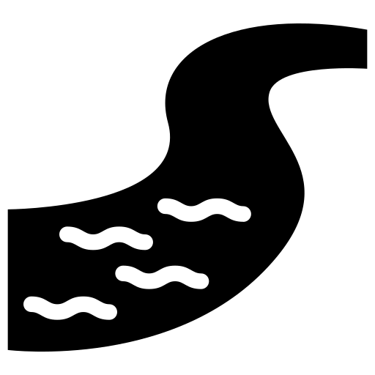
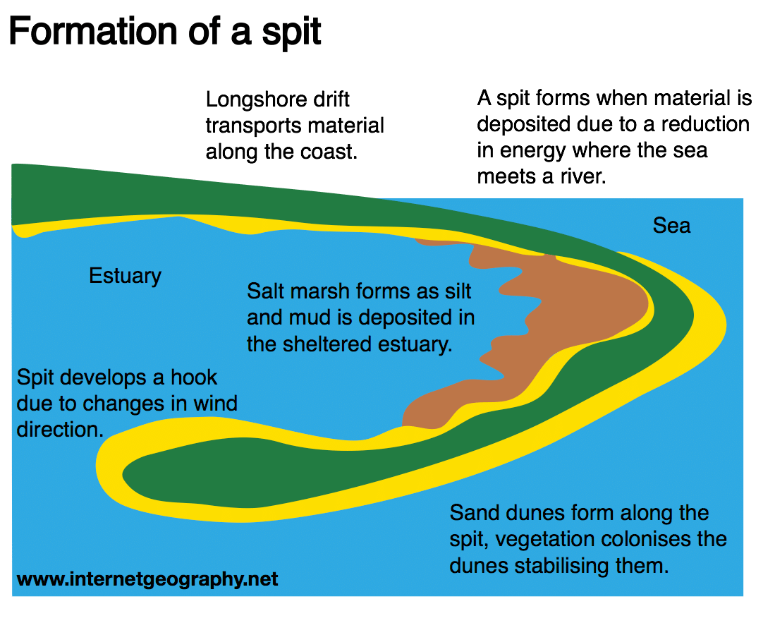
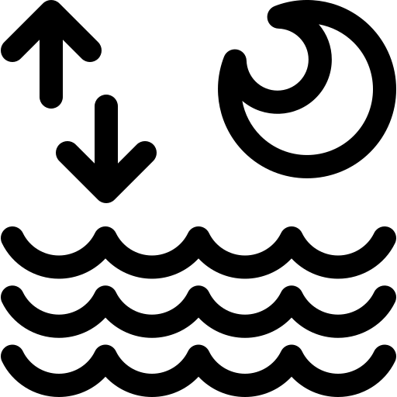
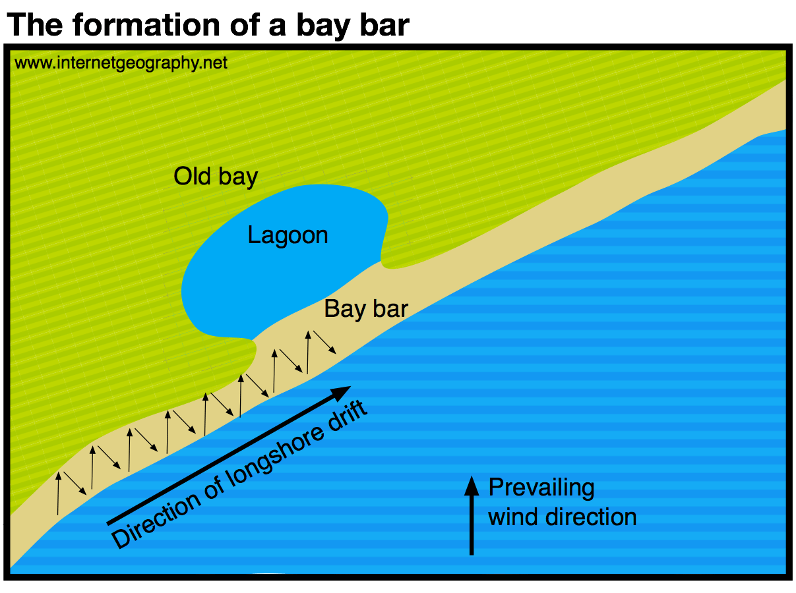
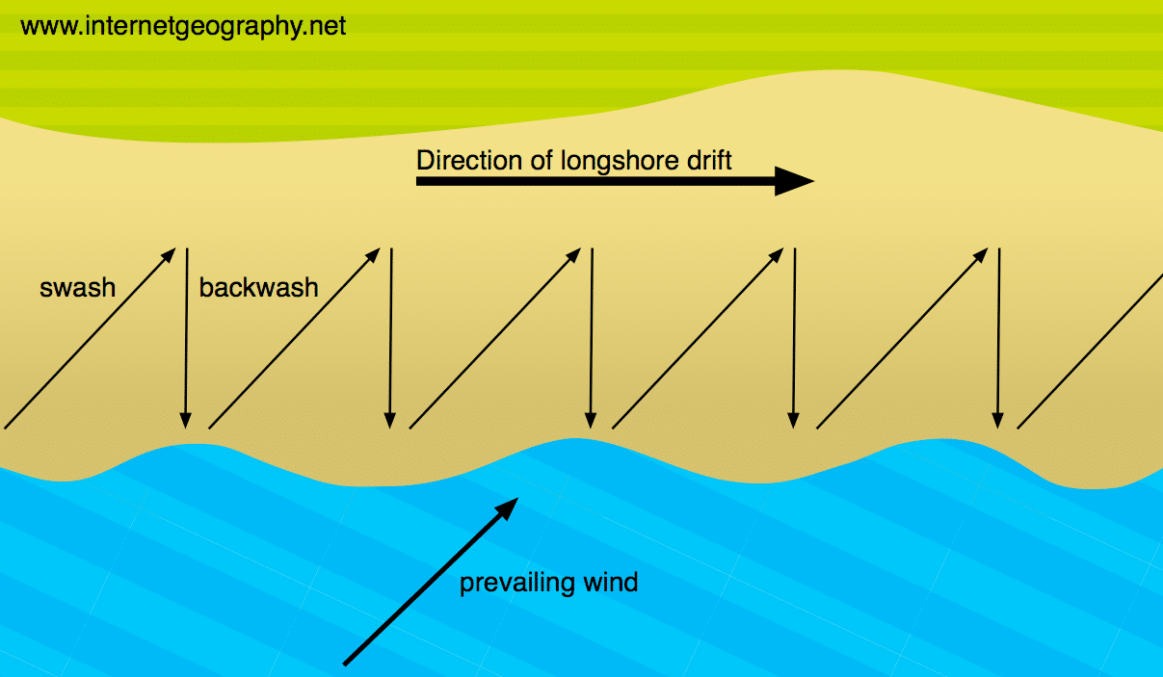
KS3 Coasts
knowledge checkers
Lesson 6
Beaches and Spits
Core knowledge
Key words
Deposition is when material that is being transported is dropped by constructive waves. It happens because waves have less energy.
Deposition is likely to occur when:
waves enter an area of shallow water
waves enter a sheltered area, eg a cove or bay
there is little wind
a river or estuary flows into the sea, reducing wave energy
Deposition - when material is dropped by the sea
Estuary – where the mouth of the river is tidal
Tidal – affect by the tides, the sea rising and falling.
Longshore drift – the zigzag motion of material along the coastline.
Knowledge Organiser
Misconceptions
Take it further...
A lagoon is only found behind a bar NOT a spit.
BBC
Video

Slide 8
KS3 Coasts
knowledge checkers
Lesson 6
Coastal Management​
Core knowledge
Key words
 | Description | Advantages | Disadvantages
Sea walls | Walls are built at the back of beaches to reflect waves back to the sea. | They prevent erosion but not the movement of sediment, which can affect other areas. Wel maintained walls can last for years. | They create a strong backwash ,which can erode wall foundations. Expensive to build and maintain.
Rock armour / rip rap | Large boulders are placed along the coastline to absorb the power of waves. | It is highly effective at absorbing wave power. It is relatively cheap, quick to build and easy to maintain. | Boulders are often sourced from other locations and may appear unsightly next to local geology.
Groynes | Concrete or wooden barriers are built at right angles to the beach to prevent longshore drift, trap sediment and absorb the power of waves. | They are relatively cheap and effective at preventing erosion. They create larger beaches, which can attract more tourists. | The restriction of movement of sediment may simply move the problems of erosion further down the coast.
Gabions | Wire cages filled with rocks are placed at the base of cliffs to absorb wave energy. | They are cheap and easy to construct. They are often made from local materials. | The wire cages are ugly and can erode within 10 years. Can become dangerous.
Beach nourishment and reprofiling | Sediment is either added to the beach from elsewhere or shifted from the bottom of the beach to the top. | These processes create a wider beach, which slows waves and provides greater protection from erosion and flooding. | These processes are expensive and must be repeated regularly. Beach access may be restricted during construction.
Dune regeneration | Dunes are created or restored by adding more sand (nourishment), building fences or planting vegetation. | Dunes form an effective barrier between land and sea, and they help maintain natural habitats. | The method is expensive and requires a lot of maintenance.
Hard engineering -involves the use of man-made structures to reduce the erosive power of waves
Soft engineering – works with the natural environment to protect coastal areas.
Shoreline Managment Plan – what actions will be taken to protect the coastline, if any.
Knowledge Organiser
Take it further...
Managed retreat allows land to become naturally flooded, creating an area of marshland or mudflats that protects inland areas. This is a cheap, natural option. However, large areas of agricultural land may be lost.
BBC Bitesize
Internet Geography

