Slide 1
It is your responsibility to make sure that you are able to answer each of the questions set in the tasks below. This will be based on what you are taught in lessons and the information included the knowledge organisers.
Task 1 What are the main types of crime? How have crime levels changed in the UK/ How have crime levels changes in South Ribble? | Task 2 Can you draw an accurate bar graph? Can you read an OS map using 4 and 6 figure grid references? | Task 3 What three things affect the location of crime? Can you explain which each of these can affect crime levels? Why is it useful to know where crimes occur?
Task 4 How are communities affect by crime? How are services affected by crime? What are some of the knock on effects of these for people? | Task 5 What is a flood? What are the natural/physical causes of flooding? What are the human causes of flooding? | Task 6 How can we reduce crime in public areas? How can we reduce crime in our homes and communities? How can shops and services reduce crime?
Knowledge Expert

Slide 2
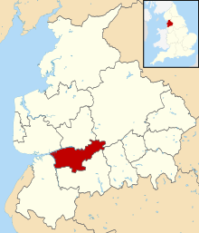
Crime
knowledge checkers
L1 – What is crime?
Core knowledge
Key words
Classification of crime
South Ribble has been shown to have had the biggest decreased in crime anywhere in the UK
Crime - An offence punishable by law
Burglary – Stealing from a house or building
Robbery – Stealing from a person.
Rape - sexual or indecent sexual act, inflicted on someone without their consent
Rape
Burglary
South Ribble includes areas such as Leyland and Penwortham
Vehicle
Drugs
Knowledge Organiser
Robbery
Damage
South Ribble has seen declines in all crimes. With theft seeing the biggest decline.
Assault
Fraud
Misconceptions
Further reading
One major misconception is that crime is on the rise. However, national statistics are showing that crime is decreasing across the UK.
Police website
Crime in my area

Slide 3
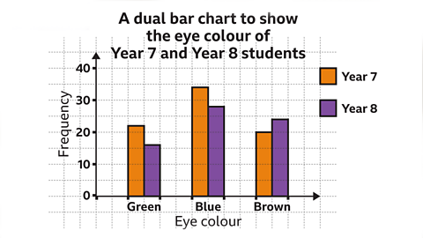
Crime
knowledge checkers
Lesson 1 – Geographical skills
Core knowledge
Key words
A bar chart is a type of graph used to represent a non-numerical or discrete set of data. It uses different height rectangles, or bars, to represent the frequency of each category.
It can be used to make comparisons between the categories in a set of data.
The frequency is usually represented on the vertical axis. The labelling on the horizontal axis depends on what data the bar chart is representing.
A bar chart should have gaps between the bars.
Bar graph – A type of graph used to represent discrete data
Frequency – How often something appears
Comparisons – see how similar or dissimilar something is
Axis – lines used to measure data on
Knowledge Organiser
Misconceptions
Further reading
A good chart displays the actual values -No. If you label each data point you get a useless table over a useless chart. Labels are not only a distraction but often actually hide patterns in the data. Short labels and annotations can, and should, be used to identify or explain outliers or other interesting data points and circumstances.
BBC Bitesize
How to read a bar chart

Slide 4
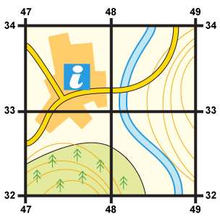
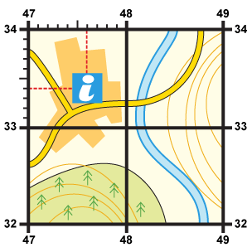
Crime
knowledge checkers
Lesson 2 – Geographical skills
Core knowledge
Four-figure grid references can be used to pinpoint a location to within a square. To find the number of the square:
Start at the left-hand side of the map and go east until you get to the bottom-left hand corner of the square you want.
Move north until you get to the bottom-left corner of the square you want. Look at the number of this grid line and add it to the two-digit number you already have. This is your four-figure grid reference.
Sometimes it is necessary to be even more accurate. In this case you can imagine that each grid is divided into 100 tiny squares. The distance between one grid line and the next is divided into tenths.
First, find the four-figure grid reference but leave a space after the first two digits.
Estimate or measure how many tenths across the grid square your symbol lies. Write this number after the first two digits.
Next, estimate how many tenths up the grid square your symbol lies. Write this number after the last two digits.
Knowledge Organiser
Core Knowledge
Further reading
A grid of squares helps the map-reader to locate a place. The vertical lines are called eastings. They are numbered - the numbers increase to the east. The horizontal lines are called northings as the numbers increase in an northerly direction.
OS maps

Slide 5
Crime
knowledge checkers
L2 – Location of Crime
Core knowledge
Key words
Population – The number of people in a place
Access – How to get to a place
Ownership – Who owns the item or land
Population
Population - Large centre of population means there is a greater opportunity to commit a crime.
Access - Good road and transport links allow criminals to move around more easily.
Ownership - Public space where there is no sense of ownership. In a private space it is easy to spot who is out of place or not there for a valid reason.
Access
Ownership
Knowledge Organiser
Identifying locations where crime might occur allows the police to increase their presence to deter any crime.
Misconceptions
Further reading
Crime is not just an urban problem.
Crime can occur anywhere. Rural areas are not crime free and areas might be targeted for specific items e.g. farm machinery
BBC Bitesize

Slide 6
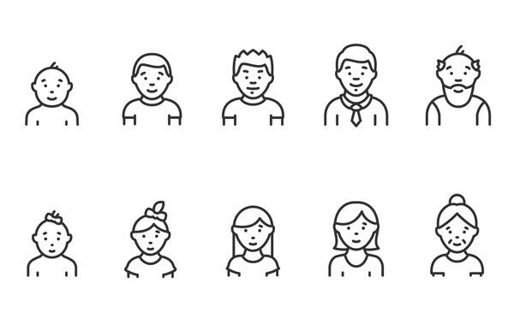
Crime
knowledge checkers
Lesson 4 – Effects of crime.
Core knowledge
Key words
One explanation for young people’s high involvement in crime can be that they seek excitement and adventure, which can sometimes get them into trouble with the authorities. Breaking the rules come with a certain excitement, which young people are especially interested in feeling
Community - a group of people living in the same place or having a particular characteristic in common
Service – Is something that provides a benefit to people or the community. E.G doctors.
Shops have to use tags on clothing
Makes people unhappy
Knowledge Organiser
NHS deal with any injuries from crime
Increases cost of insurance
Crime affects communities
Crime affects services
Further reading
Decrease house prices
Councils have to pay for CCTV
Who is affected
Cost

Slide 7
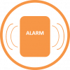
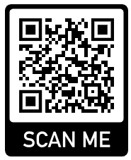
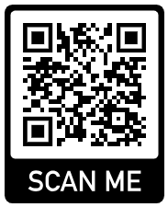
Crime
knowledge checkers
Lesson 4 – stopping crime
Core knowledge
Key words
Removing the means
Environmental change
Environment – The area where you live
Target – The item or house to steal/break in too
Offenders - Someone who I breaking the law.
Reducing cost
Deflecting offenders
Knowledge Organiser
Rule setting
Access control
Increase chance of being caught
Target removal
Target hardening
Surveillance
Misconceptions
Further reading
Crime can occur anywhere but there are things we can do to reduce the likelihood of some crimes occurring.
Uncomfortable seating
Prevent crime

