Slide 1
Place
knowledge checkers
It is your responsibility to make sure that you are able to answer each of the questions set in the tasks below. This will be based on what you are taught in lessons and the information included the knowledge organisers.
Task 1 What do we mean by a place? What can affect a place's identity? Can you give 3 examples of a place's identity? (London was our case study in lessons) | Task 2 What causes change in places? How do Preston, Liverpool and Manchester compare - know three facts. How might crime affect an area?
Task 3 What is globalisation? What do we mean by local, national and international scale? Why is the world more connected now? Can you give two examples? | Task 4 What do we mean by media? How can the media affect our impression of a place? What two different view points could we have about India?
Knowledge Expert

Slide 2
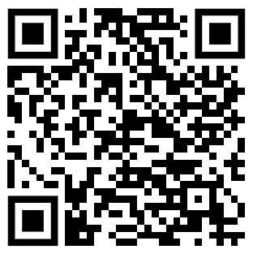
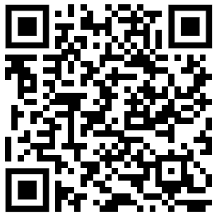
Place
knowledge checkers
What is place?
Core knowledge
Key words
A place's identity is formed by a complex and interconnected set of factors but a place does not need all of these factors to have an identity. The place can be any size - as small as a bedroom or as large as a city or even a country.
Physical
Places can be recognised and given an identity through their physical features. These can range from buildings and streets to mountains, forests and rivers. Many people will associate a place with a certain physical feature such as the coal mines in the valleys of south Wales or the mountainous landscape of the Eryri National Park.
Historical
Other factors that give a place its identity can relate to its history. This can have a role in how both local people and others might connect to a place because of its historic significance to them. That could be through the history of an industry that has played an important part in the local area or through battles that have been fought there.
Personal
We can also perceive an identity of a place on a much more personal level through our feelings, emotions and connections to it. People might see an area differently based on their experiences or connections they might have. This might be through language, culture or even sport.
A place’s identity can change over time. Migration can bring in people from different backgrounds which can influence local culture and habits. Governments may choose to invest in an area. After redevelopment and gentrification programmes, an area that was once seen as old and derelict can be given a new lease of life as a modern and influential area filled with shops, apartments and green spaces.
Endogenous – Characteristics which have originated internally.
Exogenous - Characteristics which are external – relationship to other places.
Migration – people moving in or out of an area
Gentrification - process whereby the character of a poor urban area is changed by wealthier people moving in, improving housing, and attracting new businesses
Knowledge Organiser
Take it further...
BBC
National Geographic

Slide 3
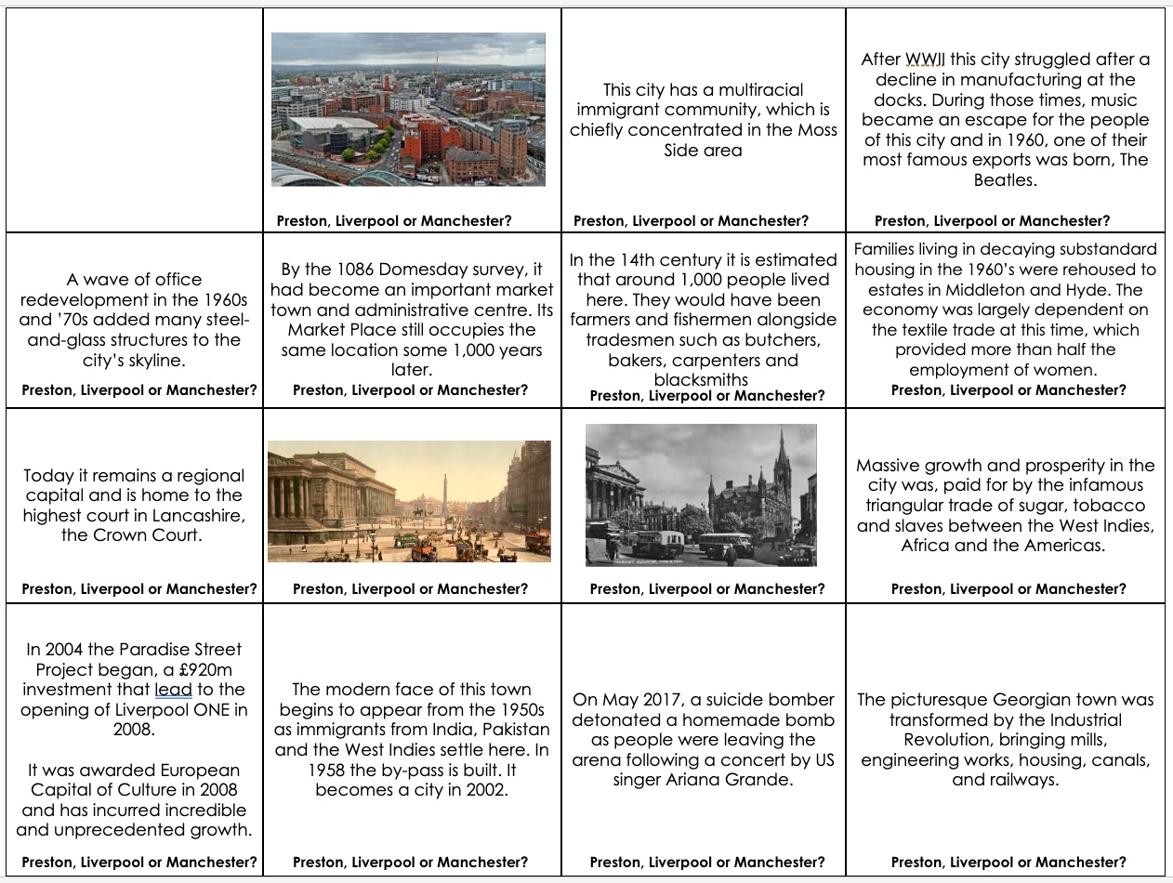
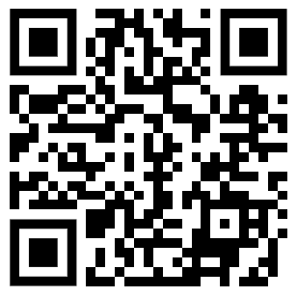
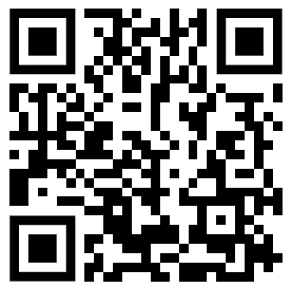
Place
knowledge checkers
Comparing Places
Core knowledge
Key words
Poverty – when a person does not have enough money for the basic things they need to live.
Qualification - something that makes a person fit for an activity or job
Income - the money you receive in exchange for your work.
Unemployment – not having a job
Knowledge Organiser
Preston, Liverpool and Manchester are all excellent examples of how places are dynamic. This means that they are ever-changing. Exogenous and endogenous factors can cause these changes to a place.
High crime rates may result in a place being scary or give somewhere a bad reputation. High price houses can make somewhere unaffordable to live, which can push people out of the place they have grown up or where they call home. Poverty refers to the state of being extremely poor. If people have poor rates of education and employment this results in high poverty in areas, which has the knock on effect of a place becoming deprived. Deprivation in an areas means people are suffering a severe and damaging lack of basic material and cultural benefits.
Take it further...
Manchester
Liverpool

Slide 4
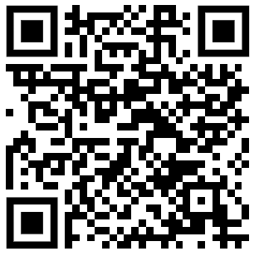
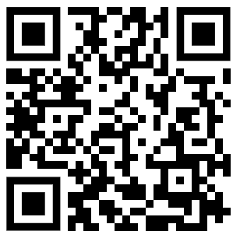
Place
knowledge checkers
Globalisation
Core knowledge
Key words
There are many ways that places around the world are connected. There are connections on a local, national and international scale.
Local refers to places close to us, for example our school is in the local area of Lancashire. ​
National refers to the country a place is located in. The government is national as it governs the whole of the UK.
International means that it is between countries, for example supermarkets like Aldi are close by which is a company originally from Germany.
Globalisation connects people and places all around the world. There are a number of reasons why globalisation is happening faster now than ever before.
As a result of globalisation, some corporations, or large companies, now operate in more than one country. These corporations are called TNCs (transnational corporations).
Improvements in technology means that we are more connected to other people and places through communication such as the internet and mobile phones.
Ships are able to transport goods on a much larger scale, faster and more efficiently. This has resulted in economic globalisation. As well as this the increase in transnational companies, which are companies that operate in more than one country e.g. Nike, Apple and MacDonalds, has resulted in more economic connections.
Shipping containers - a large, strong container, usually of metal, used to store goods in during shipment
economic- Associated with jobs and money, eg economic progress refers to how much money a country is making.
Cultural - beliefs and behaviors that are traditionally practiced by a group of people
social - Associated with people. For example, how healthy, educated and happy people are.
Political - how a country is run, the decisions it's government makes
Knowledge Organiser
Take it further...
BBC
Globalisation

Slide 5
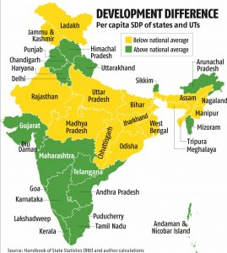
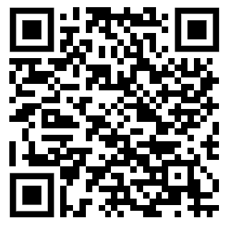
Place
knowledge checkers
Media Representation
Core knowledge
Key words
Sometimes we only know about places from what we read in books or watch in films. These can be referred to as ‘media places’.
India has changed entirely as a result of globalisation. It opened up its economy from the 1980s, removing barriers to trade and welcoming in entrepreneurs and foreign investors. As a result, it is now the fifth
Media- Media is used to pass on information to many people in a society. This information is generally used to inform, to educate, or to entertain. Different types of media include television, radio, newspapers, magazines, and the Internet.
Subjective - a persons personal point of view
Bias - our perception of the way things are or should be, even if it's not accurate
largest economy in the world in terms of GDP with particular strengths in agricultural production, information technology and manufacturing. Its economy continues to grow.​
​
There is still considerable poverty in India, despite its economic growth. The numbers of poor people have dropped, but one United Nations report suggested that there were still 80 million people in the country living on less than $1.25 per day in 2019. ​
​
The hope for those who welcome globalisation is that the wealth created will drive up living standards for everyone.​
​
Knowledge Organiser
Take it further...
Misconceptions
We quite often only see negative views of places, and these ideas stick in our memories. These can become outdated when a country improves. Remember, not all of the country will improve at the same rate.
BBC

Slide 6
Revision Notes

Slide 7
Revision Notes
___________________________________________________________________________________________________________________________________________________________________________________________________________________________________________________________________________________________________________________________________________________________________________________________________________________________________________________________________________________________________________________________________________________________________________________________________________________________________________________________________________________________________________________________________________________________________________________________________________________________________________________________________________________________________________________________________________________________________________________________________________________________________________________________________________________________________________________________________________________________________________________________________________________________________________________________________________________________________________________________________________________________________________________________________________________________________________________________________________________________________________________________________________________________________________________________________________________________________________________________________________________________________________________________

