Slide 1
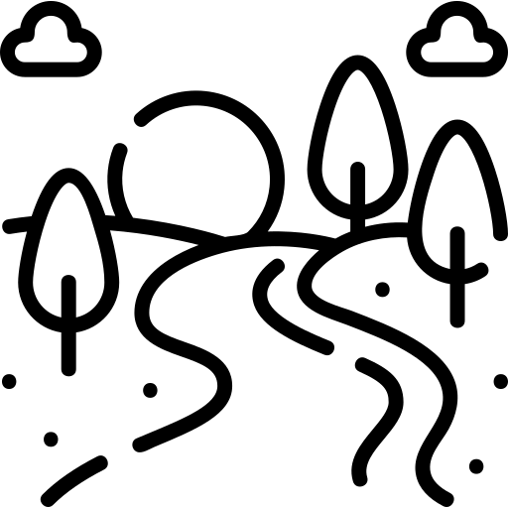
Rivers
knowledge checkers
It is your responsibility to make sure that you are able to answer each of the questions set in the tasks below. This will be based on what you are taught in lessons and the information included the knowledge organisers.
Task 1 What are the major rivers in the UK? What are the major world rivers? What is the difference between the largest and longest river in the UK? | Task 2 Explain how water moves around the water cycle. I can describe each of the key words in the water cycle diagram. | Task 3 What are the key parts of a water basin? What happens at a confluence? What is the river like at the source? What is the river like at the mouth?
Task 4 What are the three stages of a river? How does a river changes from source to mouth? What is a long profile? | Task 5 What is a flood? What are the natural/physical causes of flooding? What are the human causes of flooding? | Task 6 Why does the UK get so much rain? Why is flooding frequent in the UK? What are the worst impacts of flooding?
Knowledge Expert

Slide 2
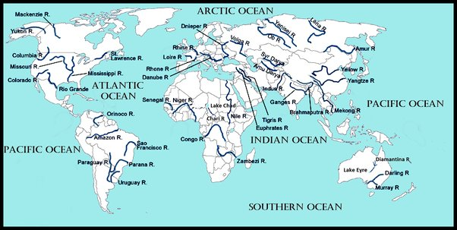
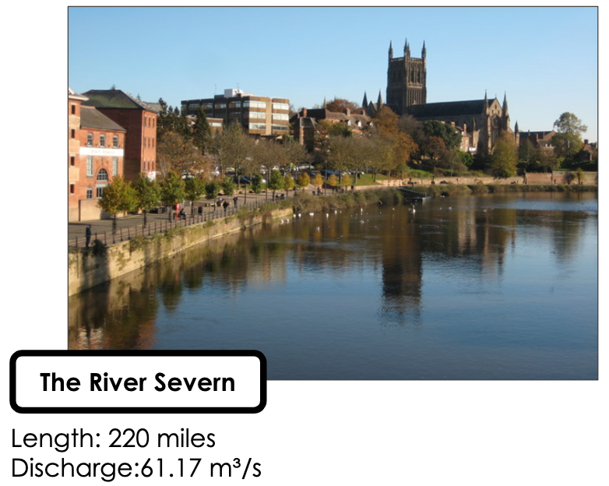
Rivers
knowledge checkers
Famous Rivers
Core knowledge
Key words
Bed - The bottom of a river channel
Bank - The sides of a river channel
Channel - The area where the water flows
Knowledge Organiser
The Volga River, the largest and longest river system in Europe rises in the Valdai hills just northwest of Moscow, and then flows 2,300 miles (3,700 km) to the east and southeast before emptying into the Caspian Sea.
Misconceptions
Take it further...
Longest refers to the length of the river, largest refers to how much water the river holds.
UK River facts
UK Rivers

Slide 3
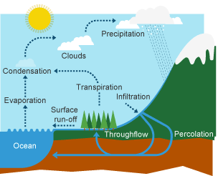
Rivers
knowledge checkers
Water Cycle
Core knowledge
Key words
Evaporation - The process in which a liquid changes state and turns into a gas.
Condensation - A change of state in which gas becomes liquid by cooling.
Precipitation - Moisture that falls from the air to the ground. Includes rain, snow, hail, sleet, drizzle, fog and mist.
Through flow - When rainfall or water flows through the land.
Percolation - When water moves downwards through the soil.
Knowledge Organiser
Misconceptions
Take it further...
Water does not only evaporate from rivers and lakes, it will evaporate from any surface, including plants.
TED Ed
MET Office

Slide 4
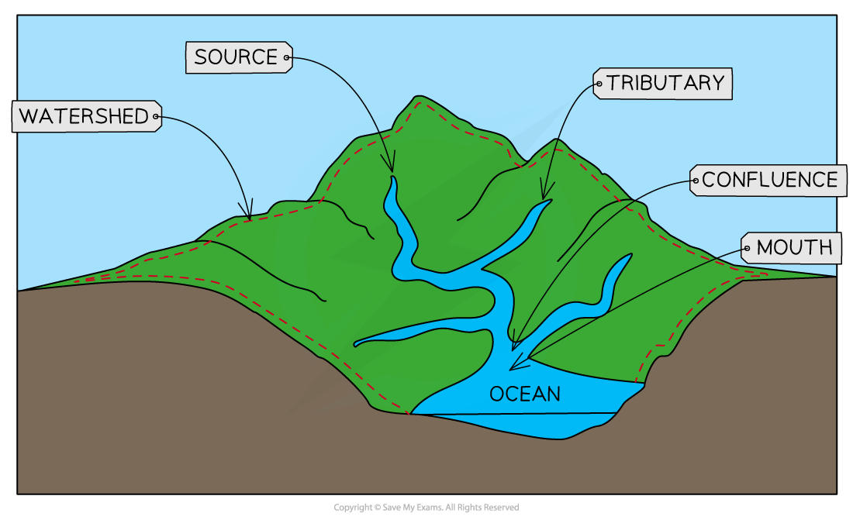
Rivers
knowledge checkers
River Basin
Core knowledge
Key words
Tributary - A small river that joins the main river channel.
Watershed- The place that divides two river basins. River basin - The area drained by a river.
Mouth - The place where a river meets the sea.
Source- The starting point of a river
Confluence - Where two rivers join together
Knowledge Organiser
Misconceptions
Take it further...
Each river does not have it's own personal watershed, many major rivers may be included in one watershed.
Drainage Basin
Video

Slide 5
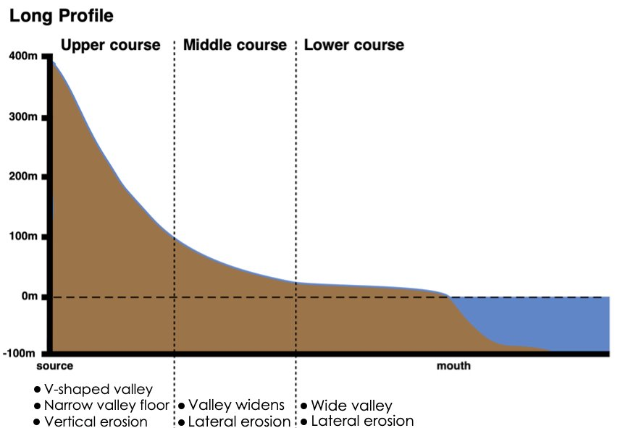
Rivers
knowledge checkers
Long Profile and features
Core knowledge
Key words
The long profile of a river is a way of displaying the channel slope (gradient) of a river along its entire length. It shows how a river loses height with increasing distance towards the sea. A river tries to achieve a smooth curve to reach its base level at sea; this is called a graded long profile. The gradient falls steeply from the source then becomes concave and then almost flat.
Long profile – The gradient of a river, from its source to its mouth.​ ​
​
River – A ribbon-like body of water that flows downhill from the force of gravity.​ ​
​
River valley – A low stretch of land between hills with a river flowing in it.
Meander– A bend in the river
Knowledge Organiser
Misconceptions
Take it further...
Although rivers appear to be very fast flowing in mountains, this is where they are at their least powerful.
BBC
BBC

Slide 6
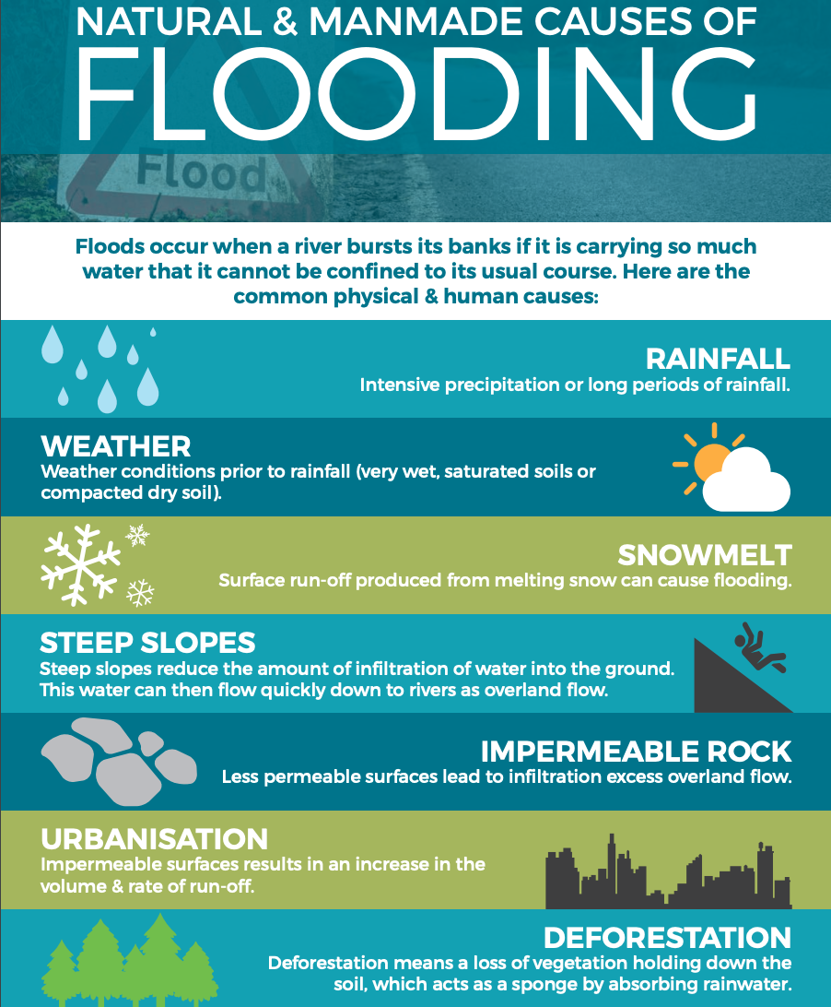
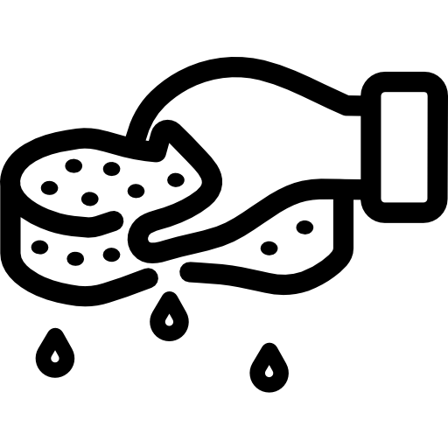
Rivers
knowledge checkers
Flooding
Core knowledge
Key words
Impermeable - A substance which fluids are unable to pass through.
Urbanisation - When humans build towns and cities in an area
Saturated- Unable to contain any more liquid.
Infiltration - The process of water soaking into the soil and ground rock.​
Interception - When leaves and plants catch precipitation and stop or slow it from reaching the ground.
Flooding occurs when a river bursts its banks and overflows onto the surrounding land.
There are many factors which can cause a flood - often the natural landscape can influence flooding and human interactions can increase the risk.
This causes major problems for people living close to the river.
Knowledge Organiser
Misconceptions
Take it further...
It is rarely one cause of flooding individually, many will work together to cause flooding.
BBC
Video

Slide 7
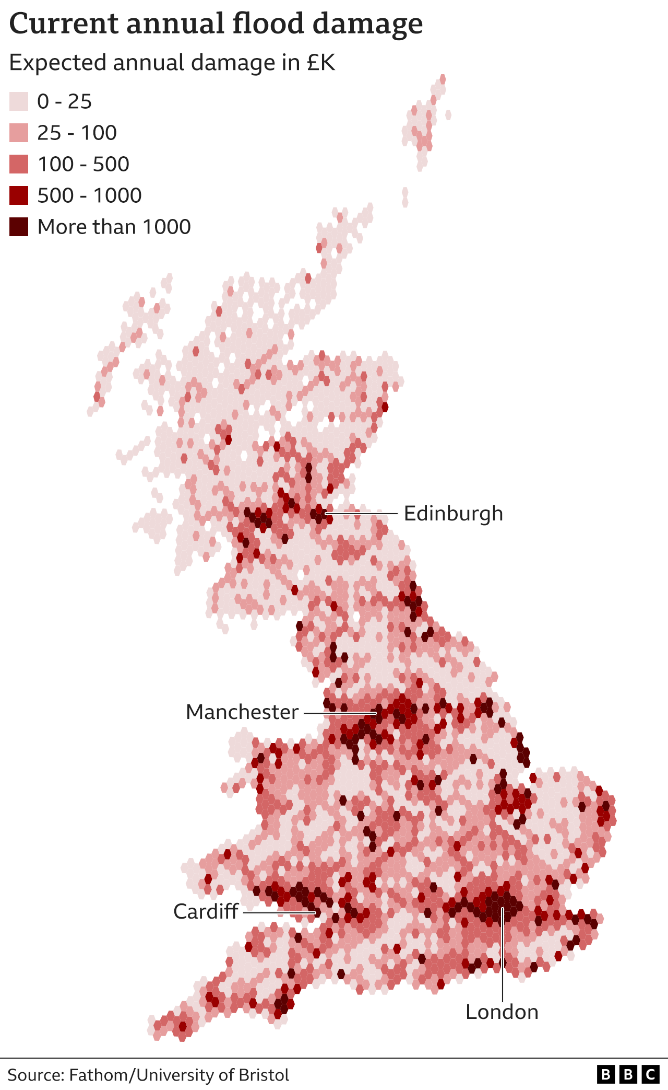
Rivers
knowledge checkers
UK Flooding
Core knowledge
Wetter weather will be a feature of our changing climate in the UK.
The Met Office predicts that by 2070, winters in the UK will be up to 30% wetter than they were in 1990 and that rainfall will be up to 25% more intense.
Summers will actually get drier overall – with more heatwaves and droughts – but when rain does come it will be heavier, 20% more intense than it was in 1990.
The most violent downpours – more than 30mm of rain in an hour – are expected to occur twice as often as they used to.
This means the increased risk of flooding – with ground becoming saturated by persistent winter rainfall and drainage systems overwhelmed by summer deluges.
Knowledge Organiser
Misconceptions
Take it further...
Different parts of the UK will experience different levels of flooding – this are not always in areas with high levels of rainfall throughout the year.
UK Rain
Flooding News

