Slide 1

Physical Education Department
GCSE PE
Video Evidence Submission
24th April 2024

Slide 2
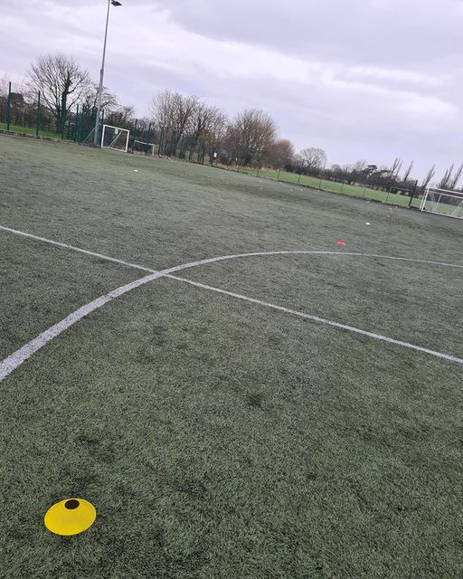
The normal process….(for on site activities)
March Year 11
Marks submitted for all three sports to OCR
Moderator chooses which on site activities/students they are coming to watch (normally 5/6 sports, around 5 students per sport
Students from3/4 different schools join together for moderation day.
Each sport has an hour session which covers the core skills, advanced skills and includes competitive scenarios
The video evidence submitted has to reflect this experience in school

Slide 3
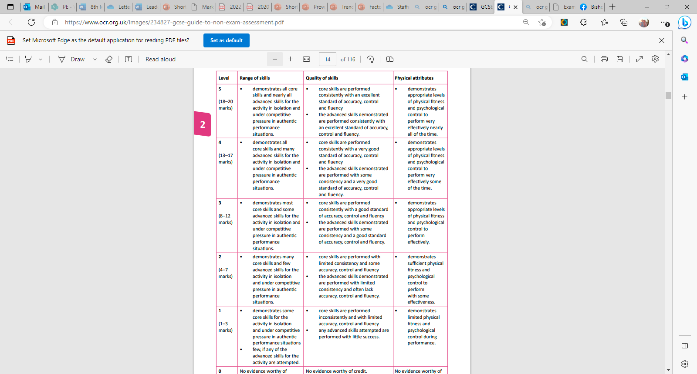
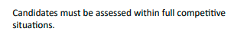
Assessment of activities
Core Skills
Advanced Skills
Decision Making/Tactical Awareness

Slide 4
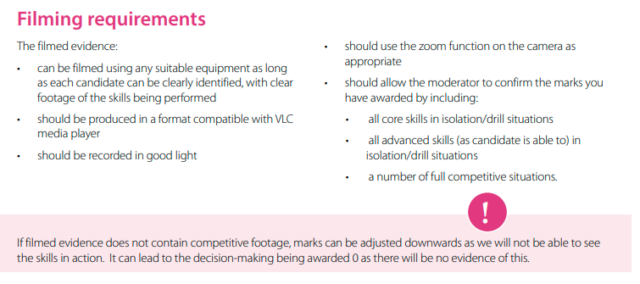
From the exam board

Slide 5
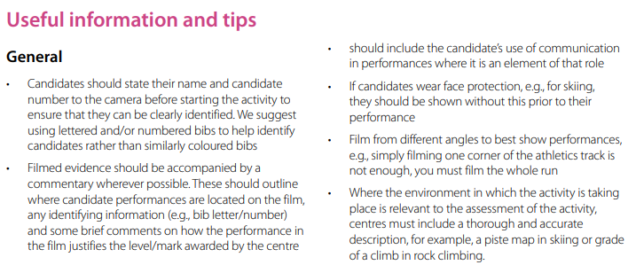

Slide 6
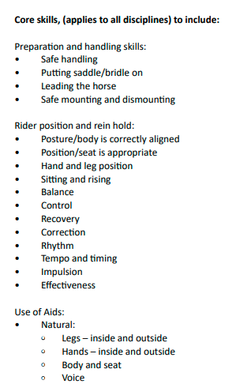
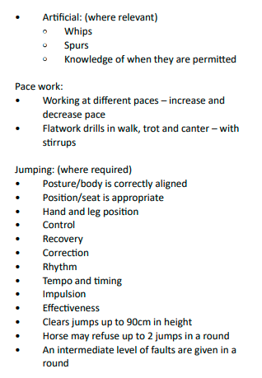
Examples of activities - Equestrian

Slide 7
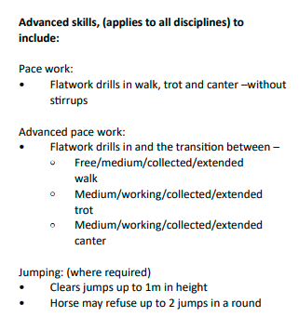
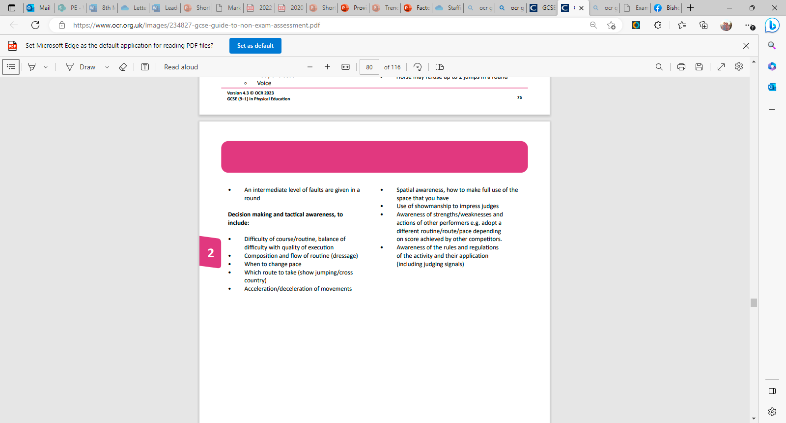
Equestrian Advanced and Decision Making
A lot of the decision making skills are assessed within the competitive element which is why it is so important.

Slide 8
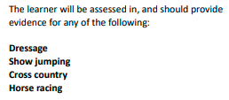
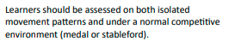
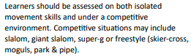
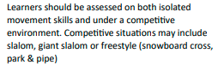
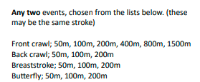
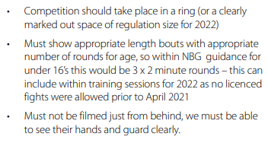
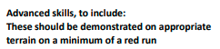
Key Information
Equestrian
Golf
Skiing
Medal – stroke play i.e. every shot counts towards final score
Stableford – score points on each hole e.g. bogey = 1 point, par = 2 points, birdie = 3 points
Snowboarding
If submitting show jumping you must be jumping over 1m in height
Swimming
Boxing
This MUST be on snow. It can be indoors i.e. chill factore BUT on a mountain is much better
A black run would be better hence why mountain skiing is better. Please show the colour of the run in the video

Slide 9
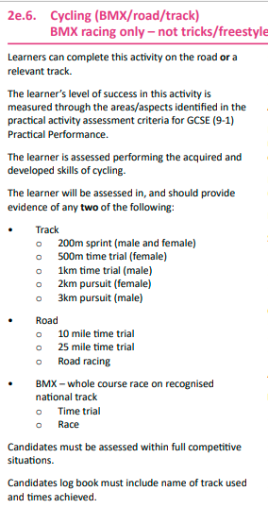
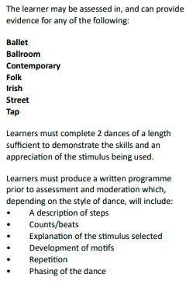
Key Information
Cycling
Dance

Slide 10
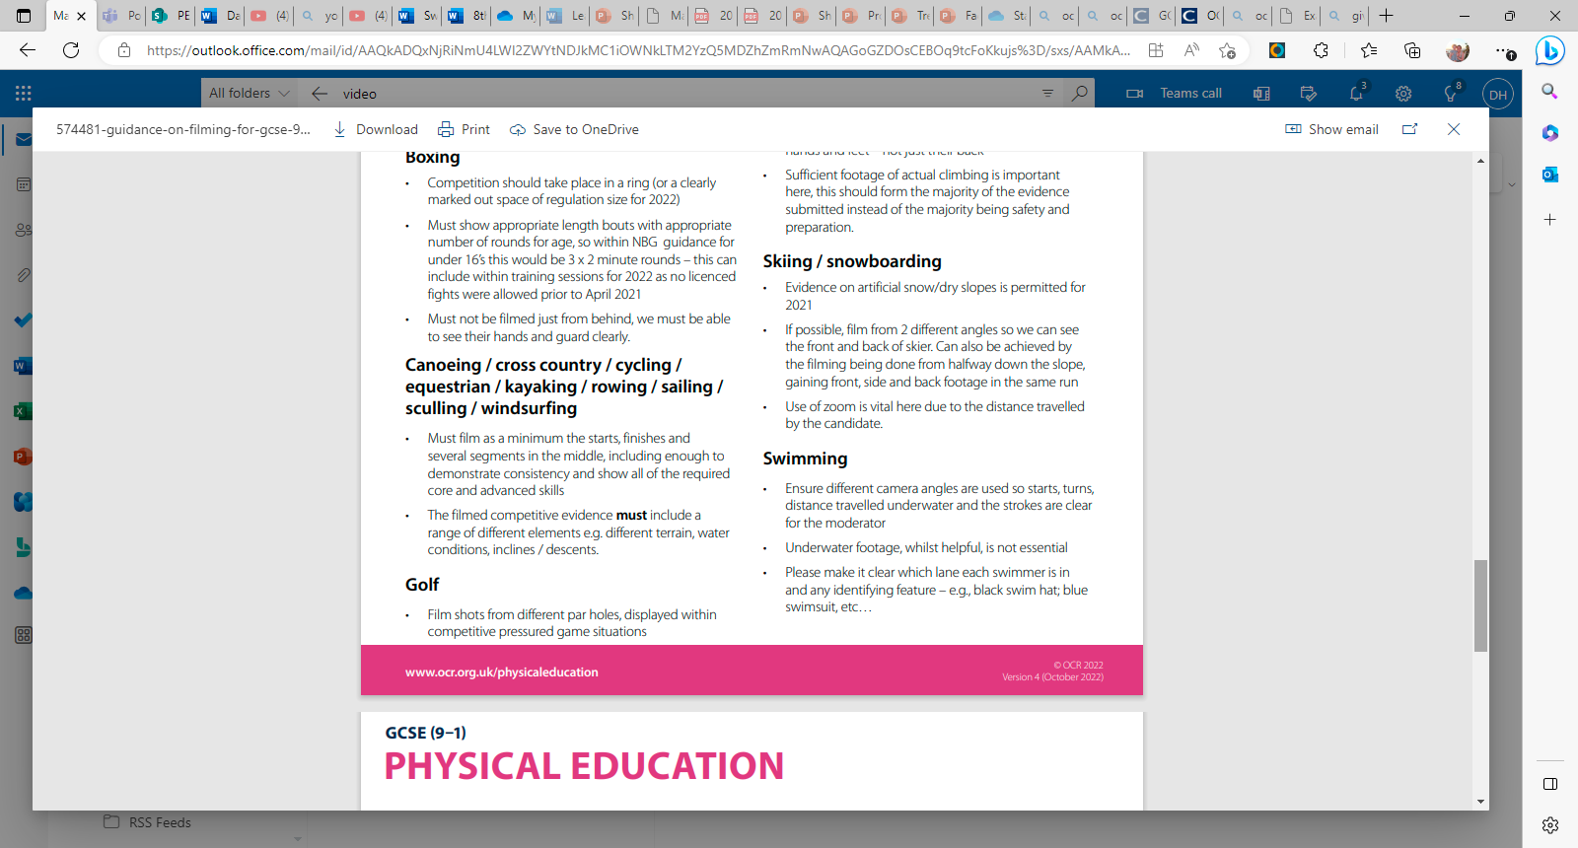
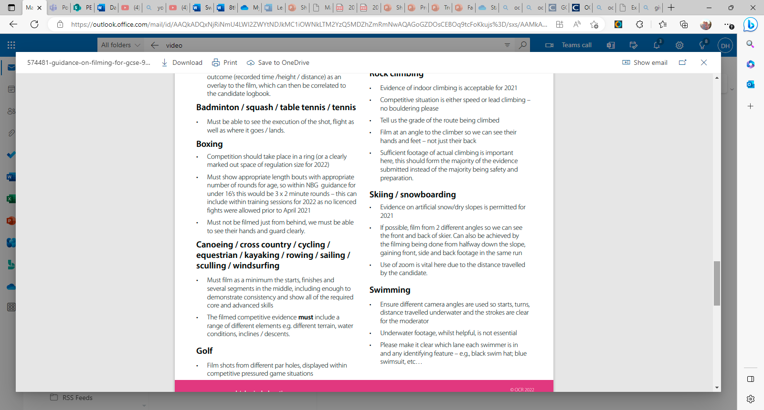
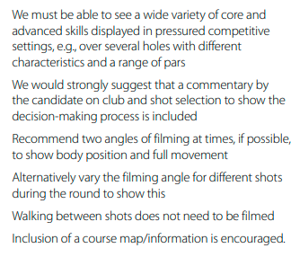
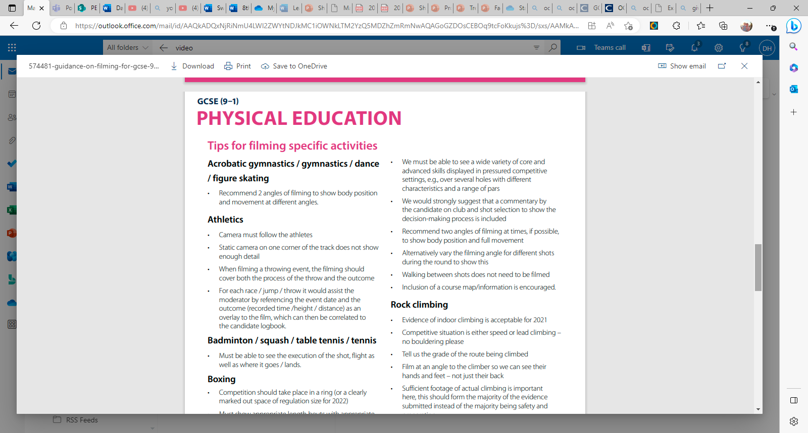
Key Information (from the exam board)
Equestrian
Golf
Skiing/Snowboarding
Swimming
Dance

Slide 11
The Video…
The structure…
Introduction
Core skills in isolation
Advanced skills in isolation
Competitive scenarios (at least three, if not more)
Decision making commentary
All handed in together as one video – titled “46915_candidate surname_and number_Activity_component”
E.g. 46915-Hornby_1234_Equestrian Dressage_J587_04

Slide 12
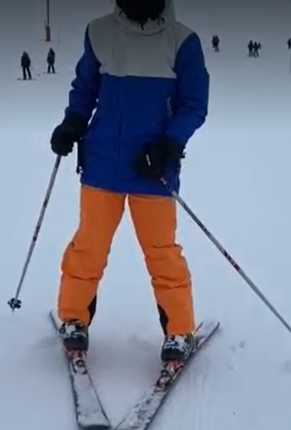
The Introduction
Students must be clearly identified all the way through the video – do this without a helmet/swimming cap/goggles on at the start.
Start the video with your name, candidate number, centre name – Bishop Rawstorne C of E Academy and centre number – 46915
Explain what sport/event you are doing.
X

Slide 13
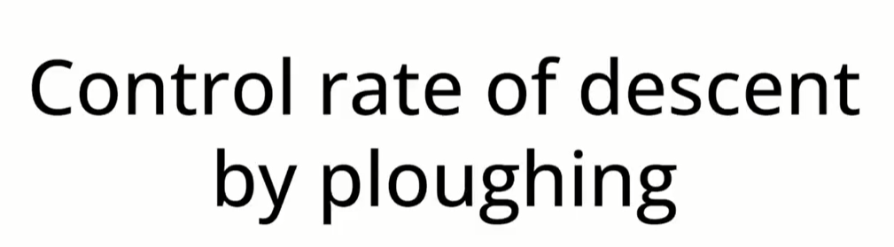
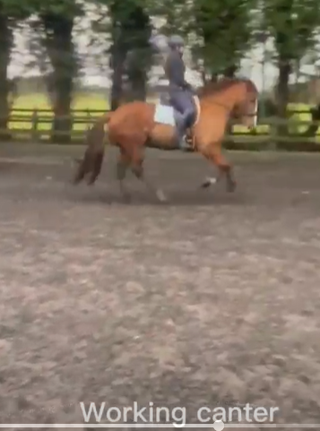
All core/advanced skills in isolation
Do
Label all skills in the video
Show each skill 3-5 times in different situations (different slopes in skiing, different holes in golf)
Show multiple angles
Show the whole skill
Wear the correct clothing e.g. proper golf attire (smart trousers, polo shirt, golf shoes), NOT tracksuit bottoms

Slide 14
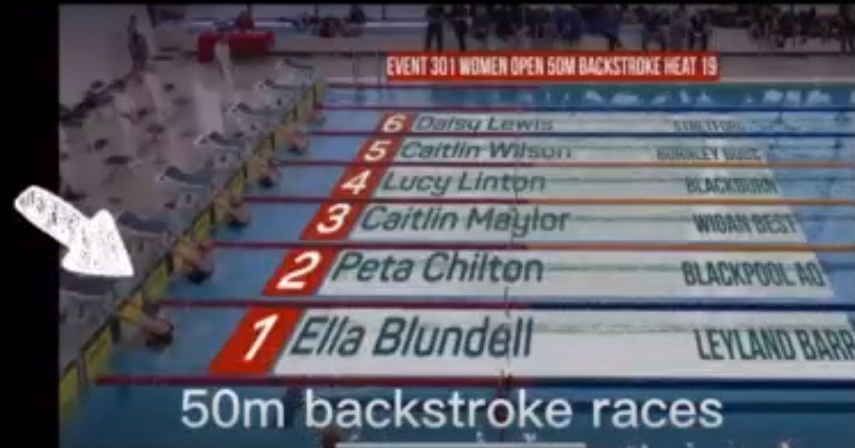
Competition/Group Footage
Make sure you identify who you are!
Add arrows/circles
This is really important in Team Dance
Try and focus solely on the individual (I appreciate this isn’t always easy)

Slide 15
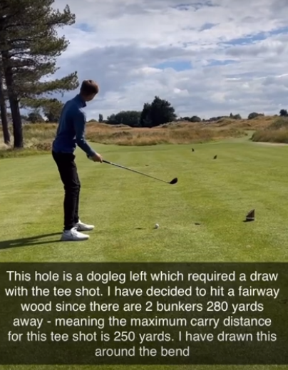
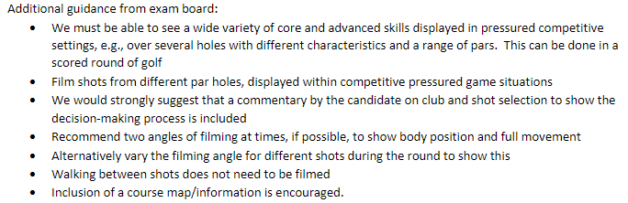
Decision making/tactical awareness
Some sports are much more difficult to show the decision making aspect.
For golf – the exam board suggest completing a commentary on the club and shot selection.
This year I have asked some of our Year 11’s to do this for other sports too.

Slide 16
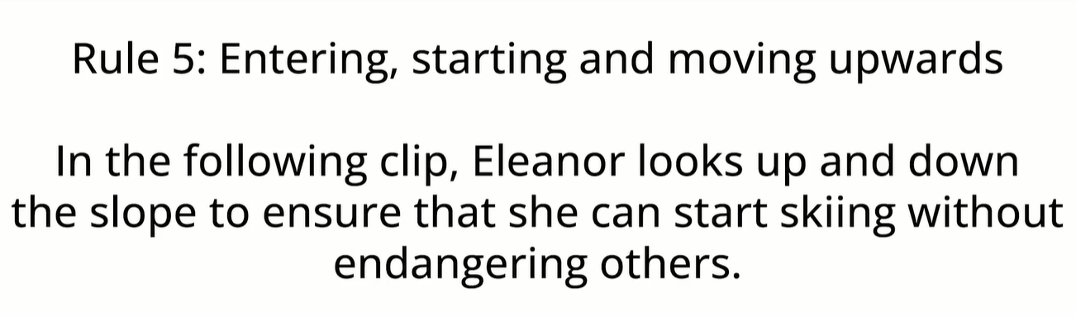
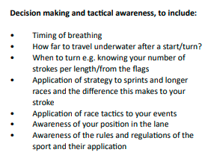
Decision making/tactical awareness
Some rules of skiing can be highlighted in the video but a commentary showing knowledge is also advised
Swimming is particularly difficult due to the nature of recording events. A commentary over the top of a race discussing all of these bullet points is essential.

Slide 17
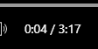
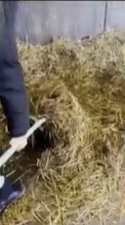

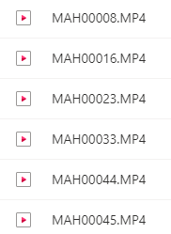
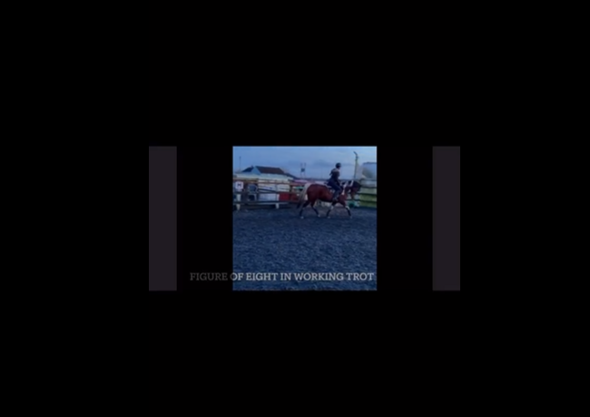
What not to do…
Hand in a short video that does not cover all the core/advanced/decision making skills
You are NOT allowed to receive guidance on your video. You can add music/mute the recording if you like
Spend a lot of time covering skills not listed in the specification e.g. mucking out
Hand in a video where we cannot see you!
Hand in numerous clips that tell me nothing about what is on them!

Slide 18
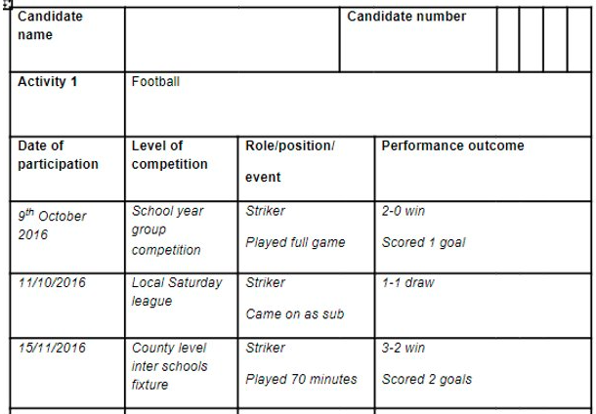
Competitive Log
Every student on the GCSE PE course MUST submit a competitive log for all three of their activities.
This is even more important for those submitting video evidence as it backs up their mark. If you are submitting a video your competitive log WILL be sent to the exam board
If a video is submitted with NO competitive log the mark will reflect this.

Slide 19
Deadlines
For those students in Year 10 – October Half Term
Why? The majority of sports can be completed over the summer months – from now until October. There will be some exceptions.
Those students who have been skiing should have already obtained some footage from February & Easter – let us look at it!!
We will then have a much better idea of what you need to do to improve AND what grade you will achieve.
For those students in Year 9 – the footage does need to be filmed in Year 10 & 11 so your deadline will also be October half term of Year 11 BUT if you have some footage – please come and give it to us!!

Slide 20

Any questions?

