Slide 1
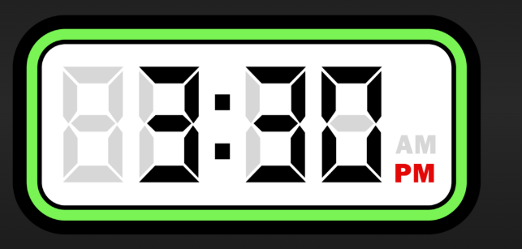
English Language Component 1 Fiction Paper
1 hour and 45 minutes

Slide 2
What is on this paper?
Section A – The reading section – 5 questions - one hour
Section B The story – four titles to choose from – 45 minutes

Slide 3
How to tackle the timing
You could start with your story first.
If you have memorised it and can complete it in less than 45 mins, this will give you more time for the reading section.

Slide 4

Tackling the story
Look at the story titles on the back page.
Spend a minute or so thinking about how you can ‘tweak’ your own story to fit one of them – there will be a way if you think outside the box!

Slide 5
Have a practice now…..
Choose either
If only I’d have said something.
Or, (b) An Embarrassing Moment
Or, (c) Write about a time when
you went on holiday.
Or (d) Write a story which begins: I have to admit that s/he was right…
Choose either
I had never known such a storm.
Or, (b) The Choice
Or, (c) Write about a time when you were scared.
Or (d) Write a story which begins: The door swung shut, leaving me totally alone…

Slide 6
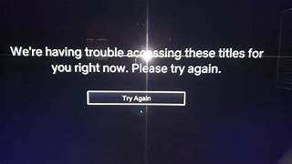
When you have chosen your title…
Put the number you have chosen and your title at the top of your story, before you begin to write.
Don’t let your examiner guess!

Slide 7
When you have finished your story in under 45 minutes …
Leave time to check it through.
You get 24 marks for content and organisation You get 16 marks for SPaG
Top tip:
Put down your pen after you have finished writing your story.
Take a deep breath.
Pick your pen back up and imagine you are an English teacher desperate to spot common mistakes.
Look for the common mistakes.
Capital letters
Commas
Full stops
Apostrophes for omission (it’s= it is, don’t) and possession (the teacher’s desk, the children’s playground, the dogs’ tails)
Homophones – their/they’re/there, were/where, you’re/your, weather/whether, too/too

Slide 8
Move on to reading section A – one hour
There are 5 questions.
Q1 = 5 marks
Q2 = 5 marks
Q3 = 10 marks
Q4 = 10 marks
Q5 = 10 marks
You should complete these two in less than 15 minutes
You should complete these three in 45 minutes

Slide 9
1st Things to do in the exam for the reading section....
SECTION OFF THE STORY USING THE LINE NUMBERS FOR EACH QUESTION
Use a pencil if you are unsure, or a pen if you feel more confident
Use a ruler to help with this and tracking through the story
Use highlighter/s to highlight key words in the questions
Use highlighters..or your pen to identify the evidence in the lines you have been given that will answer the question

Slide 10
Be confident..
If you have been asked to read lines 1-7, there will probably be evidence for your answer in every sentence!
All your information is there in front of you.
Just make sure you take enough of the information to answer the question.

Slide 11

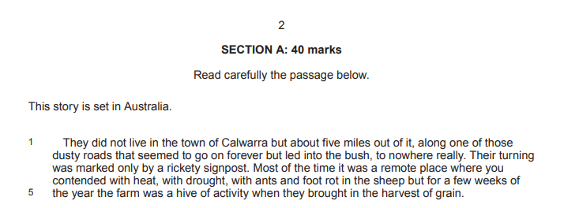
A1: The LIST question – no analysis needed – 5-7 mins or less if you can
Track the text
State the obvious
There may be more than one point in each sentence so separate them
Can you do more than 5 to be sure to get a full 5 if one is wrong ?(not too many though - stick to your timings)
Start with ‘We learn’..or He is….She is…The farm is…. (not just the quote)

Slide 12
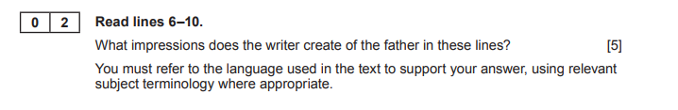

A2. The impressions question – 7 mins
Highlight key words
Track the text
State the obvious
There may be more than one point in each sentence so separate them
stick to your timings)
Start with ‘We learn’..or He is….She is…The farm is…. (not just the quote)

Slide 13
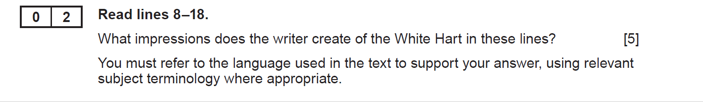
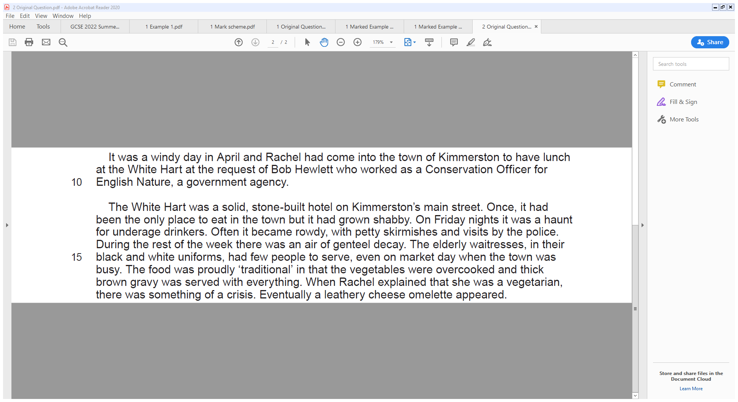
Highlight key words
5 points for 5 marks. Track every sentence.
Keep repeating key word in the question either:
The quote………… gives us the impression the White Hart is…………
or
‘The impression we get of/I get of The White Hart is……..as the text states…….(evidence)
One impression that the writer creates is that The White Hart is a well built, strong, as it is called a ‘solid stone building’.
Another impression the writer creates is that it has developed a reputation for neglected and dirty as it had grown ‘shabby’.
The quote ‘often it became ‘rowdy’ creates the impression that it can be noisy.
Furthermore, we get the impression that there are frequent ‘visits from the police’, meaning it is rough and uncivilised.
Another impression is that the food is ‘proudly traditional’ which could imply that the food is boring and old fashioned.
A final impression of The White Hart is that they are stuck in the past as they don’t cater to vegetarians. When ‘Rachel explained that she was vegetarian there was something of a crisis’.

Slide 14
Question 3 and 4…longer answers and up to 10 points for 10 marks. Aim at least for 5! Keep to the timing – 15 mins max
Remember that these questions ask you to look at how the writer uses language to create an effect on the reader and could ask you to look at:
Relationships between characters – differences, etc.
Tension and drama – look for the key moments
Character – what they say, do, think and feel
Thoughts and feelings of a character – they think/they feel

Slide 15
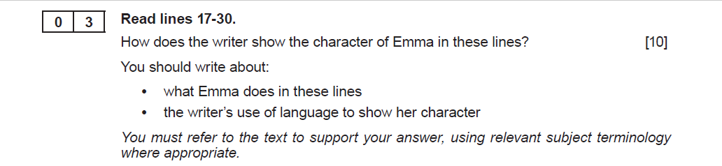
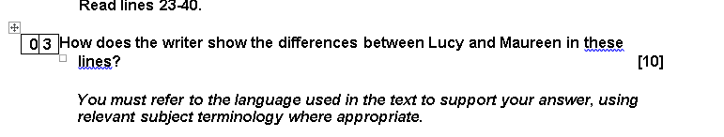
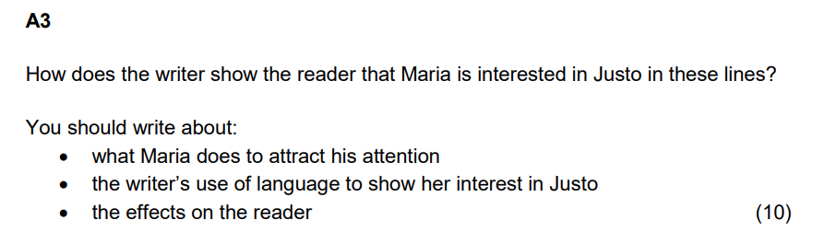
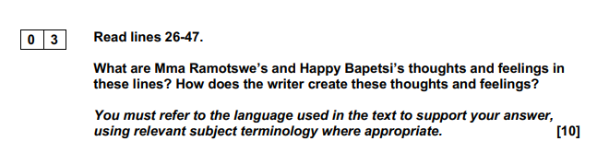
A3. The 10 marker – could be a ‘How’ or ‘What’ question – 15 mins max
10 marks = 10 things
How does the writer ….
Do track section from first line
Do TQA/QA – mostly QA or AQ
Firstly, the quote……….shows Emma was………..
Firstly, Emma seems…………. as the text says……
Do use correct terminology - know difference between a verb, adverb, adjective or don’t use at all
Do not talk about punctuation, snappy phrases’

Slide 16
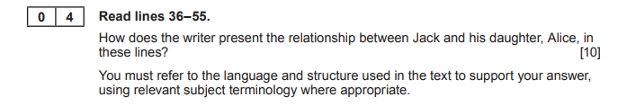
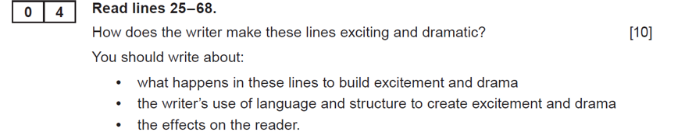
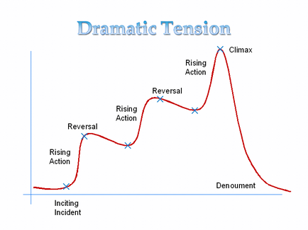
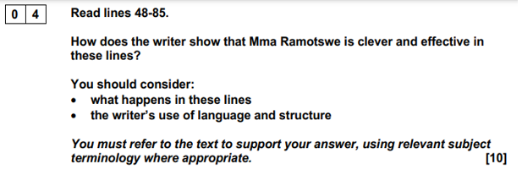
Q4 Another 10 marker – probably a‘How’ question. Often you will have a tension and drama question – 15 mins max
10 points for 10 marks.

Slide 17
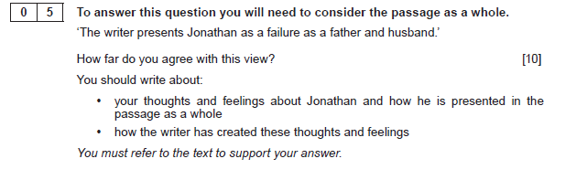
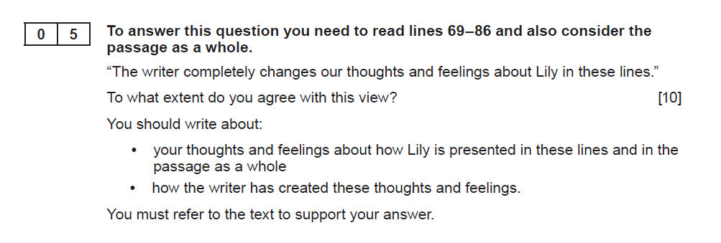
A5. The 10 marker – the evaluation question – 15 mins max
TOP TIP – This question is a gift - all the information you need will probably have been given in previous questions.
NOTE – ALWAYS LOOK FOR CHANGE AND DEVELOPMENT
YOUR IMPRESSIONS!
MUST TRACK THROUGH
MUST REFER TO PASSAGE AS A WHOLE
Could direct you to read lines first (2022)

Slide 18
Ways to do Q5
For this one –
State whether you agree or agree to some extent. It is highly unlikely that you will have evidence to disagree.
Track through and highlight a few things in the lines 69-86 about the character and as you comment on the character in those lines, compare to the impression of the character at the beginning of the text.

Slide 19
