Slide 1

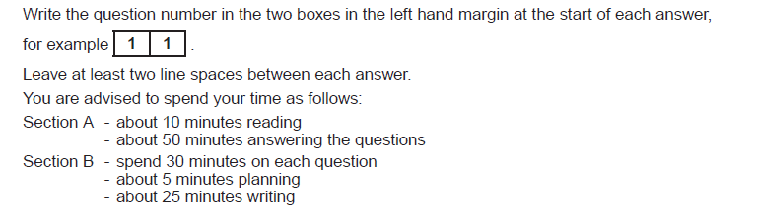
English Language Component 2 Non- Fiction Paper
2 hours
Major Tip
Don’t go over your time. If you feel you have made enough points on the 10 markers, move on. Leave some space and you can always go back. The important thing is to get to the end. A6 is a gift and you can get easy marks.

Slide 2
What is on this paper?
Section A – The reading section. Two texts – 6 questions - one hour
Section B Two transactional tasks– 30 minutes each

Slide 3
Section A – Reading.Two texts. 6 questions - one hour
A1 and 2 – the resource material and modern text
A3 and 4 – text on opposite page to questions – older text
A4 and 5 – Answer on both texts

Slide 4
Section A – one hour
There are 6 questions.
A1 = 3 marks
A2 = 10 marks
A3 = 3 marks
A4 = 10 marks
A5 = 4 marks
A6 = 10 marks
You should complete these two in less than 20 minutes
You should complete these two in less than 20 minutes
You should complete these two in 20 minutes

Slide 5
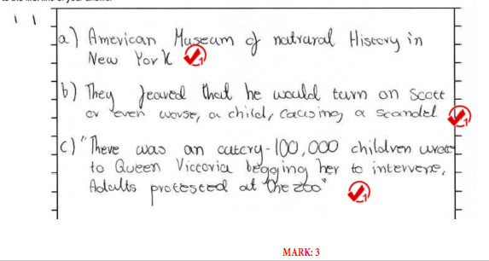
A1 – less than 5 mins
A1. 3 marker. No analysis needed. Ensure you lift enough from the text. Careful reading required.
Full name needed – American Museum of Natural History

Slide 6
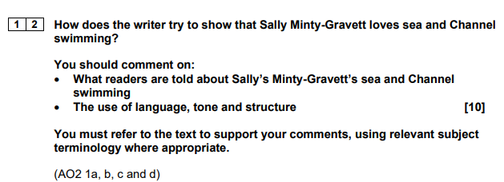
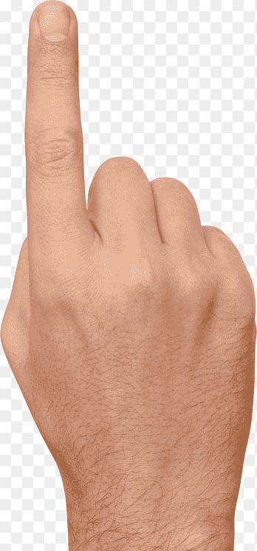
Highlight key words.
Track from first line and skim to find trigger phrase/s….
Do TQA/QA – mostly QA or AQ
Firstly, the quote……….shows Sally felt that swimming in the sea is …….
Firstly, Sally seems to adore sea swimming in open water as the text says…… which suggests
Use correct terminology - know difference between a verb, adverb, adjective or don’t use at all
Do not talk about punctuation, snappy phrases.
A2. Often a ‘how’ question. 12-15 mins
Don’t waste time developing analysis when you’ve made your point.
Use quotation marks effectively.
Cover enough points! Aim for 5 but 10 marks= 10 points

Slide 7
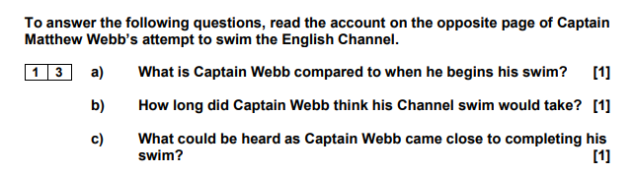
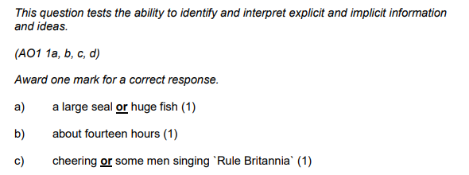
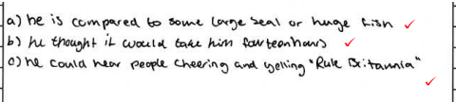

This is text 2 – the older text on the side opposite the questions.
A3 – less than 5 mins
A1. 3 marker. No analysis needed. Ensure you lift enough from the text. Careful reading required.
Allow 14 hrs
Do not allow ‘crowd’ without reference to noise of some sort.

Slide 8
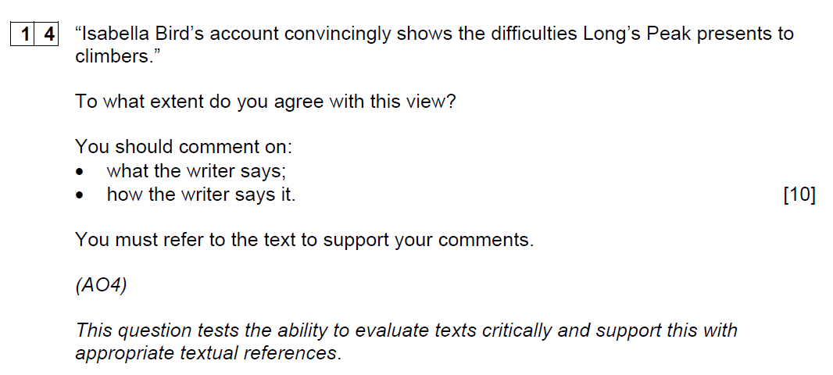
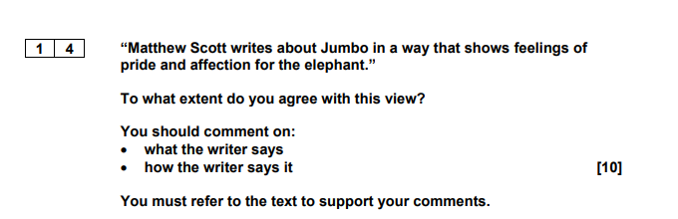
Highlight key words and find the focus.
Track from first line and skim to find trigger phrase/s….
Do TQA/QA – mostly QA or AQ
Firstly I agree/ I agree to some extent that the writer.......as they write/describe…..……….showing
Firstly, the text says…… which makes me agree with the image that…
Use correct terminology - know difference between a verb, adverb, adjective or don’t use at all
Do not talk about punctuation, snappy phrases.
A4. Often a ‘how far do you agree’ question. 12-15 mins
Don’t waste time developing analysis when you’ve made your point.
Use quotation marks effectively.
Cover enough points! Aim for 5 but 10 marks= 10 points

Slide 9
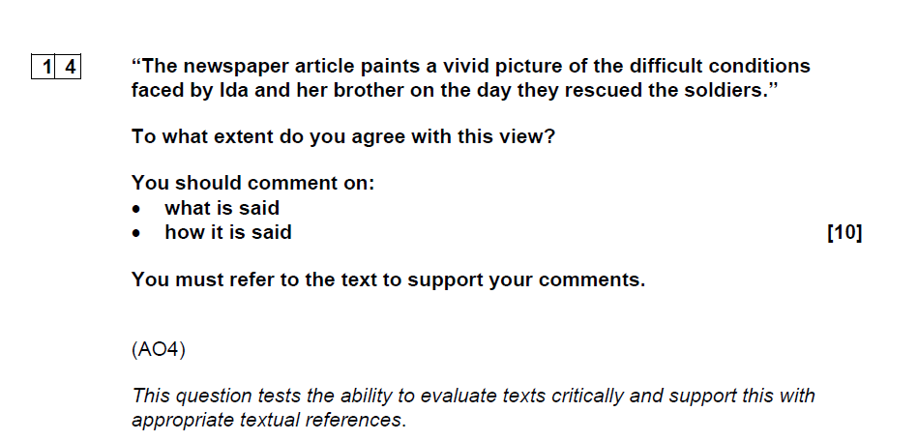
Issue – failing to focus on the conditions faced by Ida and her brother…not the soldiers.
This is an evaluate question so use evaluative comments.
Either end or start with an overview – Overall, I agree the article paints a vivid picture of the difficult conditions by stating/saying….
QA/TQA and track each line
Use personal response… I agree that the article ..it is vivid when..it is clearly difficult when

Slide 10
Using both texts question – 5 mins 4 marks
You can use ‘Both writers..’ and still gain two marks but be careful that they do.. Best to separate to be sure..
1 mark if just one text referred to.
1 mark if both but one text inaccurate.
2 marks if 3 points made but one text only.
4 marks even if you make 3 points from one and 1 from the other.
MUST IDENTIFY WRITER AND/OR TEXT – USE LAST NAME OF WRITER OR TITLE/TYPE OF TEXT.
Could use separate paragraphs/different headings.
England Vs Germany text
England =
Germany
In the 1895 report
South Team =
North Team =
Lee article
He tells us Jumbo eats hay, oats and bread
He tells us Jumbo is given whisky
Scott autobiography
He tells us he has sticky buns
He tells is he is given whisky and water

Slide 11
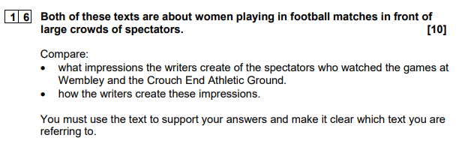
Get your focus right!
Could approach as by weaving between the two or cover one text first then the other:
Garry suggests the spectators are ………….
as they…………….QUOTE
Whilst/Whereas…the Crouch End spectators are presented as …….
as they………..QUOTE
Can say ‘both writers say/give the impression that……’
TOP TIP: your answers for this are usually covered in your response to 1.2 and 1.4. You just have to lift some of your answers and compare them
Must use names or texts accurately!
Must compare by using both texts
No need to analyse or zoom
10 marks- must make 10 points

Slide 12
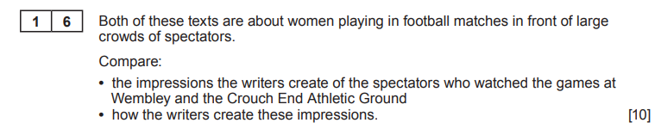
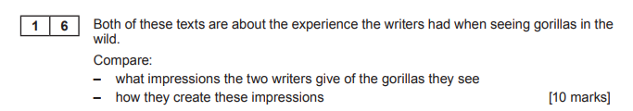
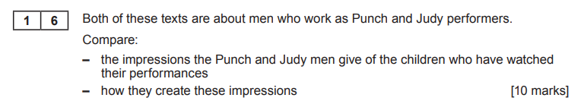
Past 1.6 questions
Common sense- how do spectators react at matches and what things do they do?
Common sense- how would gorillas act in the wild?
Common sense- how do children behave at performances – can they be good and bad?

Slide 13
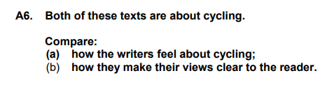
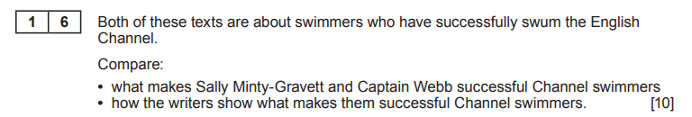
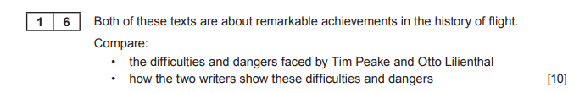
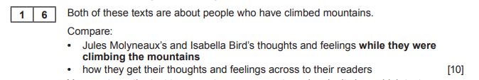
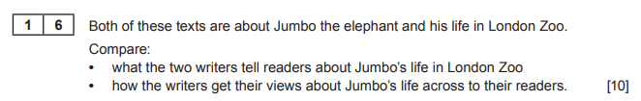
If they’re both cyclists, what can we assume without even reading the text?
Common sense- what would make anyone a good channel swimmer?
Common sense- what would be the dangers and difficulties of anyone being the first person to fly or go into space?
Notice the timing for this one.

Slide 14
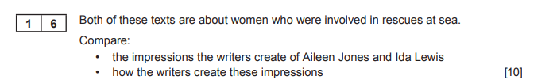
Bit of a no brainer – what are the obvious qualities of someone who goes out to rescue other people at sea and how can they show this?
Whilst text 1 ‘ We Save People’ gives the impression Aileen was heroic as she won a medal for bravery, the article from the NY Tribune states Ida was also a hero as she was called ‘brave daughter’ = 4 marks for two impressions and two pieces of evidence that prove each impression.

Slide 15
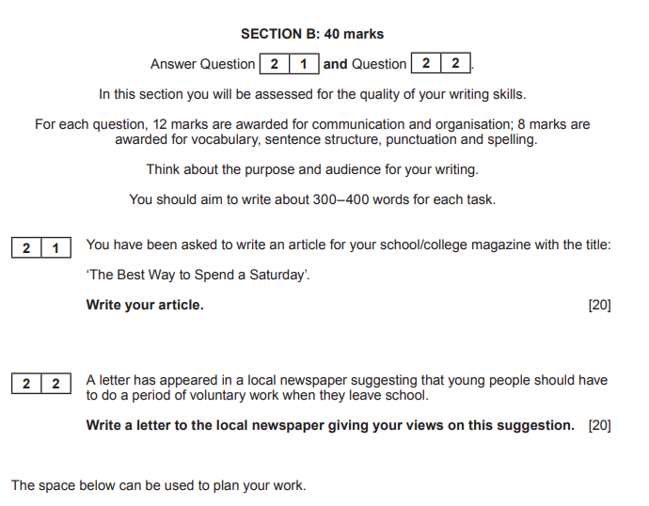
B section. Writing – 30 minutes each task.
You will only get two tasks – there is no choice.
You have to do both of them.
Do NOT count your words and write in the margin!
TOP TIPS
Always plan before you write.
Complete 2 sides/at least 400 words.
5-6 paragraphs with at least 5 sentences in each.
Use strong openings and endings
Ambitious vocab and punctuation
TAPAS your text:
T – text you are writing
A = audience you are writing for
P = purpose of writing
AS – who are you writing as

Slide 16
Basic errors: capital letters, commas, homophones, apostrophes, range of punctuation, variety of sentence structures (needed for B3)
Use a range of ambitious connectives to start.. and within paragraphs
Avoid one sentence paragraphs! One ‘long’ sentence paragraphs…
Avoid lots of ideas in one paragraph – use a topic sentence and then develop with 4/5 more sentences
AFOREST DRIP – use this to add interest and make your writing authentic and engaging
Capital I
Poor expression – proofread and plan
Strong openings but also powerful conclusions – leave a strong lasting impression on the examiner
Letters
Learn the openings and endings – introduce who you are, what you are writing about
Get the format right at the top and spell ‘address’ or ‘recipient’ correctly
The Editor is not the reader - you are writing for the newspaper readers
Do not use contractions in a formal letter
Stick with one viewpoint if you cannot manage a counter argument well
Sign off at the end correctly and use full name
Yours faithfully
Mr J Bloggs
Articles/Speeches/Reports/Review
Heading/byline/sub-titles/opening greetings
Appropriate tone –a lively article or speech/review with language techniques and effects to engage the reader
Formal tone for a report
There/their/they’re
Were/where
Your/You’re
Weather/whether
Our/are
It’s instead of its
Don’t
Should have not should of
could have, would have

Slide 17
When you have finished your transactional tasks…
Leave time to check them through.
You get 12 marks for content and organisation You get 8 marks for SPaG
Top tip:
Put down your pen after you have finished writing.
Take a deep breath.
Pick your pen back up and imagine you are an English teacher desperate to spot common mistakes.
Look for the common mistakes.
Capital letters
Commas
Full stops
Apostrophes for omission (it’s= it is, don’t) and possession (the teacher’s desk, the children’s playground, the dogs’ tails)
Homophones – their/they’re/there, were/where, you’re/your, weather/whether, too/too, right/write
Have you used the right format – article/review/report = heading, letter = address or just date and ‘Dear’, speech = opening greeting

