Slide 1
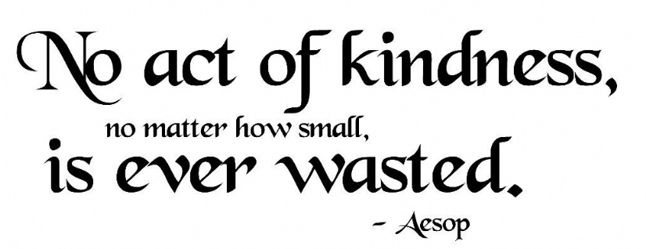
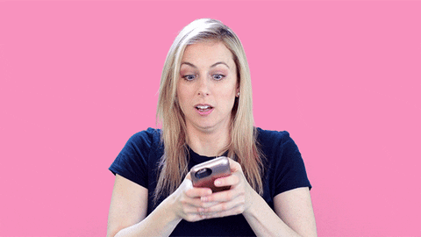
Protecting our mental health is central to us coping with, and recovering from the coronavirus pandemic, the psychological & social impacts likely to outlast the physical symptoms of the virus.
Kindness is defined by “doing something towards yourself & others, motivated by genuine desire to make a positive difference”
Kindness & our mental health are deeply connected, it’s an antidote to isolation and gives a sense of belonging.
Benefits - kindness helps reduce stress, promotes gratitude, and deepens friendships!
I’s contagious…. one act of kindness can lead to many more. So let’s start a chain & spread some kindness…..
Well Being Tip
QUICK ACT OF KINDNESS TASK… 1 MINUTE TASK!
Grab your phone (you know it’s not far away….)
Find a contact you've not spoken to for a while/someone who means a lot to you/ some who’s lonely or maybe struggling
Text something positive (an I love you/ how are you/ thinking of you/ a thank you for../ a photo that reminds you of them...) & send it!
Once sent...notice how you feel, AND when they respond, notice how you feel!

Slide 2
Be kind to yourself too.. And remember to be kind to yourself too! Take time to become more self-aware, try to deal with any inner negativity you may have without projecting your own hurt and pain. Use this learning to be kinder to both yourself and to others. It’s not just about giving kindness – it is also good to notice when others are kind to you! Give others the opportunity to be kind to you by accepting graciously – it will help you to feel valued too!

