Slide 1
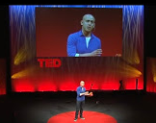
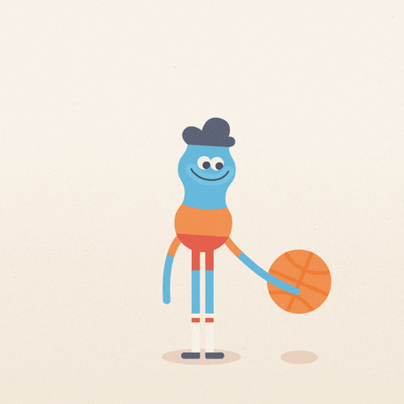
Just 10 mindful minutes…
When is the last time you did absolutely nothing for 10 whole minutes?
Not texting, emailing, eating, talking or even thinking?
Our minds are a precious resource that we depend upon to be focused, creative, spontaneous and to perform at our very best.
Yet, we probably take more care for our clothes and hair!
(Harvard research) - Tells us that on average our minds are distracted 47% of the time, & in our relatively short lifetime, it’s pretty tragic that we’re lost in thought for nearly half of our lives!
Andy Puddicombe talks about how we can step back with a different perspective, how we can’t change every little thing that happens in our lives (covid-19), but we can change the way we experience it!
So, I promise you don’t need to burn any incense or sit on the floor!
Just 9 minutes for this video & 10 daily minutes for you!
Take a look: https://www.youtube.com/watch?v=qzR62JJCMBQ&app=desktop
Andy Puddicombe - Co-founder of Headspace & Mindfulness expert
Well Being Tip 2
Notes:
When is the last time you did absolutely nothing for 10 whole minutes?
Not texting, talking or even thinking?
Mindfulness expert Andy Puddicombe describes the transformative power of doing just that: Refreshing your mind for 10 minutes a day, simply by being mindful and experiencing the present moment.
(No need for incense or sitting in uncomfortable positions.)

