Slide 1
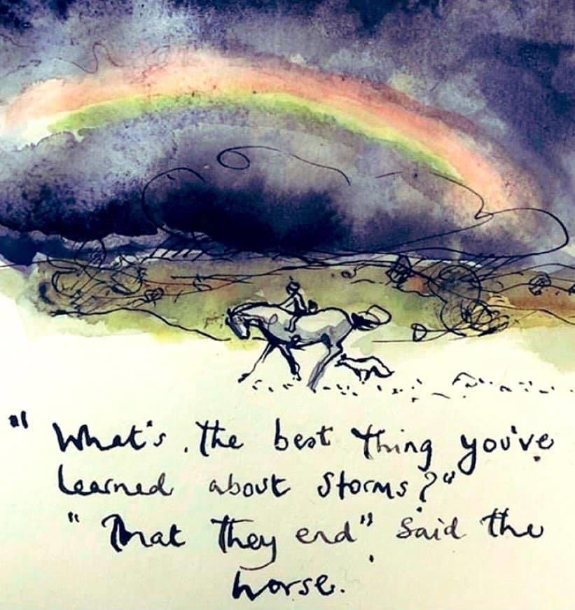
There are lots of things we can do to look after our mental health & wellbeing every day, make a start with these 6 top tips:
Reframe unhelpful thoughts. The way we think, feel and behave are linked.
Be in the present.
Get good sleep.
Connect with others.
Live a healthy life.
Do something for yourself.
NHS Tips for wellbeing
Well Being Tip 4
Notes:
https://www.inc.com/amy-morin/6-ways-to-stop-worrying-about-things-you-cant-control.html

