Slide 1
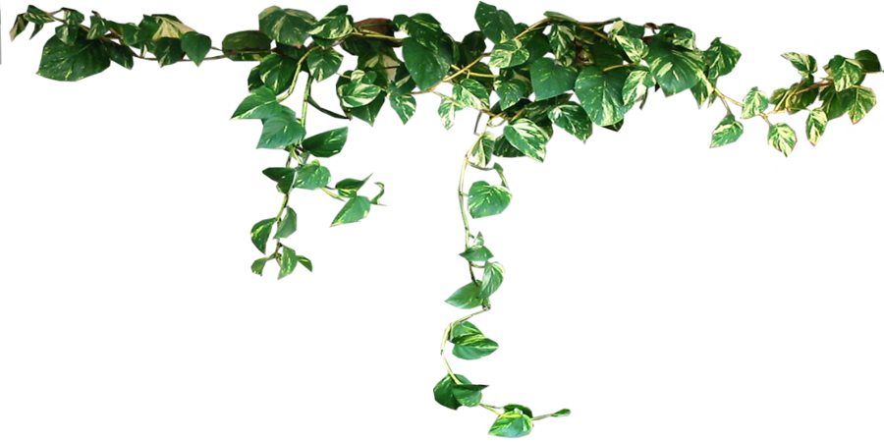
HOUSEPLANTS ARE GREAT FOR SOOTHING ANXIETY
Houseplants produce oxygen & absorb carbon dioxide, meaning they’re great for literally giving you a breath of fresh air.
A few plants around the home, classroom or office can be highly helpful for your well-being in the following ways:
Better focus
Improved mood
Raised productivity and creativity
Lower blood pressure
Increased well-being
Faster reaction times
Well Being Tip 5
6 Plants with mazing Anti-Anxiety effects

