Slide 1
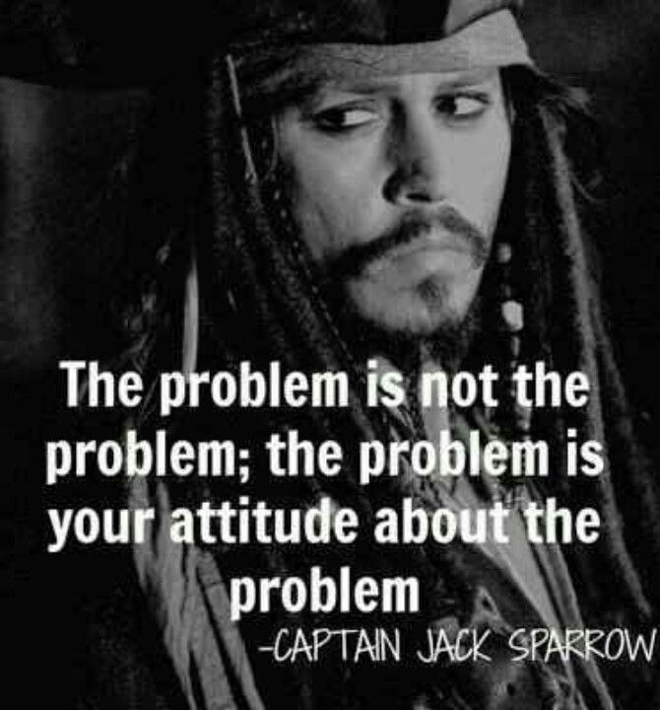
choose to respond rather than react...
Nothing can trouble us quite as much as
our own thoughts.
Most of our stress comes from how we react rather than how life actually is.
Adjust your attitude to change the way you see things & look for the good in all situations.
And most importantly
OVERTHINKING will destroy your mood.
BREATHE……. & LET IT GO!
Well Being Tip 6

