Slide 1
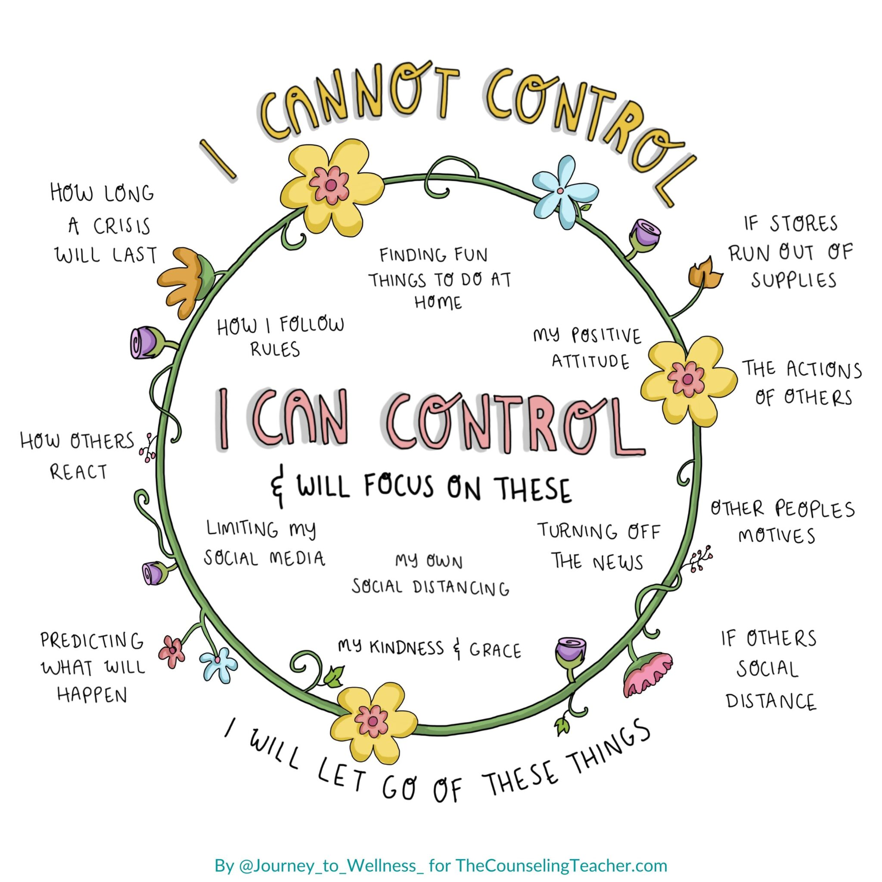
In these times of additional change & uncertainty, we mustn’t get caught up in what we can’t control.
Take a minute to examine the things you have control over. You can't prevent a storm from coming but you can prepare for it.
You can't control how someone else behaves, but you can control how you react.
Recognize that sometimes, all you can control is your effort and your attitude.
When you put your energy into the things you can control, you'll be much more effective.
Well Being Tip 7

