Slide 1
Instructions to support tutor Worship this week: Harvest
Slide 3 Entry vid with some harvesting for the farmers
Slides 4 – 7 information about the origins and traditions of the Harvest Festival
Slide 8 – Bible passage for the week
Slide 9 - Short reflections time
Slide 10 - prayer to finish

Slide 2
Fortiter Et Fideliter
Bravely and Faithfully
Hope, Service, Compassion, Fellowship, Wisdom and Peace

Slide 3
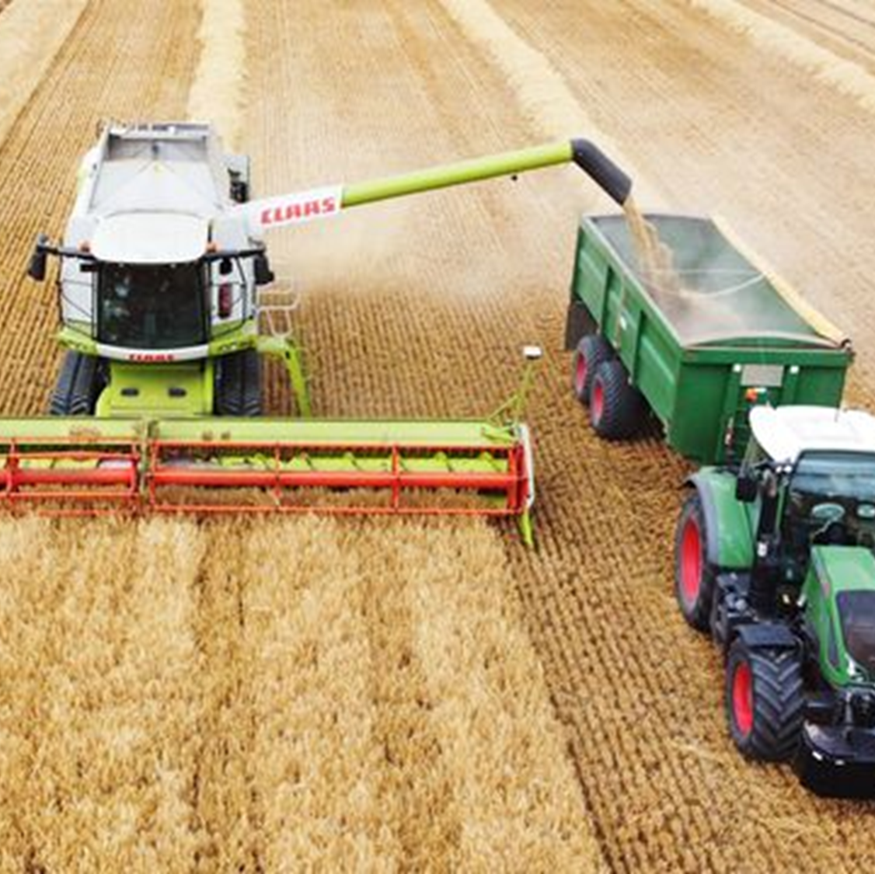
Click the picture to watch some harvesting
Notes:
You can put this on while pupils arrive https://www.youtube.com/watch?v=LnX9AOPtQS8

Slide 4
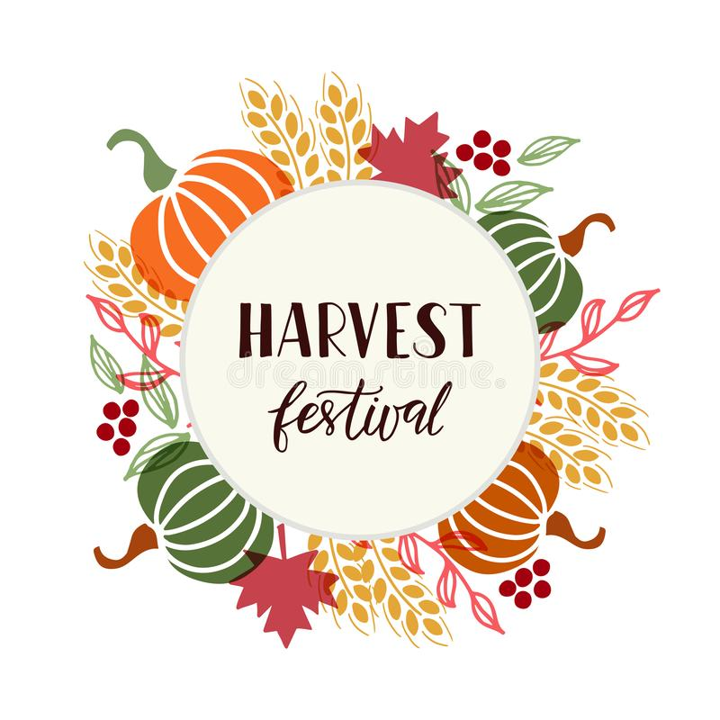
What is the Christian Harvest festival?
It’s one of the oldest and most traditional British festivals taking place at the time of the Harvest Moon, but other than gathering up tinned goods and taking them to church, what is harvest festival all about?

Slide 5
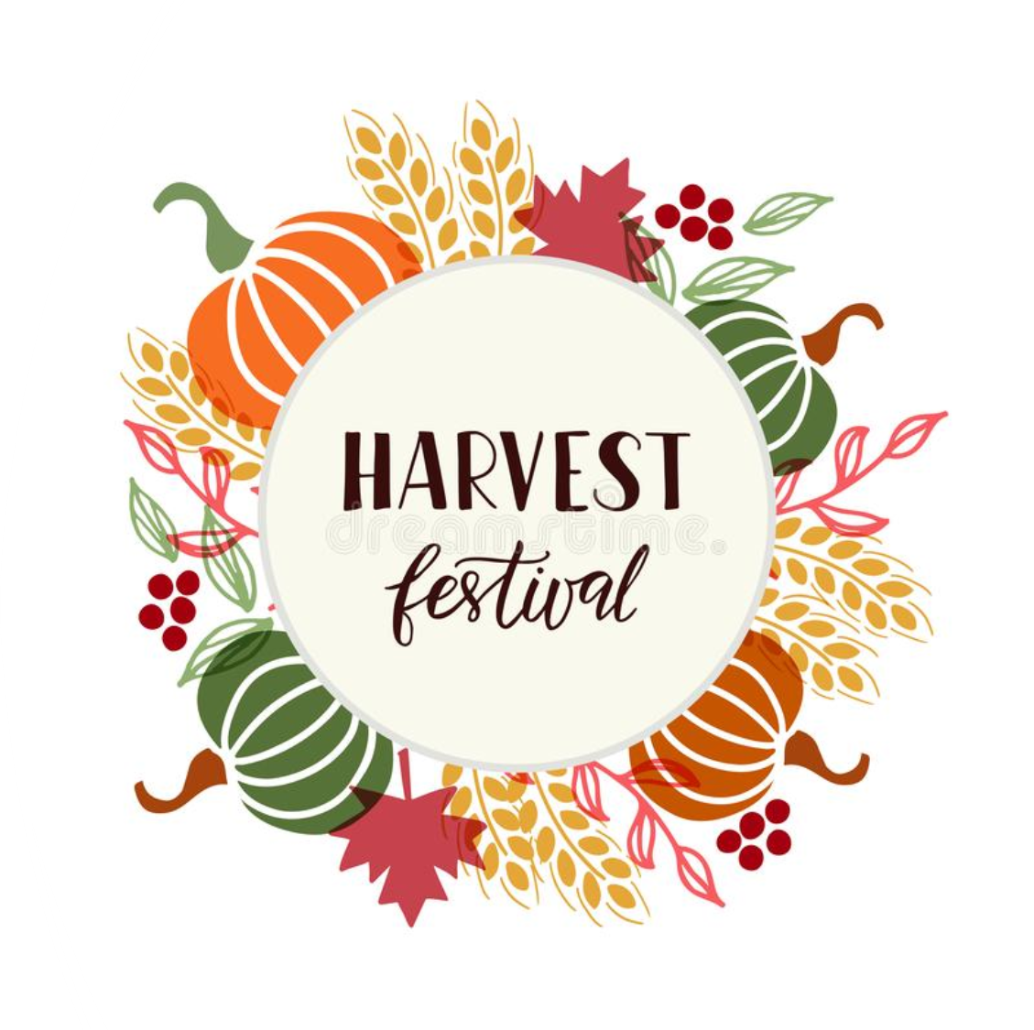
The Harvest Festival – can be traced back to an ancient pagan ‘thanksgiving’ festival that is now a big part of the Christian calendar still marked in schools and churches across the country - started as an ancient celebration of the annual ‘reaping of the crop’.
Over time, the event has taken on a charity focus, with food (traditionally bread and fruit or veg made from the glut of farm produce) laid down as part of a large community display before being donated to those in need.

Slide 6
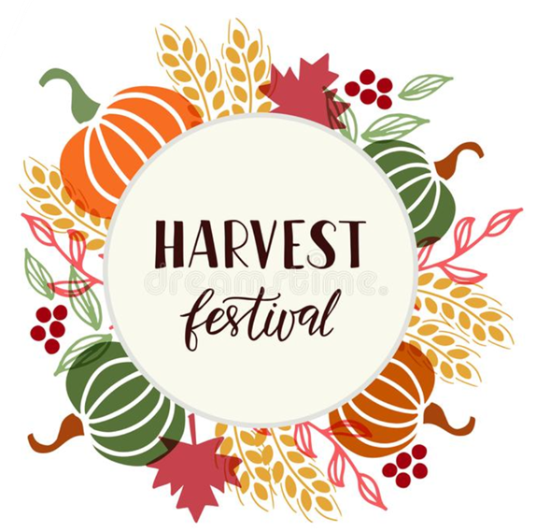
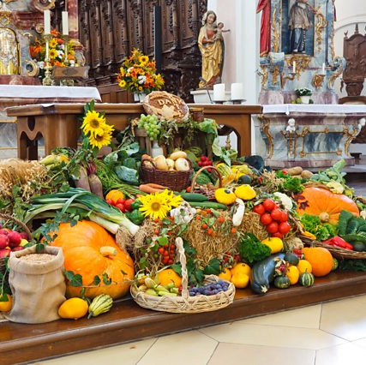
Harvest Festival was originally marked religiously on ‘Lammas Day’, and one of the main customs still observed is the baking of bread for a church service on that day at the start of August. However, the name itself comes from the old English word ‘Haerfest’, which means ‘autumn’...and so many events take place through the whole season with stalls, fairs, displays, music and poems that celebrate farmers and produce grown on their land.

Slide 7
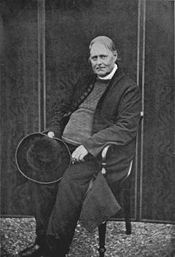
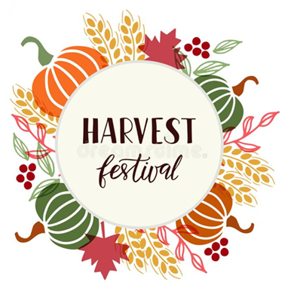
Celebrating the end of the harvest in Britain dates back centuries.
The official Christian Harvest festival began in Victorian times, when the Reverend Robert Stephen Hawker invited his parishioners to a special harvest thanksgiving service at the church in Morwenstow, Cornwall in 1843.

Slide 8
Parable of the Mustard Seed (Matt 13:30-32)
The mustard seed was the smallest seed, but it grew into a huge plant.
In this parable, Jesus teaches that although the Kingdom of God started small, with Jesus and the disciples, it would grow and spread across the world and Jesus' teaching of faith, hope and love would grow to affect Billions of people.
“Though it is the smallest of all seeds, yet when it grows, it is the largest of garden plants and becomes a tree, so that the birds come and perch in its branches.”

Slide 9
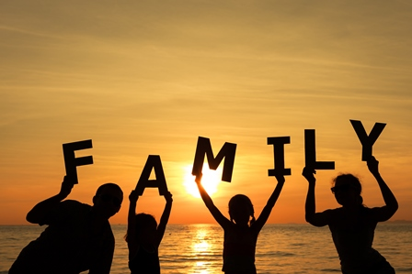
Harvest is a time to be thankful but also to think about others..
Take a minute to reflect upon what you have to be thankful for but also how you can start small but help others.

Slide 10
Our School Prayer
We bless you, God of Seed and Harvest, and we bless each other, That the beauty of this world, And the love that created it, might be expressed though our lives
And be a blessing to others, Now and always. Amen.

