Slide 1
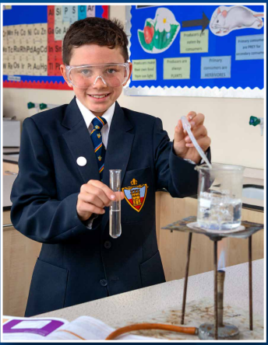
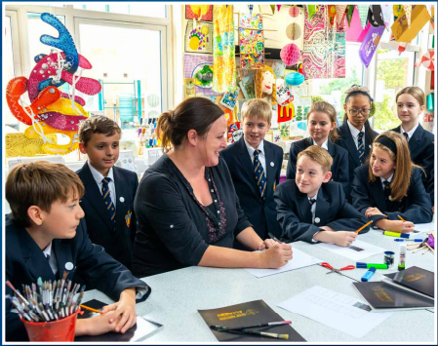
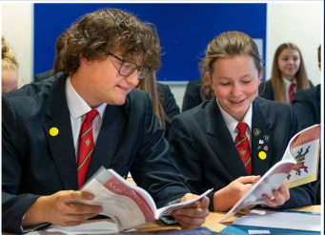
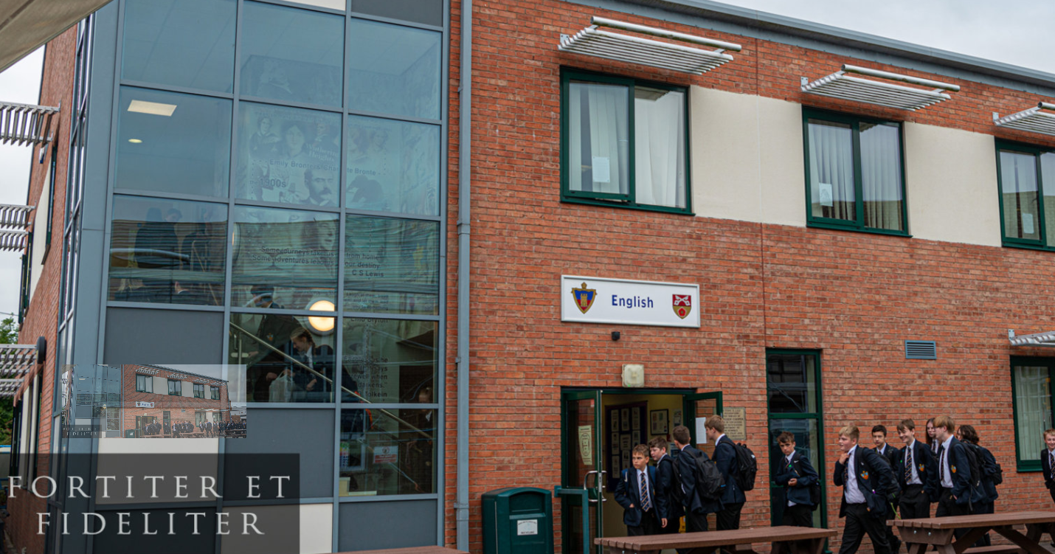
Your Timetable and School Day

Slide 2
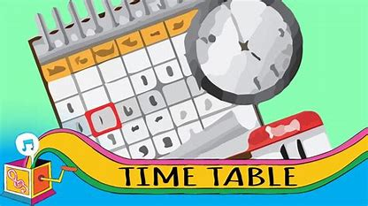
Your timetable
At Bishop Rawstorne, you will receive a timetable.
We have five periods of lessons throughout the day, and your timetable will tell you where you need to be.
It is important to get to know your timetable when you receive it in August and keep it somewhere safe.

Slide 3
It will look something like this:

Slide 4
A WEEK and B WEEK
At Bishops, your timetable runs on a two week system – A WEEK and B WEEK.
This will give you a variety of lessons to experience and enjoy.
For example:
Don’t’ worry – your tutor will tell you whether it is an A or B week during tutor time. ☺

Slide 5
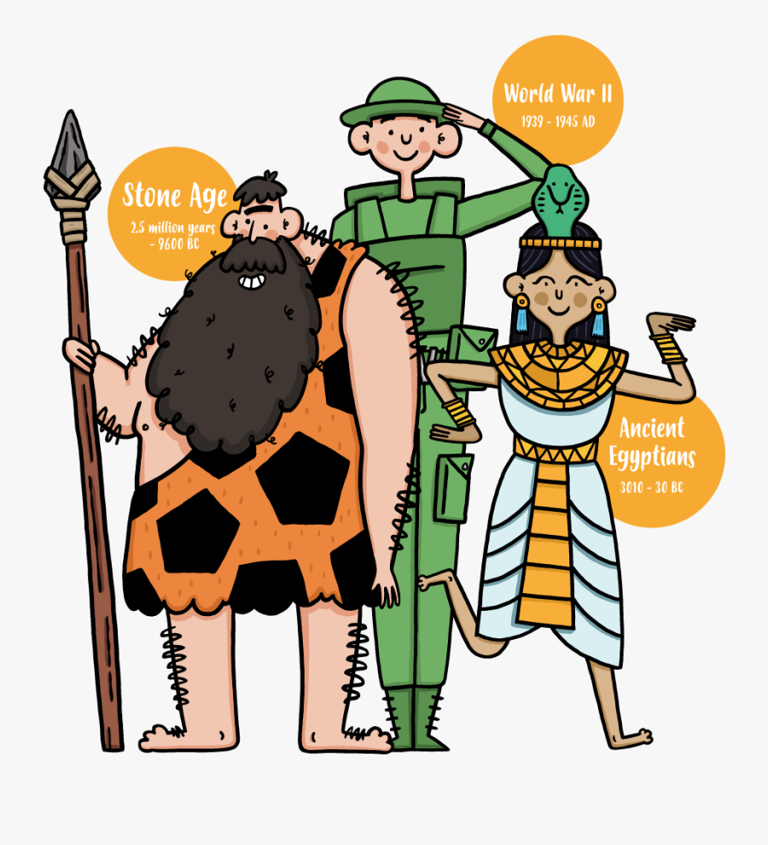
In A WEEK, you would have History with Mrs Walton in room M14 in the History section of the Main Block.
In B WEEK, you would have Geography with Mrs Cogley in room A6 in the RE section of the A Block.

Slide 6
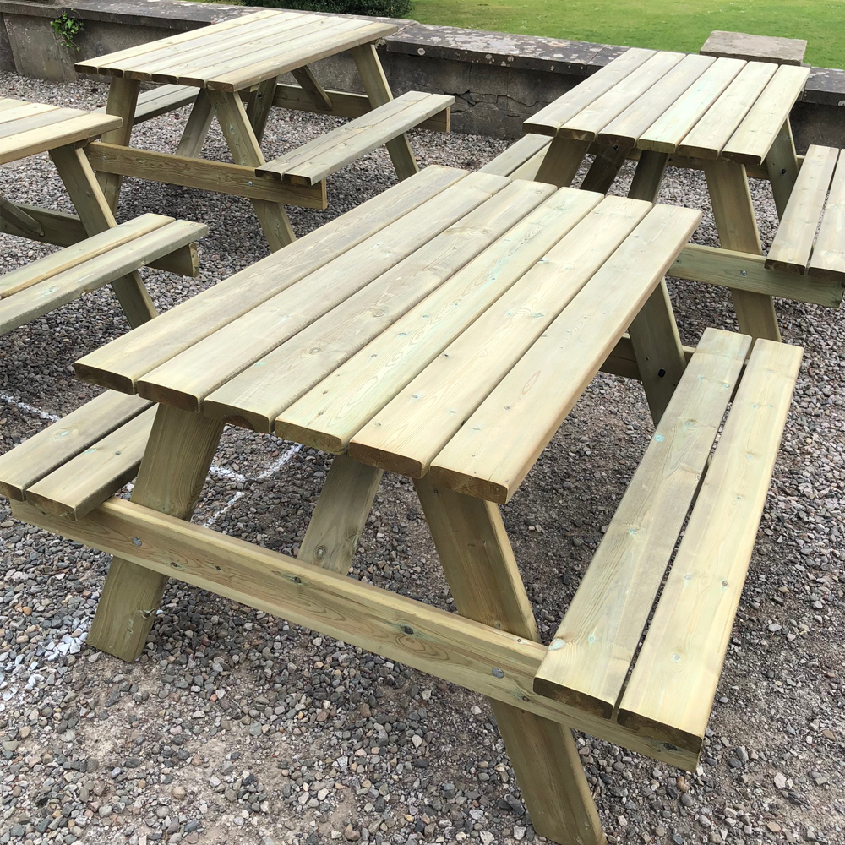
Break Time – 11.00 to 11.15 Lunch Time – 13.15 – 13.40
You have the option of buying school dinners using our cashless finger-printing system from Beaumont’s Canteen or bringing snacks and a packed lunch.
All students stay on the premises during lunchtime.
Lunch can be eaten in the dining room or out in the yard at one of our many table-benches.

Slide 7
Tutor Time – AM Registration 8.50 – 9.00
At the start of everyday, you will go to your tutor room to register and listen to the daily bulletin.
The first bell for AM registration will ring at 8.50am. This tells you to make your way to tutor.
The second bell will ring at 8.55am. You must be seated and ready for the register at this time.

Slide 8
Tutor Time – PM Registration 13.40 – 14.00
The first bell for PM registration will ring at 13.40. This tells you to make your way to tutor.
The second bell will ring at 13.45. You must be seated and ready for the register at this time.
During PM tutor, you will participate in a range of activities, including weekly WORSHIP. You will also have an ASSEMBLY in the school hall once a week on a designated day.

Slide 9
Extra-Curricular Clubs and Activities
We have an exciting range of clubs and extra-curricular activities that take place either during lunch-times or afterschool.
The start-dates and schedules for 2022-23 clubs and extra-curricular activities will be announced in the Daily Bulletin once the school year starts.

