Slide 1
Preparing for the PPEs
Session 1: Study Skills

Slide 2
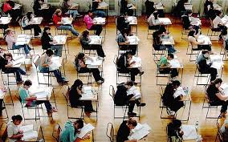
Why should I prepare for the PPEs?
The upcoming PPEs are the last opportunity you have to practice for the final exams in the summer.
In order for these to be as effective for you as possible you should treat them like the real thing- get prepared and give it everything you’ve got!
This is important for two reasons:
It allows you to see what grades you are achieving and what you need to work on before the final exams.
It allows your teachers to see what they need to go over in your remaining lessons.

Slide 3
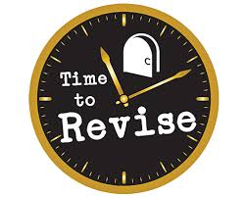
How can i prepare for the PPEs Academically?
Speak to your subject teachers and find out what areas/ modules you need to focus your revision on.
Use this information to complete a revision timetable and stick to it.
Attend as many Lesson 6 sessions as you can.
Attendance- be in school and on time to avoid losing key learning time.

Slide 4
How can I prepare for the PPEs Physically?
The exam wrappers from the last PPEs showed that many of you are not taking basic care of yourself before the exams. This can massively affect your outcomes. To ensure that you are in the best frame of mind and state of body to complete the exams to the best of your ability you must:
Sleep- set yourself a sleep routine that ensures you have 8 hours of sleep each night. This allows your brain and body to recharge.
Eat- have something to eat in the morning before the exam. Even something small like a breakfast bar/ piece of fruit will give your body the sustenance it needs for your brain to work properly. Remember free bagels are available from 8.20 in the canteen. t
Hydrate- Drink some water or juice (not coffee or energy drinks) in the morning before the exam. Dehydration will hugely impact your brain’s ability to process and relay information.

