Slide 1
Mindful Breathing
Session 2: Study Skills

Slide 2
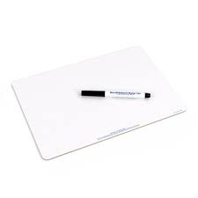
What is Mindful Breathing?
Mindful breathing is a technique used to focus your attention on your breath. It involves taking deep, slow breaths and being aware of each inhalation and exhalation.
This practice helps calm the mind and brings awareness to the present moment, making it an essential tool for stress relief and relaxation.
On your whiteboards, write down 3 situations that mindful breathing can help us with.

Slide 3
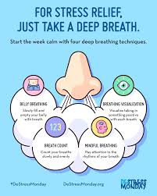
Benefits of Mindful Breathing
Mindful breathing has many benefits. It can reduce anxiety and stress, improve concentration, and enhance emotional well-being.
By practising mindful breathing, you allow your body to relax and improve your mental clarity, helping you tackle daily challenges more effectively.

Slide 4
How to Practice Mindful Breathing
To practice mindful breathing, find a quiet space where you can sit or lie down comfortably.
Close your eyes and take a deep breath in through your nose, filling your lungs completely.
Hold for a moment, then exhale slowly through your mouth. Repeat this process, paying attention to the sensation of your breath and letting any distractions fade away.
Let us first just sit up straight, and begin by taking some nice deep breaths, in through the nose and out through the mouth,
We will do this quietly for 1 minute.

Slide 5
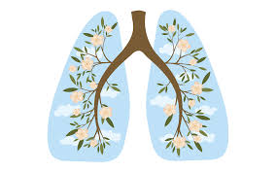
Mindful Breathing in Daily Life
Incorporating mindful breathing into your daily routine can help you manage stress more effectively.
You can practise it during challenging situations, such as before exams or while dealing with conflicts.
Regular practice builds resilience and improves your overall mental health, making it easier to navigate life's ups and downs.

Slide 6
Mindful Breathing Techniques
There are different techniques for practising mindful breathing. One technique is the '4-7-8' method, where you inhale for 4 seconds, hold your breath for 7 seconds, and exhale for 8 seconds. Another is to simply count your breaths, inhaling for a count of four and exhaling for a count of six. Find what works best for you and practice regularly.
We will be having a go at this today.
https://www.youtube.com/watch?v=1Dv-ldGLnIY

Slide 7
Reflection on Mindful Breathing
Reflecting on your mindful breathing practice can help you recognise its impact on your life. Keep a journal to jot down how you feel before and after practising. Observing changes in your mood and stress levels helps reinforce the importance of mindful breathing and motivates you to continue this beneficial habit.
On your whiteboards, write down how you feel after completing the exercise and why.

