Slide 1
Top tips for successful study
Session 3- Study Skills

Slide 2
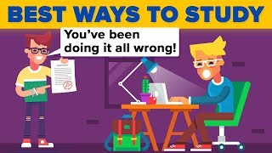
While we all learn in different ways and at different paces, there are some things we can do when studying that benefit all of us.
This video gives some great, scientifically proven, ideas that will support your studies and help you get the most out of your hard work.

Slide 3
Reflect!
On your whiteboard list as many tips from the video as you can remember in 1 minute.
Notes:
Feedback as a class and ensure all answers are given: Exercise, Not cramming, vary resources, test yourself, study partner, get outside, sleep, music, treats and rewards, strike a pose.

