Slide 1
Revision Websites
Session 3: Study Skills

Slide 2
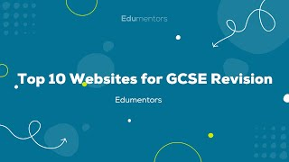
What are some good websites for revision?
There are many resources you can use for your revision such as your class books and revision guides, however there are some great websites that you can use too.
Let’s have a look at 10 highly recommended ones. You may wish to write these down.

Slide 3
Revise whilst scrolling
Hannah Kettle Maths
Primrose Kitten Academy (Science)
First Rate Tutors (English)
GCSE Maths Tutor
JC Geogsupport (Geography)
Matt Green- The Rapping Science Teacher
History with Mr. Atkinson
The Fxcking Maths Tutor
Revision Science
There are also some great TikTok accounts for revision too, offering short but effective revision videos.
In the run up to your exams, swap doom scrolling for something more useful.
These are just a few. Have a look at some of these and your algorithm will send you to others.

