Slide 1
Flashcards
Session 2: Study Skills

Slide 2
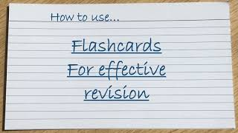
Flashcards
Flashcards can be a great revision tool. By only including key information along with some questions and prompts to test yourself with, they can be a great way to build active recall.
Watch this video to help you.

Slide 3
Make one yourself
You have each been given a flashcard.
Using one of them now, label one side of the card with the title- ‘How is guilt shown in Macbeth?’
On the other side bullet point as many ways you can remember that the theme of guilt is shown in the play. E.g. Lack of Sleep ‘Macbeth shall sleep no more’.
Compare yours with the person next you you- have you missed any?

