Slide 1
Revision Timetables
Session 4: Study Skills

Slide 2
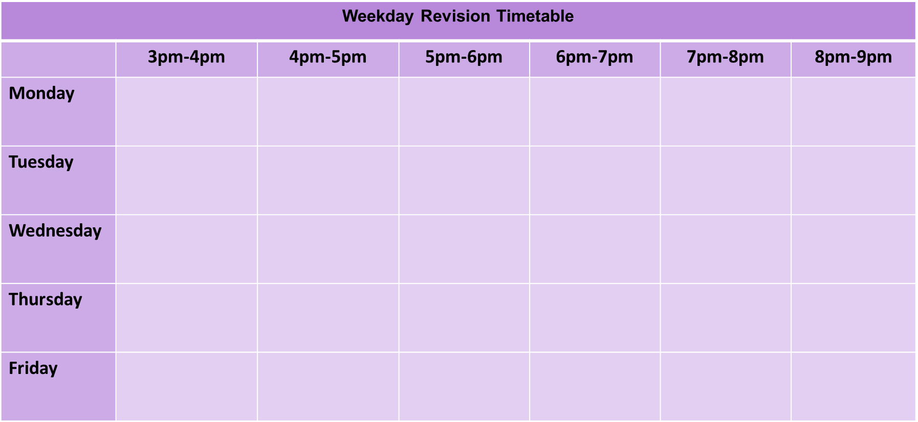
Why is it good to make a revision timetable?
Making a revision timetable will help you to organise your time effectively and will help you to prioritise the areas you need to focus on the most.
You should make a new one each week to allow you to focus on different areas of study. Aim to complete at least 1 hour of revision per day (not including lesson 6!)
If you did 1 hour of revision per day between now and the start of exam season, you will have done 150 hours of studying for your exams! Imagine the difference that would make to your final grades, and how much more prepared you would feel.

Slide 3
How do I make one?
Block out any times when you have clubs etc
Add in your lesson 6 sessions
Boxing
Maths (eg) lesson 6
Have Tea
Block out any daily routines when you won’t be able to study

Slide 4
How do I make one?
Now, with what is left, plan at least 1 hour per day where you revise a topic. This is better done in smaller chunks.
Make the focus areas specific, and start with the areas you need to focus on the most first. These can change weekly.
Maths:
algebra
Macbeth: themes

Slide 5
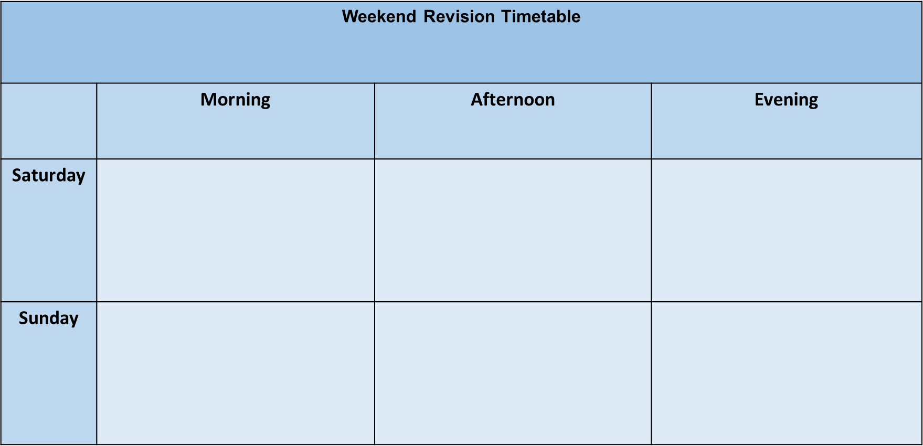
Weekend timetables
There are also timetables specifically for your weekend. Again, 1 hour a day will make a huge difference.

Slide 6
Where can I get these?
There will be copies of these timetables available in your form rooms. Take one each week and complete them on a Monday.

