Slide 1
Mind Maps
Session 5- Study Skills

Slide 2
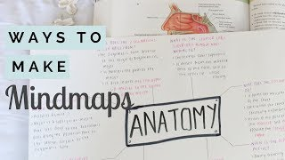
What is a mind map?
A mind map is a diagram in which information is represented visually, usually with a central idea placed in the middle and associated ideas arranged around it.
Let’s watch this video and see how to make them and use them effectively.

Slide 3
Now you try!
Key Info
First performed 1606
Using your whiteboard, spend 2 minutes mind mapping as much information about Macbeth as you can.
Here is the start of one to help you.
Macbeth
Themes
Ambition
Guilt
Kingship
Notes:
When time is up, ask the class to hold them up. Identify any misconceptions about what a mind map should include.

