Slide 1
Reviewing your PPE Results
How do I use my results to improve my progress?

Slide 2
How can I use my PPE Results to effectively prepare for final exams?
This session we will go over ways you can use your PPE results to prepare for the final exams in the summer.
You have been given a copy of this presentation so you can look at it again in your own time.
Mock exams serve as a roadmap, pinpointing exactly where to focus. Using this feedback to shape your final exam prep can boost confidence, reduce uncertainty, and improve performance, paving the way for success.

Slide 3
Analyse Your Results Carefully
Identify Strengths and Weaknesses:
Look for patterns in your results. Which sections did you excel in? Where did you struggle? Break down your scores by topic or question type.
Review Feedback and Marking Schemes:
If feedback or a marking scheme is available, go through it in detail. This will help you understand where points were lost, which concepts you missed, and the structure or style of answers that yield higher marks.
Quantify Your Mistakes:
Calculate the percentage or points lost per section, if possible. This can help you allocate study time based on how critical each section is to your overall grade.

Slide 4
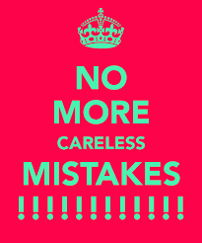
2. Understand the Types of Errors You Made
Content Gaps:
If you lost marks due to missing content knowledge, list these specific topics and prioritise them in your study plan.
Careless Mistakes:
Identify any avoidable errors, like simple miscalculations, misreading questions, or skipping steps. These can usually be addressed with increased practice.
Timing Issues:
If you found certain sections were rushed, note down where you ran out of time. This can be resolved by adjusting your timing strategy in the final exam.

Slide 5
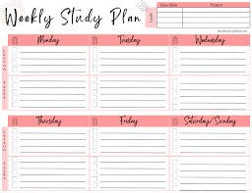
3. Create a Targeted Study Plan
Set Clear, Measurable Goals:
Based on your analysis, define specific goals, such as “Improve accuracy in algebra” or “Learn key historical dates for 20th-century events.”
Allocate Study Time Strategically:
Focus more time on weak areas while still keeping strong areas fresh. A good ratio might be around 70% on weaknesses, 30% on strengths.
Plan for Regular Review:
Schedule weekly or bi-weekly reviews of both strong and weak areas to maintain a balanced understanding across topics.

Slide 6
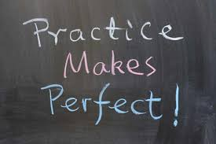
4. Practice with Purpose
Revisit Mock Exam Questions:
Go through the questions you got wrong in the mock and try answering them again after your initial review. This reinforces corrections and helps retain tricky concepts.
Use Timed Practice Sessions:
Replicate exam conditions by timing yourself on each section to improve time management. Use a stopwatch or timer for each question set.
Attempt New Practice Questions:
Use resources like past papers, online question banks, or practice worksheets to ensure you are prepared for different question types and varying difficulty levels.

Slide 7
5. Review Exam Techniques
Practice Exam-Writing Strategies:
Reflect on your approach to different question types. For essays, practice outlining your answers quickly; for multiple-choice, refine elimination tactics.
Work on Clarity and Precision:
Avoid overly complicated answers. Ensure your responses are clear, direct, and stay on-topic, as this often maximises marks.
Develop a Consistent Answer Structure:
Use structures like PEE (Point, Evidence, Explanation) for essays or work through calculations systematically for maths-based answers.

Slide 8
6. Seek Feedback and Clarify Doubts
Talk to your teachers:
Schedule a review session with teachers to discuss any lingering doubts or receive guidance on challenging topics.
Use Study Groups or Peer Reviews:
Studying with peers allows for idea exchange and constructive feedback on areas you might overlook. Discussing topics with others can also reinforce your understanding.
Consider Extra Resources:
Use educational videos, additional textbooks, or online courses for difficult concepts, especially if you feel you need a different explanation style than what the mock exam offered.

Slide 9
7. Adjust Based on Mock Exam Results
Modify Study Strategies Based on Performance:
If you scored better with a certain study method, such as flashcards or group discussions, incorporate that method more often.
Adapt Your Time Management Strategy:
Allocate time based on how long you needed to complete each section in the mock. For sections where you rushed, adjust pacing to ensure better time distribution in the final exams.

Slide 10
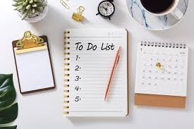
8. Stay Organised and Motivated
Track Your Progress: Use a checklist to tick off topics as you review and improve on each one, which can be motivating and provide a sense of achievement.
Take Care of Your Mental and Physical Health: Stress can impact performance, so incorporate short breaks, regular exercise, and a healthy diet into your routine.
Visualise Success: Keeping a positive outlook and visualising your final goal can reduce anxiety and help maintain focus, especially when the study load feels overwhelming.

Slide 11
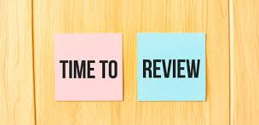
9. Do a Final Review Closer to Exam Day
Do a Final Review Closer to Exam Day
Revise Key Concepts and Weak Areas:
Do a final review of all major topics, focusing briefly on strong areas and doing a last deep dive into the weaker ones.
Skim Through Mock Exam Errors One Last Time:
Revisit the areas where you made mistakes on the mock exam, ensuring you’re clear on how to avoid them in the final exams.
Practice Relaxation Techniques:
Leading up to the final exam, try breathing exercises, visualisation, or even light meditation to calm nerves and maintain focus.

